Slide 1
Digital transmission & encoding techniques

Slide 2
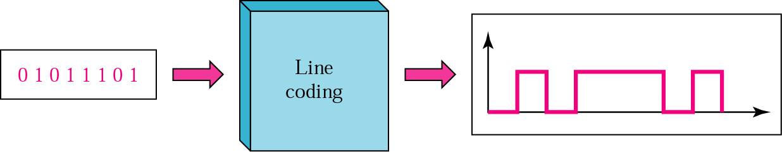
Line coding

Slide 3
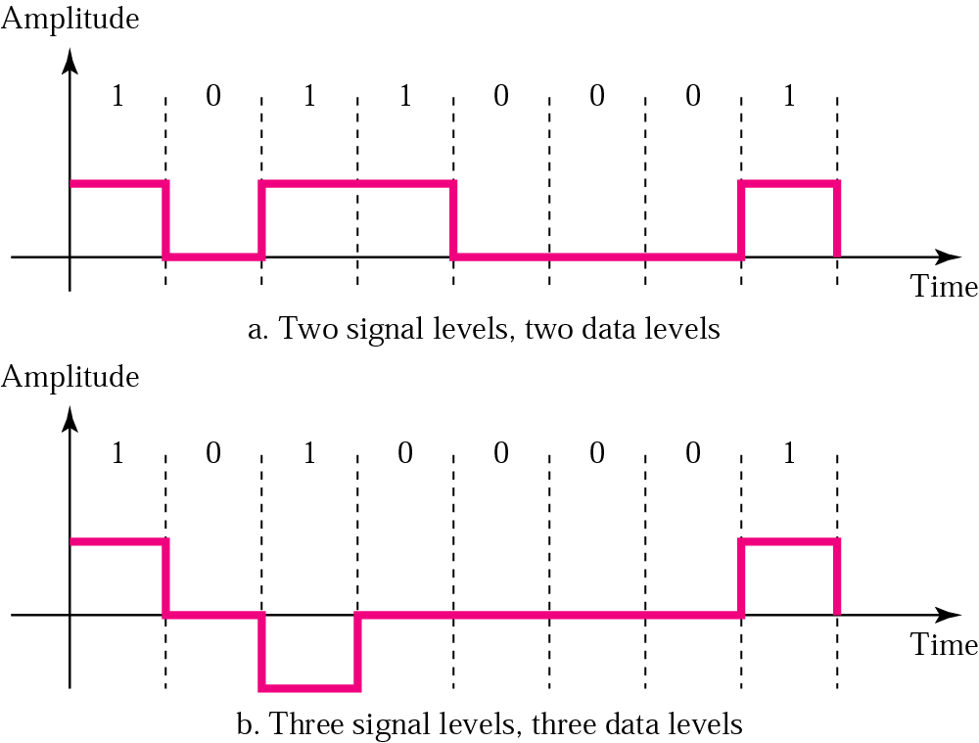
Signal level versus data level

Slide 4
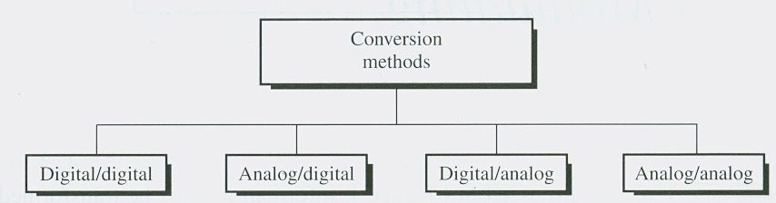
Conversion methods
Electrical signals can be of various types
Analog , Digital

Slide 5
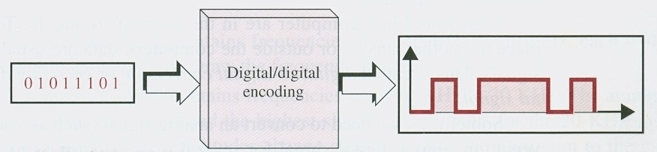
Digital to digital conversion ( encoding )

Slide 6
A signal has two data levels with a pulse duration of 1 ms. We calculate the pulse rate and bit rate as follows
Pulse Rate = = 1000 pulses/s
Bit Rate = PulseRate x log₂ L = 1000 x log₂ 2 = 1000 bps
If signal has 4 data levels
Bit Rate = PulseRate x log₂ L = 1000 x log₂ 4 = 2000 bps

Slide 7
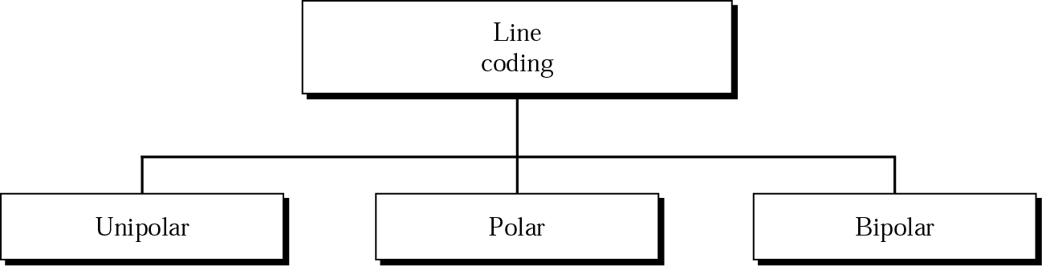
Line coding schemes

Slide 8
Unipolar encoding uses only one voltage level.

Slide 9
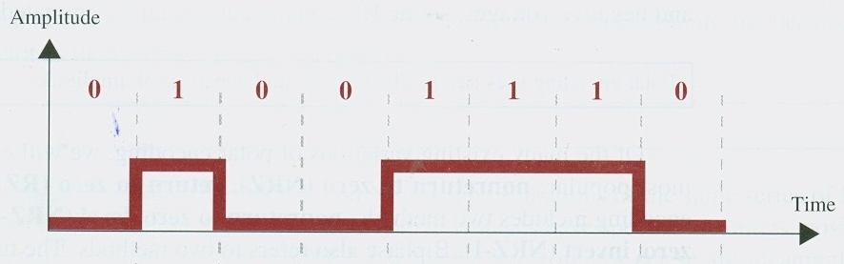
Unipolar encoding
The average amplitude of unipolar signal is non zero
1 is encoded as +ve value
0 is encoded as zero
For non chaining signal beginning & end of each bit can not be determined

Slide 10
Polar
It uses two voltage level (+ve , -Ve)
Average voltage level on the line is reduced
DC component problem can be solved

Slide 11
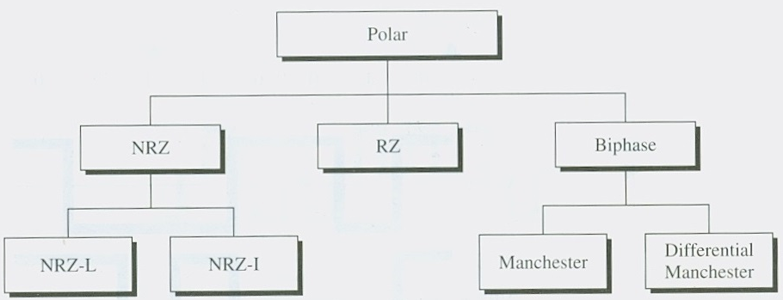
Polar encoding techniques

Slide 12
Non return to zero
In this technique the level is either +ve or negative
Two different type
NRZ-L
In NRZ-L the level of the signal is dependent upon the state of the bit.
+Ve represented as 1 and -ve represented as 0 or vice versa
Clock synchronization
NRZ I
In NRZ-I the signal is inverted if a 1 is encountered.
The signal transition can be used for clock synchronization

Slide 13
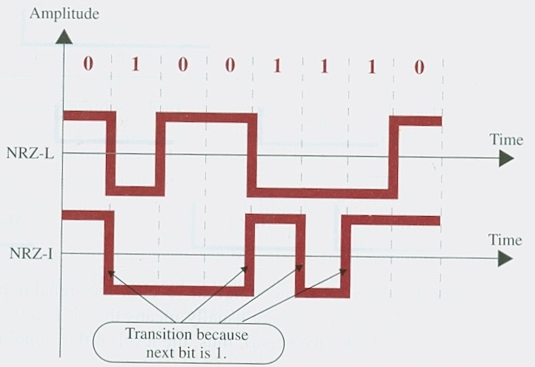
NRZ L & NRZ I
A good encoding technique must contain provision for synchronization

Slide 14
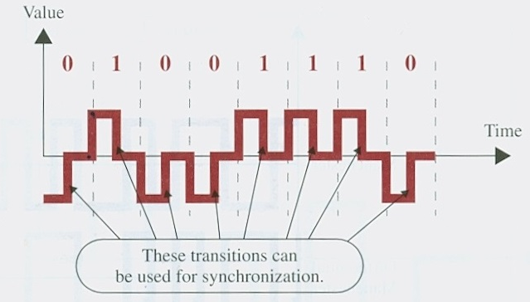
RZ encoding
Ensure that there is signal change for every bit
This requires three voltage level : +Ve zero, & negative

Slide 15
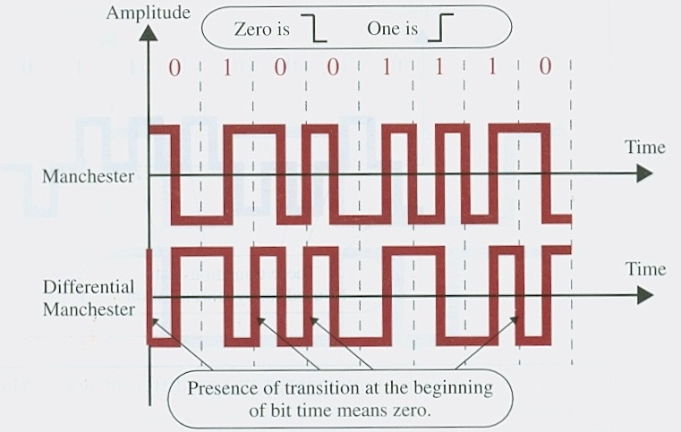
Biphase
The signal changes at the middle of the interval but does not return to zero
Manchester encoding : inversion at middle of each bit interval
Negative to positive represent 1
+ve to negative represent 0
Differential Manchester : presence or absence of additional transition at the beginning of interval is used for identifying the bit
DM require two transition to represent zero and one for Binary 1

Slide 16
Bipolar
It uses three voltage levels
+ve , -Ve & Zero
Zero level represents the binary zero
1 is represented by alternating +ve & -Ve voltages

Slide 17
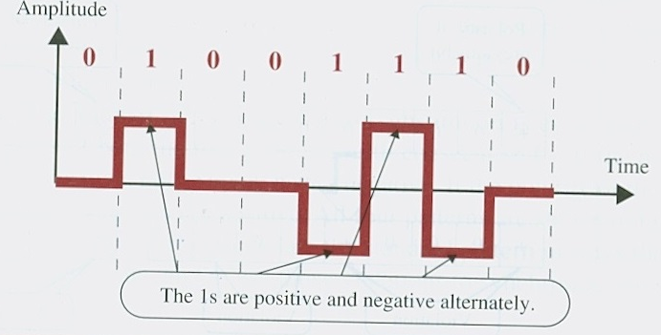
Bipolar AMI

Slide 18
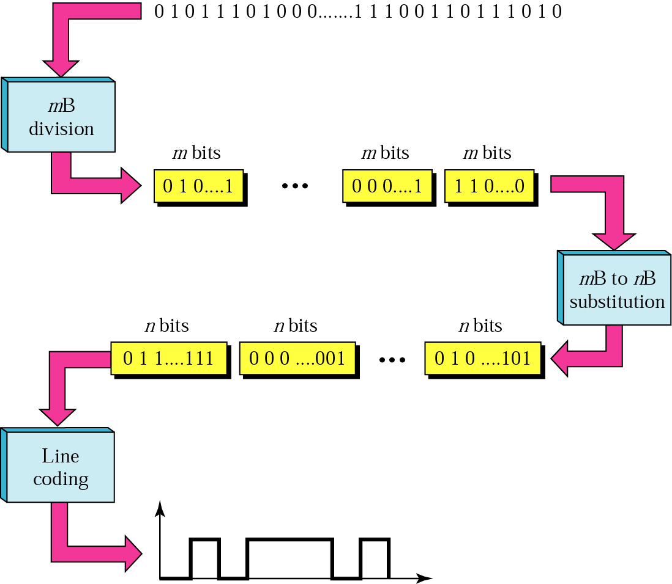
Block Coding

Slide 19
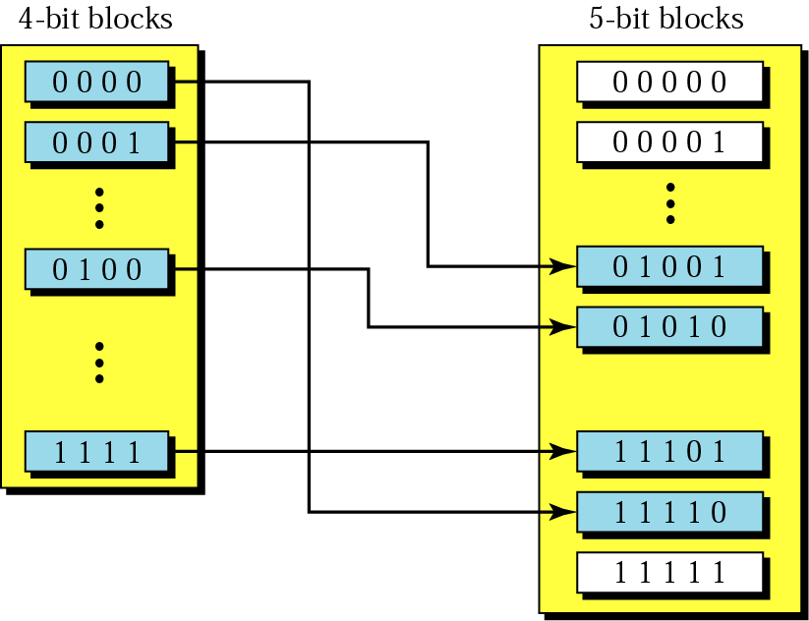
Substitution in block coding

Slide 20
4B/5B encoding
Data | Code | Data | Code
0000 | 11110 | 1000 | 10010
0001 | 01001 | 1001 | 10011
0010 | 10100 | 1010 | 10110
0011 | 10101 | 1011 | 10111
0100 | 01010 | 1100 | 11010
0101 | 01011 | 1101 | 11011
0110 | 01110 | 1110 | 11100
0111 | 01111 | 1111 | 11101

Slide 21
Data | Code
Q (Quiet) | 00000
I (Idle) | 11111
H (Halt) | 00100
J (start delimiter) | 11000
K (start delimiter) | 10001
T (end delimiter) | 01101
S (Set) | 11001
R (Reset) | 00111

