Slide 1
Understanding IP addressing

Slide 2
IP address
IP was first standardized in September 1981
It was required that each system attached to an IP-based Internet be assigned a unique, 32-bit Internet address value
The first part of an Internet address identifies the network on which the host resides,
second part identifies the particular host on the given network.
This creates the two-level addressing hierarchy

Slide 3
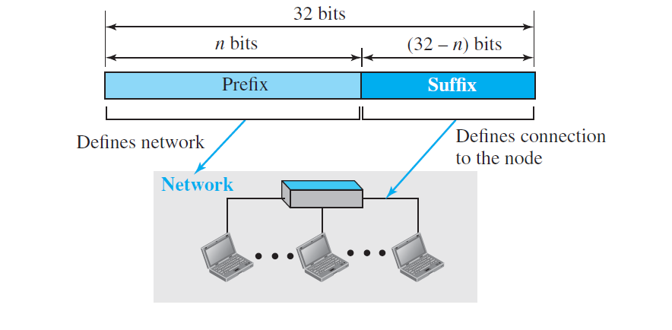

Slide 4
IP- V4 Addressing issue
Since IP address is 32 bit the total number of available addresses are limited to 2³²
The number of networks are continuously growing
This is leading to increased size of routing tables

Slide 5
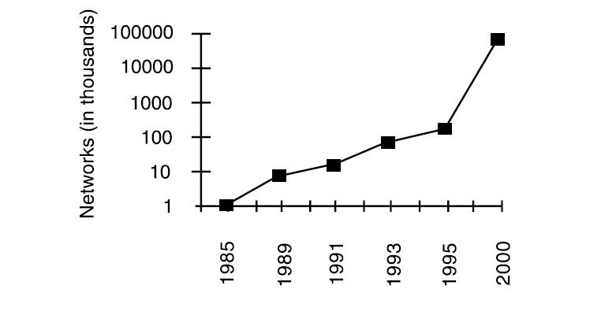

Slide 6
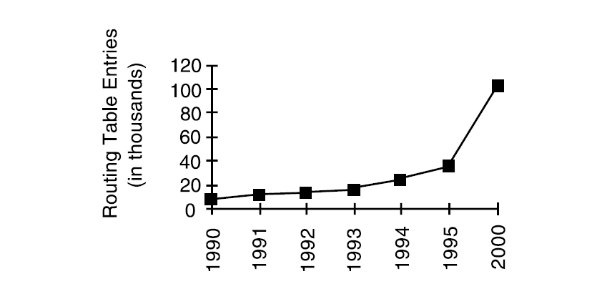
Growth of routing table

Slide 7
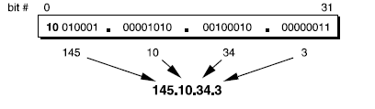
Dotted Decimal Notation

Slide 8
Classful Addressing
When the Internet started, an IPv4 address was designed with a fixed-length prefix, to accommodate both small and large networks
Three fixed-length prefixes were designed instead of one (n = 8, n = 16, and n = 24).
The whole address space was divided into five classes (class A, B, C, D, and E)

Slide 9
Classful address
In class A, the network length is 8 bits, but since the first bit (MSB), which is 0, defines the class, we can have only seven bits as the network identifier
This means there are only 2⁷ = 128 networks in the world that can have a class A address
In class B, the network length is 16 bits, but since the first two bits, which are (10)₂, define the class, we can have only 14 bits as the network identifier
This means there are only 2¹⁴ = 16,384 networks in the world that can have a class B address.
All addresses that start with (110)₂ belong to class C. In class C, the network length is 24 bits, but since three bits define the class, we can have only 21 bits as the network identifier

Slide 10
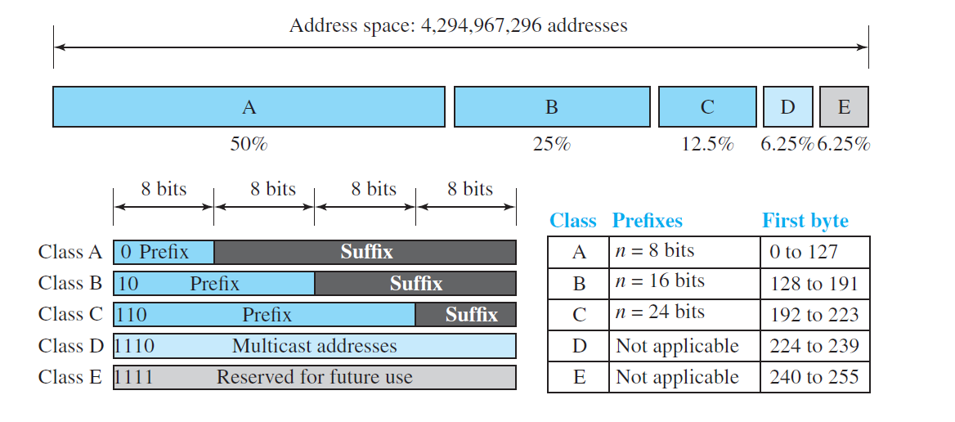

Slide 11
Primary Address Classes
Class A Networks 1.0.0.0 to 127.255.255.255
Class B Networks 128.0.0.0 to 191.255.255.255
Class C Networks 192.0.0.0 to 223.255.255.255
Class D Networks 224.0.0.0 to 239.255.255.255
Class E Networks 240.0.0.0 to 255.255.255.255

Slide 12
Private IP address
10.0.0.0 - 10.255.255.255 (10/8 prefix)
• 172.16.0.0 - 172.31.255.255 (172.16/12 prefix)
• 192.168.0.0 - 192.168.255.255 (192.168/16 prefix)

Slide 13
Sub netting
In 1985, RFC 950 defined a standard procedure to support the sub netting, or division, of a single Class A, B, or C network number into smaller pieces.
Sub netting was introduced to overcome some of the problems that Internet were beginning to experience with the classful two-level addressing hierarchy
Internet routing tables were beginning to grow.
Local administrators had to request another network number from the Internet body, before a new network could be installed at their site

Slide 14

Subnet Address Hierarchy
The route from the Internet to any sub- net of a given IP address is the same, no matter which subnet the destination host is on.

Slide 15
Subnetting overcame the registered number issue by assigning each organization one (or at most a few) network numbers from the IPv4 address space.
The organization was then free to assign a distinct sub- network number for each of its internal networks.

Slide 17
site with several logical networks uses subnet addressing with a single /16 (Class B) network address
The router accepts all traffic from the Internet addressed to network 130.5.0.0, and forwards traffic to the interior subnetworks based on the third octet of the classful address.

Slide 18
The deployment of subnetting within the private network provides several benefits:
The size of the global Internet routing table does not grow because
the site administrator does not need to obtain additional address space
the routing advertisements for all of the subnets are combined into a single routing table entry.
The local administrator has the flexibility to deploy additional subnets without obtaining a new network number from the Internet
Route flapping (that is, the rapid changing of routes) within the private network does not affect the Internet routing table

Slide 19
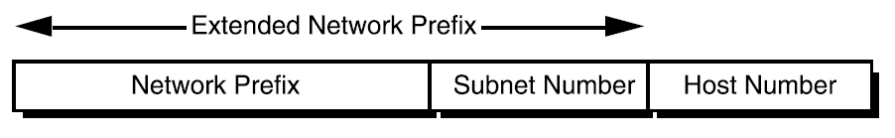
Extended Network Prefix
Internet routers use only the network prefix of the destination address to route traffic to a subnetted environment.
Routers within the subnetted environment use the extended network prefix to route traffic between the individual subnets.
The extended network prefix is composed of the classful network prefix and the subnet number

Slide 20
The extended network prefix is traditionally identified by the subnet mask
For example, if an administrator has the /16 address of 130.5.0.0 and wants to use the entire third octet to represent the subnet number, the administrator must specify a subnet mask of 255.255.255.0.

Slide 21
The bits of the subnet mask are set to 1 (one) to indicate that the corresponding bit in the IP address should be treated as part of the extended network prefix.

Slide 22
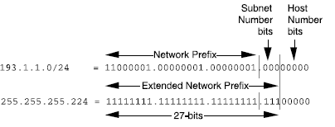

Slide 23
Subnet Design Considerations
How many total subnets does the organization need today?
How many total subnets will the organization need in the future?
How many hosts are on the organization’s largest subnet today?
How many hosts will there be on the organization’s largest subnet in the future?

Slide 24
Subnet example
Base Net: 11000001.00000001.00000001 .00000000 = 193.1.1.0/24
Subnet #0: 11000001.00000001.00000001.000 00000 = 193.1.1.0/27
Subnet #1: 11000001.00000001.00000001.001 00000 = 193.1.1.32/27
Subnet #2: 11000001.00000001.00000001.010 00000 = 193.1.1.64/27
Subnet #3: 11000001.00000001.00000001.011 00000 = 193.1.1.96/27
Subnet #4: 11000001.00000001.00000001.100 00000 = 193.1.1.128/27
Subnet #5: 11000001.00000001.00000001.101 00000 = 193.1.1.160/27
Subnet #6: 11000001.00000001.00000001.110 00000 = 193.1.1.192/27
Subnet #7: 11000001.00000001.00000001.111 00000 = 193.1.1.224/27

Slide 25
The All-0s Subnet and All-1s Subnet
RFC 950 prohibited the use of the all-0s and the all-1s subnets.
to eliminate situations that could potentially confuse a classful router
Today ,routers can be both classless and classful at the same time-it could be running RIP-1 (classful protocol) and BGP-4 (Border Gateway Protocol protocol) at the same time.

Slide 26

All 1 subnet

Slide 27
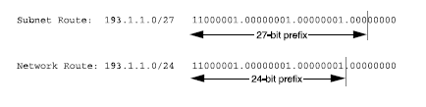
All 0 subnet

Slide 28
Defining Host Addresses for Each Subnet
According to Internet practices, the host number field of an IP address cannot contain all 0-bits or all 1-bits.
The all-0s host number identifies the base network (or subnetwork) number,
while the all-1s host number represents the broadcast address for the network (or subnetwork).

Slide 29
Variable Length Subnet Masks (VLSM)
subnetted network could use more than one subnet mask.
When an IP network is assigned more than one subnet mask, it is considered a network with (VLSM)
extended network prefixes have different lengths.

Slide 30
