Slide 1

IoT Based Predictive Maintenance
Name: Chetan Chadha
Matriculation Number: 1324510
Semester: 3rd, Master IT
Notes:
My name is chetan chadha. I am a master's student in Frakfurt university of applied science currently enrolled in 3rd semester. Today, I will be presenting on the topic IoT based Predictive Maintenance and different components involved in creating a successful PM architecture

Slide 2
Agenda
Introduction
Architecture Overview
Deep Dive
Conclusion
Questions and Answers
Notes:
The agenda of the presentation is as followed. I will begin with introduction, giving you the general overview of what is meant by IoT and IoT predictive maintenance. This will be followed by an architectural overview of the process.. Then we will be deep diving into the main concepts involved in IoT based Predivte maintenace and after that i will conclude the topic and then we will open it up for Q&A.

Slide 3
Introduction
Notes:
Lets start with the introduction

Slide 4
Internet of things
Network 2
Sensors 1
Sensor 5
Device 2
INTERNET
Device 4
Sensor 3
Sensor 6
Sensor 7
Network 1
Notes:
I will begin with giving general overview of what IoT is. As we can see in the diagram, we have multiple devices that operate individually and are also linked with each other. Each device works in its own network. All these devices are equiped with multiple sensors that transfers the data from the environment which is shared across the common network. The networks are connected with each other through internet. So, when the devices connect and share data across the network via internet is termed as internet of things. Explaining it with an example, lets say we have an automobile with sensors that is connected to the internet. The data shared by the sensors creates alerts for the driver about a possible issues that might occur such as (fuel outrage, reduction in tire pressure, or any other needed maintenance).

Slide 5
IoT based Predictive Maintenance
Watches
Mobiles
Various functions
IoT
Predctions
Cars
Aeroplanes
Industry
Notes:
Now coming to what is IoT based predictive maintenance. As depicted in the diagram the data from the various devices for example watches, mobiles, cars etc are collected over the internet based on the concept of IoT. The data collected through these devices contains various critical parameters that are necessary to predict the machine health by passing it through various mathematical functions or models. These mathematical models are used to create predictions that tell us a possible fault that might occur in future and help us in taking necessary steps to avoid these future failures. This concept together is termed as IoT based predictive maintenance. We will discuss about the various mathematical models and funcitons in the upcomming slides.

Slide 6
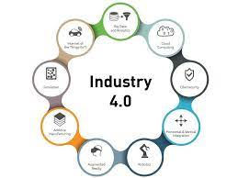


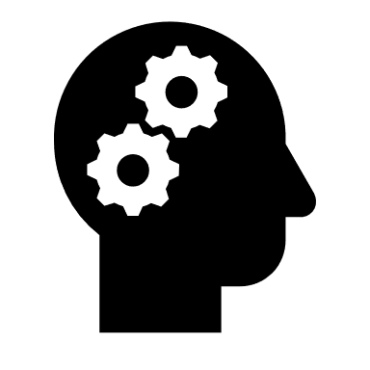
IoT based Predictive Maintenance
Time based maintenance
ARC Group study
80%
20%
Less maintenance
Early alert
Increases productivity
Reduces cost
From: https://intoindia.blog/2020/05/06/the-7-ways-business-and-brand-can-thrive-in-industry-4-0/
Notes:
Traditionally, the market has been using the time-based maintenance approach for handling the machines and taking necessary steps for maintaining the machine health. For instance, we take our cars to agencies for routinely checkup after a stipulated time. The company provides regular health checkup and fixes any components that might be working abnormally. This is the key principle on which time based maintenance works. However, a study conducted by ARC group of research suggests that time based fault consittute to only 20% of the machine faliure while the 80% of the faliure occurs randomly. This suggests a strong need to improvise the approach to deal with the random faliures through Iot based PM in industry 4.0. This will make sure that the control unit predicts the possible faliure ahead of time and the concept of timebased maintenance will be replaced by maintenance as and when the fault is detected to ouccur in the near future and hence eliminating equipment faliure altogether. As evident the benifits of IOT based PM are ………
IoT is a backbone of industry 4.0. An improvised IOT structure directly impact Industry 4.0 model . Lets have a look at how Iot Based PM architecture works and see how different components are interlinked to each other.

Slide 7
Architecture Overview

Slide 8





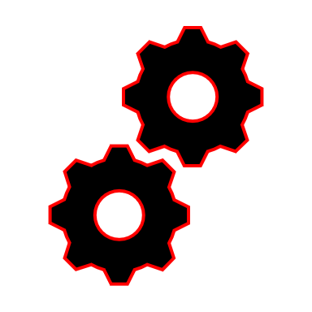

Architecture Overview
Actuator
Command
Field Gateway
Control Unit
Cloud gateway
Data Processing
Sensors
User applications
Machine Learning
Data Lake
Big Data Warehouse
Data Analytics
Hardware
Software
Notes:
The slide here will take you through the overall architecture which is used to implement IoT based predictive maintenance.
At first we have an equipment which is getting analyzed. The device is equipped with different types of sensors that detect any type of anomalies. The type of data that is collected by the sensors are pressure, temperature, running time etc. These data are first converted to the digital signals and are then passed to the cloud storages with the help of field gateways. Field gateways are used to establish a secured session (Https) with the cloud to maintain the proper security. Once the connection is successfully established the data is passed to data processing, where the unwanted parameters are removed using the concept of denoising and dimensionality reduction. After that data is stored into the data lake. Data lake is a humungous storage that can be used to dump huge amount of historical data. The data stored in data lake can be reclaimed or used again depending upon the need. In the next stage the required data on which analysis needs to be performed is passed to the big data warehouse. big data warehouse stores the relevant data on which user can work and make analysis. As you can foresee the next step will be to perform data analytics using various python modules such as numpy, jupyter notebook etc. Its important to note here that a person who is performing data analytics must have good domain knowledge to understand the behavior of the equipment properly. Parallelly this data is passed to the machine learning models where they get trained and start making predictions after some rounds of iterations. All these steps are controlled using the control unit which is further controlled by the user application (GUI). Based on the predictions user can send a command to the control unit which can further send the command to the actuators to make the required changes in the equipment. It is to note here that actuators make or may not be present for the architecture it totally depends upon the requirements.
As you can see here a lot of components and tools are required to perform the IoT based predictive maintenance. But is it noteworthy to point that the choices of these tools vary from industry to industry. It can be broadly divided into 2 categories that are hardware and software. In terms of software there are major parties in the market such as GCP, Azure and AWS. These cloud platforms provide all the required functionalities with more or less same accuracy. On the other hand hardwares should be chossen precisely as once installed they are hard to remove. Updating the hardware like sensors can result into poor performances.

Slide 9
Deep Dive
Notes:
Now lets deep dive into few of the components that are imports to perform predictive based analysis.

Slide 10
Deep Dive
Actuator
Command
Field Gateway
Control Unit
Cloud gateway
Data Processing
Sensors
User applications
Machine Learning
Data Lake
Big Data Warehouse
Data Analytics
Notes:
To brief you about the equipment that are show stoppers here are sensors, Data analytics and Machine learning. Lets understand about them in more detail.

Slide 11








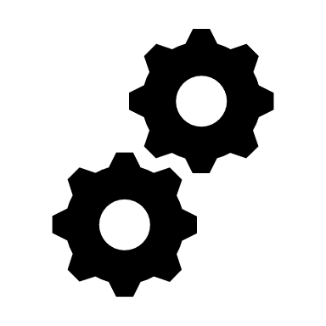



Sensors
Phsyical devices
Sensors
Eelctrical signals
Notes:
The sensor is mainly used for predictive maintenance on assets such as cars, ships, aeroplanes etc. By continuously collecting data, operators can detect abnormalities at an early stage.
The sesnors collect data from the environment and from the equipment and convert them into the electrical signals. The data fetched from the outside world can consists of oil pressure, equipment temperature and environment temperature, gas etc. All these data are interpreted as an electrical signals and these electrical signals are then passed to the cloud. Based on the stability of these electrical signals further predictions are made based on which user takes next action. So as you can see if your sensor is faulty it can result into bad signals which will result into falsy predictions. Hence sensors should be installed with proper precision and premium quality of sensors should be used to fetch the correct data.

Slide 12


Data Analytics & Machine Learning
Machine Learning
Supervised Learning
Unsupervised Learning
Input and output variable will be given
Only input data is given
Algorithms are trained using labelled data.
Algorithms are trained against data which is not labelled
Supervised learning is a simpler method
Unsupervised learning is computationally complex
$$D= {( x_{i}, y_{i})}_{i=1}^{N}$$
$$D= {( x_{i})}_{i=1}^{N}$$
Data
Oputput
Data
Input
Input
Notes:
Machine learning can be broadly divided into two categories namely supervised learning and unsupervised learning.
Explain about Labelled data with an example.

Slide 13

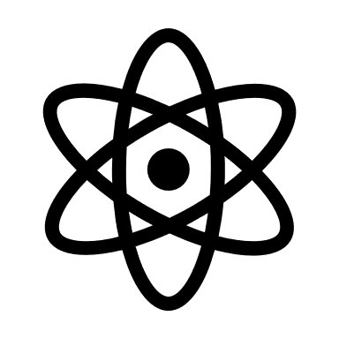
Data Analytics & Machine Learning
Failure Prediction
Data preprocessing
Training
Anomaly Detection
De-noising
Remainng useful life
Notes:
The data that is fetched from the sensors is raw and contains lot of unecessary parameters. Data pre processing is an important step as it organises the data in the format that is required by our machine learning models. The first step is to filter out the noise from the data by performing data preprocessig which includes de-noising and dimentionality reduction. This helps to clean the data and extract valuable information from it.
In the next step the cleaned data is then passed to the training models. Using this data models get trained after certain amount of iterations. Once the desired accuracy is achieved the models then make the failure porediction, anomaly detection and the remaining useful life of it.
One of the branch of ML is Deep learning that is playing an active role in PM. Lets understand about it

Slide 14


Data Analytics & Machine Learning
Deep Learning: DL is a part of machine learning, it has layered structures. In Predictive maintenance DL can help to find the relationship between the features.
$$y=f(x, ∅)$$
Learning parameters such as, # neurons in a layer, # of iterations etc
Output
Input
$y={f_{2}( f}_{1}(f(x, ∅)$))
Output
Complex functions chained over the iterations
Notes:
Deep learning is a subset of machine learning that has networks capable of learning from the data that can be unstructured or unlabelled. It has layered like structured that helps to create a relationship between the unlabelled data, just like brain. The output is linked to the input via a function and various parameters.
It can be well explained From the equation.
As we can see an input is linked to the output based on a function f . There are two parameters of the function one is the input that is the input data and the other one is the phi which represents the learning parameters such as (i.e number of neurons in a layer, number of iterations etc)
Next equation represents the relation between input and output after three iterations
The relation of the input and the output based on chained functions. As shown it has total 3 functions and hence there were 3 iterations.

Slide 15
Artificial Neural Network (ANN)
Weights 1
Weights 2
Oputput Layer
Input Layers
Hidden Layers
Notes:
I will be explaining deep learning neural network with an example of Artificial neural network. An Artificial Neural Network (ANN) is an information processing that is inspired by the way biological nervous systems, such as the brain process information. An ANN is configured for a specific application, such as pattern recognition or data classification, through a learning process.. As shown it has one input layer, one output layer and one hidden layer. All thelayers are connected with all the previous layers. ANN is also known as a feed forward (no loops). Feed forward algorithm is used for calculating the output values, while back propagation is an algorithm for trainnig neural networks (changing weights) based on erros obtained from output values. ANN can be initiated with the value of the weight, learning rate and epoch(iteration in ANN), sigmoid function is used as an activation function.

Slide 16
Conclusion
Notes:
In clonclusion I would like to say that Predictive Maintenance (PM) using IoT is one of the fastest-growing areas of modern data deluge. Sensors serve as the backbone of this revolutionary concept. The main purpose of using sensors is to acquire data for analysing the insights. The right insights at the right time about the equipment can help the engineers to take preventive actions. Right ML and DL models can help to generate precise prediction and can improve the performance of the system tremendously.

Slide 17
Q&A and Feedback!!!

