Slide 1

Disaster Management Application
Mubashir Ali Khan 1324099
Chetan Chadha 1324510
Guidance of Prof. Ulrich Trick

Slide 2
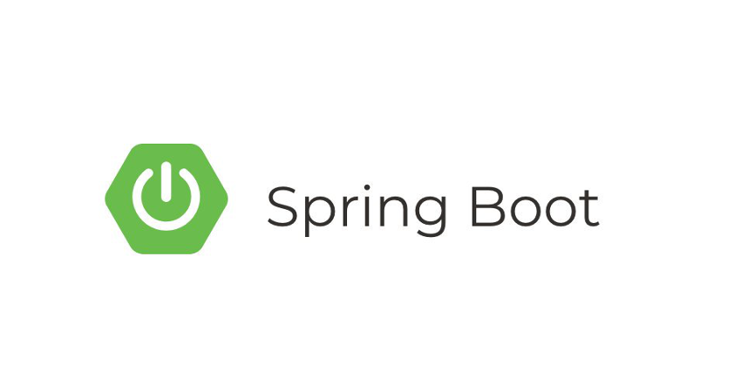

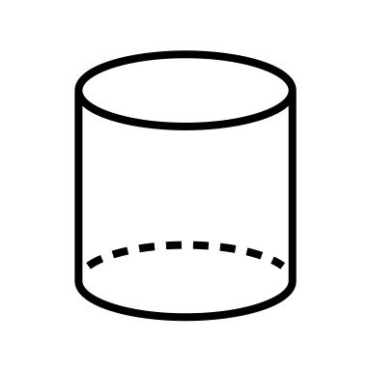
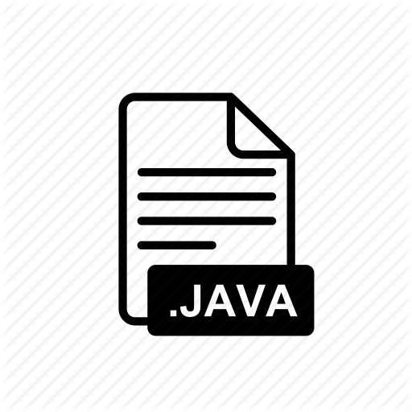



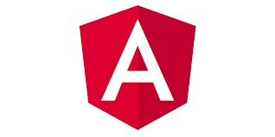

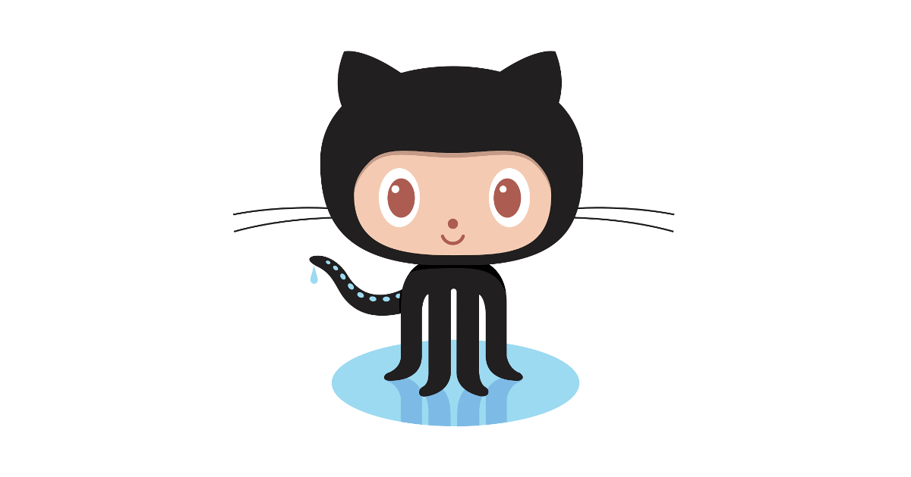
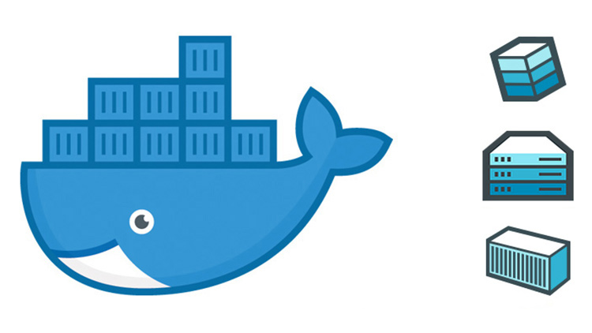
Front-End
Back-End
Presentation Layer
Application Layer
VIEW
Controller
Data Layer
HTTP: POST, GET
RescuerAPI.java
HTML
CSS
HTTP: POST, GET
UserAPI.java
TYPESCRIPT
H2 Database
HTTP: POST, GET
AdminAPI.java
Requirements Completed
Interactive website
Scalable
Accessed by web browsers
Based on WMN based network
All components containerized
Backend Part implemented in spring-boot/Java
1K LOC (line of code)
5 front-end modules
17 REST API’s
Customized Exceptions
2 git hub repositories
Front-end & Back-end
2 docker hub repositories
Front-end & Back-end
FRA-UAS
2
Notes:
So as you can see we have implemented the backedn functionality in spring boot, java.
We have 3 main APIs that is Rescuer, User and Admin. All together there were around 17 APIS that were implemented.
The data transfer between the Front end and backedn happens in JSON format,
All our data is being stored in the database named H2 database.
We have used 2 main protocols for communication that are HTTP and webscocket (is used for full duplex communication)
To accomplish all of this we have used latest high end technologies.
For the source code management we have used git hub. As you can see we have 2 repostioties as we are 2 develoeprs.
This helped us to avoid code conflicts and work professonaly
We have used docker hub to publish our containers
All together we have written 1000 lines of code in both front end and backend combined.
There are around 5 module in front end and 17 rest apis have been successfully implemented and tested in backed.
To make the website more interactive we have used customized exceptions as well. That will help the user to identify an error in backend if any
Talking about the requiremetns we have successfully completed all of them:
Firstly We have a user friendly and interactive website.
The code we have written is highly scalable
Our website can be accessed from any web browsers namely chrome, firefox and internet explorer
It is based on WMN based network.
As mentioned before all components are containerized and pushed on docker hub
Backend as required has been implemented in java.
Lets move forward with the demo.

Slide 3
Demo

Slide 4
Thank You
Special Thanks to
Prof. Ulrich Trick
Mobile Computing Team

