Slide 1

Highlights

Slide 2






Team
Chetan
Pankaj
Prashant
Member | Location
Aanchal Lohia | Mumbai, IN
Ravishekhar Gopalan | Toronto, CA
Chetan Urkudkar | Dublin, USA
Pankaj Khairnar | Mumbai, IN
Prashant Hattiholi | Pune, IN

Slide 3
Realization

Slide 4
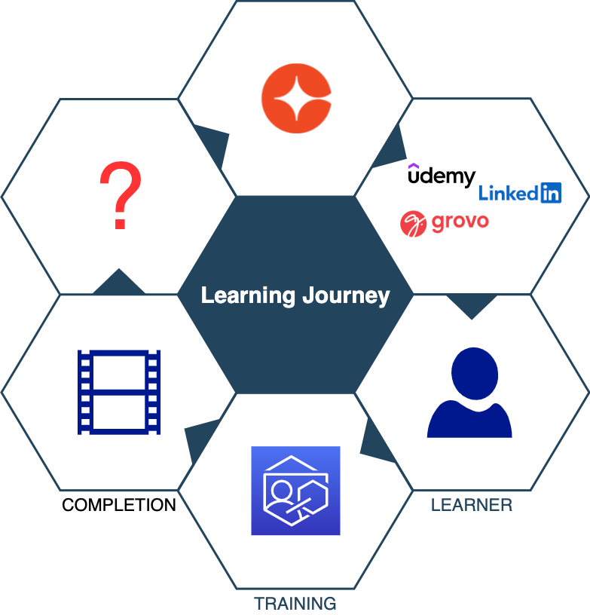
Learning Journey

Slide 5
Completion is a milestone!
Cornerstars bring best-in-class learning to learners on our platform
Learners love our excellent content.
What about after the learner completes training ?
Learning does not end with content completion
This hack enables us to continue the journey together

Slide 6
Theory
If you don’t use it, you lose it!

Slide 7
Reality
If you don’t use it
and do 100 other things your job
you already lost it!

Slide 8
Value Proposition
After completion
we take a step back
learner is on track to gradually lose what they learnt
How can we help our learners of our platform?
We can help them retain what they have learnt
Retention

Slide 9
Solution

Slide 10
Words of the wise…
Repetition
Re-inforces
Retention

Slide 11
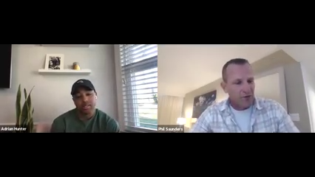
Phil Agrees

Slide 12
Demo
Re-inforcement in action

Slide 13
Re-inforcement
Repetition
Highlight portlet
Cycle through user’s highlights
Re-inforcement
Jog memory
Support additional context
Retention
Increase knowledge lifetime
Increase engagement

Slide 14
Reality - with highlights
If you don’t use it
and do 100 other things your job
but re-inforce what you learnt frequently
you lose it veeery slowly!

Slide 15
Questions

