Slide 1
CREDIT CARD FRAUD DETECTION
CHETAN KATE

Slide 2
INTRODUCTION
It is important that credit card companies are able to recognize fraudulent credit card transactions so that customers are not charged for items that they did not purchase.
Credit Card Security relies on the Physical Security of the plastic card as well as the privacy of the Credit Card Number.
Globalization and increased use of the Internet for Online Shopping has resulted in a considerable proliferation of Credit Card Transactions throughout the world.
Credit Card Fraud is a wide-ranging term for theft and fraud committed using a Credit Card as a fraudulent source of funds.

Slide 3
PROJECT OBJECTIVE
To predict Fraud Detection of Credit Card
Highlighting the main variables / factors influencing Class
Use various Machine Learning Algorithms to build the prediction model, evaluates the accuracy and performance of these model.
Finding Out the best model for our prediction.

Slide 4
problem
The datasets contains transactions made by credit cards in September 2013 by european cardholders. This dataset presents transactions that occurred in two days, where we have 492 frauds out of 284,807 transactions. The dataset is highly unbalanced, the positive class (frauds) account for 0.172% of all transactions.
It contains only numerical input variables which are the result of a PCA transformation. Unfortunately, due to confidentiality issues, we cannot provide the original features and more background information about the data.
Features V1, V2, ... V28 are the principal components obtained with PCA, the only features which have not been transformed with PCA are 'Time' and 'Amount'. Feature 'Time' contains the seconds elapsed between each transaction and the first transaction in the dataset. The feature 'Amount' is the transaction Amount, this feature can be used for example-dependant cost-senstive learning. Feature 'Class' is the response variable and it takes value 1 in case of fraud and 0 otherwise.

Slide 5
Dataset description
Source of dataset is in csv format
Total Records
There is no missing values in the provides in the input dataset
Dataset contains 284807 rows and 31 columns
Machine Learning Approach
Target
CLASS is the variable which notifies the whether:
A particular transaction is fair transaction or fraud transaction
And we will be developing our models to predict

Slide 6
METHODOLOGIES
EDA(Exploratory Data Analysis): The dataset consists of 31 variables in all. A few are continuous, rest are categorical.
Model building which includes defining the purpose if model, determine the model boundary, build the model, create an interface and export the model.
Evaluating machine learning algorithm is an essential part of project.

Slide 7
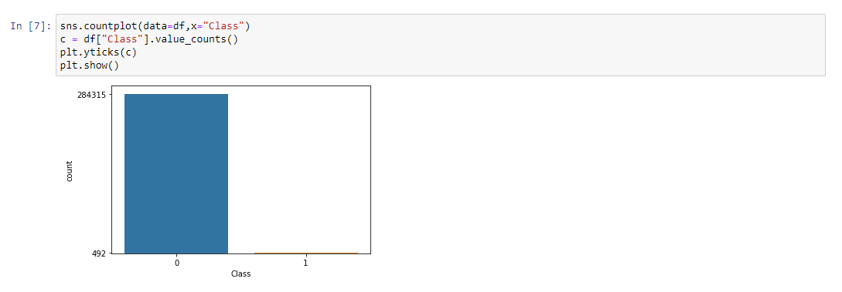
EXPLORATORY DATA ANALYSIS
Data visualization using seaborn and matplotlib
Exploratory data analysis (EDA) is an approach to analyze data sets & to summarize their main characteristics, often with visual methods.
A Statistical model can be used or not, but primarily EDA is for seeing what the data can tell us beyond the formal modelling or hypothesis.

Slide 8
Dataset overview & Sampling techniques
So, By dataset overview we come to now that our dataset is not balance. Therefore, we used Sampling techniques with RandomOverSampler for the balancing the our dataset.
Hence, it will increase the data of “Yes or Fraud as 1 ” in class variable because the available data of Yes was very less compared to No class

Slide 9
ALGORITHM USED FOR PREDICTION
TO SOLVE THIS CLASSIFICATION DATASET WE HAVE USED BELOW ALGORITHM AFTER DIVIDING IN TRAINING AND TESTING DATASET
Logistic Regression
Decision Tree Classifier (Using both Gini Index and Entropy Method) and also Random forest
Support Vector Mahcine

Slide 10
Techniques USED FOR PREDICTION
In addition to classification algorithms, we have also used below ensembling techniques for better model prediction
Pruning Techniques
Boosting Techniques
Adaptive Boosting
Gradient Boosting
Extreme Gradient Boosting

Slide 11
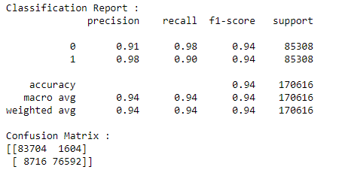
Classification Report and confusion matrix
LOGISTIC REGRESSION

Slide 12
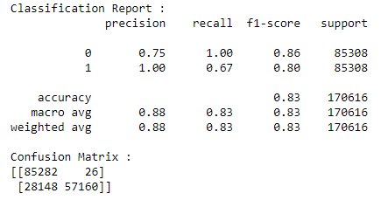
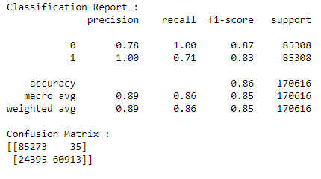
Classification Report and confusion matrix
DECISION TREE CLASSIFIER USING
GINI INDEX
ENTROPY

Slide 13
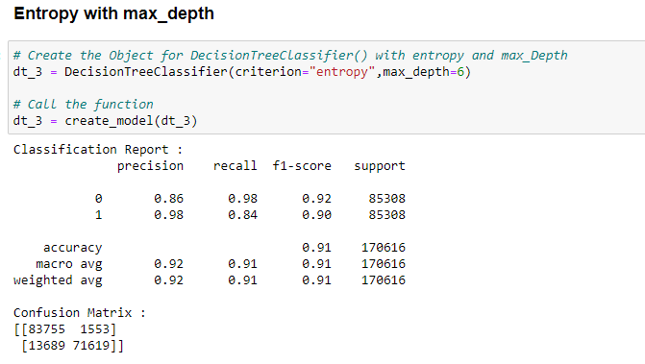
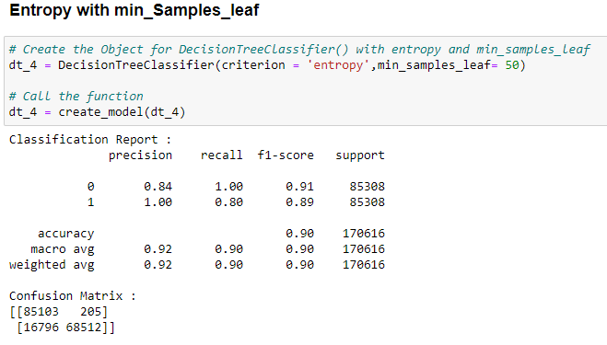
Classification Report and confusion matrix
DECISION TREE CLASSIFIER USING ENTROPY METHOD WITH MIN_SAMPLES_LEAP AND MAX_DEPTH

Slide 14
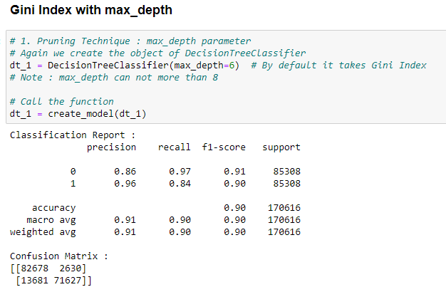
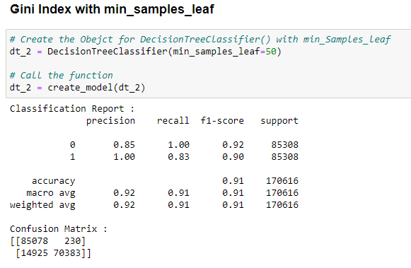
Classification Report and confusion matrix
DECISION TREE CLASSIFIER USING GINI INDEX WITH MAX_DEPTH AND MIN_SAMPLES_LEAF

Slide 15
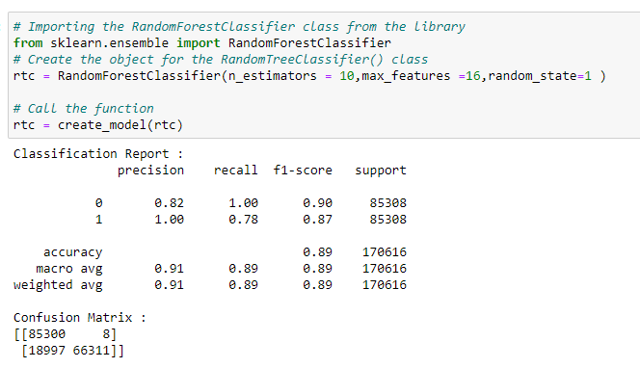
Classification Report and confusion matrix
RANDOM FOREST

Slide 16
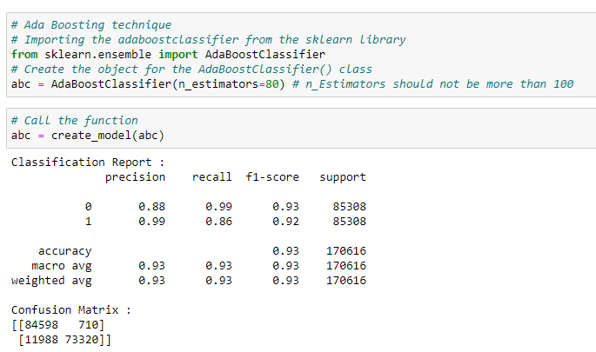
Classification Report and confusion matrix
ADAPTIVE BOOSTING

Slide 17
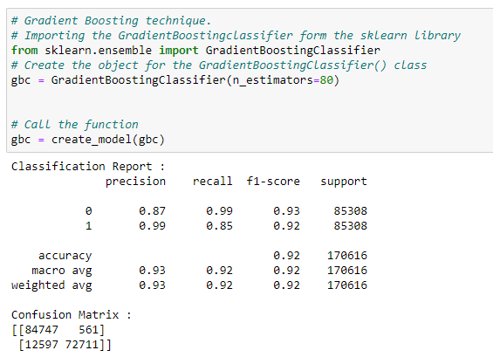
Classification Report and confusion matrix
GRADIENT BOOSTING

Slide 18
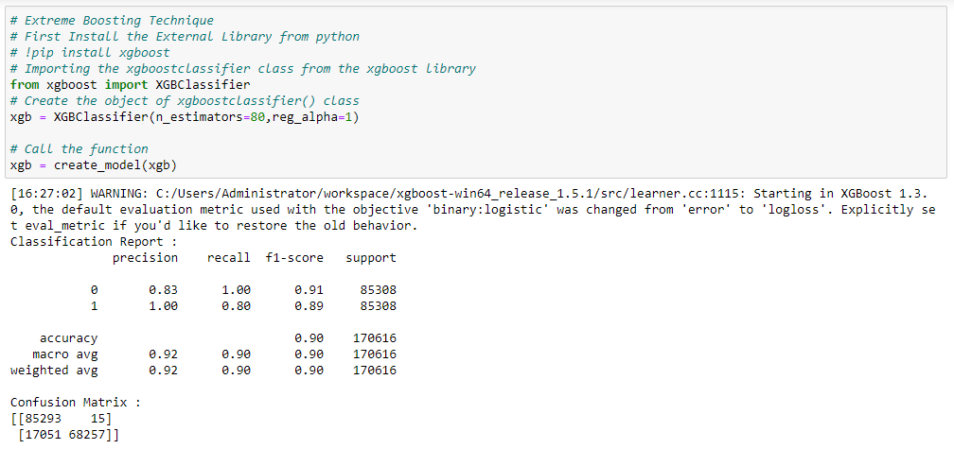
Classification Report and confusion matrix
EXTREME GRADIENT BOOSTING

Slide 19
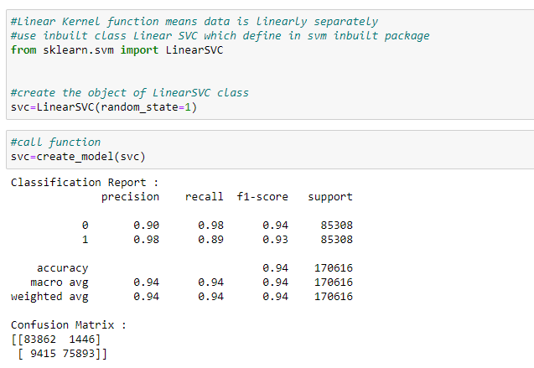
Classification Report and confusion matrix
SUPPORT VECTOR MACHINE

Slide 20
SUMMARY
We have tried several models till now with both balanced and imbalanced data. We have noticed most of the models have performed more or less well in terms of Precision and Recall.
So here, to save the banks from high-value fraudulent transactions, we have to focus on a high recall in order to detect actual fraudulent transactions.
After performing several models, we have seen that in the balanced dataset with the Logistic regression model and Support Vector Machine (SVM) has good Precision values and also high Recall.
Hence, we can go with the logistic model here. It is also easier to interpret and explain to the business.

Slide 21
THANK YOU

