Slide 1

LIFE@IITD
Immerse yourself in daily life at iit delhi to win …

Slide 2
Objective and About
Life@IITD is a 2 player maze game set in a simplified map of IIT Delhi where the objective is to complete as many tasks as possible in the given time.
Whichever player completes more tasks in the given time, wins the game.
IIT Delhi has a lot of cool places, hopefully you will visit as many as possible while playing this game ☺

Slide 3
CONTROLS
Player-A
Up Arrow Key – Up
Player-B
W Key – Up
Down Arrow Key – Down
Left Arrow Key – Left
Right Arrow Key – Right
A Key – Down
S Key – Left
D Key – Right

Slide 4
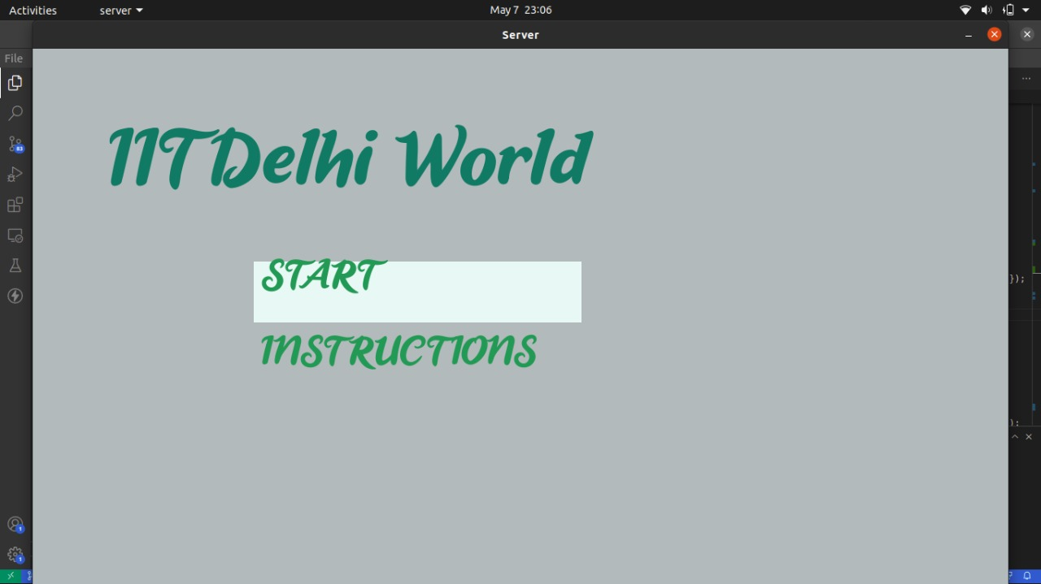
Game screens
Home Screen

Slide 5
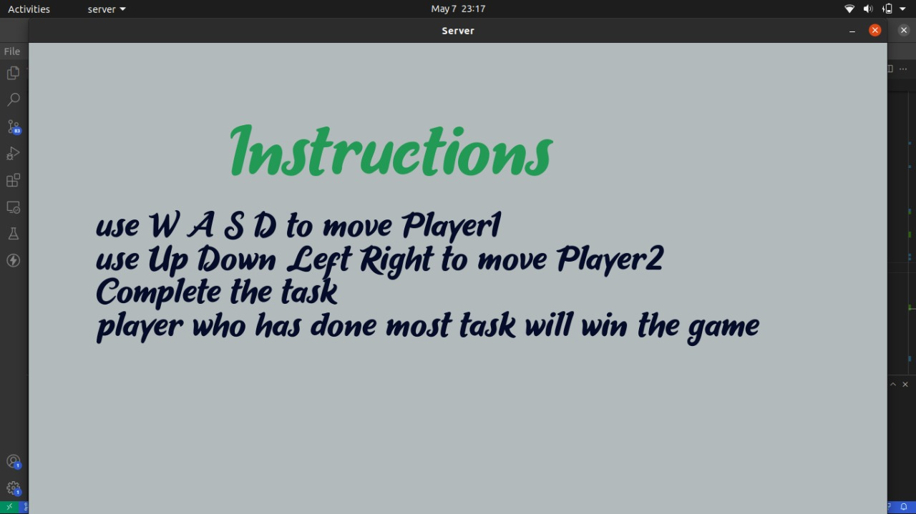
iNSTRuctions screen

Slide 6
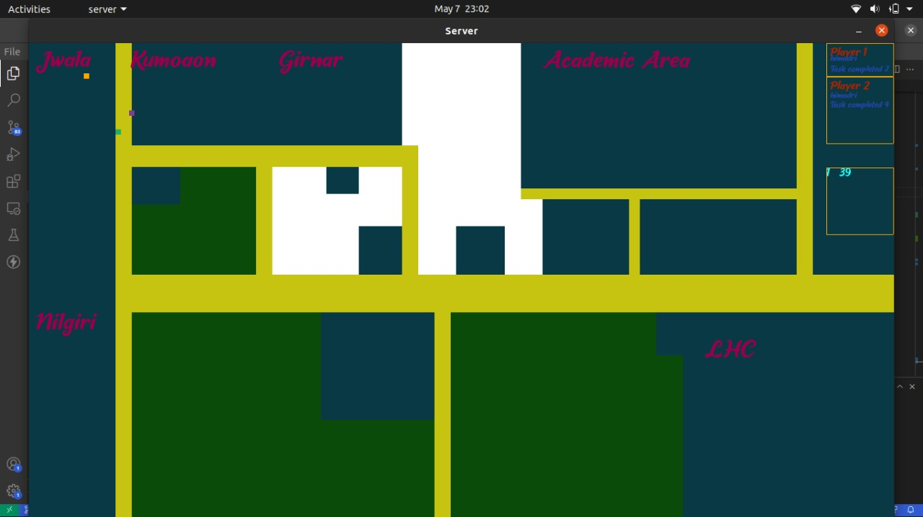
Map screen

Slide 7
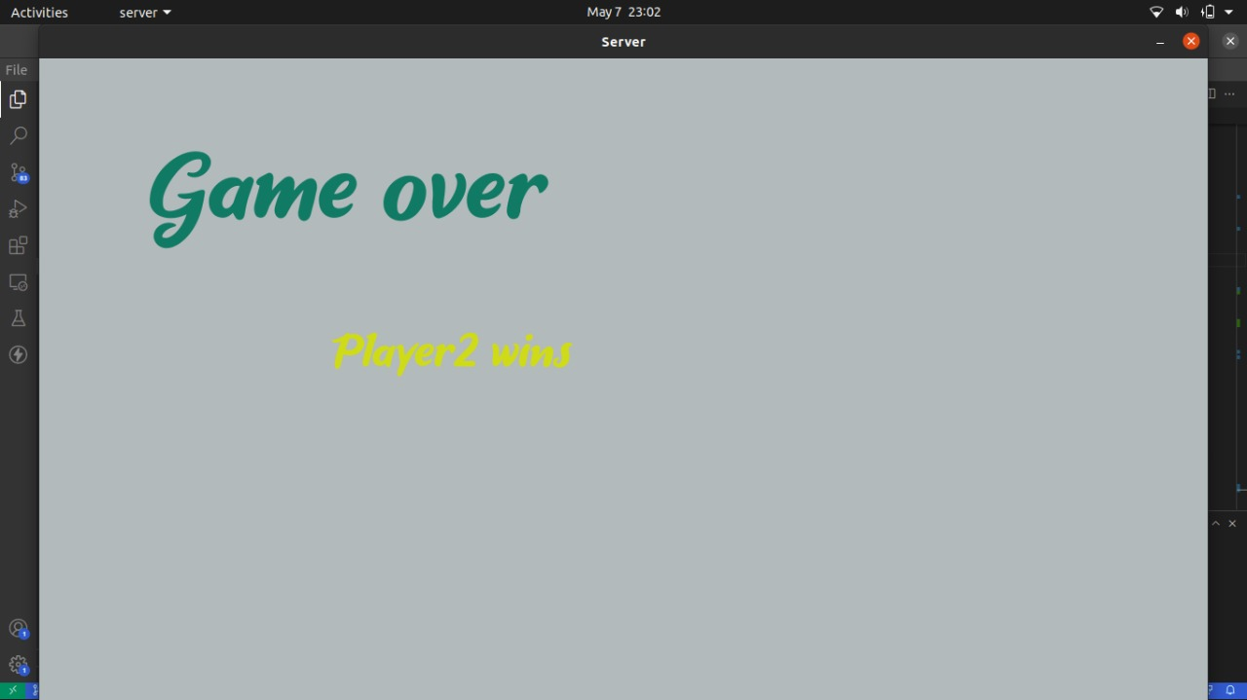
Game over screen

