Slide 1

CNN pipeline on 1024*1024 input with 4*4 kernel
Chetan Somana / csomana

Slide 2
Design split into three stages
Convolution
Leaky ReLU
Pooling
The Kernel and input data of 1024*1024 are required for stage 1, convolution.
Challenges A
1. How the design issues read command and read addr to DRAM input memory.
2. How does the design stores the output of DRAM input memory.
3. In which pattern do we slide?
4. How big is the register file?
Each slide operation will populate convolution matrix.
Challenges B
1. Where do I store MAC output?
2. How big is my convolution register file
Leaky ReLU
Challenges C
1. How big is my Leaky ReLU register file
2. Modifying the weights based on if the number is positive/negative.
Pooling
Challenges D
1. How big is my Pooling register file

Slide 3
Decisions made in Challenges A influence other Challenges
Challenge A -3 “In which pattern do we slide? ”
I can think of these two possibilities for this
First Possibility : Red ->blue->green->black Second Possibility Red ->shift down blue-> shift up grean -> down black
Sliding one way all the way 1021 times generates 1021 convolution elements. We need 4 elements in a 2*2 grid to perform average pool. But we have all the elements in for just one row. With this methods my convolution register file should be at least 1021B or more
If we want to limit the register file of convolution to 4B then we need to slide first at (x,y) -> (x,y+1) -> (x+1,y) -> (x+1,y+1)

Slide 4
Challenge A -3 solves Challenge B-2, C-2, D-1
Convolution register File 4B. Need to think if I should declare as reg [7:0] con_reg_file[2][2] or reg [7:0] con_reg_file[4]
Do I keep separate Leaky ReLU or overwrite the convolution register file ? If I have a separate Leaky ReLU one extra cycle is needed. Leaky ReLU reg file 4B.
Pooling reg file 8B
Challenges A
How the design issues read command and read addr to DRAM input memory.
How does the design stores the output of DRAM input memory.
In which pattern do we slide?
How big is the register file?
Challenges B
Where do I store MAC output?
How big is my convolution register file
Challenges C
How big is my Leaky ReLU register file
Modifying the weights based on if the number is positive/negative.
Challenges D
1. How big is my Pooling register file

Slide 5
As we are sliding in inverted N pattern, we need to have data from 5 adjacent rows.
Address 0 and 8 are occupied by the kernel in the DRAM input memory.
1024 * 1024 matrix is stored in the DRAM input memory.
Starting address for a particular row : 16 + 128 * (#row -1) * 8
Ending address for a particular row: starting address + 127 * 8
ROWS
Kernel | 1 2 3 4 5
Read address 0->8->16->1040->2064->3088->4112
Design clock 0->8->16->24->32->40 ->48 ->56
Data capture 5->13->21->29->37 ->45 ->53->61 [5 cycle latency]
Data availability 13->21->29->37 ->45 ->53 ->61->69
First slide start at 69

Slide 6
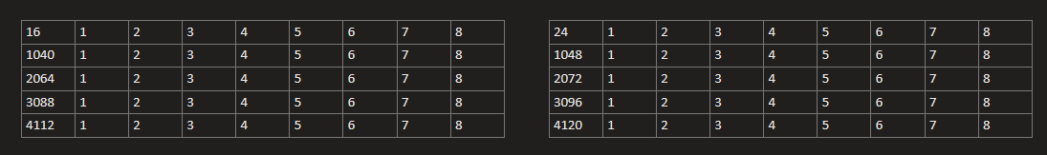
Addr DATA
Addr DATA
Slide 1
Slide 2
Slide 3
Slide 4

Slide 7
Slide 5
Slide 6
Slide 7
Slide 8

Slide 8
Slide 9
Slide 10
Slide 11
Slide 12

Slide 9
Slide 13
Slide 14
Slide 15
Slide 16

Slide 10
5*8 Register file 1 5 * 8 Register file 2
2*8 highlighted elements in yellow can be removed as we have utilized them completely. Achieve by overwriting.
3*8 highlighted elements in green moved to a buffer which is SRAM of size 32Kb or 3KB Register file.
Copy
After 15 slide is done, copy the first row from 5*8 RF2 to 5*8 RF1 so that 11th read can be stored
In 5*8 RF2.
After 16 slide is done, wait till 10 read is completed and then copy next four rows from 5*8 RF2 to 5*8 RF1
Give 12,13,14,15 reads while 11 read is not completed

Slide 11
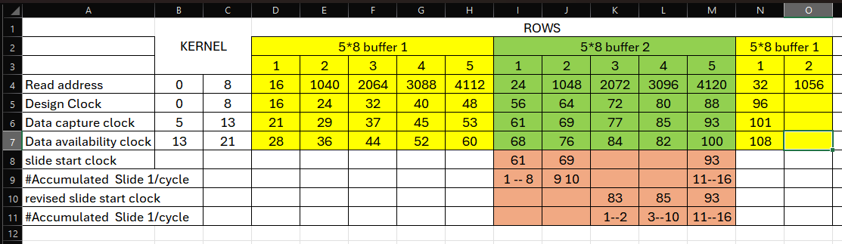
When the clock is at 98, i.e 15th slide is completed, generate control signal which triggers to copy RF2 row1 to
RF1 row1.
When the 11th read data capturing begin, generate a control signal to copy RF2 row2-5 to RF1 row 2-5.

Slide 12
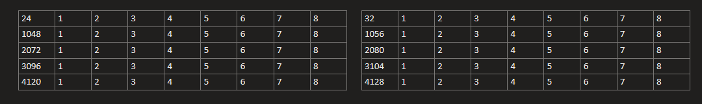
5*8 Register file 1 5 * 8 Register file 2
The new data always comes to RF2. Where as the the bottom 3 rows of RF1 is being sent to SRAM or 3KB register file( Not decided yet. Will change based on the synthesis/performance problems)
Row transitioning discussed on next slide

Slide 13
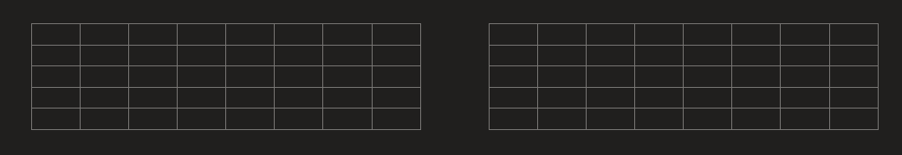
RF1 : Last read – 1 of the row RF2: Last read of the row
RF1 : Last read of the row RF2: New read of the next row(last row +5)
RF1 : New read of the next row(last row +5) RF2: New read +1 of the next row(last row +5)

Slide 14
Challenges A
How the design issues read command and read addr to DRAM input memory. Rows 1 to 5 till last read of the row
How does the design stores the output of DRAM input memory. Two 5*8 RF and buffer unused RF data
In which pattern do we slide? Inverted N
How big is the register file? Two 5*8 RF
Challenges B
Where do I store MAC output? In convolution reg file
How big is my convolution register file 4B
Challenges C
How big is my Leaky ReLU register file 4B
Modifying the weights based on if the number is positive/negative.
Challenges D
1. How big is my Pooling register file 8B

Slide 15



5 rows -> 5 read counter. Each row initialized
After reset, FSM always transitions from IDLE to READ LOAD
IDLE : 5 read counter are initialized to 0
READ LOAD :
If number of rows_reads ==0 then
Row1_read_count = 16;
Else
Row1_read_count = 16 + 128*8*(3 + 5*(rows_read-1);
READ INCR: (if the 32 cycles has passed only then we should enter this state)
Row1_read_count = Row1_read_count + 8;
Row2_read_count = Row1_read_count + 1024;
Row3_read_count = Row2_read_count + 1024;
Row4_read_count = Row3_read_count + 1024;
Row5_read_count = Row4_read_count + 1024;
Need extra logic to choose which row*_read_count should be sent on addr of input DRAM
6 bit counter is sufficient as we need to count till 40 cycles.
Decide between counter or FSM with 6 states and a 3bit counter to goto next state.

Slide 16
Writes to output DRAM
Convolution buffer is filled in row order form, thus decreasing complexity on write.
Write address start at 0. Increment write address by 8.
Whenever pooling buffer is accessed assert a pooling_buffer_accessed signal.
Count pooling_buffer_accessed signal, when it reaches 7 trigger write and
Control signals identified
last_read : Keep tracks of how many reads for a row has undergone.
two_rows_used : is set when the first two rows of the input matrix is utilized
swapped : is set when RF2 contents is swapped to RF1, this information is useful for sliding.
Relu start : indicates 4 sliding has been done in inverted N pattern. Convolution matrix is ready with 4 elements.
write_buffer : is set when there are 8 bytes of information which is ready to write to output DRAM
slide enable : perform slide only when this bit is set high
First_row_swap : is set when RF2 row1 can be copied to RF1 row1. Usually set for after every 10th read
16_slides_dones : indicates 16 convolution data is generated, (write_buffer should go with in few clock cycles)

Slide 17


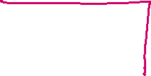

Slide 1
Slide 2
Slide 3
Slide 4

Slide 18
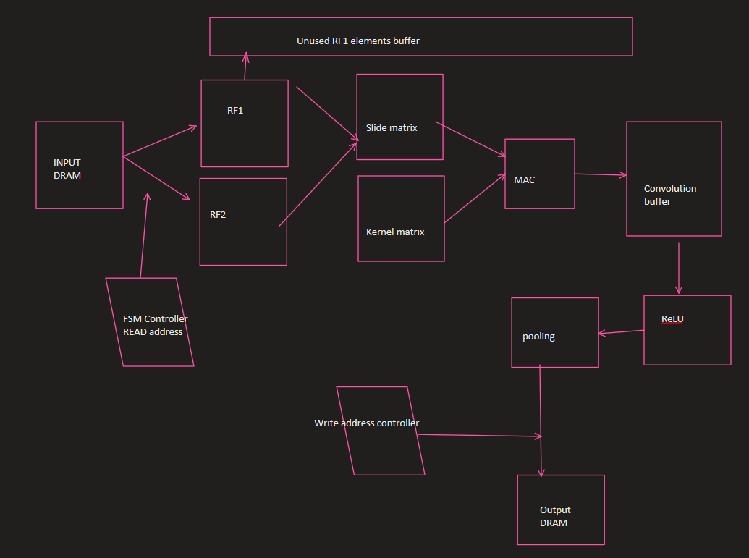

Slide 19
Storage / Controller elements identified in the design
Two 5*8 to store data from output DRAM
3*1024 or SRAM to transfer back unused data ( decide based on synthesis/performance)
4B Convolution Buffer
4B Leaky ReLU Buffer
8B Pooling buffer
Read address generator logic.
Sliding logic
MAC logic
Register swap logic
Write address generator logic

Slide 20
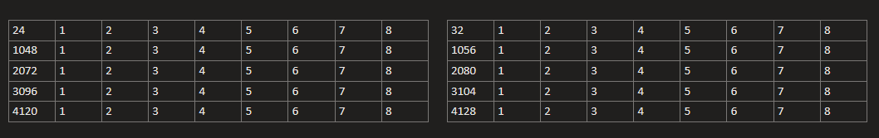
Make the flag 1 when RF2 contents are swapped to RF1. When this flag is set, sliding should always start from 4 location from the left as the previous elements are
Used in earlier slides. Process repeated till slide 2047,2048 before switching to the next row
Slide 17
Slide 18
Slide 19
Slide 20

Slide 21
Slide 21
Slide 22
Slide 23
Slide 24

Slide 22
Slide 25
Slide 26
Slide 27
Slide 28

Slide 23
Slide 25
Slide 26
Slide 27
Slide 28

Slide 24
Every row should issue 128 reads to fill 1024 locations. Maintain a counter when 127 is hit, we know it’s the last read and
We should switch to the next row
Slide 29
Slide 30
Slide 31
Slide 32

