Slide 1

Analysis And Classification of Job Postings as Fake / Legitimate
(CSC 522)
Chetana Chunduru cchetan2@ncsu.edu
Notes:
Hello everyone, I am Abhishek, this is amey, Vaidehi and Chetana and we have chosen a topic which is very close to our hearts - analysis and classification of job postings as fake or legitimate.

Slide 2

Introduction
Recession in IT sector
Due to this, there is significant increase in the number of Fraudulent job postings
People scammed out of $68 million in the first quarter of 2022 *
Goal:
Using a classification model, we want to determine in which category - fake or real - the job posting belongs.
* https://www.fastcompany.com/90803825/that-new-job-offer-may-be-a-scam-heres-what-to-look-out-for
Notes:
Because of the post covid pandemic situation, there are many difficulties that are being faced by different companies. Majority of the companies have chosen layoffs as their go-to method. This has created a desperate situation for many individuals. Due to this, many people are applying for jobs which are not even verified or seem real. According to a blog, people are scammed out of 68 million dollars in the first quarter of 2022 only. We do a lot of hardwork and boom, everything is gone. So our goal is to now classify the jobs as fraud vs legitimate based on the data we have from earlier phases.

Slide 3
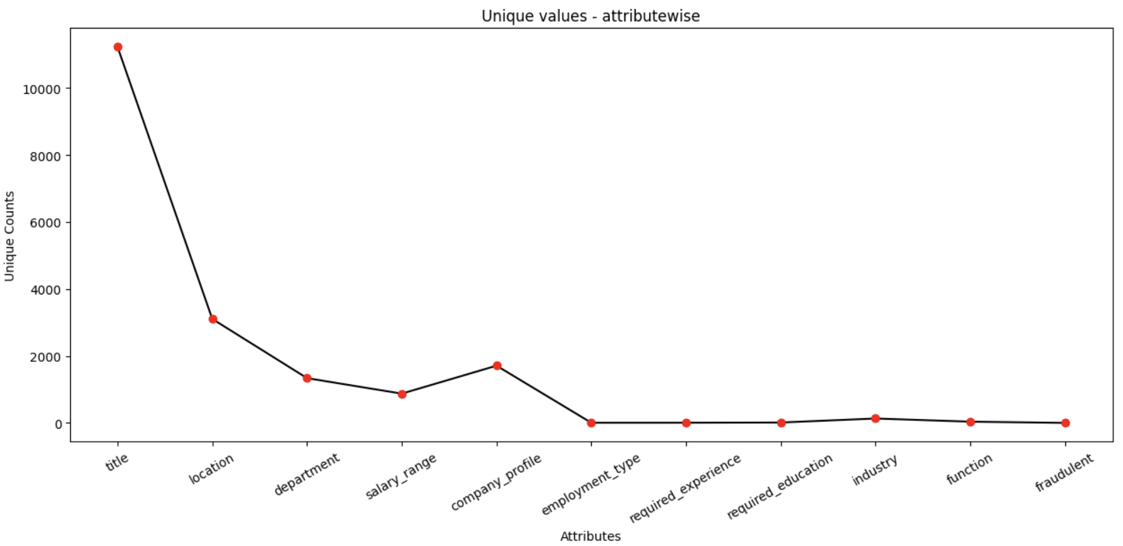

Data Selection
Independent variables
Title
Location
Department
Salary range
Company profile
Employment type
Required experience
Required education
Industry
Function
Dependent variable
Fraudulent
* https://www.kaggle.com/datasets/shivamb/real-or-fake-fake-jobposting-prediction
Notes:
We are using data from 3 years ago found on kaggle and same techniques we are using here can be used with recent data. We didn’t get recent data but the models we have tried to classify will definitely work on the new datasets. We used Extra Tree Classifier to get the important features and we could see

Slide 4
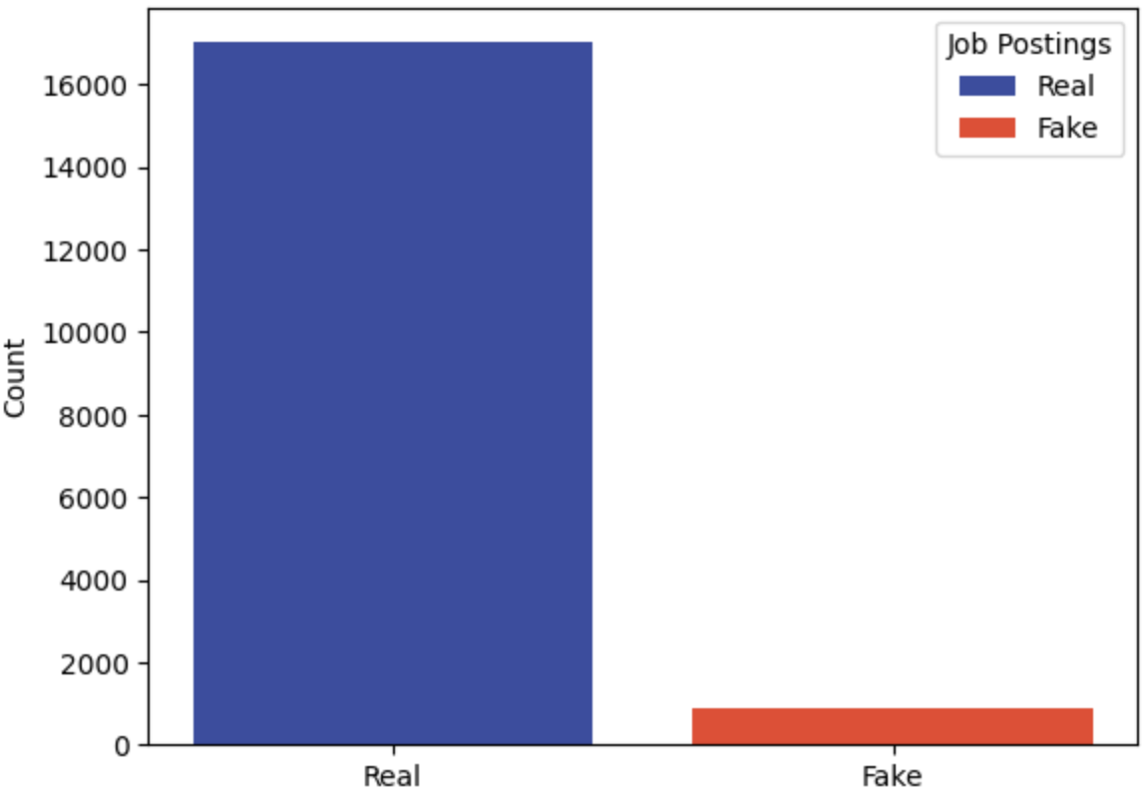
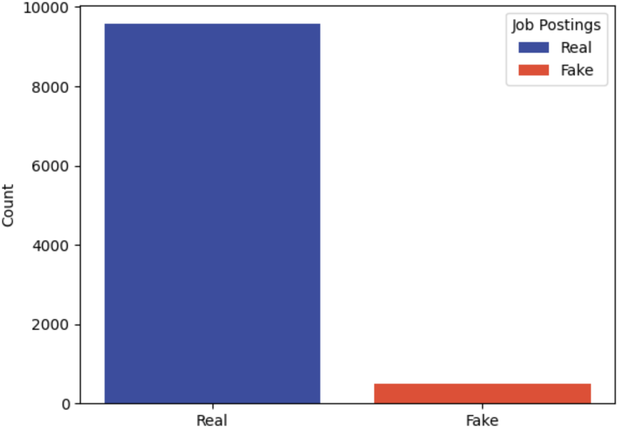
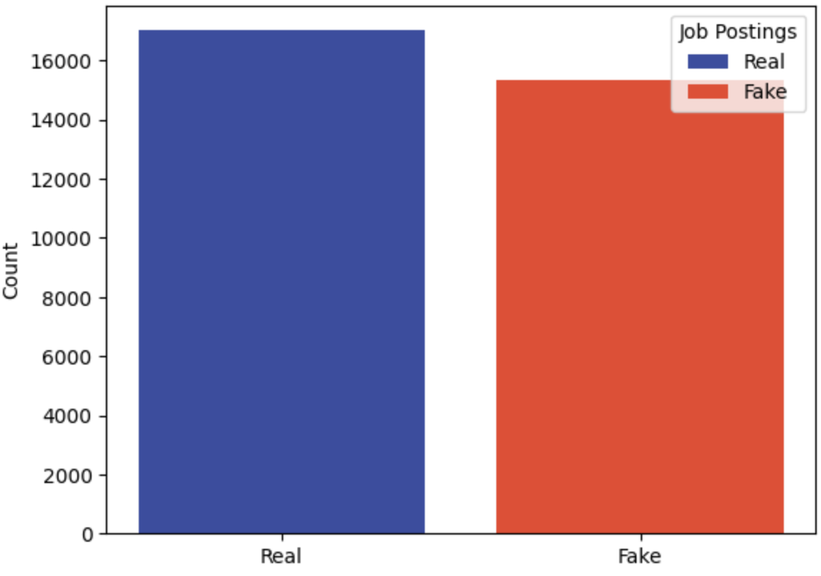
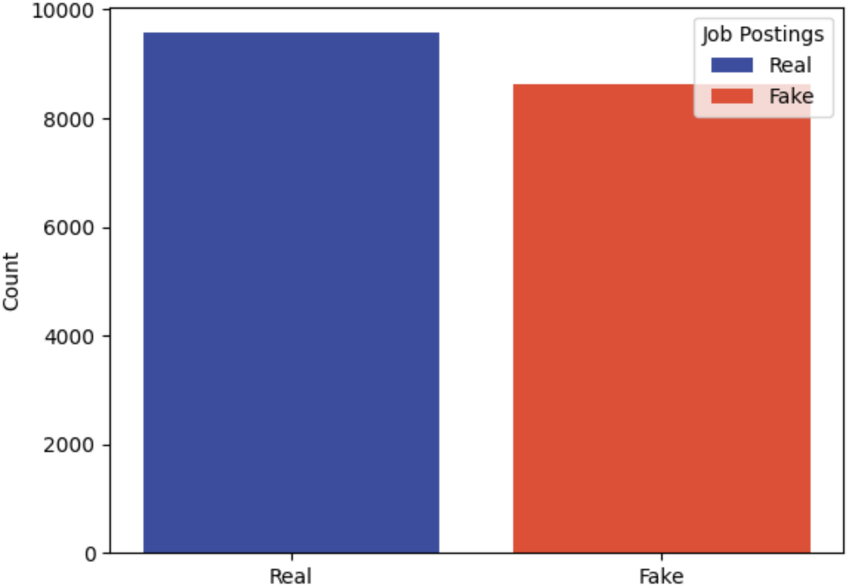

Data Preprocessing
SMOTE - Synthetic Minority Oversampling TEchnique
To overcome the problem of imbalanced class distribution that existed in our dataset
→
* https://machinelearningmastery.com/smote-oversampling-for-imbalanced-classification/
Notes:
So, the data we have is biased towards real data. We were getting unreal accuracy on such data. Basically, we had less fake data to work on. So even if we would take a blind guess, the probability will be getting a real job. So to get over this problem of imbalanced class distribution - that’s technical term - we used a technique called SMOTE - Synthetic Minority Oversampling Technique. Well, instead of just duplicating rows from minority class, there is some sampling and k nearest neighbor searching and then rows are synthesized with new data.

Slide 5
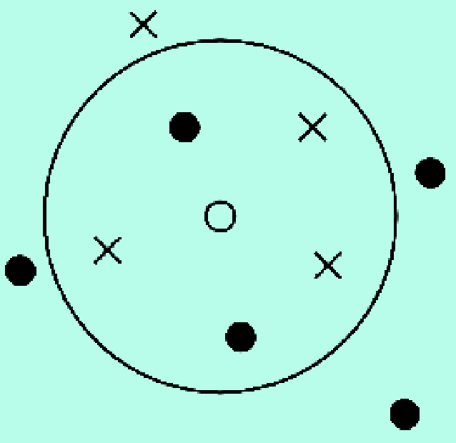


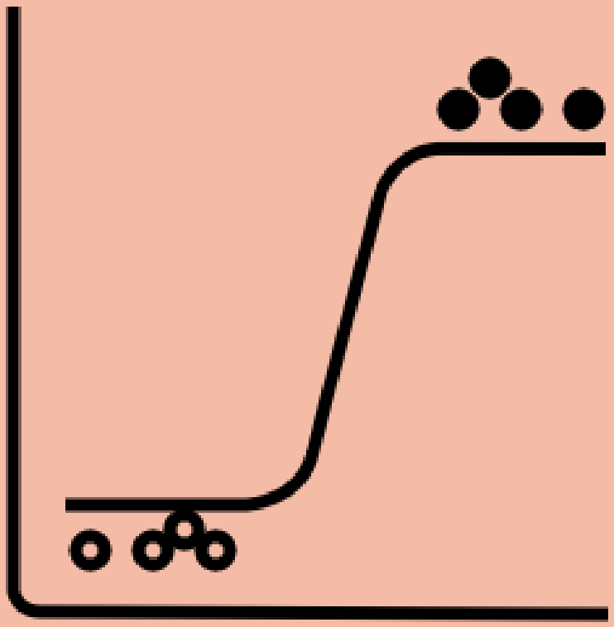

Models
K Nearest Neighbors
To estimate likelihood of a datapoint becoming member of a group or another based on which group that datapoint is nearest to
Decision Tree
To estimate which class datapoint belongs to based on a set of if-else conditions
Naive Bayes
To classify a datapoint assuming conditional independence between every pair of features given the value of the class variable
Logistic Regression
To predict the relationship between the binary-natured class (Y) and the independent variables i.e. features (X)
Notes:
So that was about SMOTE. And, here are the models we used in this project. KNN - it is based on grouping, DT - its like if condition, then 0 else 1, NB - based on Conditional probability between every pair and LR - for binary classes.

Slide 6
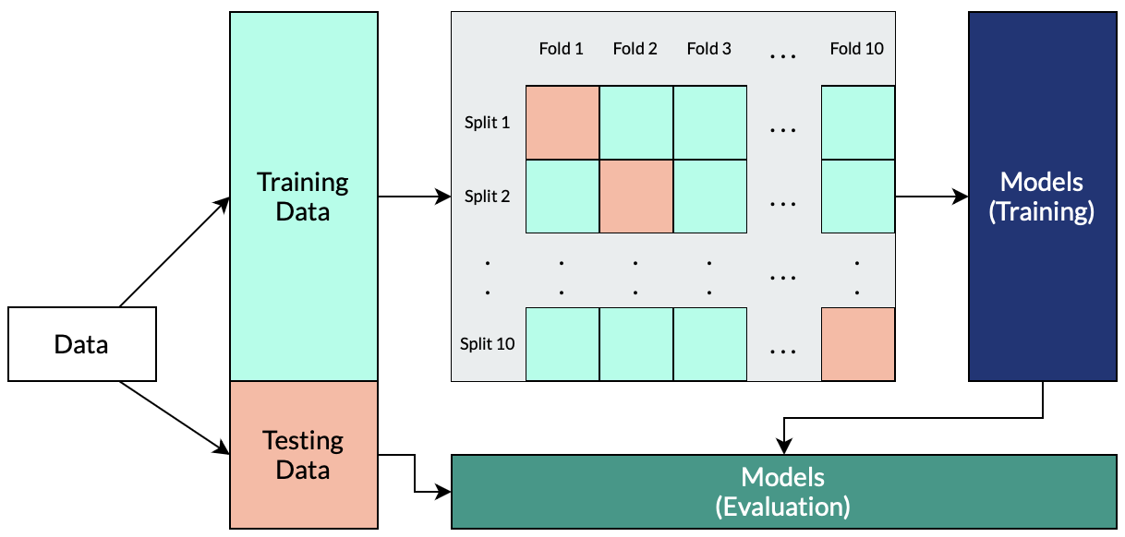

Model Evaluation
Cross Validation
Implemented 10 fold cross validation technique on our dataset for different model parameters.
* https://machinelearningmastery.com/k-fold-cross-validation/
Notes:
Let’s talk about model evaluation too. So Cross-validation, we have used 10 fold cross validation on our dataset. So, we split our training data in 10 parts, 1 part test, 9 part train and evaluate and retrain. We can use 5 or 10, no formal rule, but as k goes up, the bias towards one class goes down.

Slide 7
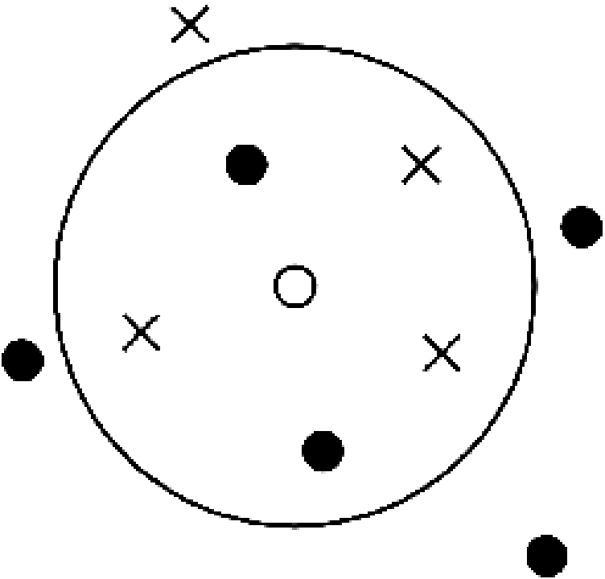
K Nearest Neighbors
Main idea:
Uses proximity to make classifications or predictions about the grouping of an individual data point.
Parameters to consider:
Distance metric (Manhattan, Euclidean or other)
Value of the number of means (k)
Initial values or seed values for the means

Slide 8
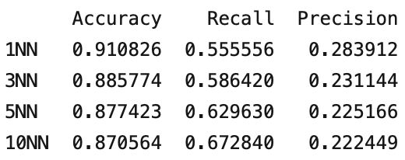
K Nearest Neighbors
Advantages:
Easy to implement
Adapts easily
Few hyperparameters
Disadvantages:
Does not scale well, since lazy evaluation
Curse of dimensionality
Prone to overfitting
Results:
Notes:
What is the k-nearest neighbors algorithm? | IBM

Slide 9

Decision Trees
Main idea:
Split the dataset as a tree, based on a set of rules and conditions.
Parameters to consider:
Need to consider the criteria for the split (Gini, Entropy)
Need to handle missing data in training as well as testing data properly
Can consider a max depth of tree parameter to limit overfitting the tree

Slide 10
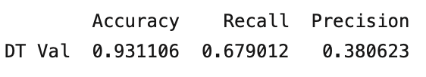
Decision Trees
Advantages:
Highly intuitive and easy to understand.
White box model, easy to understand the conditions for the decisions of the model.
Cost of using the tree is dependent upon the depth of the tree.
Disadvantages:
Are unstable. Some changes in data can dramatically alter entire predictions.
Can create over-complex trees that do not generalize the data and overfit to the dataset.
Results:

Slide 11
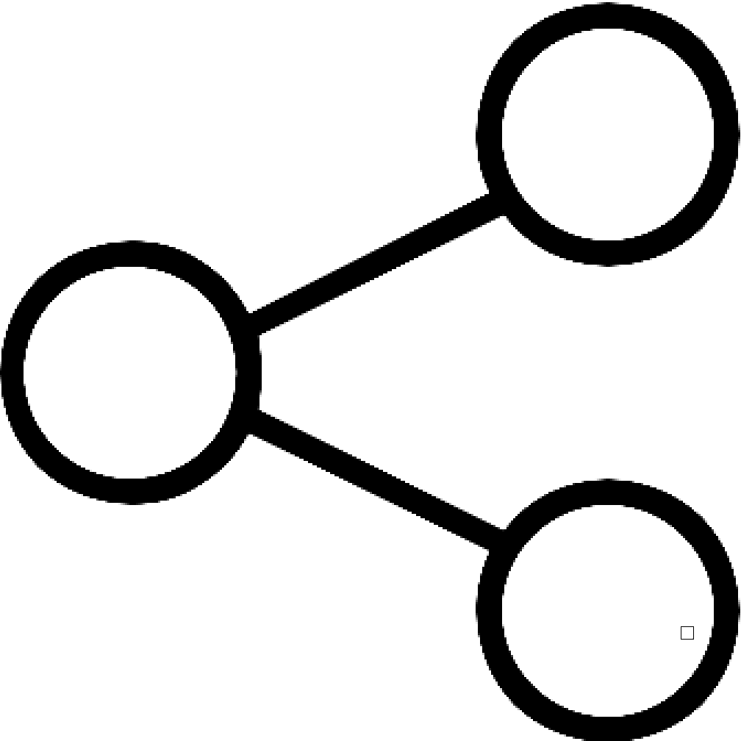
Naive Bayes
Main idea:
Uses the Bayes theorem with an assumption that the presence of a particular feature in a class is unrelated to the presence of any other feature, which helps in reducing the computation for classification task
Parameters to consider:
Need to stratify data set properly to avoid the zero probability phenomena
Apply smoothing technique if zero probability phenomena is frequent or unavoidable
Notes:
Another model that we have used is the Naive Bayes Model. The reason we chose this model are:
It is easy to implement and the decisions are fast
It assumes that each of the feature equally contributes to the outcome decision
So, Naive bayes uses the Bayes theorem with an important assumption that each feature are independent of one another, which lessens the computation.

Slide 12
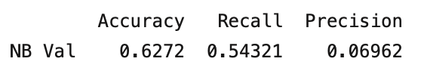
Naive Bayes
Advantages:
Simple, Fast in processing, and effective in predicting the class of the dataset.
It performs well in case of text analytics problems
Easy to obtain the estimated probability for a prediction.
Disadvantages:
Not ideal for data sets with a large number of numerical attributes.
It relies on an often-faulty assumption of equally important and independent features which results in biased posterior probabilities
Smoothing techniques are required to deal with unknown categorical data which are not present in training data.
Results:

Slide 13
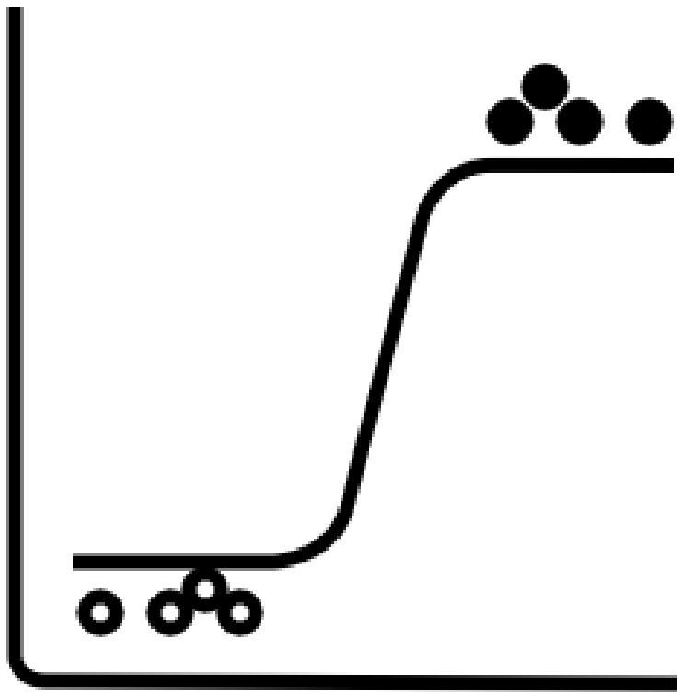
Logistic Regression
Main idea:
Logistic Regression is a classification technique which uses a logistic function to model the dependent variable. It is basically used to calculate or predict the probability of a binary (yes/no) event occurring.
Parameters to consider:
Can set different values for solvers (‘newton-cg’, ‘lbfgs’, ‘liblinear’, ‘sag’, ‘saga’)
Can set different values for C (penalty strength)
Notes:
Solvers - optimizers
Logistic regression python solvers' definitions - Stack Overflow
Reasons why we chose Logistic Regression:
Since Logisitc Regression is able to classify the prediction in binary, this is one of the reason we chose this as our prediction has to be binary, either real or fraud
Logistic regression works well with large data sample sizes and as we have around 17000 records, we thought it would perform better

Slide 14
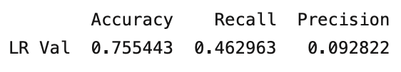
Logistic Regression
Advantages:
Logistic Regression is easier to implement
It is very fast at classifying unknown records.
It performs well when datasets are linearly separable.
Disadvantages:
The major limitation of Logistic Regression is the assumption of linearity between the dependent variable and the independent variables.
It constructs linear boundaries.
It can only be used to predict discrete functions
Results:

Slide 15
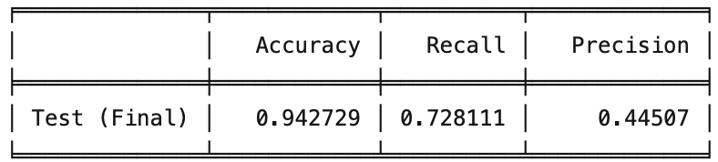

Conclusion and Inference
We evaluated our models based on Recall, since cost for predicting a fake job as legitimate would carry more cost to it since it would adversely affect the user. Since, this is a case of false negative, we are preferring the Recall metric for our evaluation of the models.
Thus, based on “RECALL” values, we chose Decision Tree Classifier.
Results:
Notes:
Since our project is to classify a job as real or fake, we consider the recall metric to be more important than precision as the impact of classifying a fake job to be legitimate is more than classifying a legitimate job as fake which is given by precision. From the metrics that we calculated for each model previously, when we check for the RECALL metric, and Decision Tree Classifier turns out to be better than the other. So we clubbed original training and validation data, applied SMOTE on it and tested Decision tree again and given are the results for the same. And as Vaidehi said, we got Decision tree as simple as well as best. Thank you!!

