Slide 1
Telecom
Chetana Sadare

Slide 2
What is Telecom?
Telecommunications, also known as telecom, is the exchange of information over significant distances by electronic means and refers to all types of voice, data and video transmission.

Slide 3
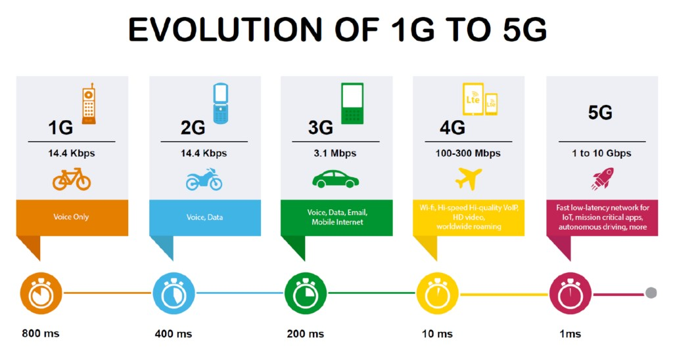
What is 5G?

Slide 4
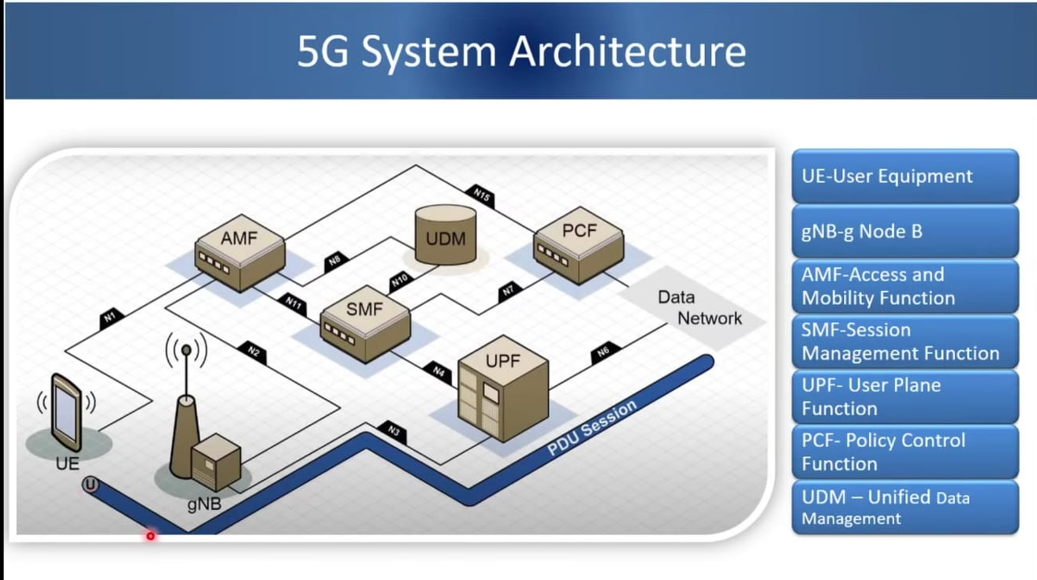
What is Network Function(NF):

Slide 5
What is NRF?
Oracle Communications Cloud Native Core, Network Repository Function (NRF) works as a centralized repository for all the 5G network functions (NFs) in the operator's network. The NRF allows 5G NFs to register and discover each other via a standards-based API.

Slide 6
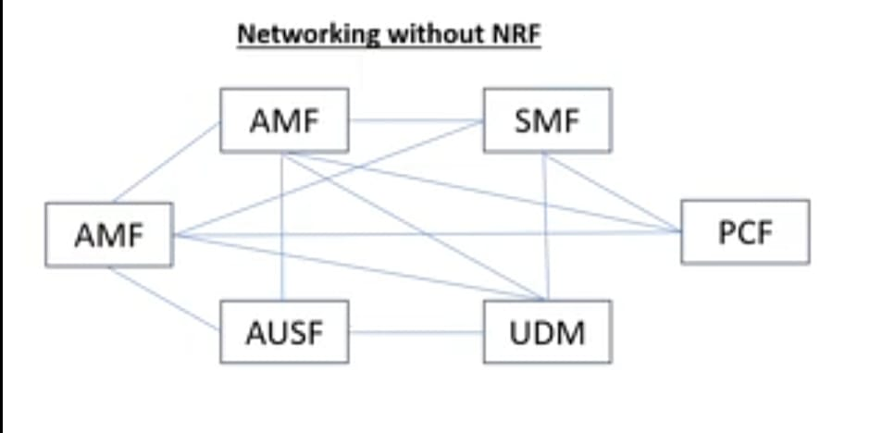
Networking Without NRF

Slide 7
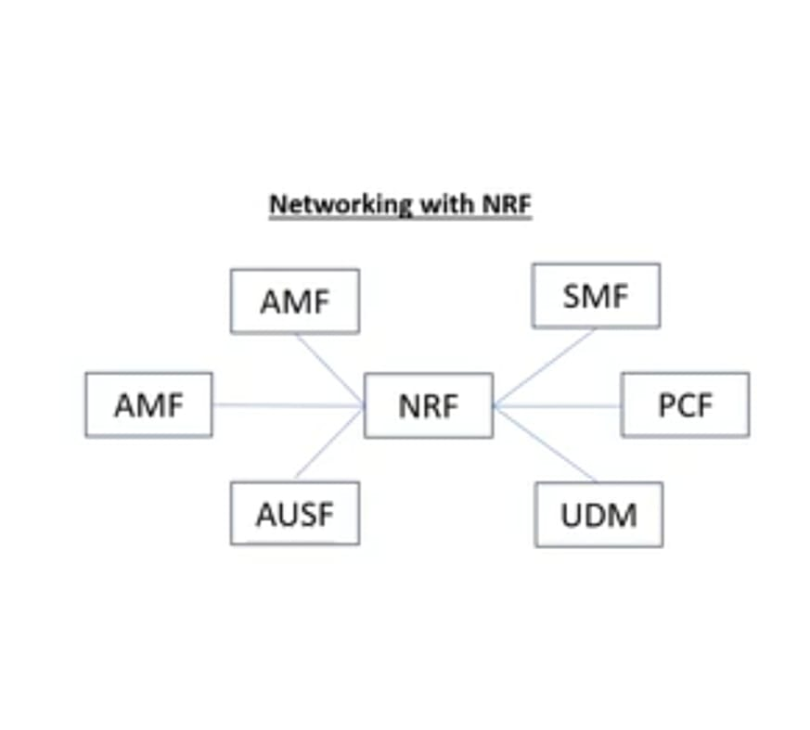
Networking With NRF

Slide 8
NRF Flow-I
request
NRF
Network Function
(AMF,SMF,PCF,..)
Notify
Network Function
(AMF,SMF,PCF,..)
NFRegistration
NFManagement
response
subscribe

Slide 9
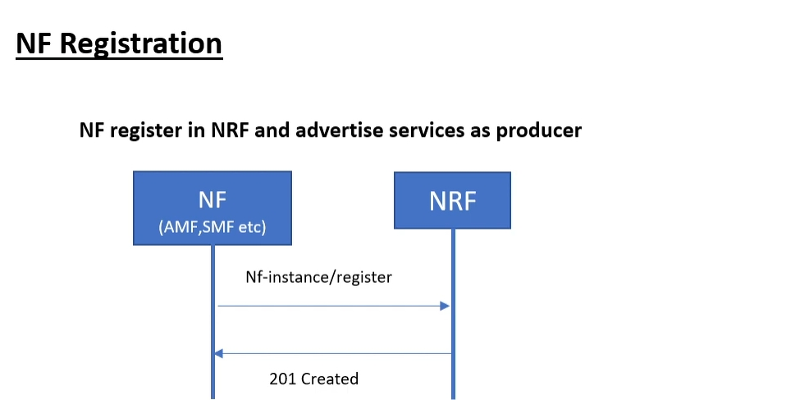
NRF Flow-II
Post: /nnrf-nfm/v1/nf-instances
Request :
{
"networkFunctionInstanceType" : String,
"status" : enum,
"heartBeatTimer" : integer,
"nfProfile" :
{
"ipV4Addresses" : String,
"nfService" : [
{
"nfServiceName" : String,
"scheme" : String,
"apifullVersion" :String,
"nfServiceStatus" : enum
},
{
"nfServiceName" : String,
"scheme" : String,
"apifullVersion" :String,
"nfServiceStatus" : enum }
]
}
}

Slide 10
Spring boot Project :
Package Structure
Technical specification documents
Roles & Responsibility
Technologies used in project
Git
Different Server in company

Slide 11
Technologies
Programming language - Core Java
Web service - Restful
Frameworks-Spring Boot, Hibernate
Database-MYSQL
Server - Apache tomcat
Version control- GIT/BitBucket
Building tool- Maven
SDLC - Agile
Testing- Manual testing
Log management tool- Logger
API testing tool- Postman
Project management tool- Azure Board
IDE- Spring Tool Suite(STS)
Design pattern

Slide 12
Roles and Responsibilities
Working as team member
Producing the restful web service
Analysis the requirement, coding, testing, etc.
Prepare the test plan
Perform the manual testing
Bug fixing
Analyze the program to identify the code changes as per business requirement.
Involved in knowledge sharing activities in the team.
Prepared the technical specification document based on existing system

Slide 13
Thank you.

