Slide 1
Standard Operating Procedure
DL Based Lung and Airway Segmentation
PI: Harrison Kim, Ph.D., Dept. of Radiology
The University of Alabama at Birmingham (UAB)

Slide 2
Table of Contents
Index | Topics | Slide No.
1. | Introduction | 3
2. | Pre-Requisites | 4
 | 2.1. Image Format | 4
 | 2.2. Naming Conventions | 5
3. | Running the Program from Scratch (Training, Prediction and Evaluation) | 6
 | 3.1 In personal Computer | 6
 | 3.1.1 Setting up the Environment | 7
 | 3.1.2 Accessing the Program | 9
 | 3.2 In lab Computer | 12
 | 3.2.1 Activating the Environment | 12
 | 3.2.2. Accessing the Program | 13
4. | Running only Predictions on New Data in Lab computer / Personal computer | 14
5. | Running only Predictions when Python and Jupyter are not Installed | 18

Slide 3
1. Introduction
This SOP describes DL-based lung and airway segmentation.
The Source code can be found in the following links -
Github (referred to as link 1 in upcoming slides):
https://github.com/chetana348/Lung-and-Airway-Segmentation
Colab (referred to as link 2 in upcoming slides):
https://drive.google.com/drive/folders/1SBL6bOjsyhwK8Ib5fgrQa4Zr8peVuYXn?usp=sharing

Slide 4
2. Pre-requisites
2.1. Image Format
The program expects the input images to have the following properties:
3D images (width x height x depth).
8-bit TIFF images (.tif). Other bit sizes are not supported.
Single channel images (Grayscale).
The program is intended to run on the Windows operating system.

Slide 5
2.2. Naming Conventions
The program expects the input image names to have the following properties and length:
Identifier_UniqueID_Type.tif
2 characters 6 characters 1 character
Each image name should have four substrings where the first three substrings are separated by an underscore (_).
The total name length including the underscore and .tif should be 15.
The ‘Type’ substring should be ‘M’ for images and ‘K’ for labels.
Examples
For a folder arranged as follows
Denise Smoke
ET567F
ET567F bin
An example of naming would be:
DS_ET567F_M.tif for images
DS_ET567F_K.tif for labels
For a folder arranged as follows
2 Month CTRL
ET641F
ET5641 bin
An example of naming would be:
2C_ET641F_M.tif for images
2C_ET641F_K.tif for labels
Labels are not required for testing the model on new data.
Labels are required for training.

Slide 6
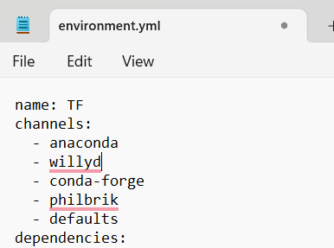
3. Running the Program from Scratch
3.1. In Personal Computer
If you do not have Python, Anaconda, or Jupyter installed, please follow the below links to install them.
Python: https://www.datacamp.com/blog/how-to-install-python
Anaconda: https://docs.anaconda.com/free/anaconda/install/
Jupyter via Anaconda: https://noteable.io/jupyter-notebook/install-jupyter-notebook/
Once installed, please check if the programs are installed properly by locating them in the Windows search option and opening them. Please uninstall and re-install if the program doesn’t open.
Once done, download the source code from the GitHub repository (link 1) and unzip the folders. Locate the environment.yml file. This file contains all the packages that are required to run the DL program. Note the name of the environment given in the first line. It is TF. You are free to change it.

Slide 7
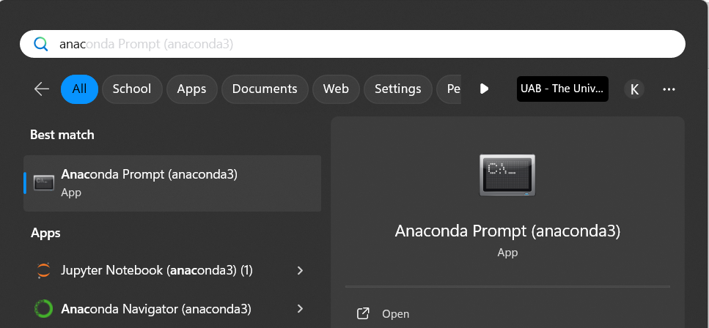
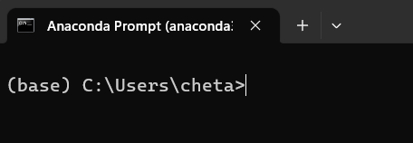
3.1.1. Setting up the Environment
The default base is set to your C drive and username. You can optionally change your base by following the below link.
https://shorturl.at/dwxFG
Open Anaconda Prompt from Windows search
Enter the command to create the conda environment from the .yml file
Use the cd command to navigate to the path to where your environment.yml file is located.

Slide 8
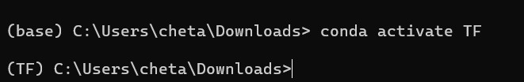
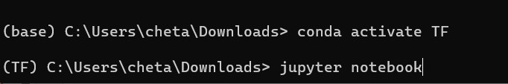
3.1.1. Setting up the Environment (Contd…)
Once created, activate the environment with its name (TF here). Note that once activated, the base path changes to the environment’s name.
Open the Jupyter notebook. The notebook will open as a local host in your recently closed browser.
If the environment fails to create, then observe the error message and manually install the packages mentioned using pip by the command - pip install package_name
Eg: pip install numpy

Slide 9
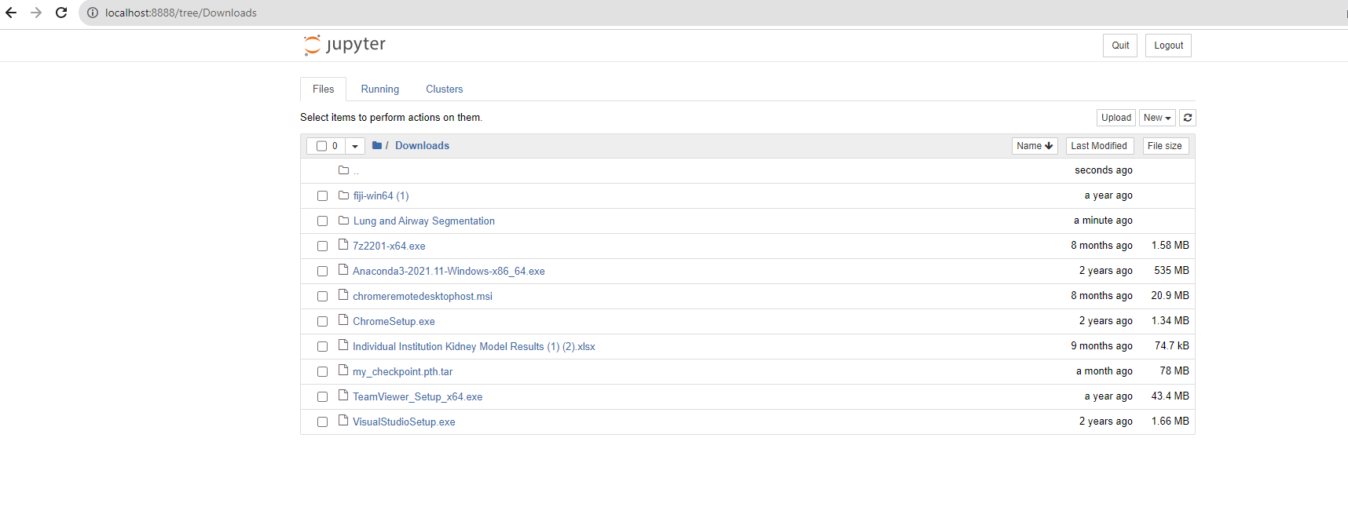
3.1.2. Accessing the Program
Once the notebook opens, navigate to the source code folder.

Slide 10
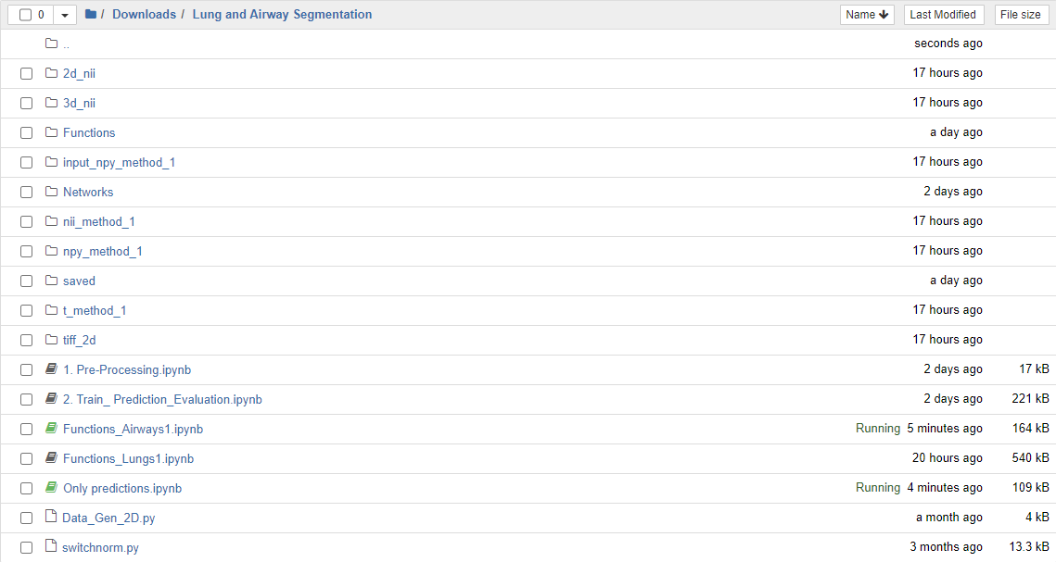
3.1.2. Accessing the Program (contd…)
You can start by running the Preprocessing followed by Train_Prediction_Evaluation

Slide 11
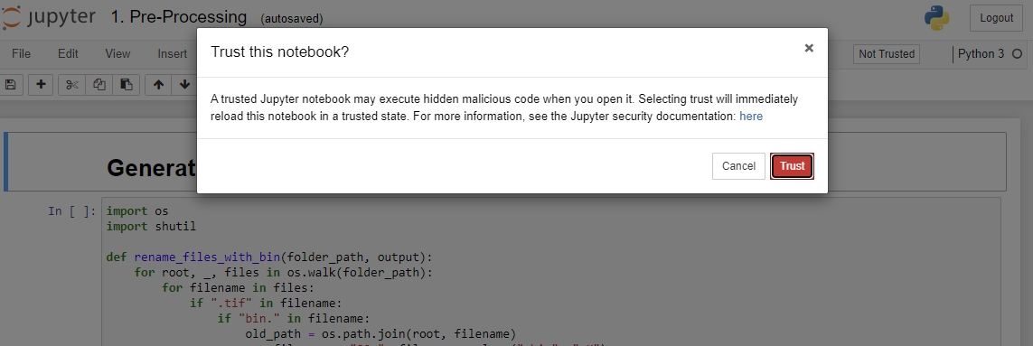
3.1.2. Accessing the Program (contd…)
Once the code opens, click on Not Trusted and select ‘Trust’ from the pop-up.
Optionally, you can turn ON autosave mode.

Slide 12
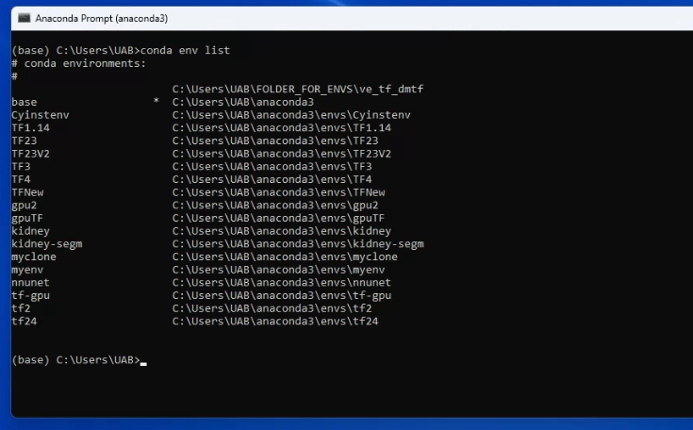
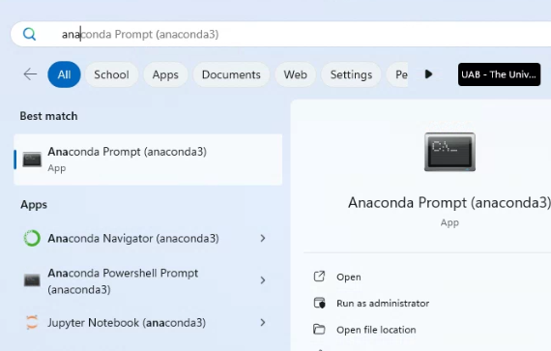
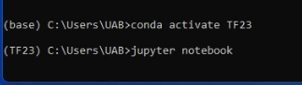
3.2. In Lab Computer
3.2.1. Activating the Environment
Download the source code from the GitHub repository (link 1) and unzip the folders.
Open Anaconda Prompt from Windows search
The default base is set to the C drive and username. Typing the shown command displays the list of environments available. Our environment is TF23.
Activate the TF23 and observe the change in the base. Open the Jupyter notebook. The notebook will open as a local host in your recently closed browser.

Slide 13
3.2.2. Accessing the Program
Please follow the steps described in slides 9, 10, and 11.

Slide 14
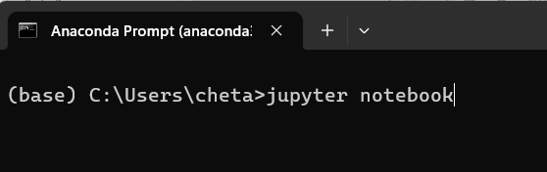
4. Running only Predictions on Lab/Personal Computer
If you only need to run predictions on new data, you do not need to set up the environment. However, you will need to have Python, Jupyter and Anaconda installed. Please refer to slide 6 for installation guide. Download the source code from link 1 and unzip it.
Open the Jupyter notebook. The notebook will open as a local host in your recently closed browser.
Open Anaconda Prompt from Windows search

Slide 15
4. Running only Predictions on Lab/Personal Computer (contd…)
Once the notebook opens, navigate to the source code folder.

Slide 16
4. Running only Predictions on Lab/Personal Computer (contd…)
Run ‘Only prediction’ notebook and follow steps in slide 11.

Slide 17
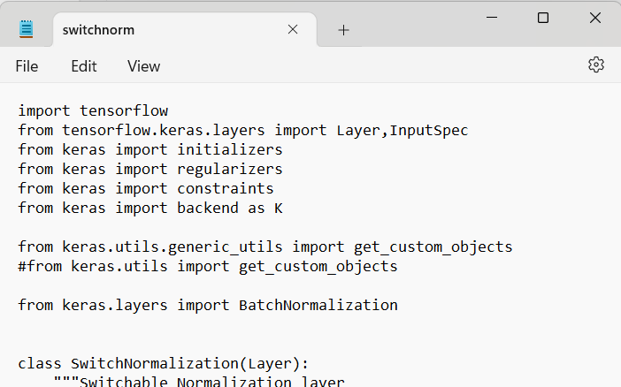
4. Running only Predictions on Lab/Personal Computer (contd…)
If you get an error saying ‘no module named ‘keras.utils.generic_utils’, locate switch_norm file in source code and change the following.
Uncomment the highlighted line and comment the previous line and save it.

Slide 18
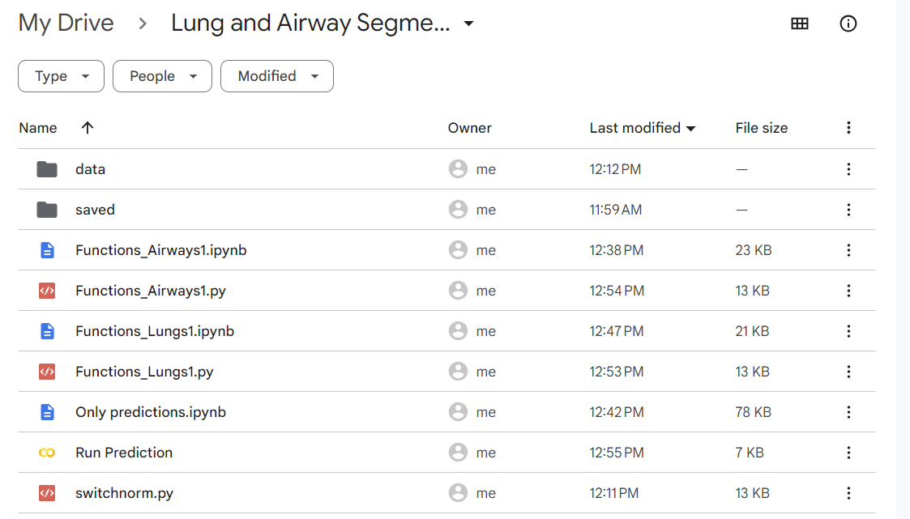
4. Running only Predictions When Python/Jupyter not Installed
You can run the predictions on new data on your personal computer even if you do not have Python and other packages installed.
Click on Colab link (link 2).
Upload your images to the ‘data’ folder
Click on this notebook for the code

Slide 19
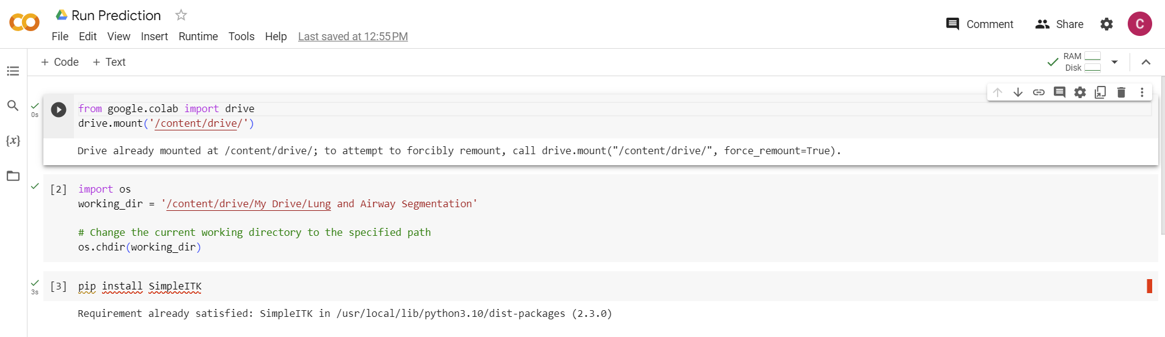
4. Running only Predictions When Python/Jupyter not Installed (contd..)
The first three shown cells should be run in the given order mandatorily.

Slide 20
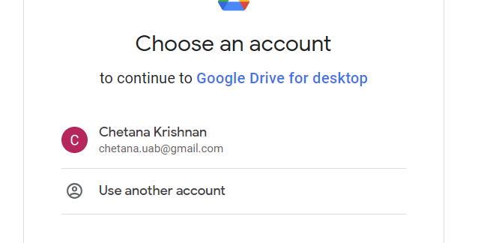
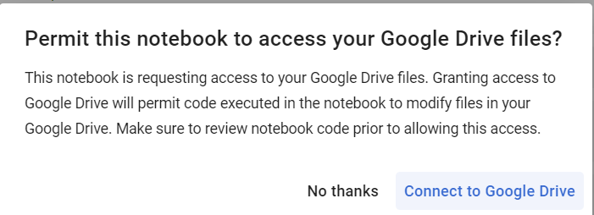
4. Running only Predictions When Python/Jupyter not Installed (contd..)
When the first cell is run, a pop up asking for permission will appear. Give permit access when popped up.
Select your drive account to continue
Connect to drive
You can continue using the notebook after permission is granted.

