Slide 1

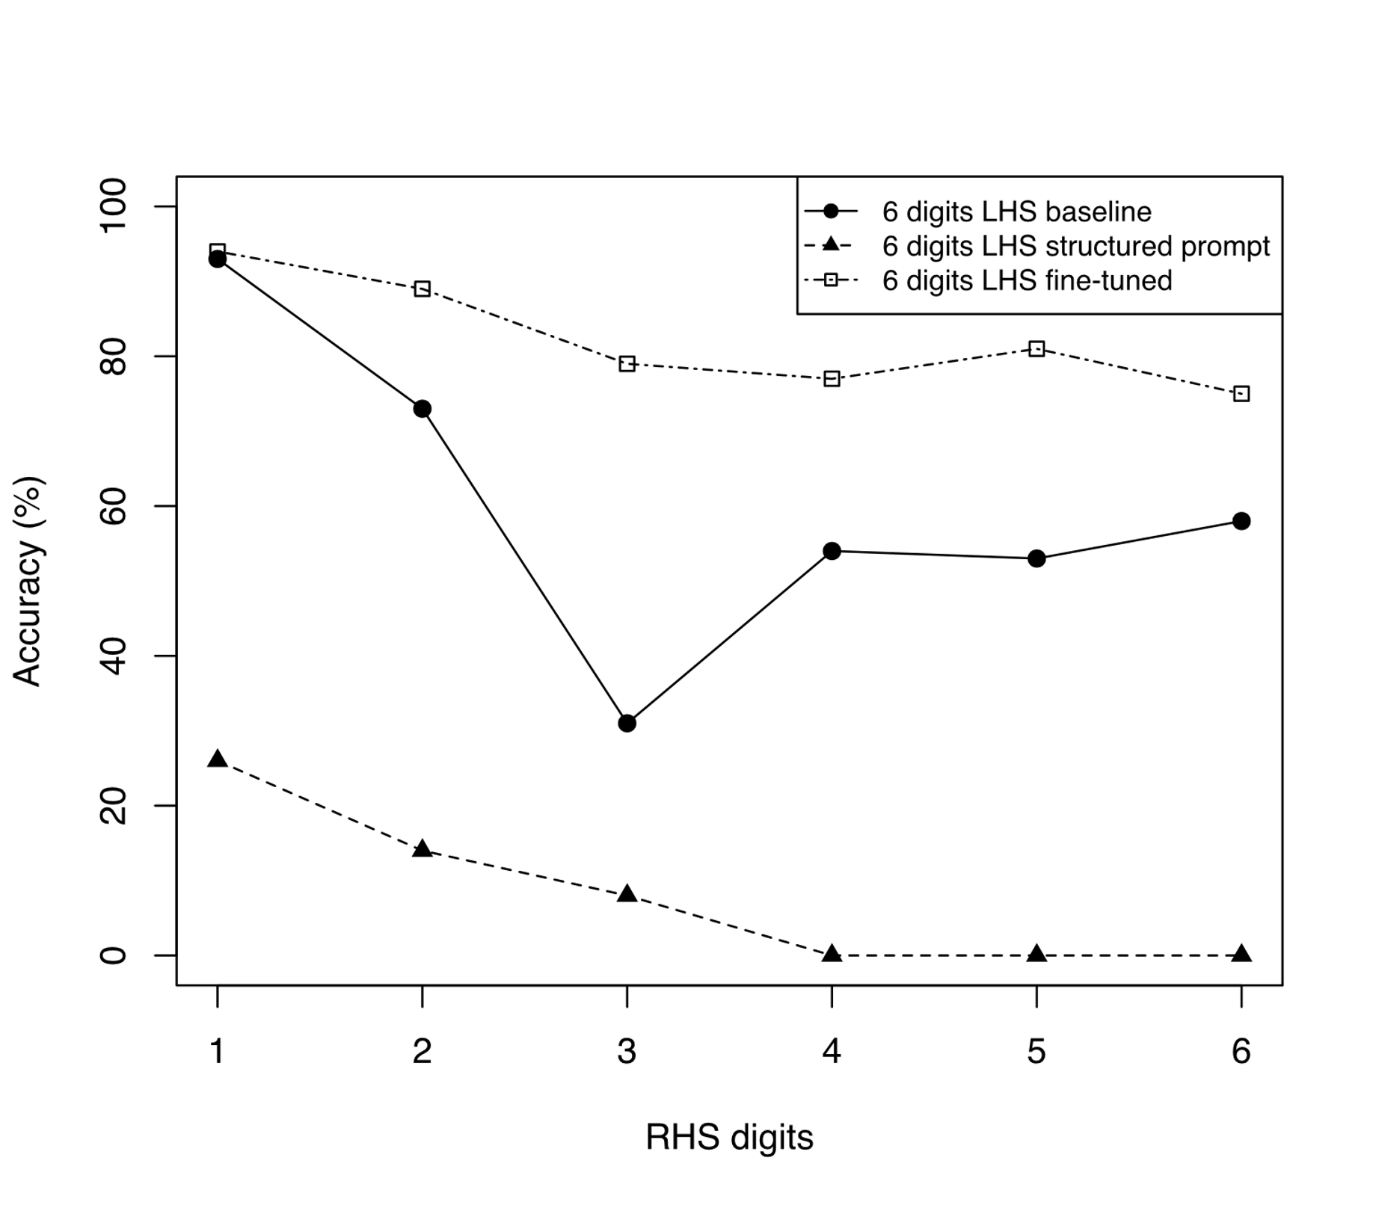
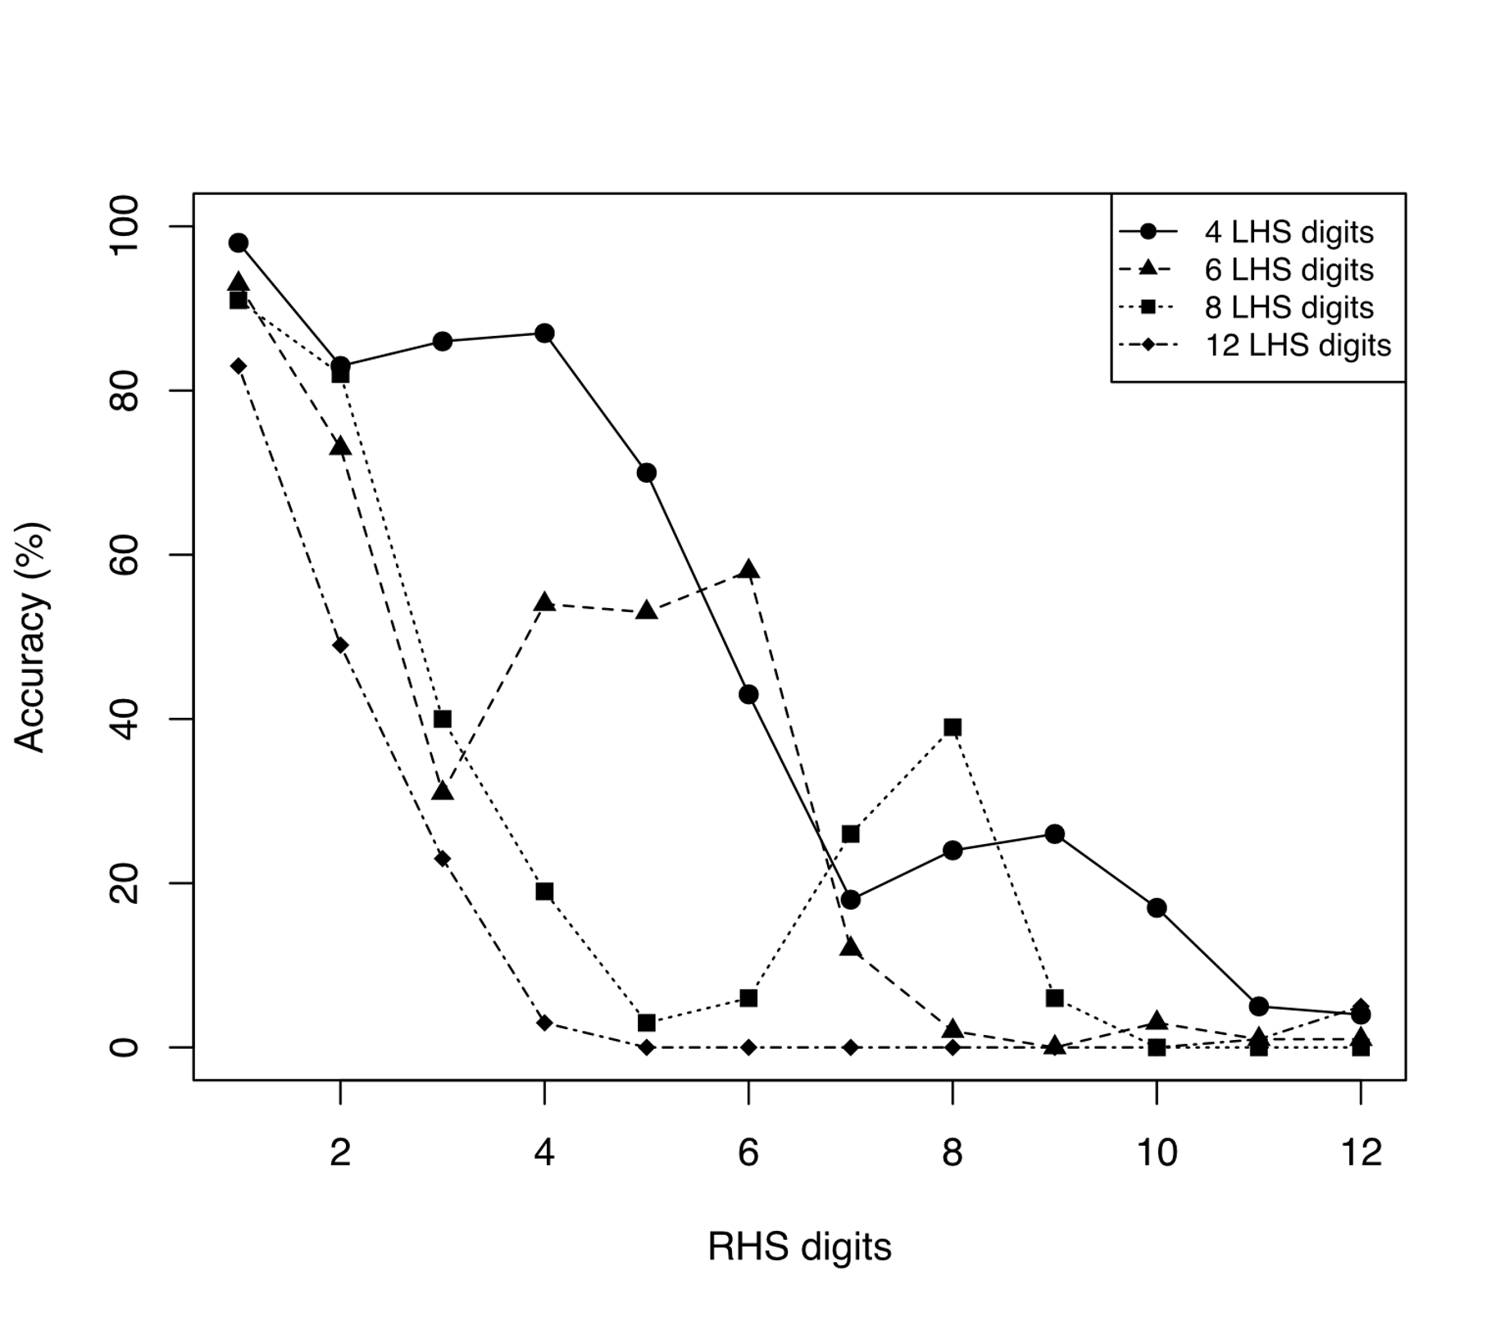
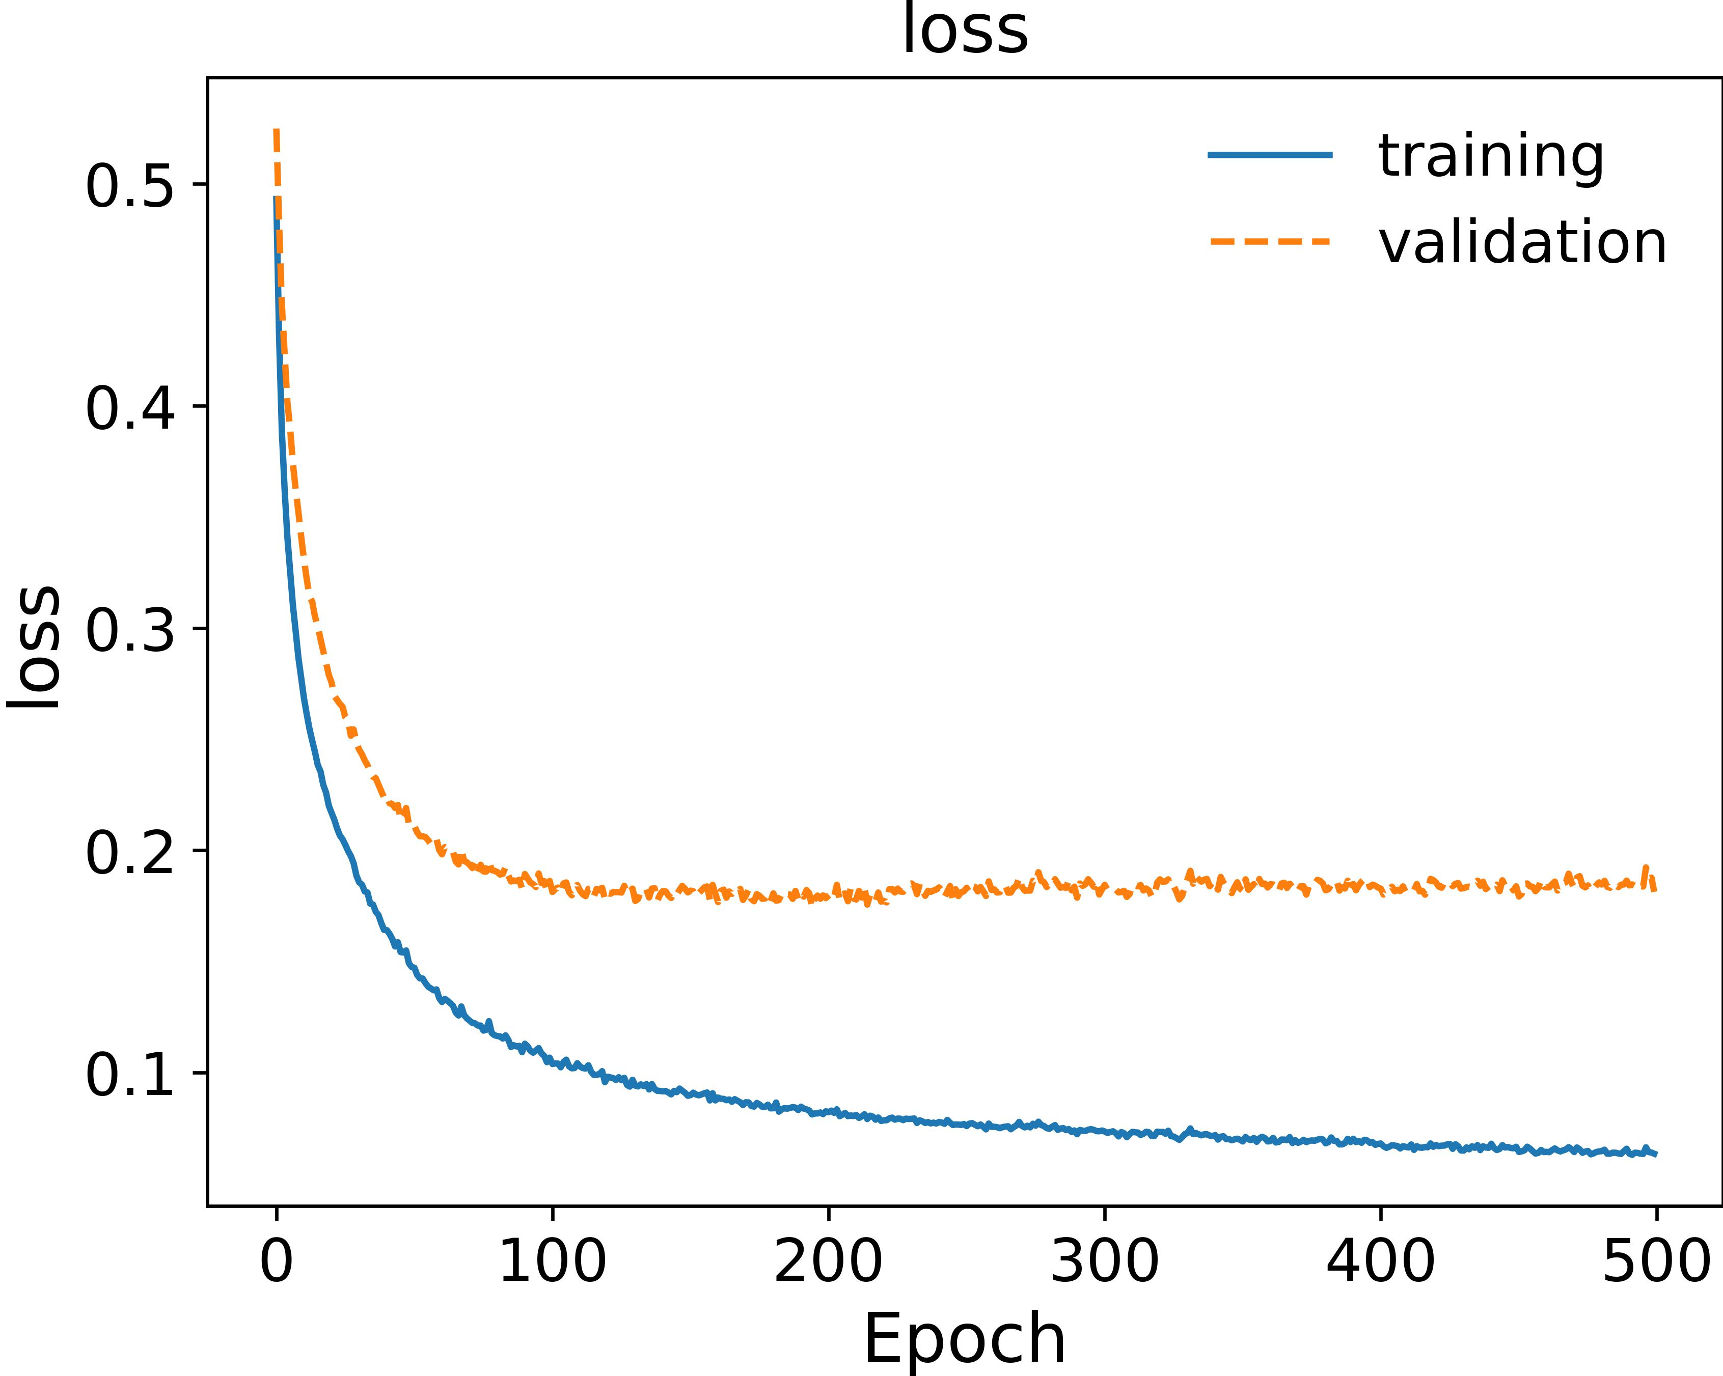
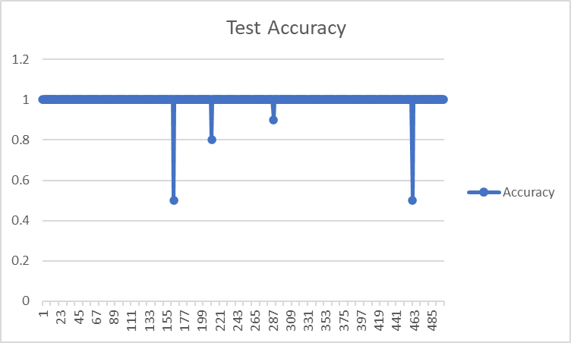
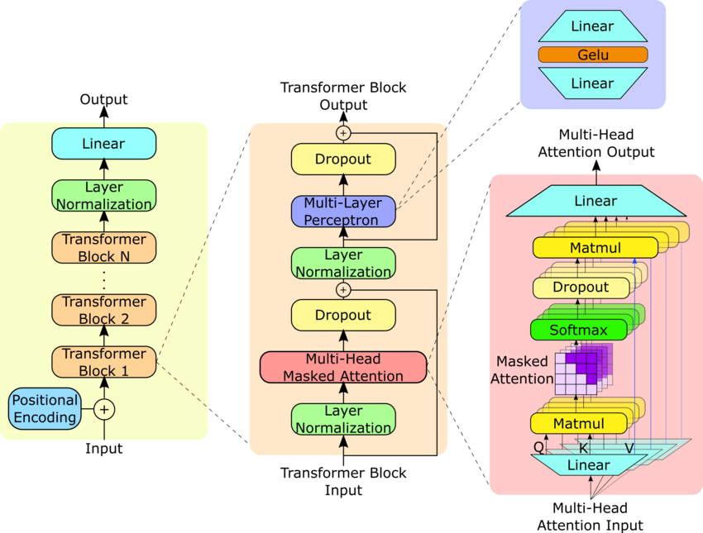
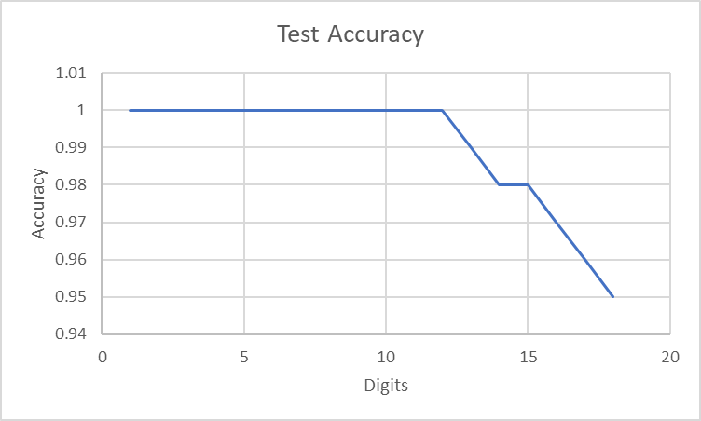
Exploring the Arithmetic Capabilities of Transformer-Based LLMs
Jack R Wimbish, Chetana Krishnan and John D Osborne
The University of Alabama at Birmingham
INTRODUCTION
MISTRAL ADDITION ACCURACY
State-of-the-art pretrained LLMs such as the GPT models excel at many complex tasks, but often fail to correctly perform basic arithmetic problems. We examine the relationship between operand digit length and answer accuracy, and whether accuracy can be improved by instructing the LLM to reason through these problems step-by-step.
We also examine whether fine-tuning on arithmetic problems can improve accuracy, and train GPT2 architecture models from scratch to do narrow classes of simple arithmetic.
METHODS
We tested the Mistral-7B-Instruct-v0.1 base model for accuracy on addition problems of various digit lengths. We repeated these trials with structured addition prompts designed to guide the model into showing the reasoning behind its answers. The addition trials were repeated after fine-tuning the base model for this task.
Separately, we trained our own base models using the GPT2 architecture using random data generator and our own generated training data to solve narrow classes of addition and multiplication problems.
GPT2 5 Digit Multiplication
GPT2 5 DIGIT MULTIPLICATION
GPT2 5 Digit Multiplication
RESULTS
Answer accuracy generally decreased with increasing digit length of the operands. Accuracy ranged from nearly 100% at short digit lengths to 0% at longer digit lengths. Our structured prompts resulted in the model attempting to break down the problem into smaller intermediate steps, this did not improve performance, and in fact sharply degraded accuracy. A small amount of fine-tuning on examples of addition problems and their solutions resulted in significantly increased accuracy from the baseline.
A GPT2 architecture model trained to solve 5-digit by 5-digit multiplication problems achieved near 100% accuracy on that class of problems, only failing on a few edge cases. Specifically, it did not perform well on operands containing repeating zeros.
Another GPT2 architecture model we trained on generated data to solve addition problems for operands up to 18 digits achieved nearly 100% accuracy for problems of that class.
GPT2 ADDITION
Pseudo random generator is used to generate 10K training expressions and 500 test samples.
GPT 3 works on repeated addition algorithm.
Proposed model works by breaking down multi-digit multiplication into single-digit operations, making it easier for the model to handle. The computation proceeds from right to left, calculating the sum of two numbers at a time while considering carries. The model first finds the appropriate digit, then computes the carry and one's digit. If the numbers have different digit lengths, zeros are added for alignment. The process continues until all digits and carries are zero, allowing for efficient multi-operation arithmetic.
Trained a multi head GPT2 model for addition on 2K training and 100 test samples for 1 to 18 digits.
GitHub: https://github.com/chetana348/NLP-Project/tree/main
Jack: Finetuning
Chetana: GPT2 Addition and Multiplication

