Slide 1
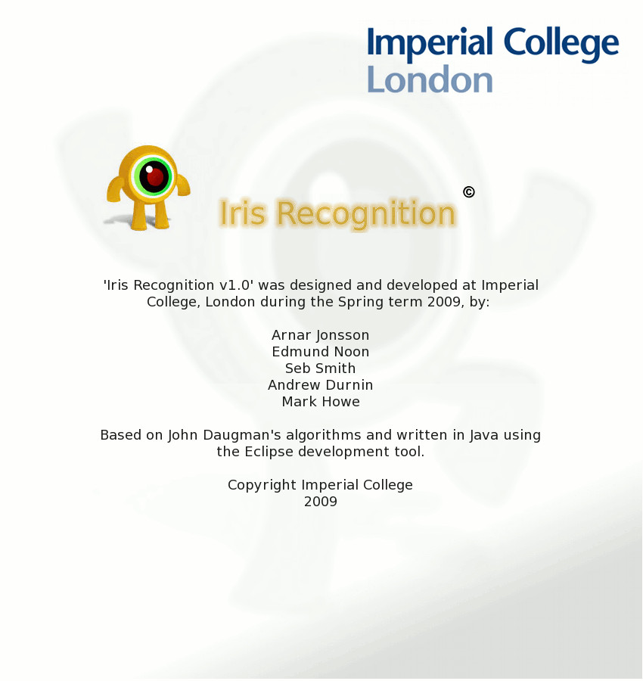

Slide 2
Iris Recognition
Introduction
Iris location
Unwrapping
Bit-code generation
Database access
Hamming distance
Demonstration
Results and conclusions

Slide 3
Introduction - Motivation
Iris is good for identification
Low correlation

Slide 4
Introduction
John Daugman
Dennis Gabor

Slide 5
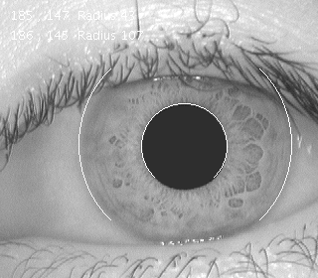
Iris Location

Slide 6
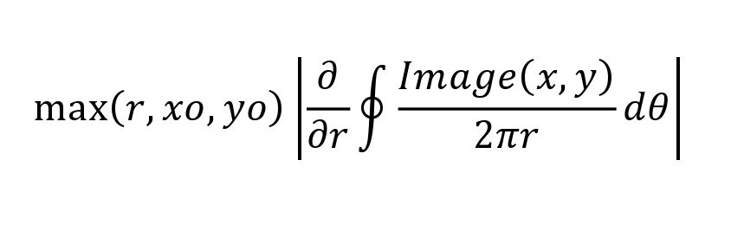
Iris Location

Slide 7
Iris Location

Slide 8
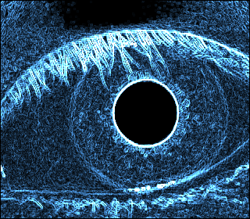
Iris Location

Slide 9
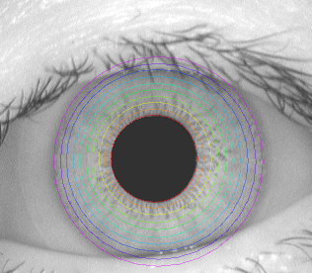
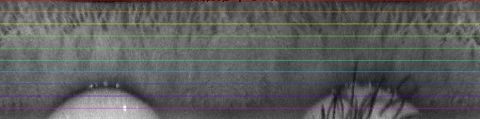
Unwrapping the iris
We want to turn this:
... into this:
Why?
Because it’s computationally cheaper to work with

Slide 10
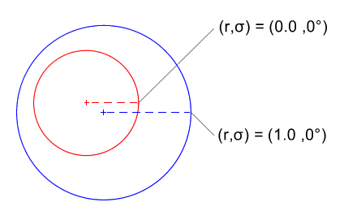
Unwrapping the iris
The problem:
Iris bound by two nonconcentric circles
The human iris is not static (can be thought of like a rubber sheet)
The solution:
Similar to warping from Polar to Cartesian

Slide 11
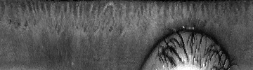

Bitcode generation
Now we want to turn this:
... into this (bitcode):
Why?
To have a way of storing and comparing irises

Slide 12
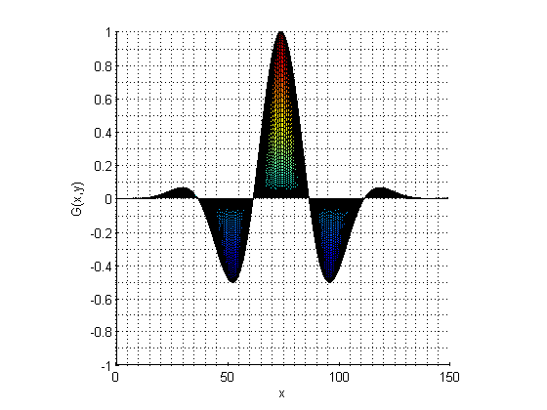
Bitcode generation: Gabor filtering
Gabor wavelets
Essentially just trigonometric functions in a Gaussian envelope
6 constants define shape of each wavelet
Real and complex part

Slide 13
Bitcode generation: Gabor filtering
To generate one bit in the bitcode:
Define a Gabor wavelet
Convolve wavelet with unwrapped image
Calculate a sum of the resulting matrix
If the result is > 0, add a bit with value of 1, otherwise, add a bit with value of 0
Bitcode size determined by number of different wavelets

Slide 14

Bitcode generation: Video

Slide 15
Database
Where to store
What to store
How to access it
How to manage data/ view metadata

Slide 16
Where to store
DoC Postgres Database
Ease of shared access
JDBC interface compatibility
SQL coverage in lectures

Slide 17
What to store
Images or just bit-code
Advantages or disadvantages – future compatibility vs speed vs size
What other metadata
Access information
What format to store the bit-code in

Slide 18
Converting bit-code
Byte array format for admission into postgres
Converting functions:
public static byte[] toByteArray(BitCode bitcode){
byte[] result = new byte[bitcode.length()/8+1];
for(int i=0; i<bitcode.length(); i++){
if (bitcode.get(i))
result[result.length-i/8-1] |= 1<<(i%8);
}
return result;
}

Slide 19
Converting cont.
Returns a byte array of at least length 1.
The most significant bit in the result is guaranteed not to be a 1
(since BitSet does not support sign extension).
The byte-ordering of the result is big-endian which means the most significant bit is in element 0.
The bit at index 0 of the bit set is assumed to be the least significant bit.

Slide 20
How to store it
JDBC Package
Advantage of using Java for implementation
Class databaseWrapper is in itself a new connection to the database with a scrollable resultset (requires remote ssh connection)
Allows other parts of the software to implement db functions and access metadata

Slide 21
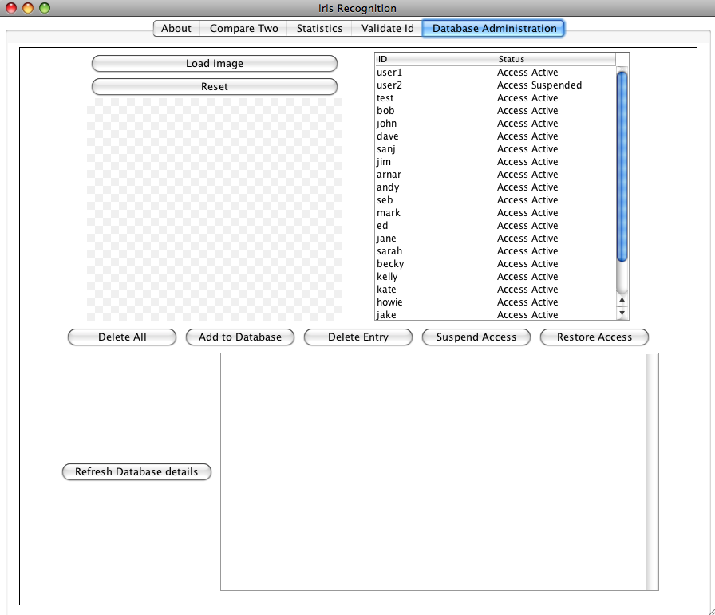
How to manage data
Administrators need to see and manage the db from the gui
Means the db is fully integrated i.e software cannot be used without a connection

Slide 22
Iriscode Matching: Hamming Distance
Simplest approach among many.
A fractional measure of the dissimilarity between the two codes.
The total number of corresponding bits which disagree, divided by the total number of bits:

Slide 23
In theory...
For two images of the same iris, the Hamming distance is zero.
Different (independent) irises should give a Hamming distance of around 0.5.

Slide 24
In practice...
Will never quite get zero (image noise and normalisation algorithms not perfect).
Make use of result by Daugman:
4000 images studied, probability of obtaining false positive is 1 in 16 million if Hamming distance lies between 0 and 0.33.
So 0.33 is our threshold point.

Slide 25
Two things to be wary of...
One: There will be noise in all images. Since we really should only consider bits which do not correspond to noise, we need an algorithm to detect noise. More later.
Two: Rotational inconsistencies between the two iris images, i.e. head tilt and movement of eye within its orbit, result in misaligned iriscodes. We address this as follows...

Slide 26
Bitshifting
Hold one code in place and bitshift the other left/right, each time obtaining a different Hamming distance.
Take the minimum such distance. It corresponds to our best match.

Slide 27
Limitations of Algorithms: Normalisation
The normalisation algorithm which unwraps the iris relies on a model of how the iris looks when the pupil and limbus boundaries are not concentric.
More than one model. Different models give different results.
Implies no one method is perfect.

Slide 28
Limitations of Algorithms: Noise Detection
No noise detection algorithm will detect, with 100% accuracy, all noise present in image.
Some noisy bits go undetected and are passed into Hamming algorithm as valid bits.
Cannot then get zero, even with two images of same iris.

Slide 29
GUI

Slide 30
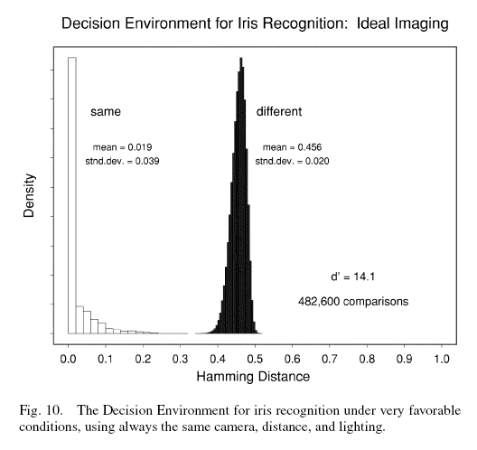
Results Daugman

Slide 31
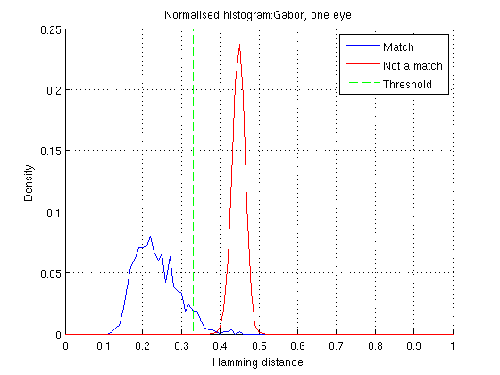
Results One Eye

Slide 32
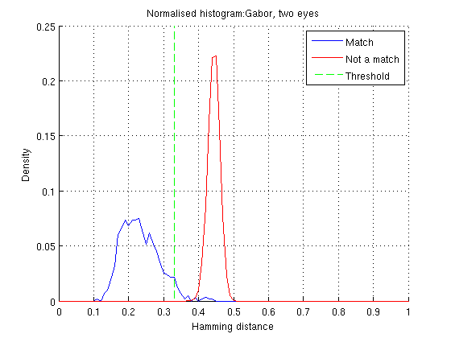
Results Two Eyes

Slide 33
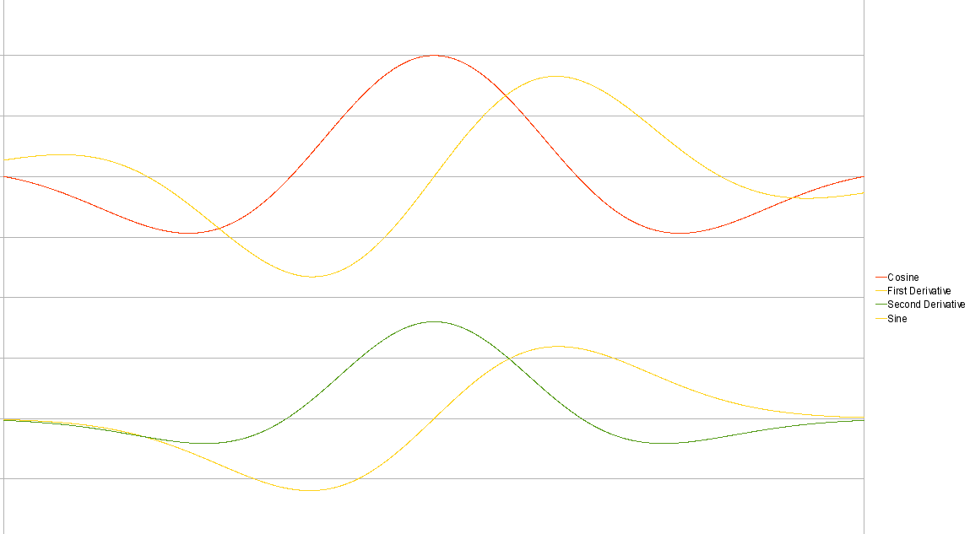
Spot the difference...

Slide 34
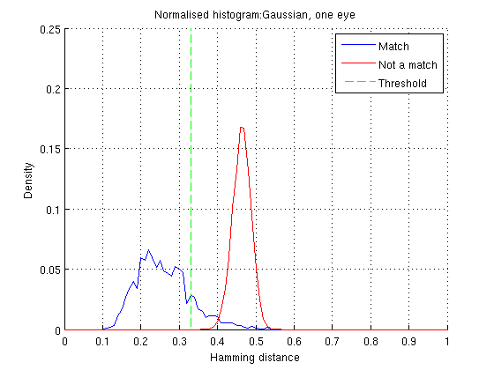
Results Gaussian

Slide 35
Conclusion
The team produced much more than any one individual could have in the time
There is a lot still to learn...
...good start understanding Iris Recognition...
...and engineering software in teams

Slide 36
Acknowledgements
Dr. Ashok Argent-Katwala
Supervisor
Professor Duncan Gillies
Additional advice
David McBride
Help with Condor

Slide 37
Bibliography
"High confidence visual recognition of persons by a test of statistical independence." . Daugman, J. 1993. s.l. : IEEE Transactions on Pattern Analysis and Machine Intelligence, 1993, Vols. vol. 15(11), pp. 1148-1161.
‘How Iris Recognition Works’. Daugman, J. 2004. vol.14(1), s.l. : IEEE TRANSACTIONS ON CIRCUITS AND SYSTEMS FOR VIDEO TECHNOLOGY, 2004.
A 3x3 Isotropic Gradient Operator for Image Processing. Sobel, I. and Feldman, G. 1968. s.l. : presented at a talk at the Stanford Artificial Project ., 1968.
A Linear Algorithm for Incremental Digital Display of Circular Arcs. Bresenham, J.E. 1977. s.l. : Communications of the ACM, 20(2), 1977. Vols. February ,100-106.
Bresenham, J.E. (1965) “Algorithm for computer control of a digital plotter”. IBM Systems Journal Vol 4(1).
Nelder, J.A. and Mead, R. 1965. s.l. : Computer Journal, 1965, Vols. vol.7, pp.308-313.
W.K Kong and D. Zhang (2001), “Accurate Iris Segmentation Based on Novel Reflection and Eyelash Detection Model,” Proceedings of International Symposium on Intelligent Multimedia, Video and Speech Processing,Hong Kong.
Libor Masek, Rocognition of Human Iris Patterns for Biometric Identification, University of Western Australia, 2003.
Arvacheh, E.M.; Tizhoosh, H.R. (2006) 'IRIS Segmentation: Detecting Pupil, Limbus and Eyelids', Image Processing, 2006 IEEE International Conference.

