Slide 1
TEAM No-12 TEAM MEMBERS: CHETANA N PATIL – PES2UG20CS504 JYOTHI S – PES2UG20CS513
Machine Intelligence - UE20CS302
PROJECT TITLE: HAND WRITTEN CHARACTER RECOGNIZATION WITH NEURAL NETWORKS

Slide 2












































PROBLEM STATEMENT

Slide 3
APPLICATIONS AND USES
The main focus of this work is to investigate CNN capability to recognize the characters from the image dataset and the accuracy of recognition with training and testing.
•CNN recognizes the characters by considering the forms and contrasting the features that differentiate among characters. Our CNN implementation is experimented with the dataset NIST to obtain the accuracy of handwritten
characters.
•A CNN can capture the spatial dependencies inside an image to relate with the content of the image for recognition purpose.
The CNN design provides a strong fit of the source image to find the distinguishing features inorder to be classified.
•The weights, parameters and the biases involved with the transformations from original image to feature vector to know better about the nature of the image are found during the training stage

Slide 4
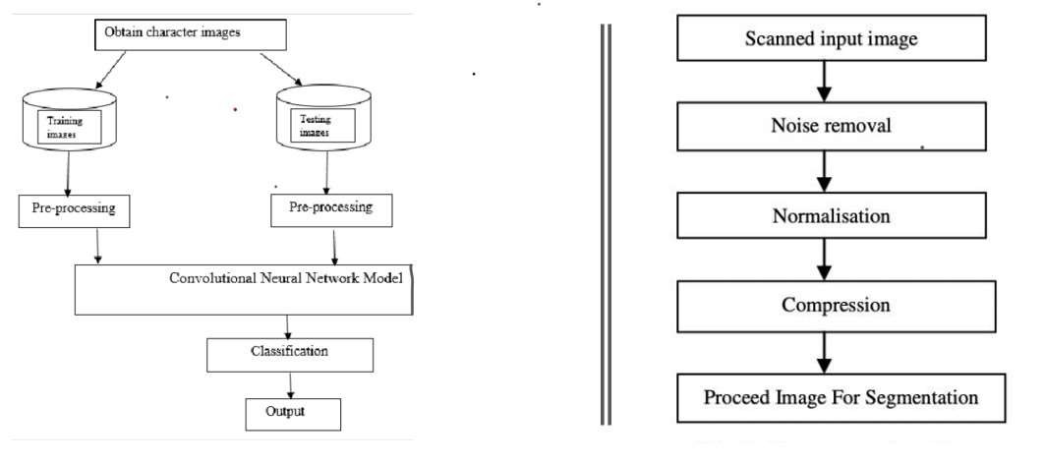
HIGH LEVEL ARCHITECTURE

Slide 5
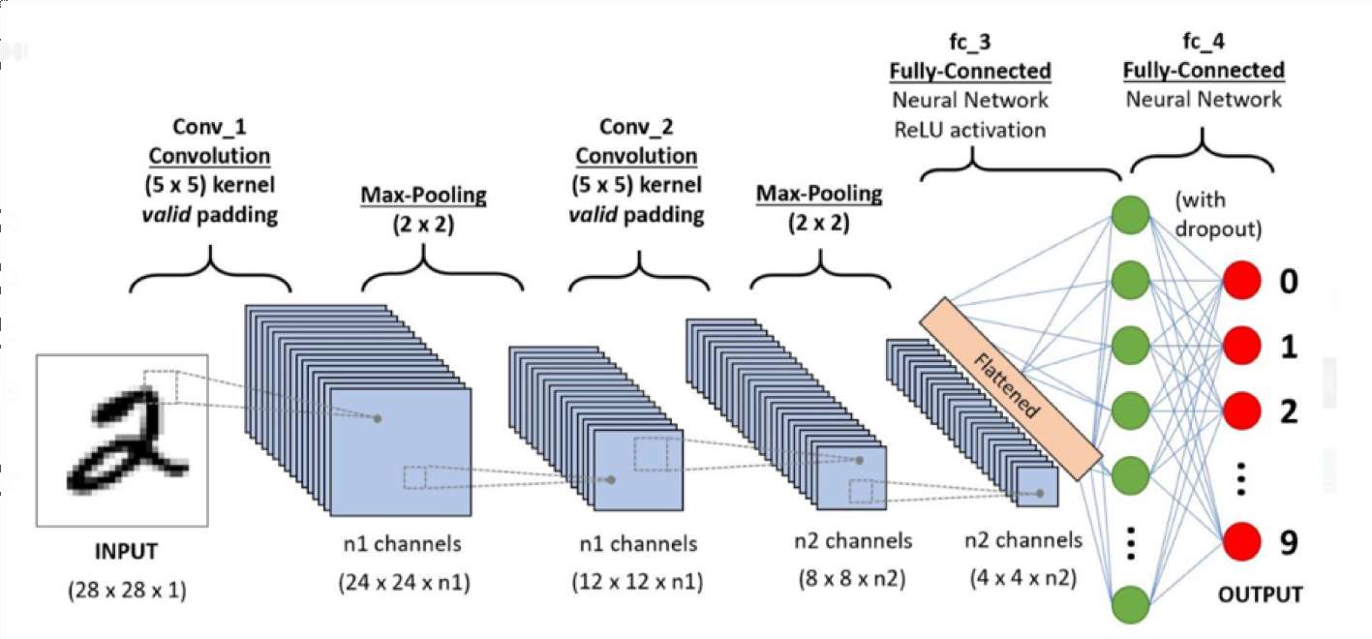
HIGH LEVEL ARCHITECTURE

Slide 6





























LITERATURE SURVEY

Slide 7



































LITERATURE SURVEY

Slide 8
Proposed Approach
CNN stands for Convolutional Neural Networks that are used to extract the features of the images using several layers of filters.
The convolution layers are generally followed by maxpool layers that are used to reduce the number of features extracted and ultimately the output of the maxpool and layers and convolution layers are flattened into a vector of single dimension and are given as an input to the Dense layer (The fully connected network).
•Split data into images and their labels
•Reshaping the data in the csv file so that it can be displayed as an image
•we are reshaping the train & test image data so that they can be displayed as an image, as initially in the CSV file they were present as 784 columns of pixel data. So we convert it to 28×28 pixels. •Reshaping the training & test dataset so that it can be put in the model •Model creation, compiling,fitting and prediction of characters.

Slide 9
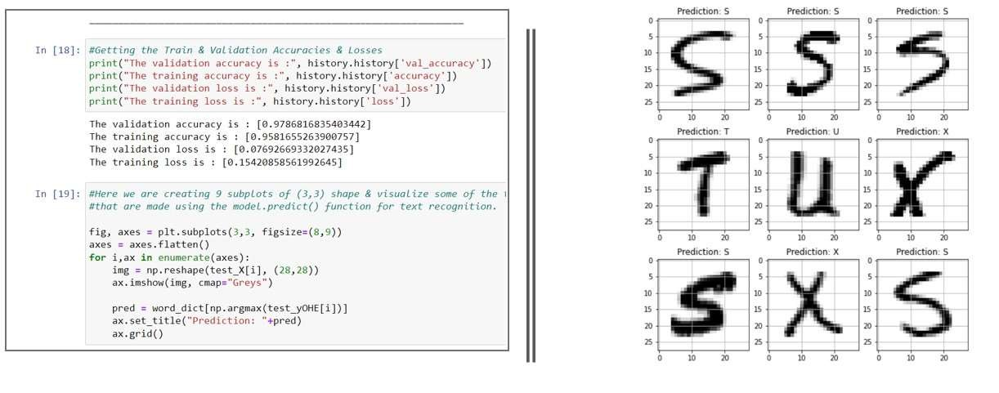
RESULTS AND DISCUSSION

Slide 10













REFERENCES

Slide 11

THANK YOU

