Slide 1
UE20CS334 – NLP Project Approval
Project Title : SPAM TEXT CLASSIFICATION
Project ID : 15
Project Team
Students Name : Mekala Sanjana
Chetana N Patil

Slide 2
Outline
Problem Statement
Scope and Feasibility study
High Level Diagram
Approach
Expected Deliverables

Slide 3
Problem Statement
Congrats!! You just won a $1 million dollar. Fill in the below form with your details to get the money in your account.How often have we come across such messages saying that we have won some prize or won a trip to Hawaii. This form of scam through sms which are generally spam texts is called smishing.The goal of our project is to use data science and NLP to build a model particularly text analysis and classification methods to classify the sms into spam or ham(non-spam).Text Classification is a part of NLP where the text is converted into a machine-readable form by performing various methods.

Slide 4
Scope and Application of the Problem
Tokenizing, part-of-speech tagging, stemming, chunking are some of the text classification methods. Implementing these methods on our data gives us a classified data on which we will train the model to detect spam and ham messages using Scikit-Learn Classifiers. We will propose a model to solve the issue of classifying messages as spam or ham by experimenting and analyzing the relative strengths of several machine learning algorithms such as K-Nearest Neighbors (KNN), Decision Tree Classifier, Random Forest Classifier, Logistic Regression, SGD Classifier, Multinomial Naive Bayes(NB), Support Vector Machine(SVM) to have a logical comparison of the performance measures of the methods in this research.

Slide 5
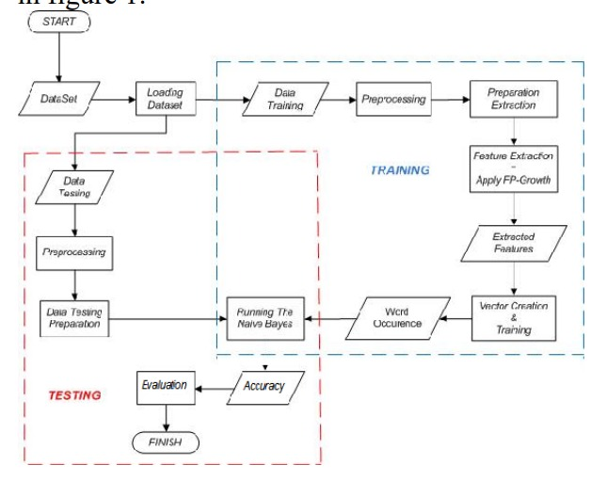
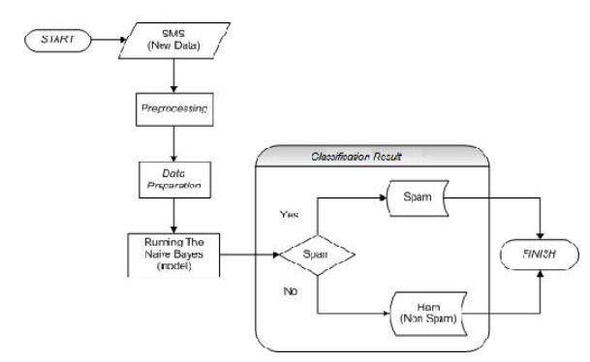
High level design

Slide 6
Approach
● Step 1: Data Collection
● Step 2: Data Preparation
● Step 3: Data Exploration
● Step 4: Text Analysis
● Step 5: Classification

Slide 7
Expected Deliverables
In this problem, we use Naive Bayes, Decision Tree and SVM classifiers to classify text messages as ham or spam. We will generate the feature vectors of the text messages using count (frequency) vectorizer and TfIdf vectorized as input to our machine learning models.At the end model will be able to classify the message as spam or ham.

Slide 8
Thank You

