Slide 1
UE20CS334 – NLP Project Approval
Project Title : SMS CLASSIFICATION
Project ID : 15
Project Team
Students Name : Mekala Sanjana - PES2UG20CS194
Chetana N Patil - PES2UG20CS504

Slide 2
Outline
Problem Statement
Scope and Feasibility study
High Level Diagram
Approach
Expected Deliverables

Slide 3
Problem Statement
Message classification using natural language processing (NLP) is a powerful technique that involves using machine learning algorithms to automatically categorize text messages into predefined classes. The goal of our project is to use data science and NLP to build a model particularly text analysis and classification methods to classify the sms into different categories or classes.As the amount of digital data continues to grow, message classification using NLP is becoming an increasingly important tool for businesses and researchers alike.Text Classification is a part of NLP where the text is converted into a machine-readable form by performing various methods.

Slide 4
Scope and Application of the Problem
Tokenizing, part-of-speech tagging, stemming, chunking are some of the text classification methods. Implementing these methods on our data gives us a classified data on which we will train the model to classify the messages using Scikit-Learn Classifiers. We will propose a model to solve the issue of classifying messages by experimenting and analyzing the relative strengths of machine learning algorithms such as Multinomial Naive Bayes(NB), Support Vector Machine(SVM), Linear SVC to have a logical comparison of the performance measures of the methods in this research.

Slide 5
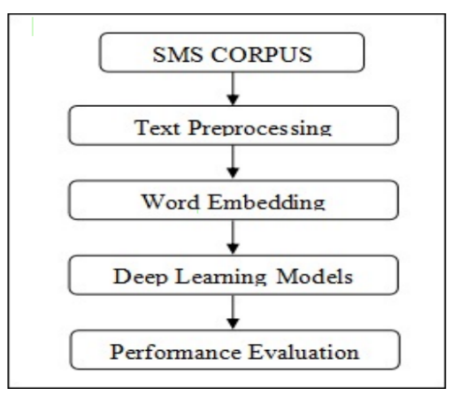
High level design

Slide 6
Approach
● Step 1: Data Collection
● Step 2: Data Preparation
● Step 3: Data Exploration
● Step 4: Text Analysis
● Step 5: Classification

Slide 7
Expected Deliverables
In this problem, we use Naive Bayes and Linear SVC classifiers to classify text messages into different categories. We will generate the feature vectors of the text messages using count (frequency) vectorizer and TfIdf vectorized as input to our machine learning models.At the end model will be able to classify the message accordingly.

Slide 8
Thank You

Slide 9

NLP Project Phase #2
(Project High Level Architecture and Literature Survey)
Project Title : SMS Classification
Project ID : 15
Project Team : Mekala Sanjana - PES2UG20CS194
Chetana N Patil - PES2UG20CS504

Slide 10
Outline
Abstract
Motivation Scope of the Project
Suggestions from Review – 1
Literature Survey (12 papers) (Individual information is mandatory)
Summary: Learning from Literature Survey
High Level Architecture (DIAGRAM)
Work Done So far
References

Slide 11
Abstract
Message classification using natural language processing (NLP) is a powerful technique that involves using machine learning algorithms to automatically categorize text messages into predefined classes. NLP techniques like tokenization, stemming, and feature extraction are used to preprocess the text data before it is fed into the classifier model. The classifier model is trained on a labeled dataset, and then used to predict the class of new, unseen messages. This approach has a wide range of applications, including spam filtering, sentiment analysis, and topic modeling. By automating and streamlining text analysis tasks, message classification using NLP can help organizations save time and resources, and make better informed decisions. As the amount of digital data continues to grow, message classification using NLP is becoming an increasingly important tool for businesses and researchers alike.

Slide 12
Motivation and Scope of the Project
SMS spamming has become a serious problem for mobile subscribers. Spam SMS refers to unwanted text messages that are usually either someone promoting a product or service or someone attempting to scam a subscriber into providing personal information. It incurs substantial costs in terms of lost productivity, network bandwidth usage, management, and raid of personal privacy.
The motivation for using message classification with NLP is to improve the efficiency and accuracy of text analysis tasks. With the increasing amount of digital data, manual analysis is becoming increasingly time-consuming and error-prone. By automating text analysis tasks using NLP, businesses can save time and resources, make better informed decisions, and provide better customer service. In addition, the insights gained from message classification can help businesses identify areas for improvement and make data-driven decisions.

Slide 13
Suggestions from Review – 1
Instead of classifying the message into only spam or ham we are going to classify the messages like bank,education,recharge etc.
Applications:
1)Spam filtering: Message classification can be used to automatically detect and filter out unwanted messages, such as spam emails, from reaching users.
2)Sentiment analysis: Message classification can be used to identify the sentiment of text messages, such as positive, negative, or neutral. This is useful for understanding customer feedback, monitoring brand reputation, and analyzing social media sentiment.
3)Topic modeling: Message classification can be used to group messages by topics, allowing businesses to identify trends and topics of interest to their customers.
4)Customer service: Message classification can be used to automatically route customer service requests to the appropriate department or agent, improving response times and overall customer satisfaction.

Slide 14
Individual Information on Literature Survey
S.N. | Name of the Student | SRN | Paper |  | Paper Title
1 | Mekala Sanjana | PES2UG20CS194 | 1 |  | A Study on Analysis of SMS Classification Using Document Frequency Thresold.
 |  |  | 2 |  | A comparative study of word embedding techniques for SMS spam detection.
 |  |  | 3 |  | How AI Can be Used for Governance of Messaging Services: A Study on Spam Classification Leveraging Multi-Channel Convolutional Neural Network.
2 | Chetana N Patil | PES2UG20CS504 | 5 | SMS Spam Classification–Simple Deep Learning Models With Higher Accuracy Using BUNOW And GloVe Word Embedding
 |  |  | 6 | Multiclass SMS Message Categorization: Beyond Spam Binary Classification
 |  |  | 7 | Word Embedding Method of SMS Messages for Spam Message Filtering
 |  |  | 8 | SMS TEXT CLASSIFICATION MODEL BASED ON MACHINE LEARNING

Slide 15
Literature Survey
Paper-1
Paper Details (Citation) | Objective of paper, Techniques/Methods | Detailed explanation along with results | Limitations
N. Cristianini, and J. Shawe-Taylor, Support Vector and Kernel Methods, Intelligent Data Analysis: An Introduction Springer – Verlag, 2003. | A document frequency feature selection criteria for SMS classification based on support vector machine classifier is proposed.Selecting the best features to represent documents can reduce the dimensionality of feature space hence increase the performance. | The experiment is performed with NUS SMS text messages data set. In this paper, a document frequency feature selection criteria for SMS classification based on support vector machine classifier is proposed.The proposed medium Document frequency threshold is used to enhance the F1-measure with less computational cost. | In the case of noisy data, forcing zero training error will lead to poor generalization. Select features without using any statistical measure such as information gain, correlation etc., and this method simply select the features without any prior knowledge about features

Slide 16
Paper-2
Literature Survey
Paper Details (Citation) | Objective of paper, Techniques/Methods | Detailed explanation along with results | Limitations
P. Joseph and S. Y. Yerima, "A comparative study of word embedding techniques for SMS spam detection," 2022 14th International Conference on Computational Intelligence and Communication Networks (CICN), Al-Khobar, Saudi Arabia, 2022, pp. 149-155, doi: 10.1109/CICN56167.2022.10008245. | It is important to develop high accuracy spam detection models to effectively block spam messages, so as to optimize resources and protect users. Various word-embedding techniques such as Bag of Words (BOW), N-grams, TF-IDF, Word2Vec and Doc2Vec have been widely applied to NLP problems, however a comparative study of these techniques for SMS spam detection is currently lacking. | In this paper, they provide a comparative analysis of popular word embedding techniques for SMS spam detection by evaluating their performance on a publicly available ham and spam dataset. They investigated the performance of the word embedding techniques using 5 different machine learning classifiers i.e. Multinomial Naive Bayes (MNB), KNN, SVM, Random Forest and Extra Trees. Based on the dataset employed in the study, N-gram, BOW and TF-IDF with oversampling recorded the highest F1 scores of 0.99 for ham and 0.94 for spam. | However, their paper did not consider investigating different word embedding techniques. To evaluate the effect of oversampling, due to having an unbalanced dataset, they applied SMOTE to the training sets prior to training the classifiers.

Slide 17
Paper-3
Literature Survey
Paper Details (Citation) | Objective of paper, Techniques/Methods | Detailed explanation along with results | Limitations
A comprehensive study of spam detection in e-mails using bio-inspired optimization techniques International Journal of Information Management Data Insights, 1 (1) (2021), p. 100006, 10.1016/j.jjimei.2020.100006 | Studies using deep learning have shown promising results for spam classification, and in this paper, extending these studies, they have proposed a Multi-Channel CNN architecture with static and dynamic embeddings for SMS spam classification. | The proposed model has an accuracy of 96.12% and overcomes certain disadvantages associated with some of the state-of-the-art deep learning models. The dataset is created by merging UCI’s SMS Spam Collection Dataset (Almeida, Hidalgo, & Yamakami, 2011, 2012) and self-collected messages. The raw data collected is then pre-processed, followed by tasks like data augmentation, tokenization, stop-word removal, and lemmatization to get an N-vector representation of the text. | This paper overcomes certain disadvantages associated with some of the state-of-the-art deep learning models. A model with a larger number of trainable parameters needs more computational resources.The dataset lacks in diversity- it is composed of very few spam samples and the non-spam samples are mostly sourced from informal conversations.

Slide 18
Paper-4
Literature Survey
Paper Details (Citation) | Objective of paper, Techniques/Methods | Detailed explanation along with results | Limitations
Surajit Giri, Sayak Das, Sutirtha Bharati Das, and Siddhartha Banerjee∗ Department of Computer Science, Ramakrishna Mission Residential College, Narendrapur, West Bengal, India . Accepted: Nov. 30, 2022 | Initially,preprocessing is done on the messages in the SMS corpus. After preprocessing, two different word embedding techniques are applied to extract the context of each word in the messages. This context information is used in the training phase of two deep learning models. Finally, testing is applied to evaluate the performance of the proposed model. GLOVE and BUNOW embedding techniques are used. Tokanization,Stemming,Lemmatizer,Word embedding techniques,Deep neural network models. | Tiago’s dataset is used. CNN-LSTM BUNOW perform best among four models with accuracy 99.04%, 99.01%, 98.92% and 98.44% for 85% – 15%, 80% – 20%, 75% – 25% and 70% – 30% train-test splits respectively. | Though GloVe word embedding considers the global context of words but does not succeed to achieve the best accuracy in this context. Without using LSTM model, we cant achieve the context of the message.

Slide 19
Paper-5
Literature Survey
Paper Details (Citation) | Objective of paper, Techniques/Methods | Detailed explanation along with results | Limitations
Fatia Kusuma Dewi, Mgs. M. Rizqi Fadhlurrahman, Mohamad Dwiyan Rahmanianto, Rahmad Mahendra Faculty of Computer Science, University of Indonesia Accepted: 2017 | Past researches on SMS spam detection only classified SMS into two categories, spam and not spam. The binary classification of SMS spam prevents the user from seeing the spam messages that they do not really hate, e.g. an advertisement from their favourite product. In this paper, we propose multiclass classification of SMS into: regular, info, ads, and fraud. We use content-based (top-N unigram) as well as non-content based features. The result shows that the best accuracy is achieved by logistic regression that is 97.5 % accuracy with configuration of normalization preprocess and 4096 top-N unigram features. | First, we collected and annotated the SMS data. Then, the texts of content are tokenized, normalized, and/or stemmed. The features are engineered from content of messages as well as non-content related. Information, e.g. messages sender. We built the model using several machine learning algorithms. We evaluate the model using factorial design analysis and feature selection. Best FI measure is achieved by logistic regression algorithm, that is 97.47%. | custom features creation is limited, because it is tailored and derived from observation of our dataset. For future research, we suggest collecting more SMS data in order to produce a generalized custom features.

Slide 20

Literature Survey
Paper-6
Paper Details (Citation) | Objective of paper, Techniques/Methods | Detailed explanation along with results | Limitations
XIAO FEI1 , LI JIANPING1 , GAO YUAN1 , ZHOU YUE1 1 ,School of Computer Science and Engineering, University of Electronic Science and Technology of China, Chengdu 611731, China Accepted: 2021 | Preprocesses the text in the SMS data set used to a certain extent, using the Tf-Idf model. The frequency of the text unit is counted as the feature value of the corresponding vector of the text, so that the text is converted into a vector, and then these vectors are fitted and predicted by the support vector machine algorithm. | Dimensionality of the vector-when the data set is larger and the text content is richer, the vocabulary will become larger and larger, and the dimensionality of the vector representing the text will be larger, and each vector is very sparse. The vector formed by counting the frequency of words will lose the spatial information of the text, thereby affecting the quality of the model. This problem can be alleviated by the N-grams method . N-grams combine two adjacent words in a text into another unit. 2-grams is also called Bigrams, which uses two words as a unit to form a feature. | The characteristic matrix obtained from the above is a sparse matrix. The direct use of the matrix is not good and adds a lot of time overhead. Therefore, we need to reduce the dimensionality of it, and use a binary bit to represent the category of each text.

Slide 21
Summary :Learning from Literature Survey
Collect and preprocess data: Collect a dataset of messages with corresponding labels/categories. Preprocess the data by cleaning, tokenizing, and removing stop words, punctuations, and other irrelevant characters.
Split the data into training and test sets: Split the preprocessed data into training and test sets. The training set will be used to train the model, and the test set will be used to evaluate its performance.
Define features: Define the features to be used in training the model. For text data, common features include bag-of-words, n-grams, and word embeddings.
Choose a classification algorithm: Choose a classification algorithm that works well with the chosen features. Popular algorithms for text classification include Naive Bayes, logistic regression, SVM, and neural networks.
Train the model: Train the chosen classification algorithm on the training set using the chosen features.
Evaluate the model: Evaluate the performance of the model on the test set. Common evaluation metrics include accuracy, precision, recall, and F1 score.
Tune hyperparameters: Experiment with different hyperparameters of the chosen algorithm to optimize its performance on the test set.
Deploy the model: Once the model's performance is satisfactory, deploy it for use in production. This may involve integrating it into a larger application or API, or making it available as a standalone service.

Slide 22
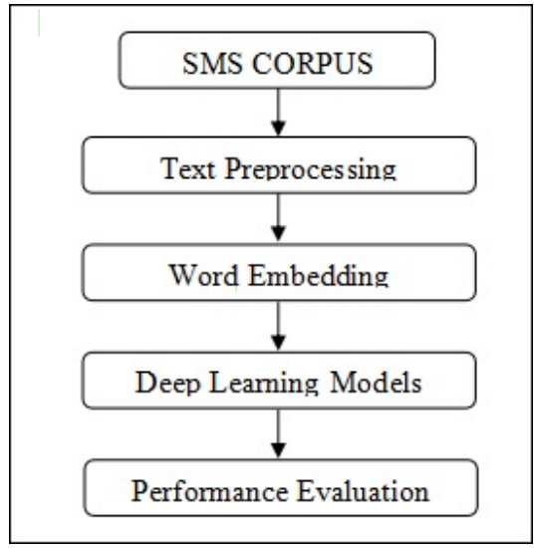
High Level Architecture Diagram

Slide 23
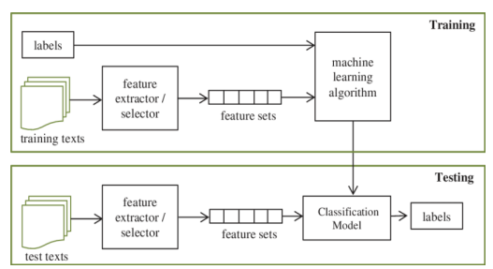
High Level Architecture Diagram

Slide 24
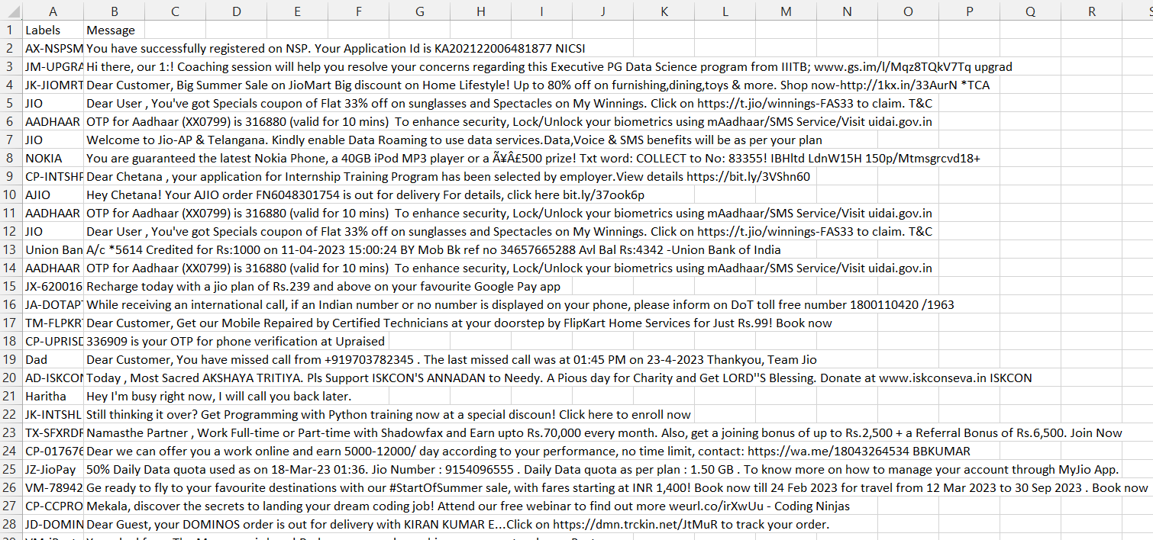
Dataset overview

Slide 25
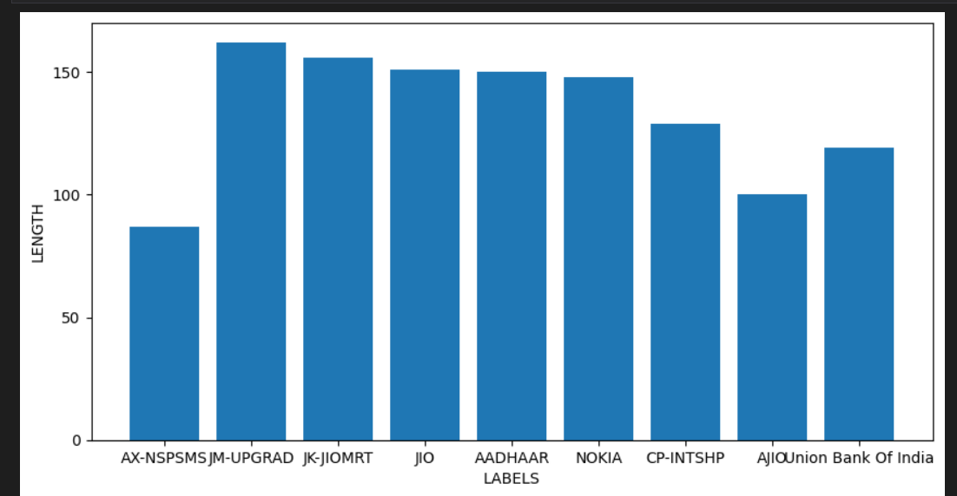
Data Visualisation

Slide 26
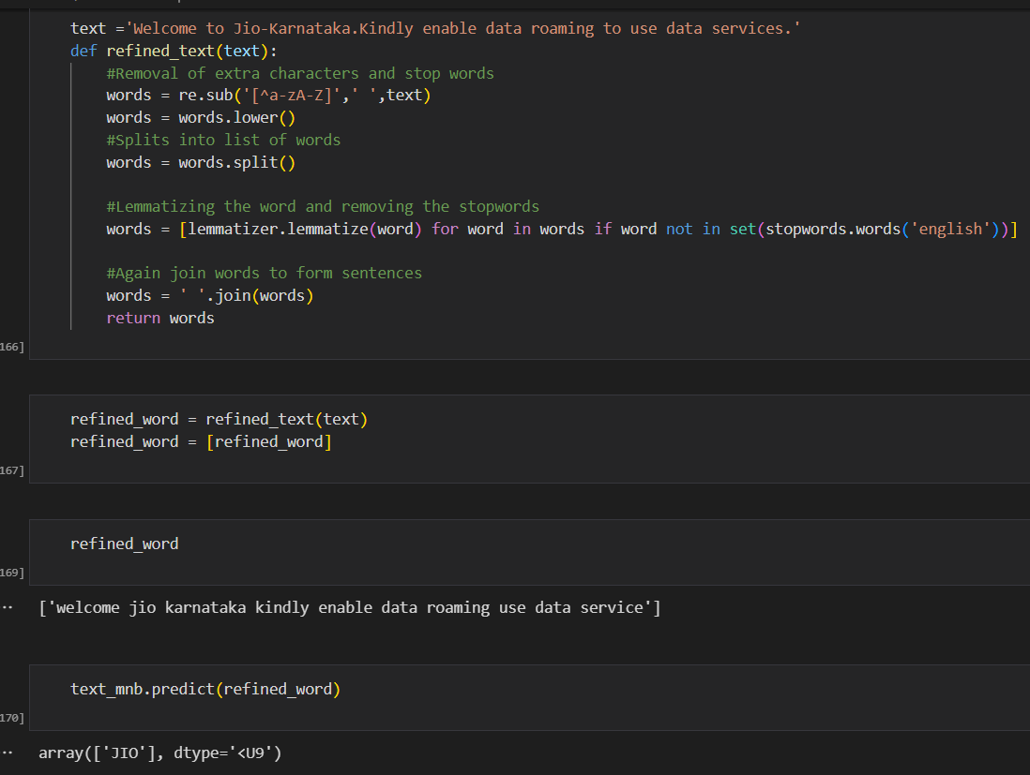
Predicted output

Slide 27
Conclusion
SMS categorization is an essential task in naturallanguage processing with numerous practical applications suchas spam detection, sentiment analysis, and topic modeling. Theapplication of machine learning techniques and NLPalgorithms has enabled the development of efficient andaccurate SMS classification systems.The system has beenshown to achieve high accuracy and precision in variousstudies, and the choice of algorithm depends on the specificrequirements of the task and the characteristics of the data.Naive Bayes is simple and efficient and can perform well withsmall to moderate-sized datasets, while linearSVC is morecomplex but can handle high-dimensional datasets andnon-linearly separable classes.Overall, the development of an efficient and accurateSMS classification system using NLP and machine learningtechniques involves careful consideration of the datapreprocessing, feature extraction, and model selection stages.The proposed system has the potential to improve the accuracyand efficiency of SMS classification and can be applied invarious practical scenarios such as spam detection, sentimentanalysis, and topic modeling.

Slide 28
References
SMS Spam Classification–Simple Deep Learning Models With HigherAccuracy Using BUNOW And GloVe Word Embedding.Surajit Giri, Sayak Das, Sutirtha Bharati Das, and Siddhartha BanerjeeDepartment of Computer Science, Ramakrishna Mission Residential College, Narendrapur, West Bengal, India. Pulication: 2022.
Multiclass SMS Message Categorization: Beyond Spam Binary Classification.Fatia Kusuma Dewi, Mgs. M. Rizqi Fadhlurrahman, Mohamad Dwiyan Rahmanianto, Rahmad MahendraFaculty of Computer Science, University of Indonesia. Publication: 2017.
SMS Text Classification Model Based On Machine Learning. XIAO FEI, LI JIANPING, GAO YUAN, ZHOU YUE,School of Computer Science and Engineering, University of Electronic Science and Technology of China, Chengdu. Publication: 2021.
A Study on Analysis of SMS Classification Using Document Frequency Thresold. N. Cristianini, and J.Shawe-Taylor,Support Vector and Kernel Methods,Intelligent Data Analysis: An Introduction Springer– Verlag, 2003.
A comparative study of word embedding techniques for SMS spam detection.P. Joseph and S. Y. Yerima, "A comparative study of word embeddingtechniques for SMS spam detection," 2022

Slide 29
Thank You

