Slide 1


MUSIC STREAMING ANALYSIS
TEAM MEMBERS:
SINDHUJA BOLLIKONDA
LAKSHMI SAI AMULYA PRATTI
CHETANA RAMYA MALAMPATI

Slide 2

INTRODUCTION
MOTIVATION :
Growing popularity of music streaming platforms has given a chance to analyze vast data related to music that is helpful in extracting meaningful insights from that data.
During the analysis of music data, some key points to be considered are user preferences, popular genres, top artists etc., that help in enhancing the user experience and content curation.

Slide 3
SIGNIFICANCE
By analyzing the dataset, patterns in user interaction with various artists acoustic tracks can be found that is helpful to identify elements that increase popularity.
Songs that match the user preferences can be recommended by streaming platforms by understanding the traits of well-liked tracks of users.
Also streaming platforms analyze various artist’s track popularity and display the popular artists and their tracks.

Slide 4

OBJECTIVES
On the basis of track popularity, genres can be divided into most and least popular.
Trends in the songs that have become popular can be determined based on different artists and their songs over that period of time.
Can identify features that are important in finding the popularity of a track.
Also examine the user preferences when deriving meaningful insights from the data.

Slide 5

FEATURES
Popularity is a metric that is used in many analyses for acquiring how well a track is liked.
Features like danceability, key, tempo, loudness, mode, acousticness, instrumentality, liveness, valence and duration_ms plays a crucial role in analysis of music streaming data.
Mainly it consists the name of artists and their track details.

Slide 6
BACKGROUND
For this project we have gathered the data from various sources like current music streaming platforms, publicly available datasets and added some data related to goals of our project.
1
Thoroughly analyzed the data and identified limitations in the data and handled them by using pre-processing techniques.
2
Explored relationships between different features in the data and created new features from the existing ones , so that performance of the model can be increased.
3
Based on the explorations we have interpreted the results according to our context of the project.
4
Also we have seen few visualization plots to visualize the results after the analysis of data.
5

Slide 7
PROBLEM STATEMENT
There are many challenges that occurred while integrating the key attributes.
Our main motto is analyzing the whole music streaming dataset and performing the framework integration using the hadoop and spark functions.

Slide 8
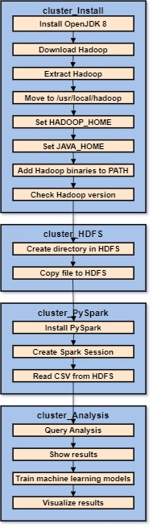
ARCHITECTURE DIAGRAM ->The first two clusters in the diagram represents the installation of the hadoop and creation of directory in HDFS. -> Next two clusters represents installation of pyspark and data analysis and analytics.

Slide 9
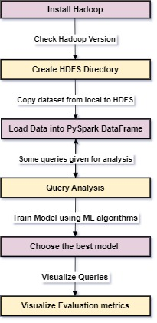
WORKFLOW DIAGRAM -> Installation of Hadoop -> Installation of pyspark -> Integrating both frameworks -> Analyzing queries -> Training model by using any two ML algorithms -> Choosing best model -> Visualizing queries and evaluation metrics

Slide 10
DATASET
DESCRIPTION :
Artist name: Name of the singer.
Track name: Title of the music track.
Track Id: The Id assigned to the track.
Popularity: This metric is evaluated based on rankings, followers, comments, etc.,
Year: Released year of the song.
Genre: Consists of different categories in music like pop, rock, classic, hip-hop, etc.,
Danceability: Rating a song according to user preferences particularly for dance based on energy qualities and rhythmic insights of a song.

Slide 11

CONT…
Key: The major and minor music notes.
Loudness: The intensity of sound in a song.
Mode: The intervals between the music notes, generally on a scale from 0 to 1.
Acousticness: The natural instrumentation which is produced using non-electrical instruments.
Instrumental: The use of musical instruments and on a scale 0 to 1.
Liveness: The energy of a performance or song.
Valence: Mood conveyed by music in different emotions.
Tempo: The speed or pace of the musical composition and is denoted in BPM.
Duration ms: The duration of a musical track.
Time signature: Based on number of beats and rhythm, the musical time is categorized.

Slide 12
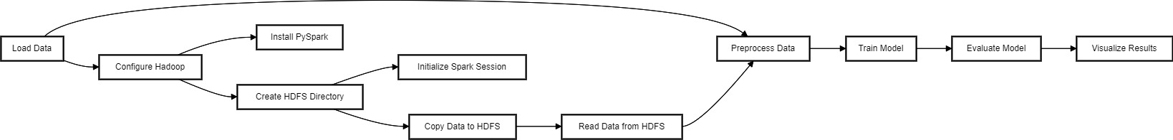
DESIGN OF FEATURES

Slide 13
DATA PRE-PROCESSING
Missing values in the dataset are identified and handled using ‘df.isnull().sum()
While preprocessing data some attributes are dropped as they are irrelevant.
Also, we converted year and time signature columns into categorical data while checking data types of each columns.
One-hot encoding technique is performed on categorical columns.
Standardized numerical columns wherever it is required.

Slide 14
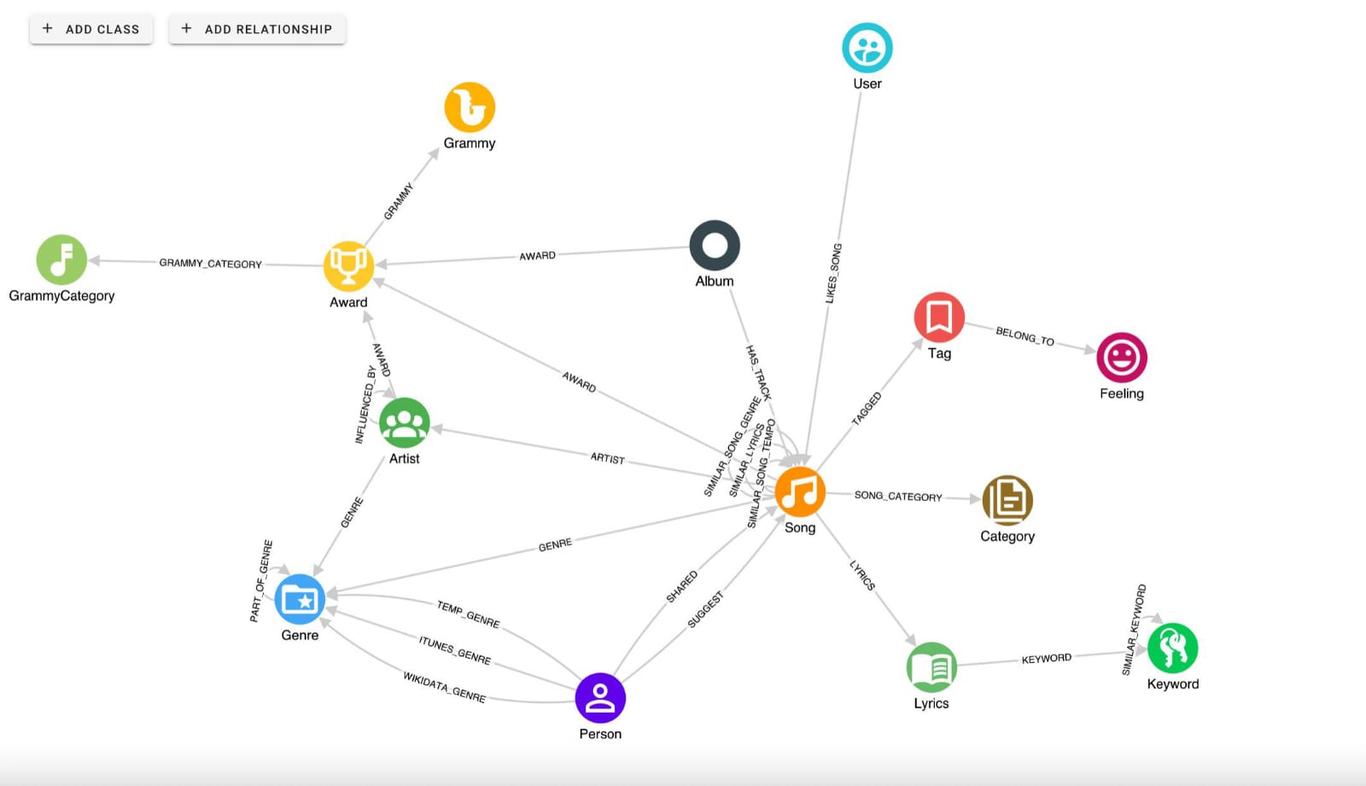
GRAPH MODEL

Slide 15
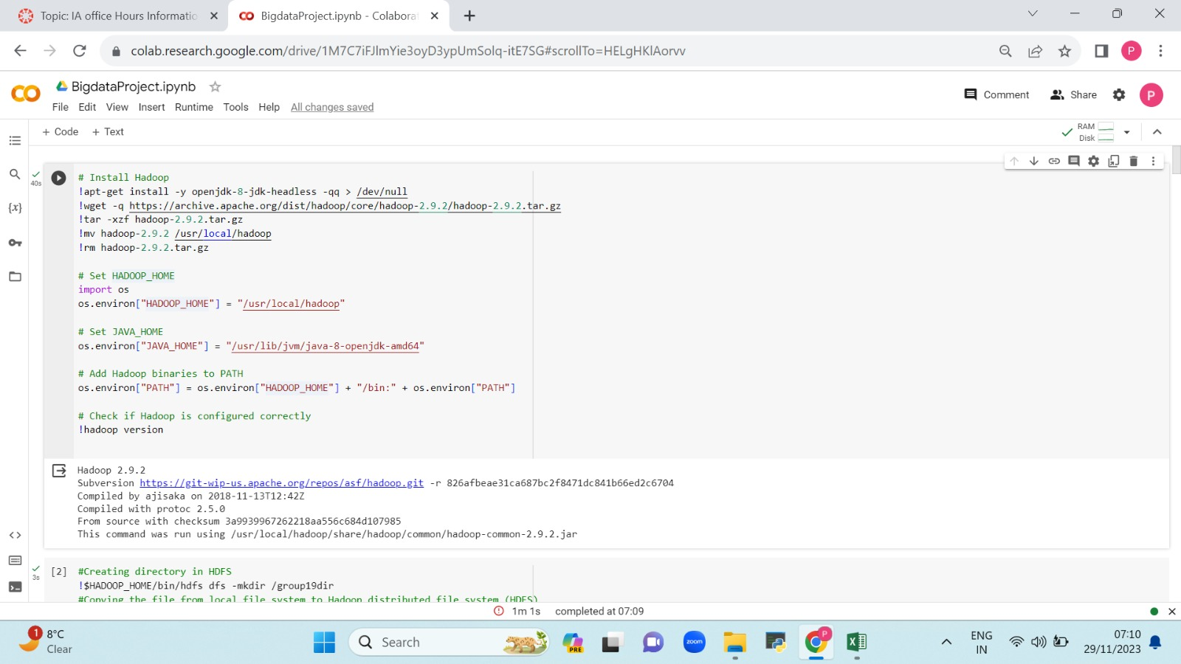
IMPLEMENTATION

Slide 16
CONT…
Initially we have installed Hadoop on Google Colab.
For that installation we have generated hadoop and java home environments.
We have added some hadoop binaries for generating the path.
After the above processes are done, we have checked whether hadoop is installed correctly by knowing its version.

Slide 17
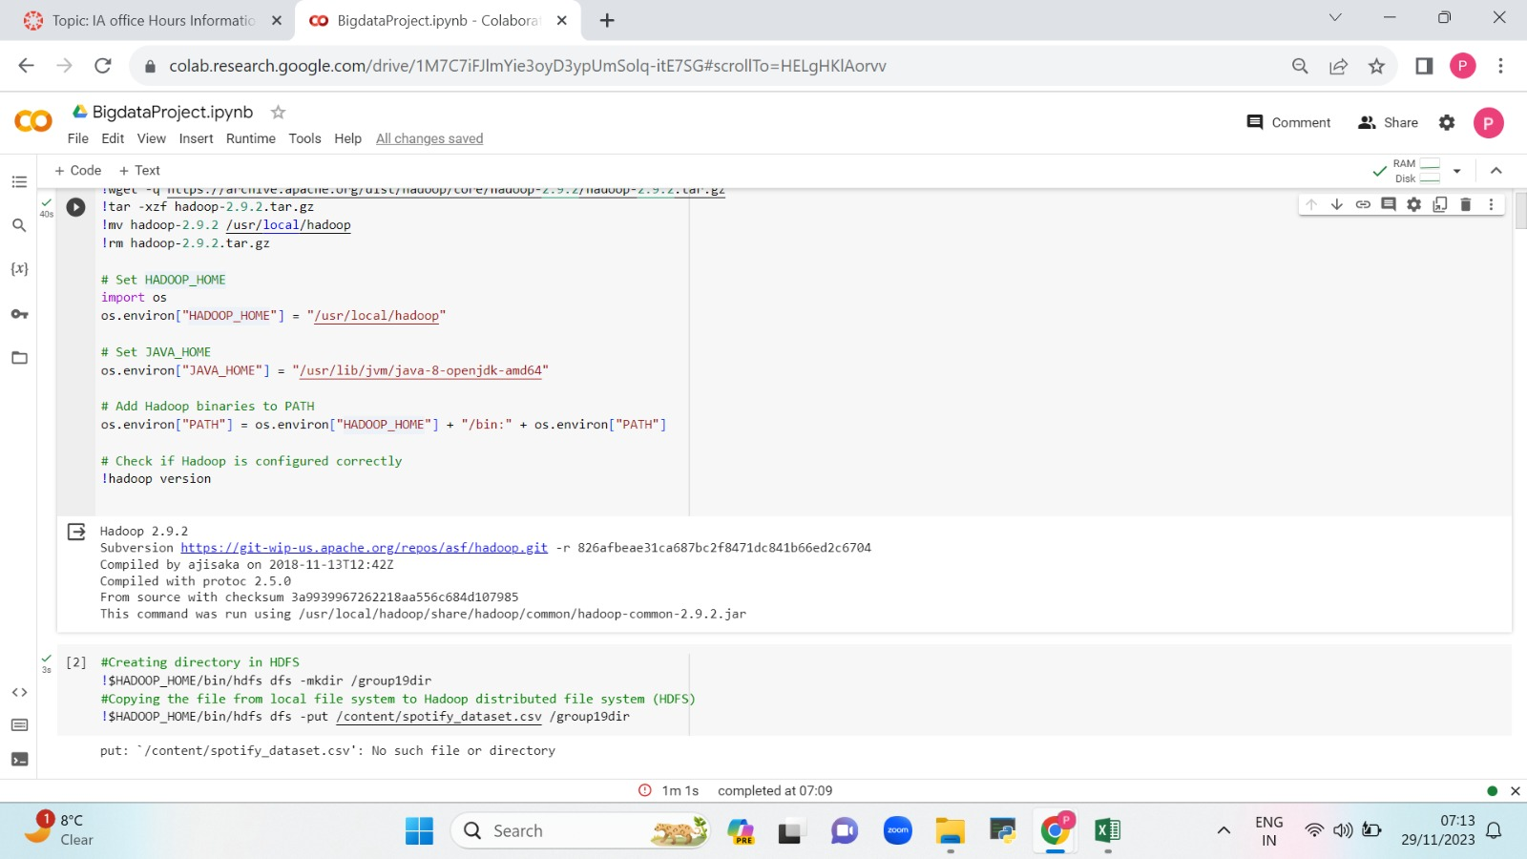

Slide 18
CONT…
After successful installation of hadoop, a directory is created in HDFS using the below command:
‘!$HADOOP_HOME/bin/hdfs dfs –mkdir /group19dir’
Next, the dataset is copied from the local file system to HDFS by giving the below command:
‘!$HADOOP_HOME/bin/hdfs dfs –put /content/spotify_dataset.csv /group19dir

Slide 19
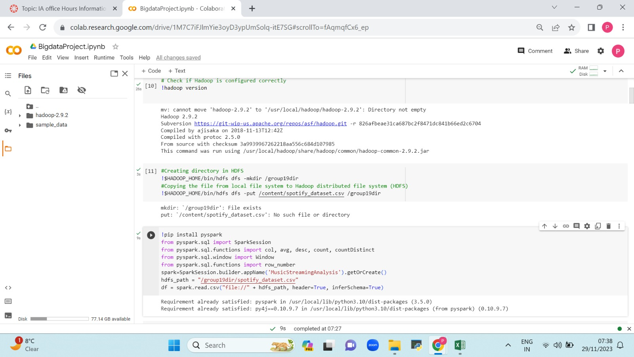

Slide 20
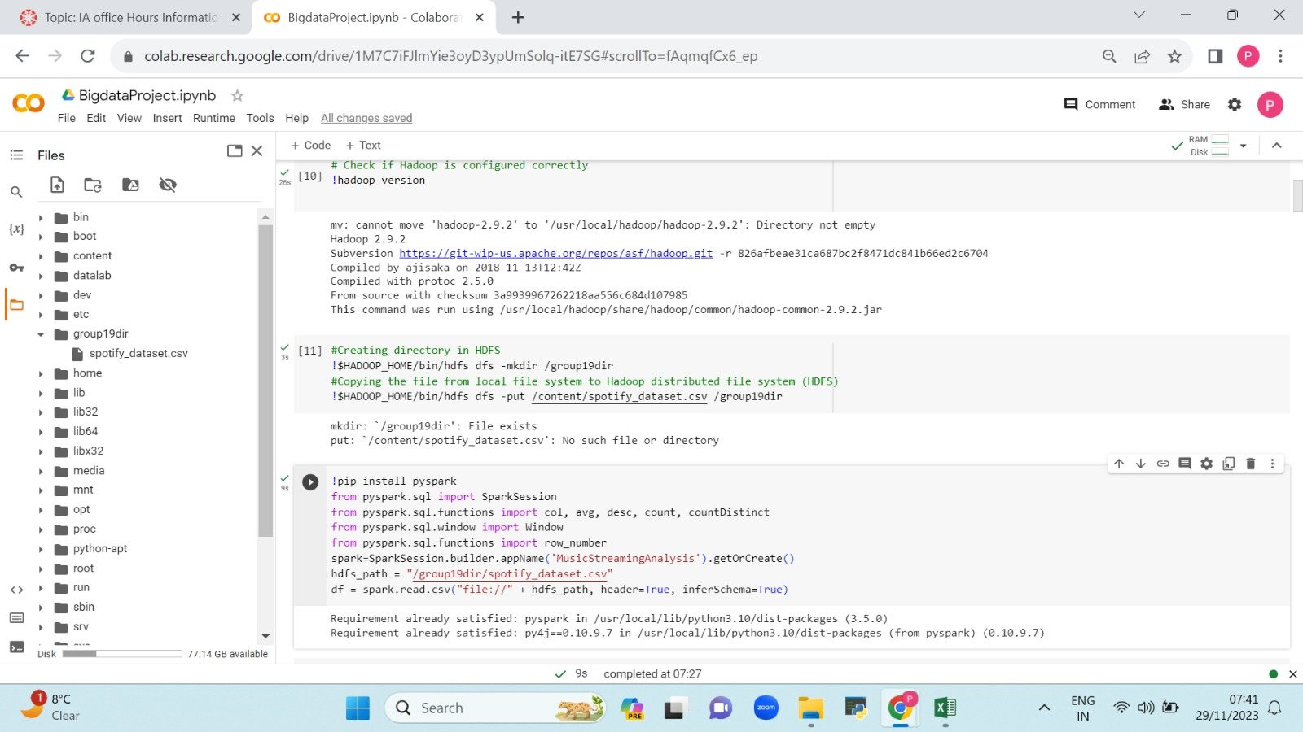

Slide 21
INTEGRATION
Here, we have installed pyspark and imported all the necessary pyspark sql functions which are useful in executing the suitable tasks required for the project.
Next, we have started the spark session by giving a unique name to the session.
We have integrated hadoop and spark frameworks by using the above generated path in HDFS and the data from the file (which is already stored in hadoop) is taken / read by using spark dataframe.
Few tasks are performed in the code snippet using spark dataframe.

Slide 22
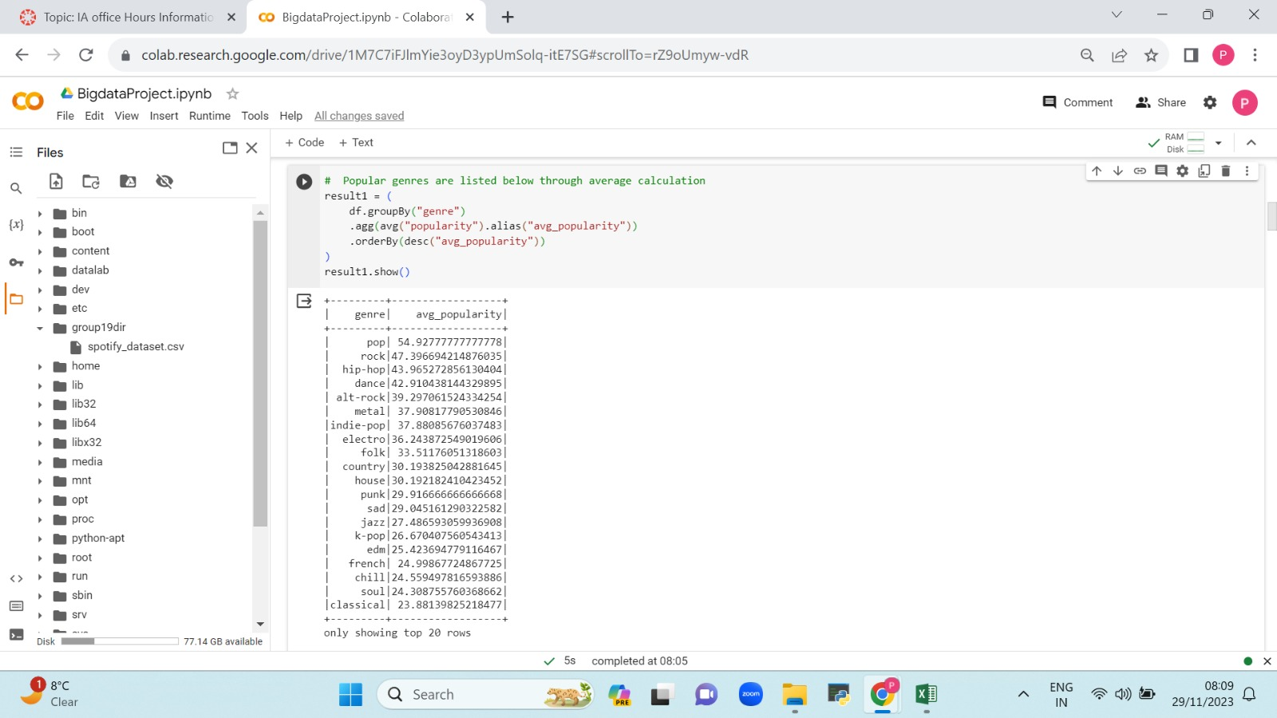

Slide 23
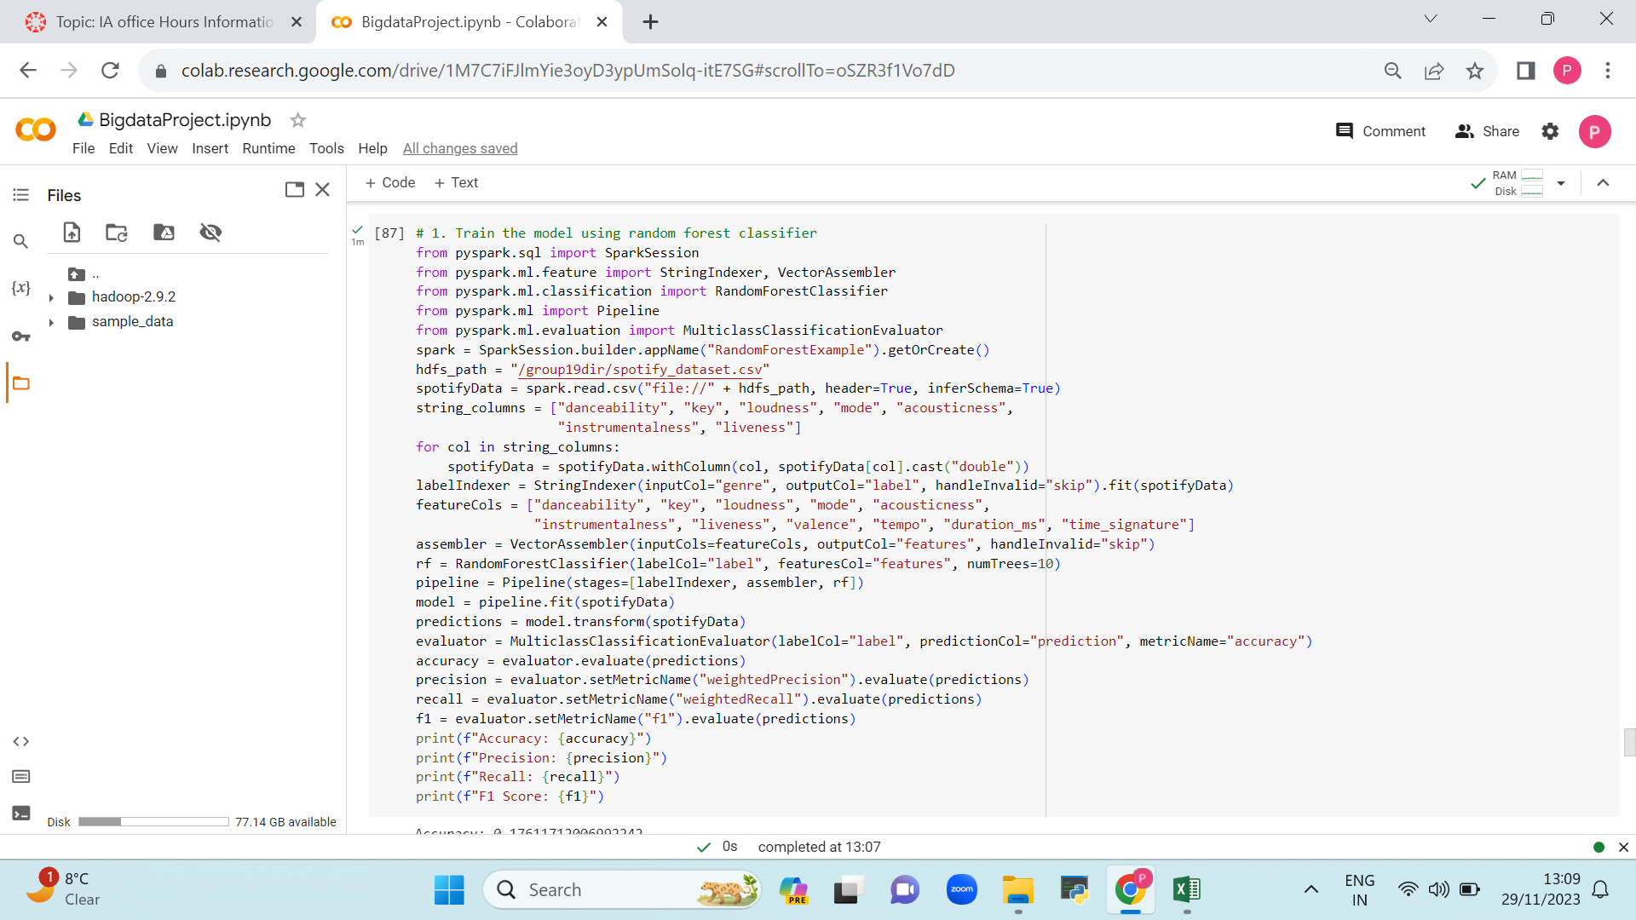
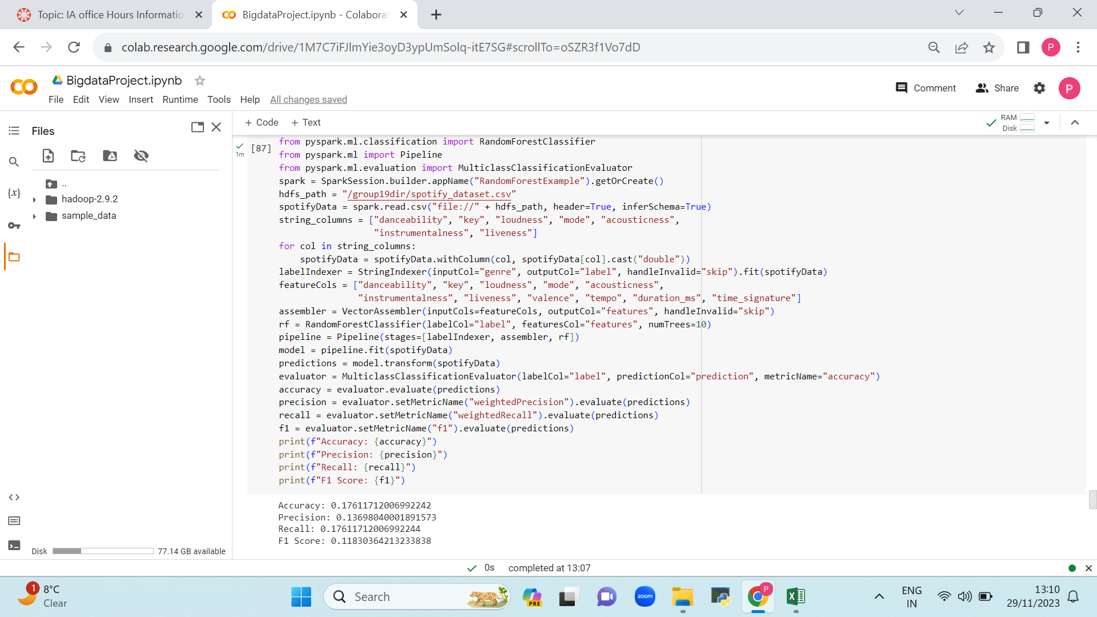

Slide 24
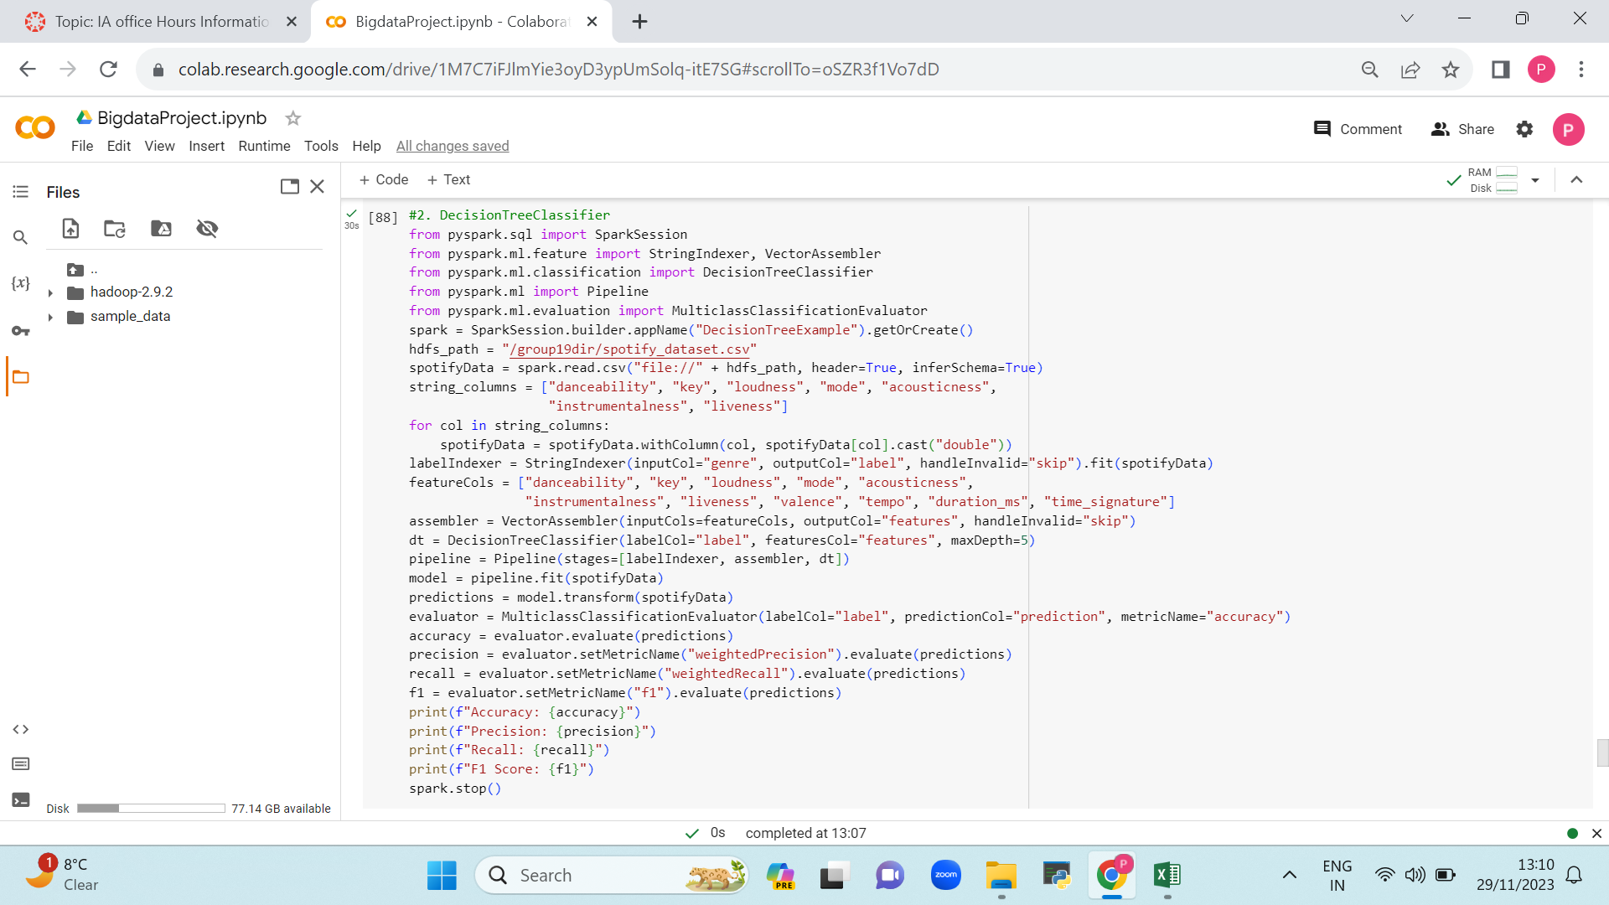


Slide 25
TRAINING MODEL USING RF & DT
Firstly, we have imported ML libraries which are used for calculating the evaluation metrics using random forest classifier.
Using spark session, the data is retrieved from HDFS. For few features we have performed the metrics to obtain the accuracy, precision, F-1 and recall.
Next, we have done the same process using decision tree classifier and the metrics are calculated.
After, the metrics of both classifiers are compared and accordingly the best one is been chosen to train the model.

Slide 26
COMMENTS
Missing integration of two frameworks data analysis and data analytics.
Explanation :
a)Apache Spark : Use Case- The general purpose of the Spark library is for data processing and data analytics.
Integration – Spark can be integrated for the batch processing of the large datasets and ML tasks within our project Music Streaming Analytics.
b)Apache Hadoop : Use Case- It is a powerful open-source framework that is used for the distributed storage , as well as for the data processing using large clusters.
Integration – Hadoop provides HDFS as it has the capability to store large amounts of data which is used for the integration process.

Slide 27
CONT…..
Missing deliverables, uniqueness, technical features and mile stone.
Explanation :
Deliverables – Uniqueness –
i)Personalized recommendation engine i)Dynamic playlist adaption
ii)Real time analytics API ii)Sentiment analysis for songs
iii)Data processing pipelines iii)Collaborative playlist creation
iv)User engagement reports
Technical Features – Mile-Stone –
i)Real time stream processing *Recommendation engine integration
ii)ML models

Slide 28
CONT….
Missing flow chart .
Explanation : We have worked on it and we have implemented the workflow diagram in the presentation.
Not mentioned clearly why it was imperative to accomplish the project purpose.
Explanation : As it works as an effective recommendation system.
Provides dynamic playlist adaption.
Useful in decision making.
User engagement and retention in nature.
Not mentioned clearly how it is related to big data project.
Explanation : It is closely related to bigdata project, as it generates vast amount of data which can be analyzed to improve user experience, enhance recommendation system and in deriving valuable insights.

Slide 29
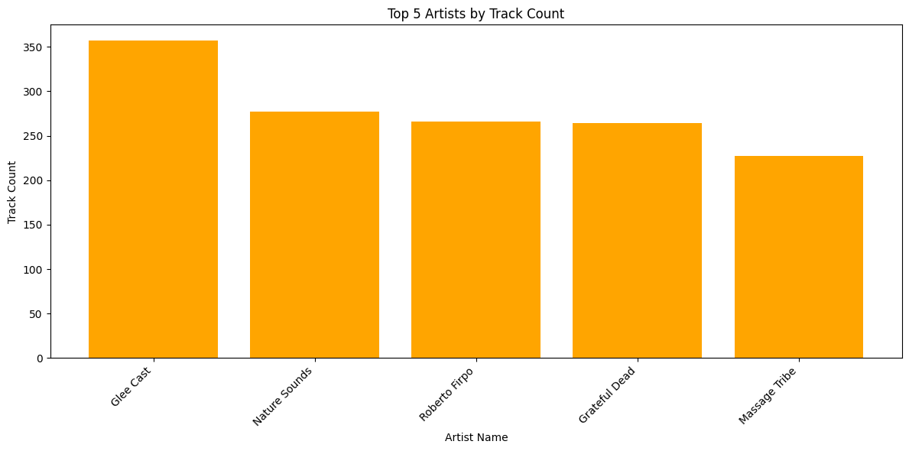
RESULTS ->Here we have imported the visualization libraries such as matplotlib , pandas -> The below bar graph displays the top 5 artists based on track count

Slide 30
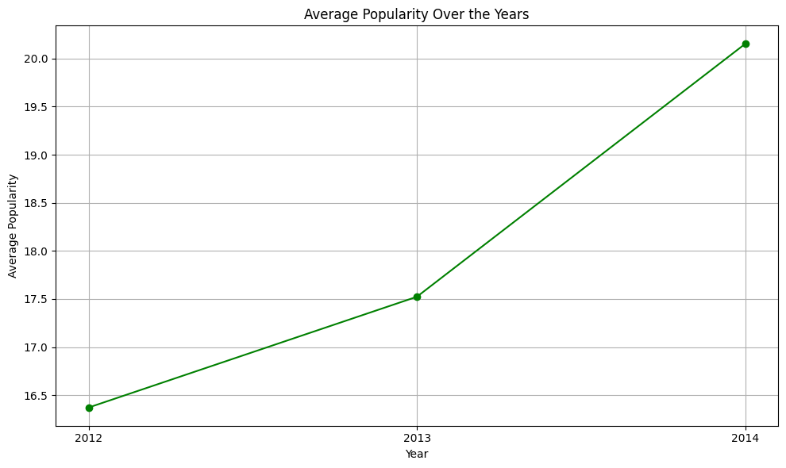
-> This line chart depicts the average popularity over the years

Slide 31
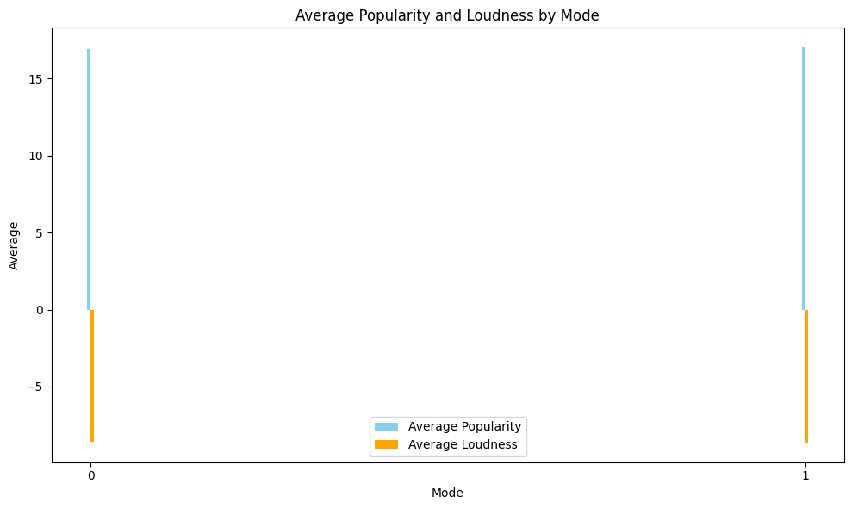
->The below plot represents grouped bar plot for showing the average popularity and loudness by mode

Slide 32
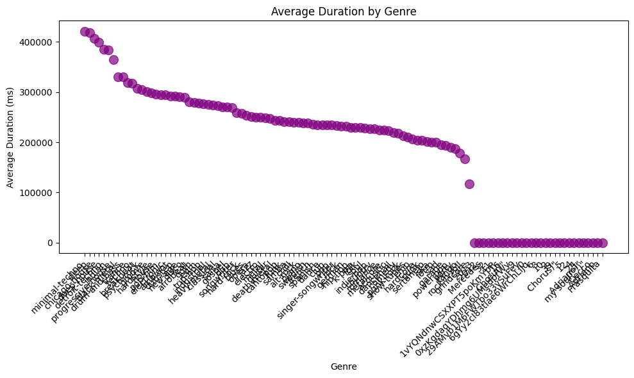
-> The below bubble chart shows the average duration of different genres

Slide 33
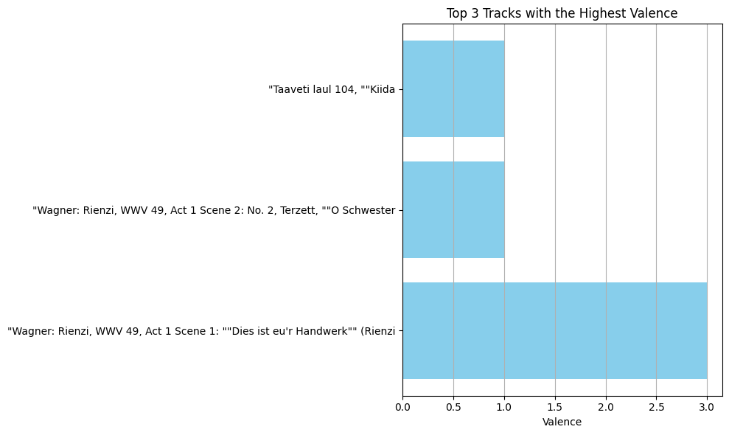
-> This horizontal bar chart visualizes the top 3 tracks with their highest valence

Slide 34
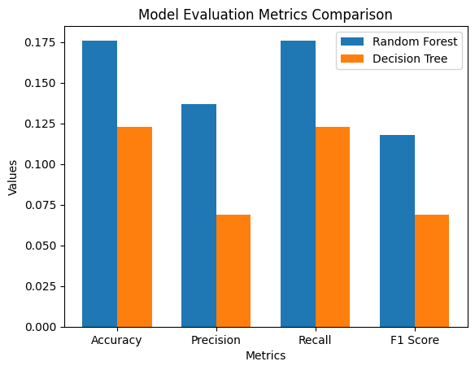
VISUALIZING EVALUATION METRICS
This represents the comparison of results obtained by evaluating metrics for random forest and decision tree.
Through this metrics we conclude that random forest is the best classifier.

Slide 35
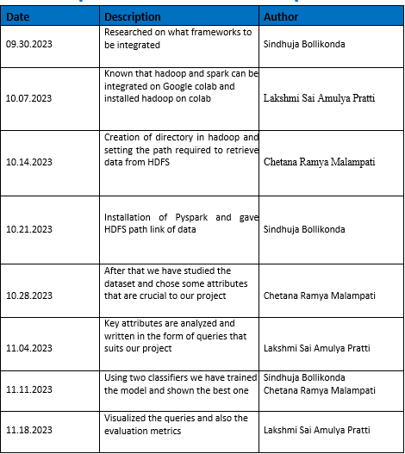
PROJECT MANAGEMENT
IMPLEMENTATION STATUS REPORT :

Slide 36
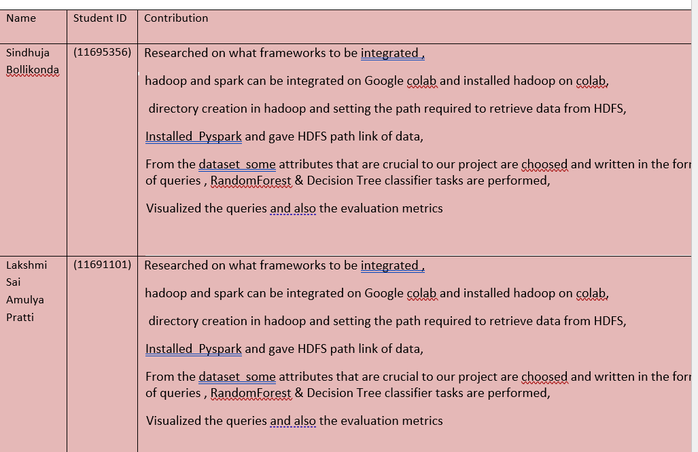
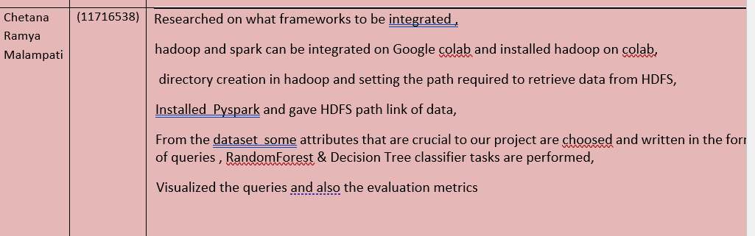
RESPONSIBILITY AND CONTRIBUTION

Slide 37
PERCENTAGE: SINDHUJA BOLLIKONDA – (33.33%) LAKSHMI SAI AMULYA PRATTI –(33.33%) CHETANA RAMYA MALAMPATI –(33.33%)

Slide 38

REFERENCES
https://doi.org/10.1177/0163443717745147
https://outsideinsight.com/insights/how-ai-helps-spotify-win-in-the-music-streaming-world/
https://medium.com/@maxtingle/can-data-science-save-the-starving-music-artist-a53bc8a8ece0

Slide 39
PRESENTATION LINK
https://drive.google.com/drive/folders/1Rd_xARPoP6l6Z1h_uBR3dBMx5I65ITp8?usp=drive_link

Slide 40

THANK YOU

