Slide 1

Course Project Recommendation Expert System
Student
Academic Year 2025-26
AI And Data Science
First Year Capstone Project Presentation
Department

Slide 2
Background
What Is an Expert System?
An expert system is an AI program that simulates the decision-making ability of a human specialist. It uses a knowledge base and an inference engine to provide intelligent recommendations — making expert-level guidance accessible to everyone.
Knowledge Base
Inference Engine
Stores domain expertise and rules
Applies logic to draw conclusions
In academic settings, students often struggle to identify projects that align with their skills and interests. An intelligent recommendation system bridges this gap by applying rule-based logic to deliver personalized, actionable project suggestions.
User Interface
Connects student to the system

Slide 3

Problem Statement
Overwhelming Choices
Students face difficulty selecting suitable academic projects from a vast, unfiltered pool of options.
Lack of Personalized Guidance
Conventional approaches ignore individual skills, interests, and experience levels entirely.
No Intelligent System
There is a clear need for an AI-driven tool that matches students to projects using structured reasoning.

Slide 4

Goals
Objectives of the System
1
2
Smart Recommendations
Skill & Interest Analysis
Match students with suitable projects based on declared skills and interests.
Evaluate user inputs to build a learner profile and identify the best project fit.
3
4
AI Rule-Based Logic
Implementation Guidance
Apply IF-THEN inference rules to simulate expert-level academic advising.
Provide step-by-step development roadmaps and curated learning resources.

Slide 5

Tech Stack
Technologies Used
HTML5
CSS3
Structures the user interface and content layout of the web application.
Delivers responsive, modern styling and a clean visual design.
JavaScript
VS Code
Powers the inference engine and all rule-based recommendation logic.
Primary development environment used to build and debug the project.
GitHub
Netlify
Version control and source code management for collaborative development.
Cloud platform used to deploy and host the live web application.

Slide 6
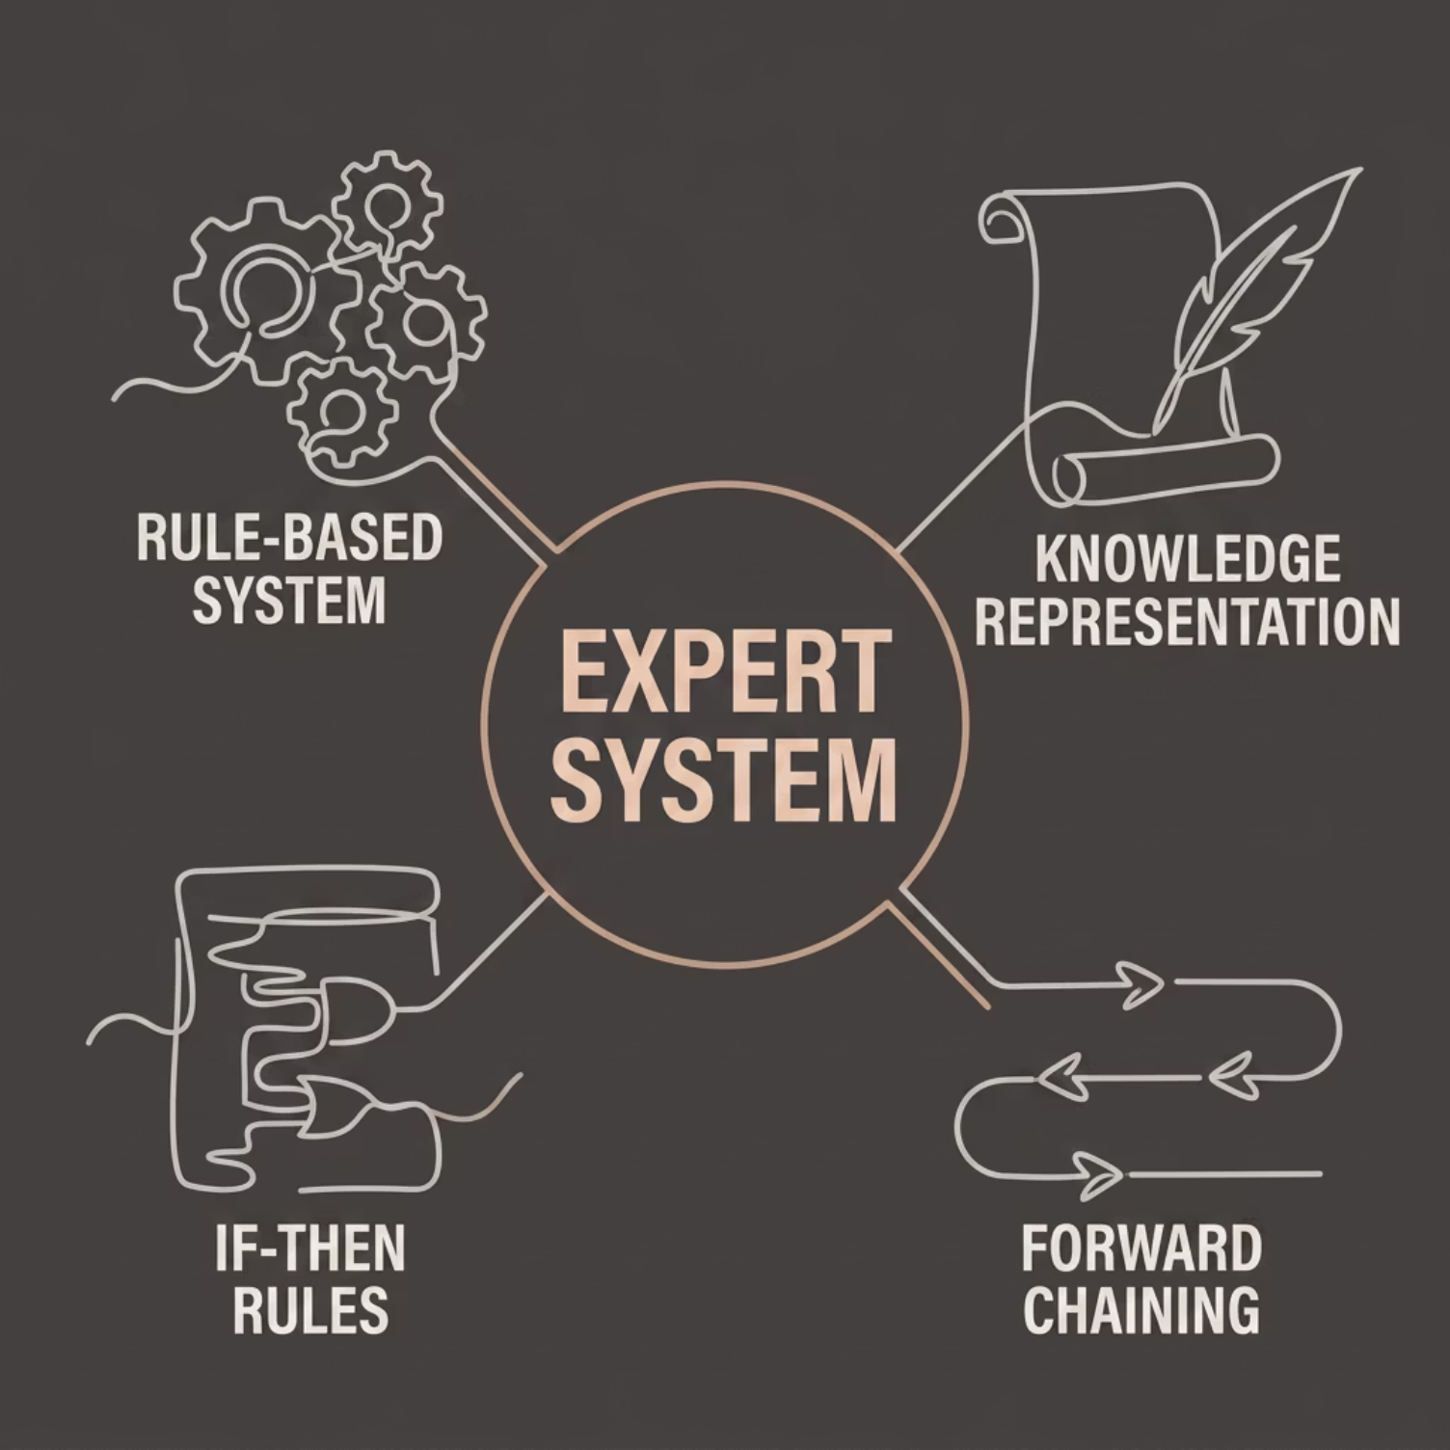

AI Foundation
Core AI Concepts Applied
Expert System
Mimics a human advisor's domain knowledge.
Rule-Based System
Uses predefined logical rules to guide decisions.
IF-THEN Rules
Core inference mechanism: If skill=Python, Then recommend ML project.
Forward Chaining
Data-driven reasoning — starts from inputs to reach conclusions.

Slide 7

How It Works
System Workflow
Student Inputs
Rule Processing
Project Matching
Output Delivered
The system processes student inputs in real time through a JavaScript inference engine. Matching rules fire sequentially using forward chaining, producing a tailored project recommendation complete with difficulty level, required technologies, and curated learning resources — all within seconds.

Slide 8
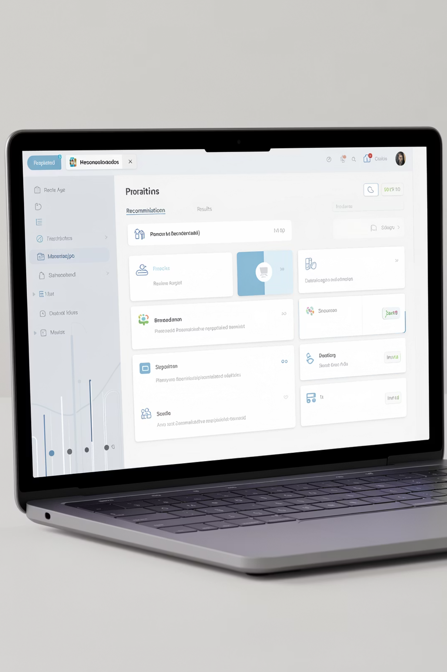



Key Features of the System
Detailed Recommendations
Learning Resources
Curated links to tutorials, documentation, and reference websites.
Full project descriptions with difficulty ratings and tech requirements.
Responsive UI
Clean, beginner-friendly interface that works across all screen sizes.

Slide 9
Impact
Advantages of the System
100%
0$
AI
Personalized
Free to Use
Practical AI
Every recommendation is tailored to the individual student's profile.
Fully open-source, hosted on Netlify — no cost to any student.
Demonstrates real AI concepts in a tangible, accessible web application.
By combining intelligent rule-based logic with a clean, accessible interface, this system helps students save time, reduce confusion, and make confident, well-informed project decisions — all without requiring any prior technical expertise.

Slide 10
What's Next & Conclusion
Future Enhancements & Takeaways
Planned Enhancements
Conclusion
01
This project demonstrates how expert systems and AI rule-based logic can solve real academic challenges. By bridging the gap between student potential and project selection, it showcases the practical power of artificial intelligence in education.
Machine Learning Integration
Adaptive recommendations that improve with usage data.
Intelligent recommendation systems are the future of personalized academic guidance — and this project is a meaningful first step.
02
User Login & Profiles
LINK :https://chetanay1636-afk.github.io/course-project-expert-system/
Save progress, revisit recommendations, and track learning goals.
03
Chatbot & PDF Export
Conversational guidance and downloadable project reports.

