Slide 1
Problem Statement
Create application to select world’s best cricket team based on player’s past performance in T2o world cup 2022

Slide 2
Architecture
Data collection : use web scraping with beautifulsoup form espncricinfo website
Data processing : data cleaning and data transformation with python and pandas
Data Analysis : choose criteria for player selection and use of matplotlib & seaborn for data visualization
Create Interface : use Flask application and create interface
Compare the results and select top 11 players.

Slide 3
Criteria for player selection
Openers
Middle Order
Lower Order
Parameter | Criteria
Batting Average | > 30
Strike Rate | > 140
Innings Batted | > 3
Boundary % | > 50
Batting Position | < 4
Parameter | Criteria
Batting Average | > 40
Strike Rate | > 125
Innings Batted | > 3
Avg. Balls Faced | > 20
Batting Position | > 2
Parameter | Criteria
Batting Average | > 25
Strike Rate | > 130
Innings Batted | > 3
Avg. Balls Faced | > 12
Batting Position | > 4
Innings Bowled | > 1
Parameter | Criteria
Batting Average | > 15
Strike Rate | > 130
Innings Batted | > 2
Batting Position | > 4
Innings Bowled | > 2
Bowling Economy | < 7
Bowling Strike Rate | < 20
Fast Bowler
All-Rounder / Spinner
Parameter | Criteria
Innings Bowled | > 4
Bowling Economy | < 7
Bowling Strike Rate | < 16
Bowling Average | < 20
Dot Ball % | > 40

Slide 4
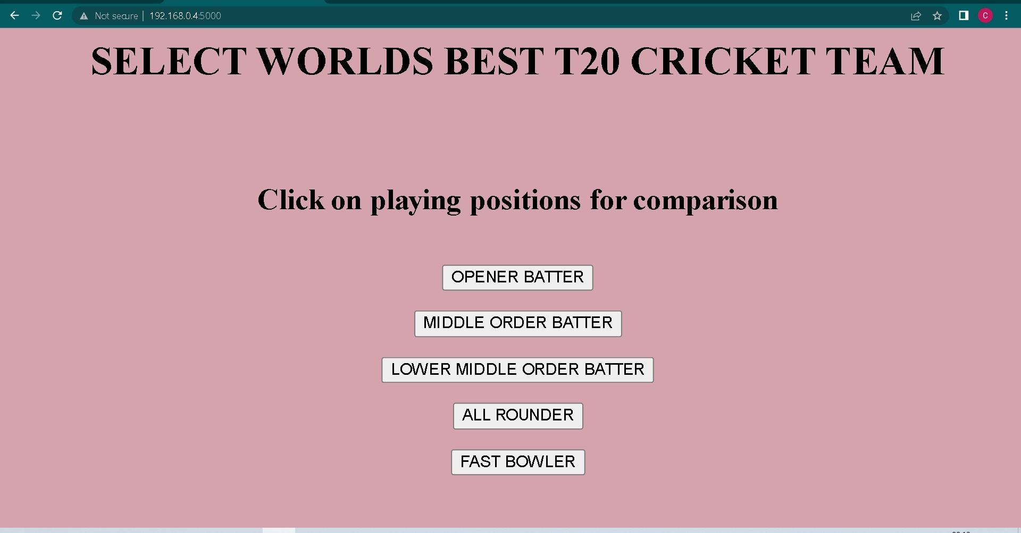
Flask Application Home Page

Slide 5
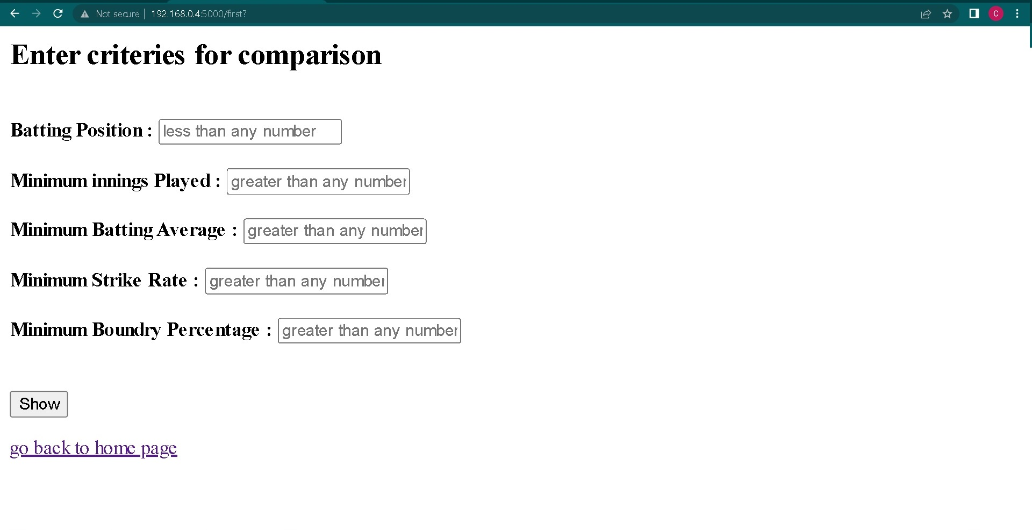
Application page for selecting best openers

Slide 6
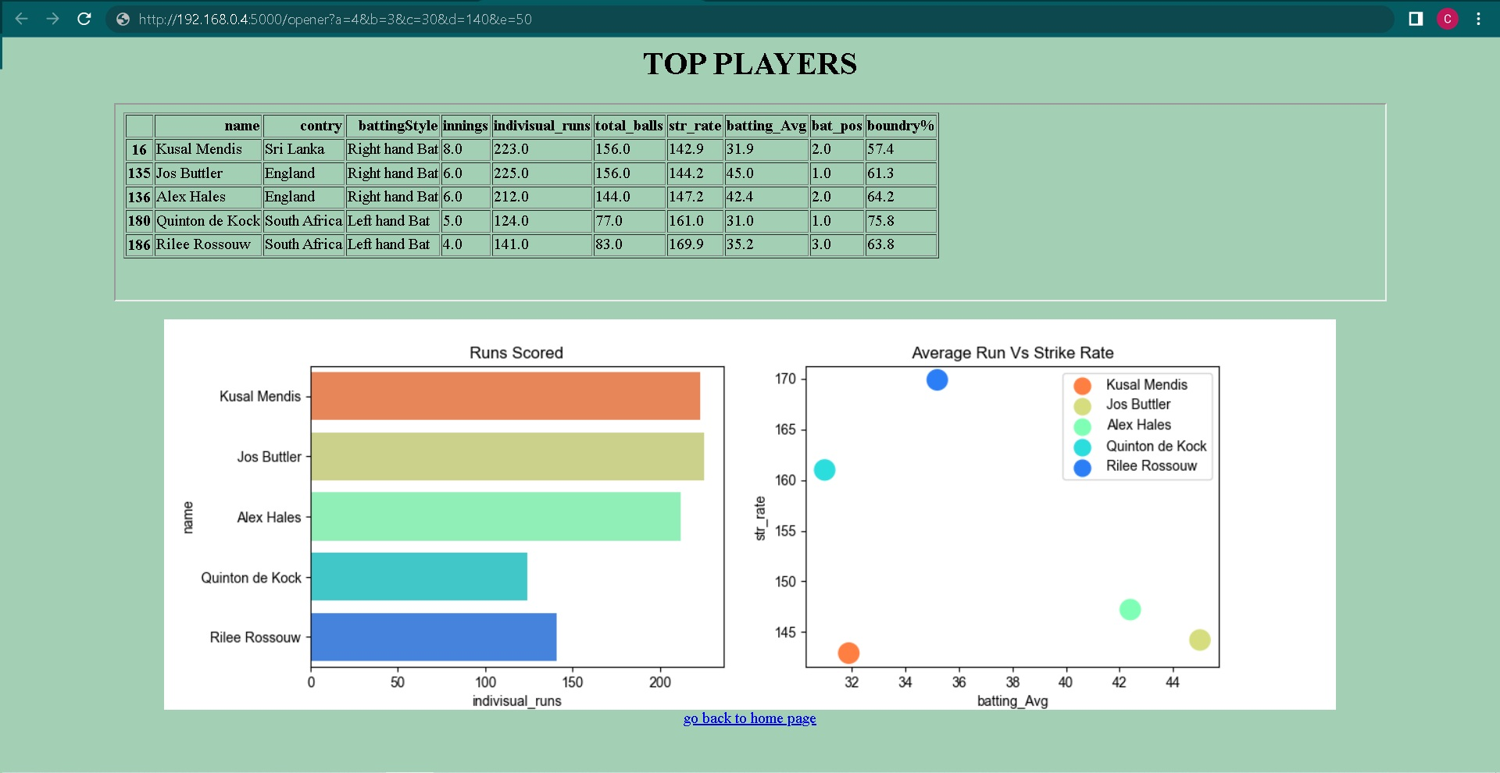
Application result page for comparison

Slide 7

THANK YOU !

