Slide 1
Chapter 4:
Fundamental of Cellular Systems
  Associate Prof. Yuh-Shyan Chen
  Dept. of Computer Science and Information Engineering
  National Chung-Cheng University

Slide 2
Outline
Fundamental of Cellular Systems
Cellular System Infrastructure

Slide 3
Fundamental of Cellular Systems
The same principle of frequency interference avoidance is used in cellular systems with a more powerful transmitting station, or BS.
The shape of the cell can be circular around the microwave transmitting tower.
The radius of the circle is equal to the reachable range of the transmitted signal
  The actual shape of the cell, indicating a true coverage area, may be of a zigzag shape
  The cell is approximated by a hexagon

Slide 4
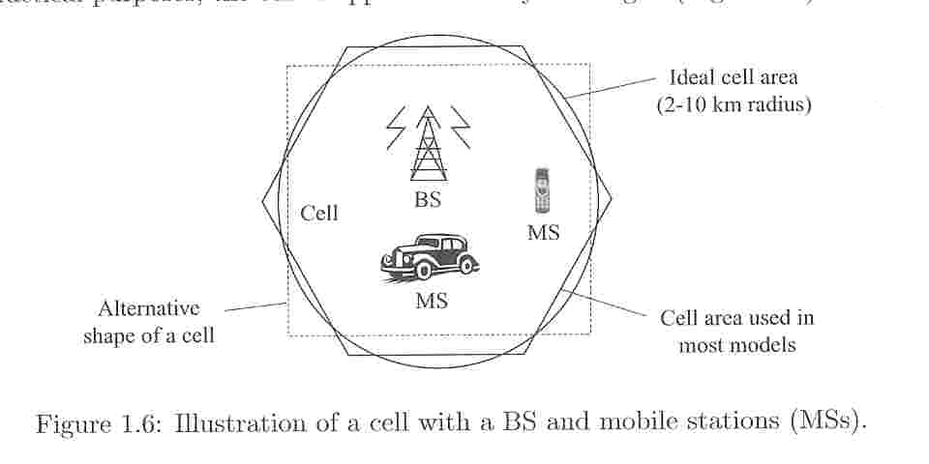
Illustration of a cell with a BS and mobile stations (MSs)

Slide 5
Cellular System
It allows a larger region to be divided into nonoverlapping hexagonal subregions of equal size
  With each one representing a cell area
  The square is another alternative shape
  The triangle is another alternative less frequently used coverage area
  Octagons and decagons do represent shape closer to a circular area as compared to a hexagon (But it is not possible to divide a larger area into nonoverlapping subareas of the same shape)

Slide 6
Multiplexing technique
In each cell area, multiple users or subscribers are served by a single BS
Only a limited amount of bandwidth is allocated for the wireless service
  To increase the effectiveness of the overall system, some kind of multiplexing technique need to be employed

Slide 7
Three basic multiplexing techniques
FDMA (frequency division multiple access)
TDMA (time division multiple access)
CDMA (code division multiple access)

Slide 8
Frequency division multiple access (FDMA)
The allocated frequency band is divided into a number of subbands, called channels.
One channel is allocated by the BS to each user
FDMA is used in all first-generation cellular systems

Slide 9
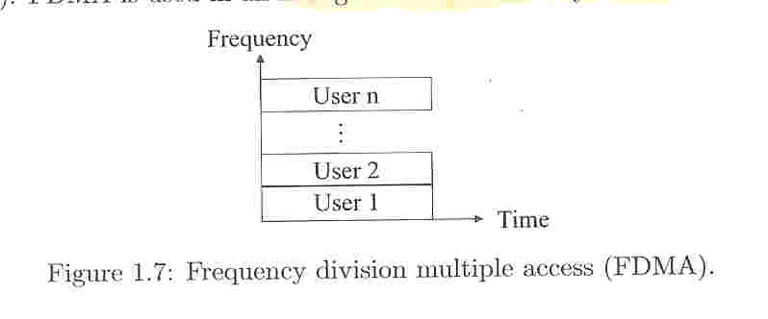
Frequency division multiple access (FDMA)

Slide 10
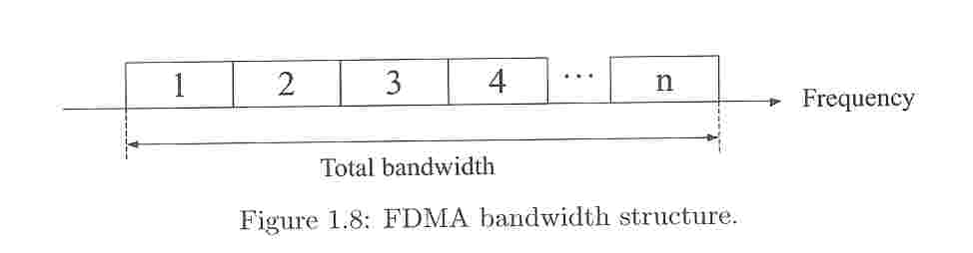
FDMA bandwidth strcuture

Slide 11
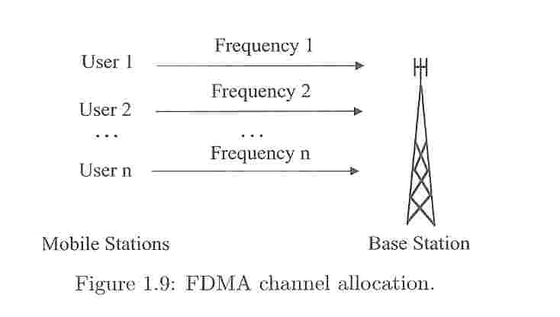
FDMA channel allocation

Slide 12
Time division multiple access (TDMA)
One channel is used by several users, with BS assigning time slots for different users, and each is served in a round-robin method
Most second-generation cellular systems are based on TDMA

Slide 13
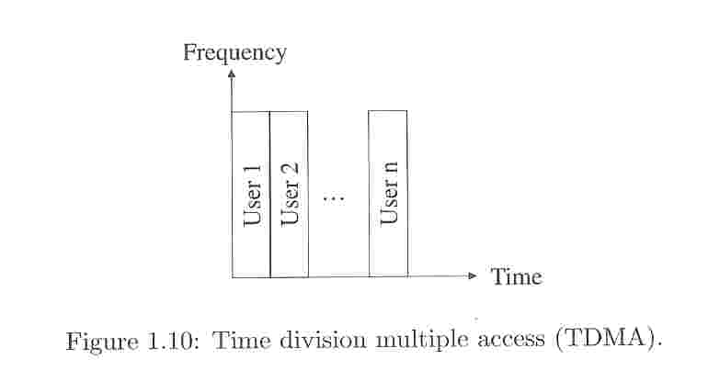
Time division multiple access (TDMA)

Slide 14
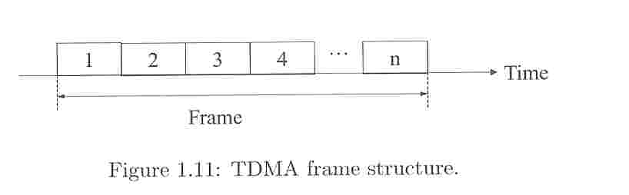
TDMA frame structure

Slide 15
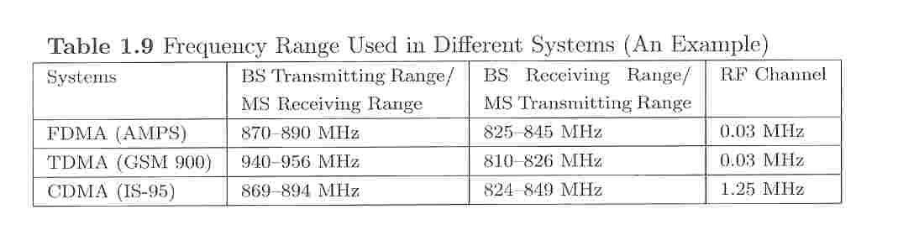
Frequency range in different systems

Slide 16
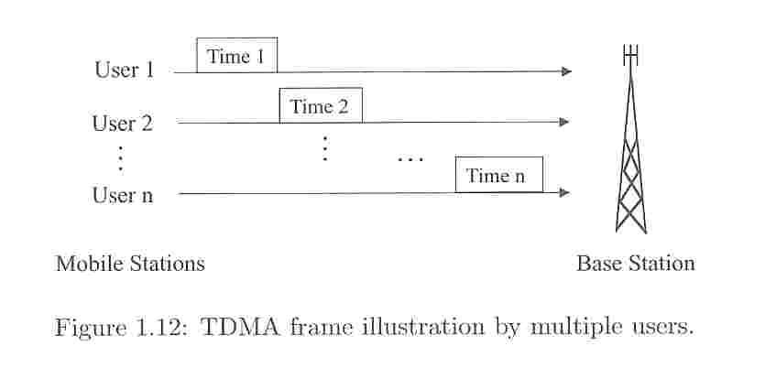
TDMA frame illustration by multiple users

Slide 17
Code division multiple access (CDMA)
The third and most promising CDMA technique utilizes a wider frequency band for each user
As the transmission frequency is distributed over the allocated spectrum, this technique is also known as spread spectrum (展頻)
  One unique code is assigned by the BS to each user and distinct codes are used for different users

Slide 18
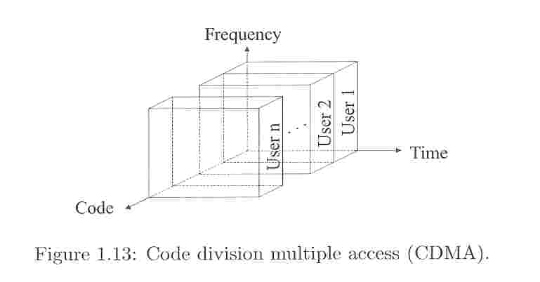
Code division multiple access (CDMA)

Slide 19
CDMA
This code is employed by a user to mix with each bit of information before it transmitted
The same code (or key) is used to decode these encoded bits
Any variation of the code interprets the received information simply as noise

Slide 20
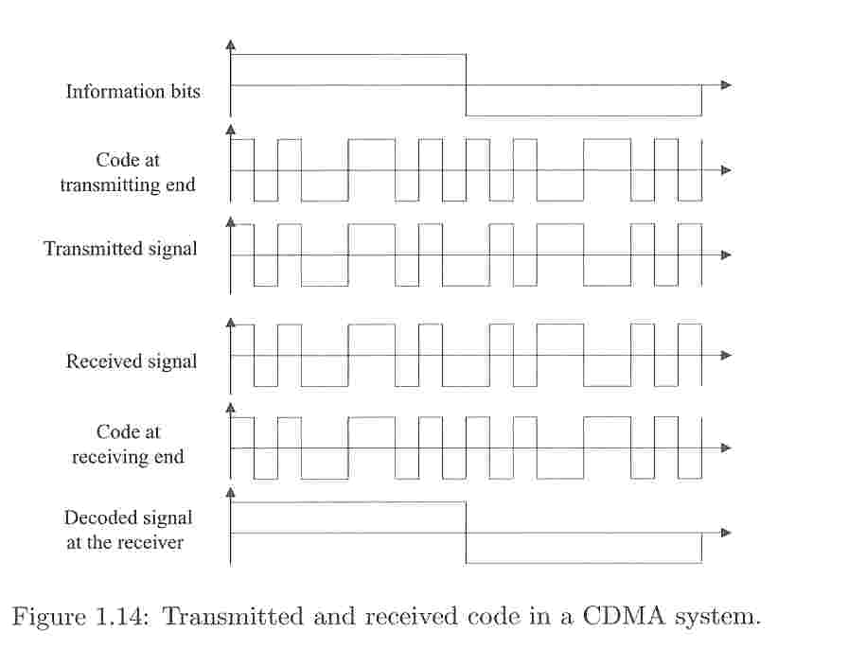
Transmitted and received code in a CDMA system

Slide 21
CDMA
The orthogonality of the codes enables transmission of data from multiple subscribers simultaneously using the full frequency band assigned for a BS
Each receiver is provided the corresponding code so that it can decode the data it is expected to receive
The number of users being serviced simultaneously is determined by the number of possible orthogonal codes that could be generated

Slide 22
CDMA
The encoding step in the transmitter and the corresponding decoding at the receiver make the system design robust but complex

Slide 23
Variants and combinations of FDMA, CDMA, and CDMA
Frequency hopping
  As a combination of FDMA and TDMA in terms of the frequency use and time multiplexing
One user employs one channel for a prespecified time period and then changes to another channel for transmission
  The receiver can tune into the transmitter provided that it also knows the frequency hopping sequence

Slide 24
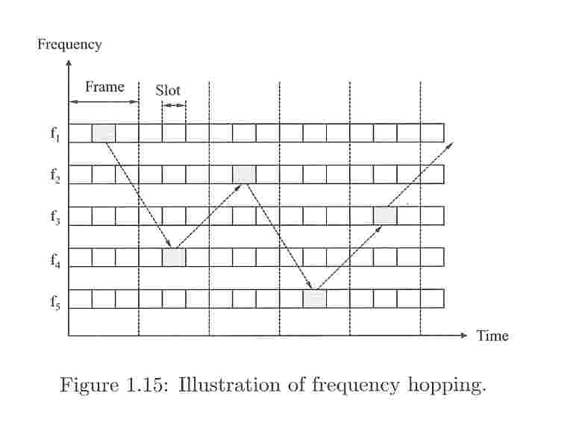
Illustration of frequency hopping

Slide 25
Frequency hopping
The sequence is repeated after all channels to be used in the sequence have been exhausted
For multiple users, different frequency hopping sequences can be used for transmitting information as long as, at any given time, one channel is used by only one user
Primarily introduced for defense purpose
  It was also introduced to avoid the “jamming” effect

Slide 26
Cellular System Infrastructure
Early wireless systems had a high-power transmitter, covering the entire service area
The cellular system replaced a large zone with a number of smaller cells, with a single BS covering a fraction of the area
The wireless device
  Wireless phone, personal digital assistant (PDA), Palm PilotTM, laptop with wireless card, or Web-enabled phone
  For simplicity, it can be called a MS

Slide 27
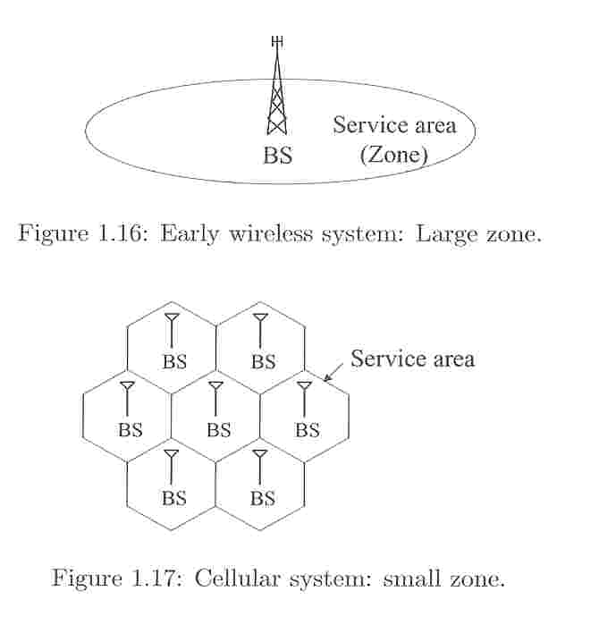
Wireless System: large/small zone

Slide 28
Cellular System Infrastructure
The only underlying requirement is to maintain connectivity with the world while moving, irrespective of the technology used to obtain the ubiquitous access
In a cellular structure, a MS needs to communicate with the BS of the cell where the MS is currently located, and the BS acts as a gateway to the rest of the world

Slide 29
Cellular System
To provide a link
  The MS needs to be in the area of one of the cells (and hence a BS) so that mobility of the MS can be supported
  Several BSs are connected through hardwires and are controlled by a BS controller (BSC), which in turn in connected to a mobile switching center (MSC)
  Several MSCs are interconnected to a PSTN (public switched telephone network) and the ATM (Asynchronous Transfer Mode) backbone

Slide 30
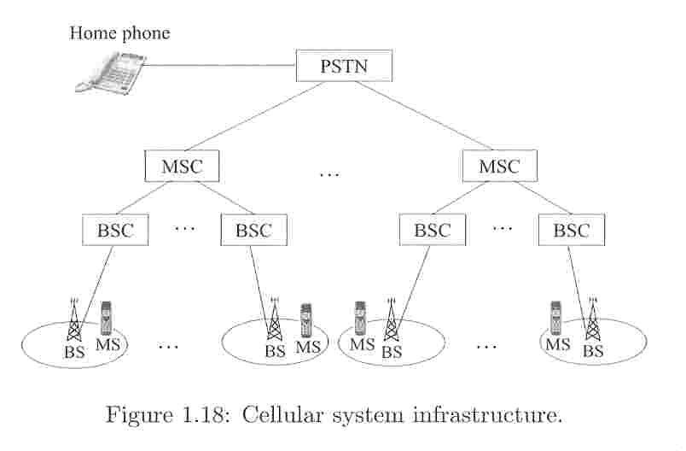
Cellular system infrastructure

Slide 31
Cellular System
A BS consists of a base transceiver system (BTS) and a BSC
  Both tower and antenna are a part of the BTS, while all associated electronics are contained in the BSC
The home location register (HLR) and visitor location register (VLR) are two sets of pointers that support mobility and enable the use of the same telephone number worldwide

Slide 32
HLR/VLR
HLR is located at the MSC where the MS is registered and is where the initial home location for billing and access information is maintained
Any incoming call, based on the called number, is directed to HLR of the home MSC and the HLR redirects the call to the MSC (and the BS) where the MS is currently located
VLR basically contains information about all visiting MSs in that particular MSC area

Slide 33
Four simplex channels
To exchange synchronization and data between BS and MS
  The control links are used to exchange control messages (such as authentication, subscriber information, call parameter negotiations) between the BS and MS
  Traffic channels are used to transfer actual data between the two
The channels from BS to MS are known as forward channels (called downlinks outside America)
Reverse channels (uplinks) is used for communication from MS to BS

Slide 34
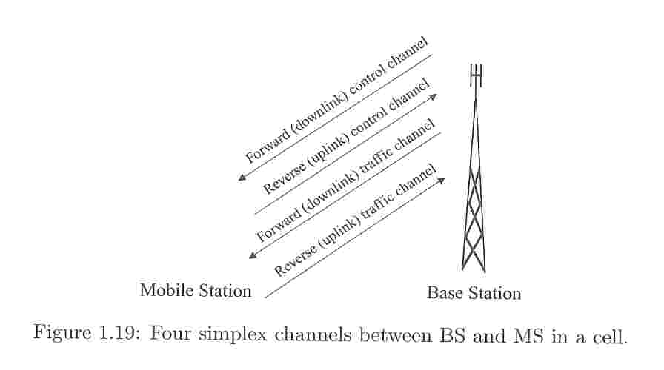
Four simplex channels between BS and MS in a cell

Slide 35
Four simplex channels
Control information needs to be exchanged before actual data information transfer can take place
Simplified handshake steps for call setup are illustrated

Slide 36
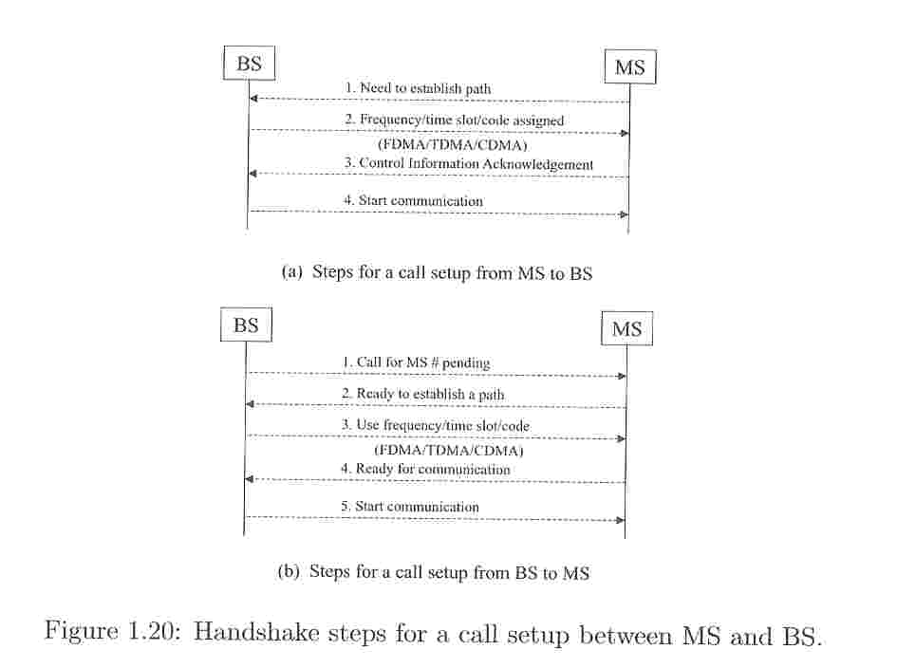

Slide 37
Extensive signal processing
Is required before any signals are transmitted
  We concentrate primarily on the system aspect of wireless data communication

Slide 38
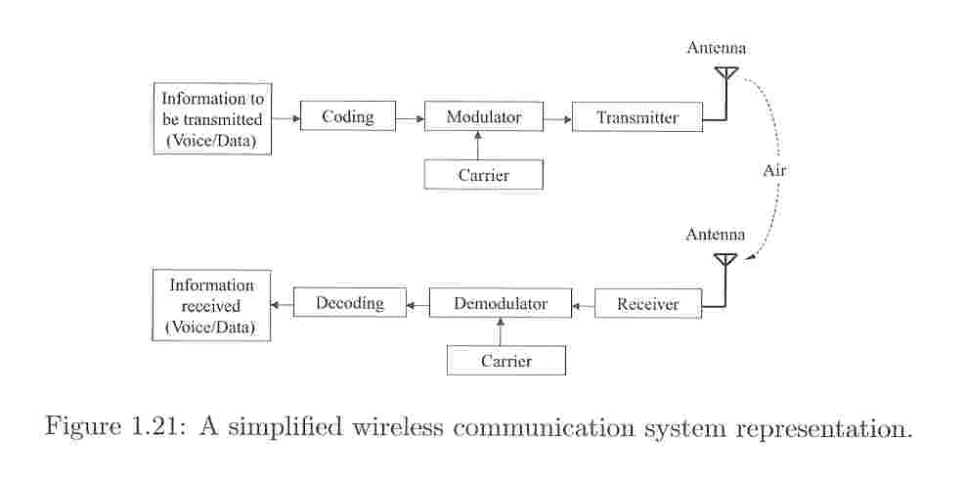
A simplified wireless communication system representation

