Slide 1
Chapter 5:
The Cellular Concept
  Associate Prof. Yuh-Shyan Chen
  Dept. of Computer Science and Information Engineering
  National Chung-Cheng University

Slide 2
Introduction
A cell is formally defined as an area wherein the use of radio communication resources by the MS is controlled by a single BS.
The size and shape of the cell and the amount of resources allocated to each cell dictate the performance of the system to a large extent
  Given the number of users, average frequency of calls being made, average duration of call time

Slide 3
Cell Area
Ideally, the area covered by a cell is a circular cell
Many factors
  Reflection, refraction of the signals, presence of a hill or valley or a tall building, and presence of particles in the air
Actual shape of the cell is determined by the received signal strength in the surrounding area

Slide 4
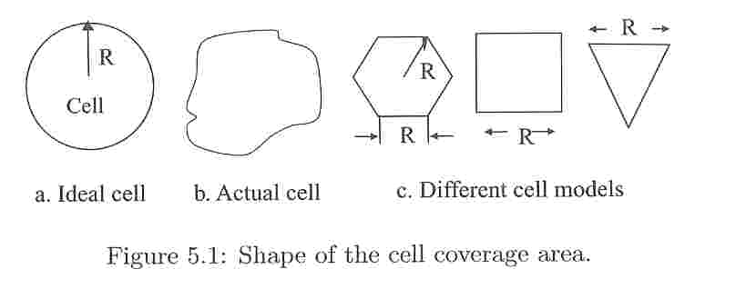
Shape of the cell coverage area

Slide 5
Models
Hexagon, square, and equilateral triangle
In most modeling and simulation
  Hexagons are used
  Square is employed as the second choice

Slide 6
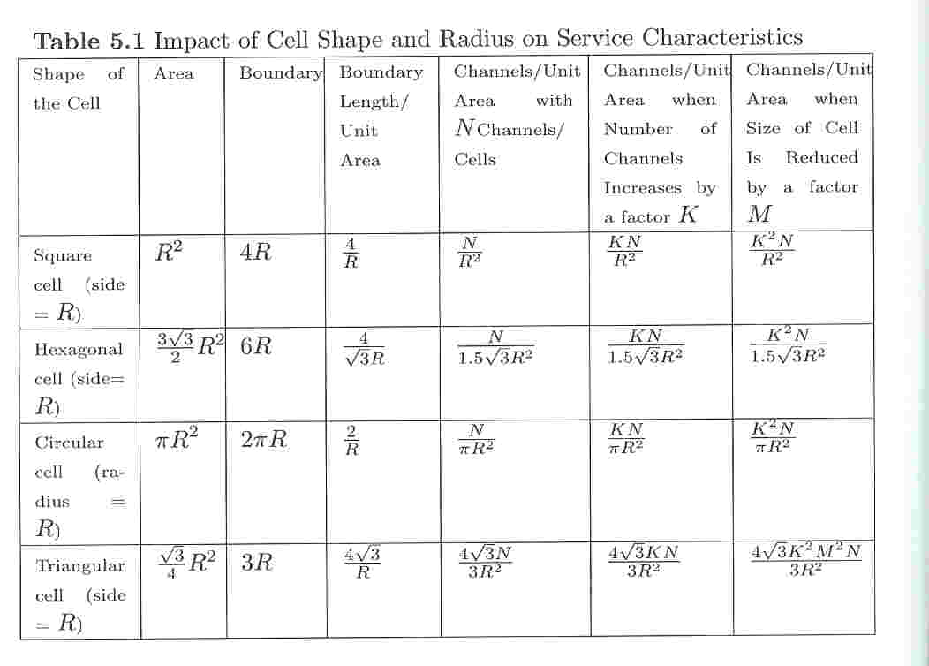
Impact of cell shape and radius

Slide 7
Signal Strength and Cell Parameter
As the MS moves away from the BS of the cell, the signal strength weakens, and at some point a phenomenon known as
  Handoff, hand-off, or hand off
  Handover outside North America

Slide 8
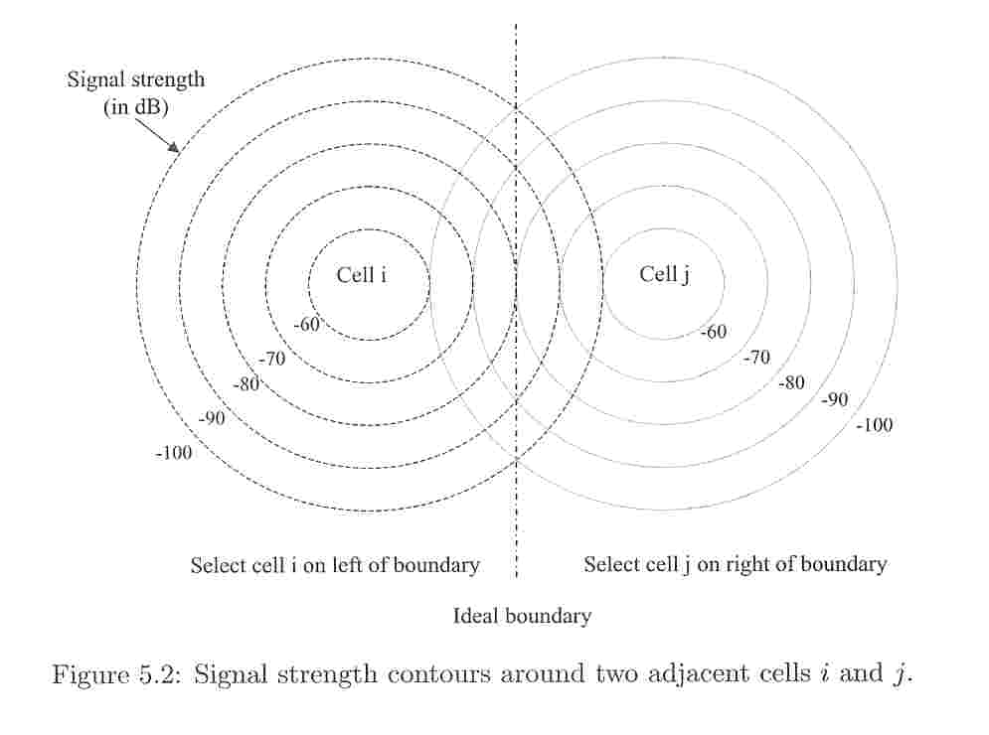
Signal strength contours

Slide 9
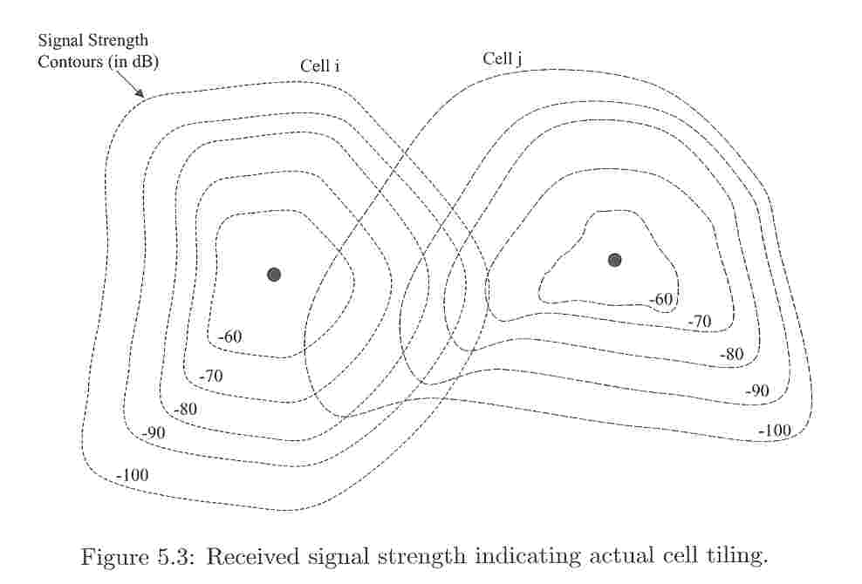
Received signal strength

Slide 10
The received signal strength
The received signal strength at the MS can be approximated by curve as shown in Fig. 5.4

Slide 11
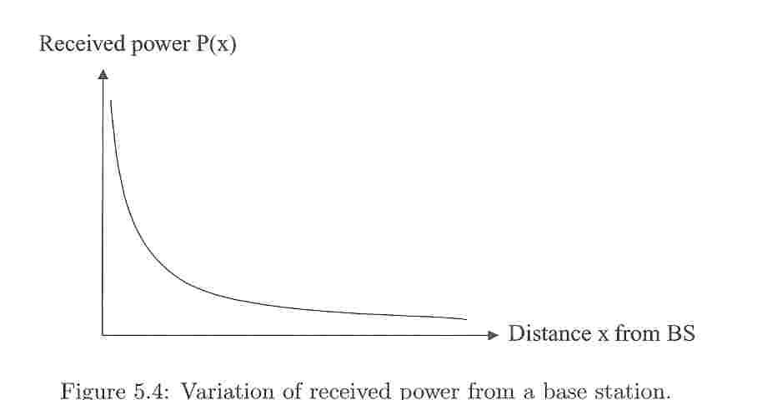
Variation of received power

Slide 12
Handoff
To receive and interpret the signals correctly at the MS, the radio received signals must be at a given minimum power level Pmin.
The MS can be served by either BSi or BSj between points X3 and X4.
If the MS has a radio link with BSi and is continuously moving away toward BSj , then the change of linkage from BSi to BSj is known as handoff

Slide 13
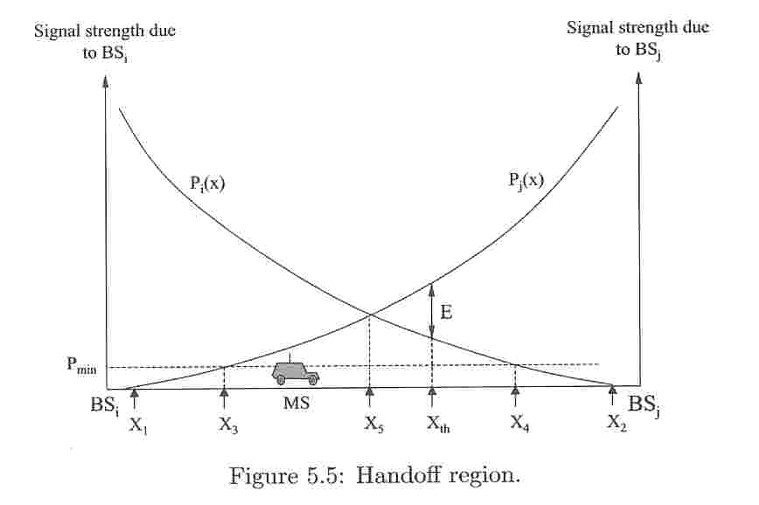
Handoff region

Slide 14
Handoff area
Region X3 and X4
Where to perform handoff procedure depends on many factors
  One option is to do handoff at X5, where two BSs have equal signal strength
  A critical consideration is that the handoff should not take placed too quickly to make the MS change BSi to BSj too frequently if the MS moves back and forth between the two cell areas due to terrain or intentional movements

Slide 15
To avoid the ‘ping-pong’ effect
The MS is allowed to continue maintaining a radio link with the current BSi until the signal from BSj exceeds that of BSi by some prespecified threshold value E

Slide 16
Another factor that influence handoff
Area and shape of the cell
An ideal situation is to have the cell configuration match the velocity of the MSs and to have a larger boundary where the handoff rate is minimal
  The mobility of an individual MS is difficult to predict
  Each MS having a different mobility patterns

Slide 17
Frequency Reuse
Earlier cellular systems employed FDMA, and the range was limited to a radius of from 2 to 20 km
The same frequency band or channel used in a cell can be ‘reused’ in another cell as long as the cell are far apart and the signal strength do not interfere with each other

Slide 18
Example
A typical cluster of seven such cell and four such cluster with no overlapping area is shown in Fig. 5.7.

Slide 19
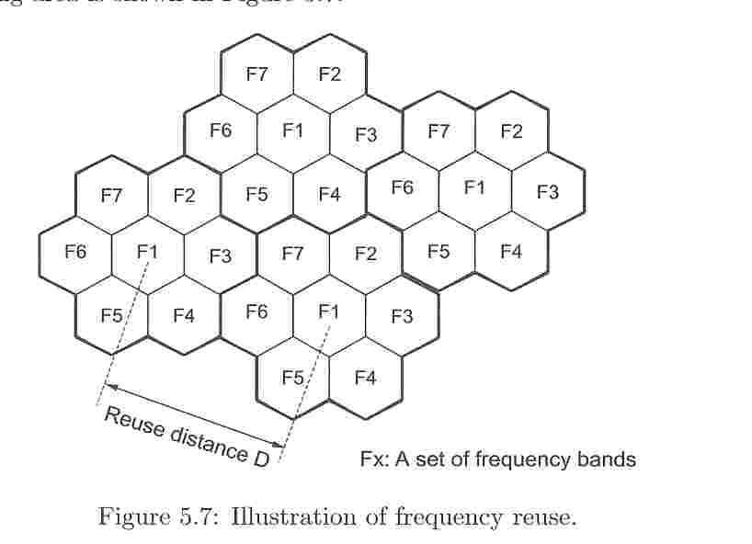
Frequency reuse

Slide 20
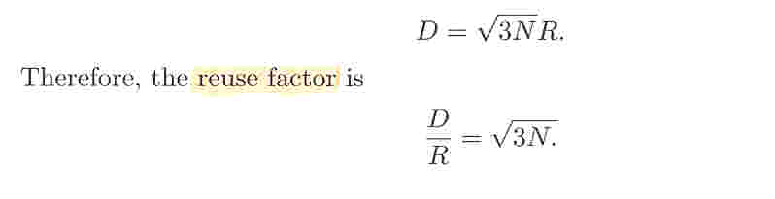
Reuse distance
The distance between the two cells using the same channel is known as the ‘reuse distance’ and is represented by D.
There is a close relationship between D, R (the radius of each cell), and N (the number of cells is a cluster), which is given by

Slide 21
Common reuse pattern
Many possible cluster sizes with different values of N are shown in Fig. 5.9.

Slide 22
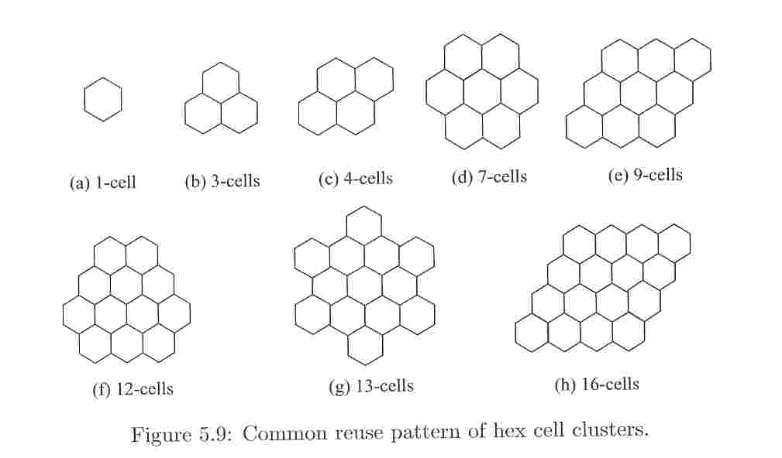
Common reuse pattern

Slide 23
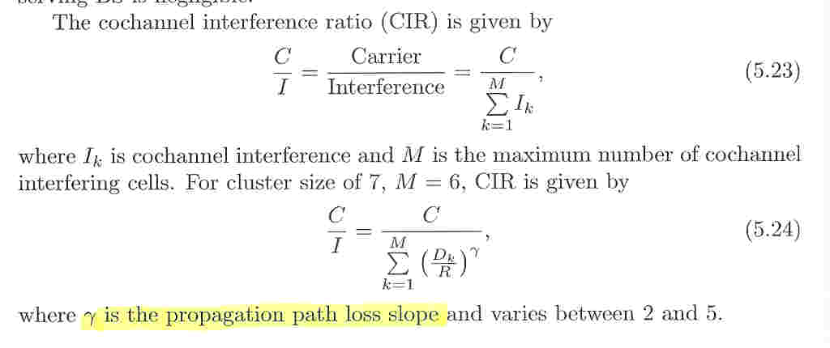
Cochannel Interference

Slide 24
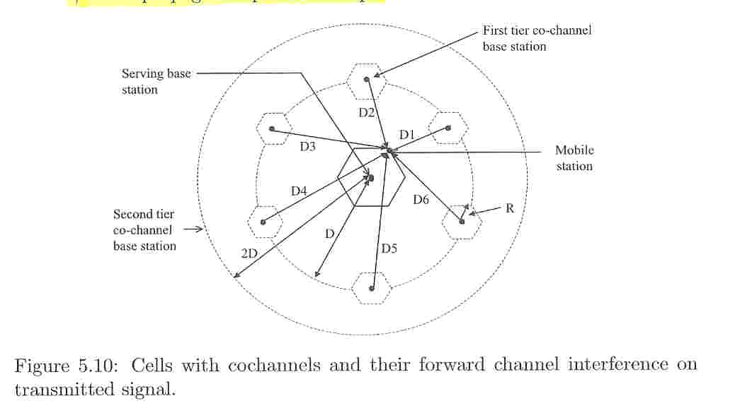
Cells with cochannels and their forward channel interference

Slide 25
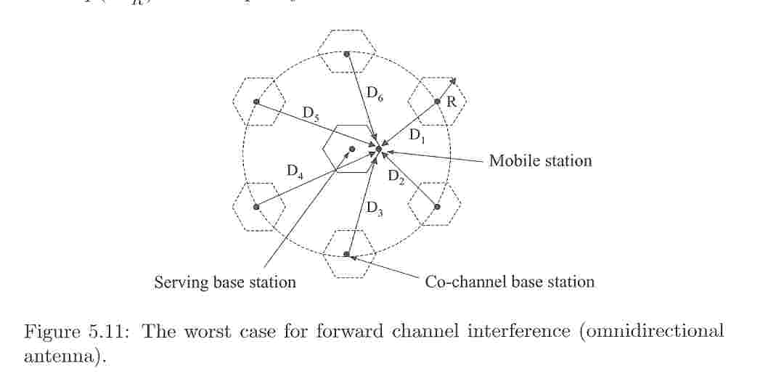
The worst case for forward channel interference

Slide 26
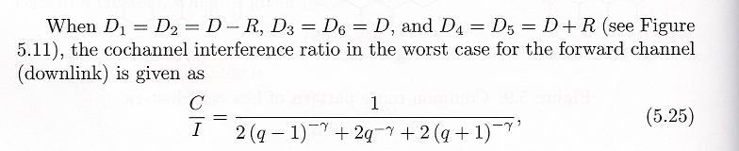
Cochannel interference ratio
Where q = D/R is the frequency reuse factor

Slide 27
To reduce interference
Cell splitting
Cell sectoring

Slide 28
Cell Splitting
One way to cope with increased traffic is to split a cell into several smaller cells
As the coverage area of new split cells is smaller, the transmitting power levels are lower, and this help in reducing cochannel interference.

Slide 29
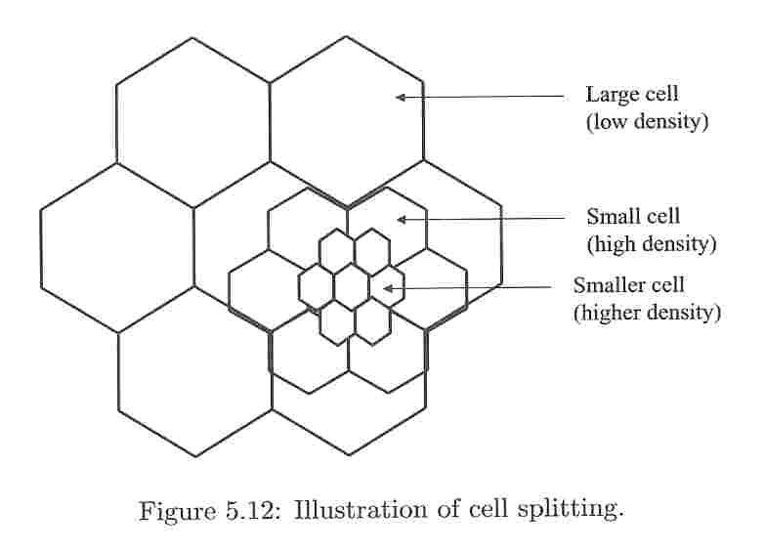
Cell splitting

Slide 30
Cell Sectoring
Omnidirectional antennas
Directional antennas
  It is difficult to design such antennas, and most of the time, an antennas covers an area of 60 degrees or 120 degrees
  Cells served by them are called sectored cells
  Different sizes of sectored cells are shown in Fig. 5.13

Slide 31
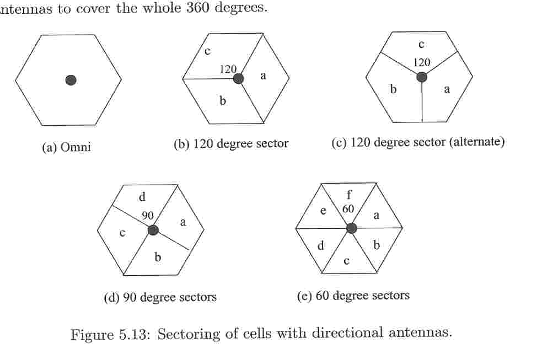
Sectoring of cells with directional antennas

Slide 32
Advantage of sectoring
It requires coverage of a smaller area by each antenna and hence lower power is required in transmitting radio signal
It also helps in decreasing interference between cochannels
It is also observed that the spectrum efficiency of the overall system is enhanced

Slide 33
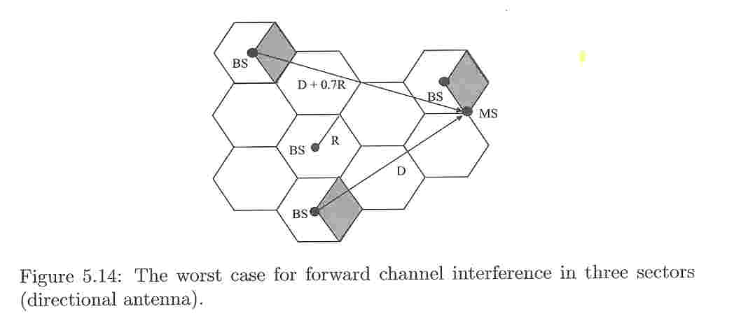
The worst case for forward channel interference

Slide 34
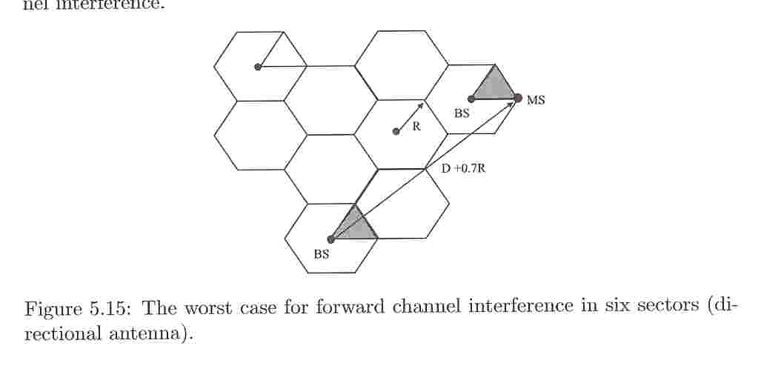
Six sectors

Slide 35
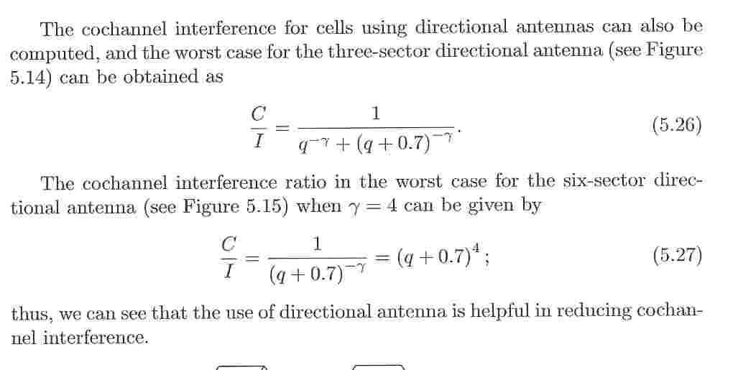
The cochannel interference for cells using directional antennas

Slide 36
Alternative way of providing sectored or omni-cell coverage
By placing directional transmission at the corners where three adjacent cell meet
It may appear that arrangement of Fig. 5.16 may require three times the transmitting towers as compared to a system with tower placed at the center of the cell.

Slide 37
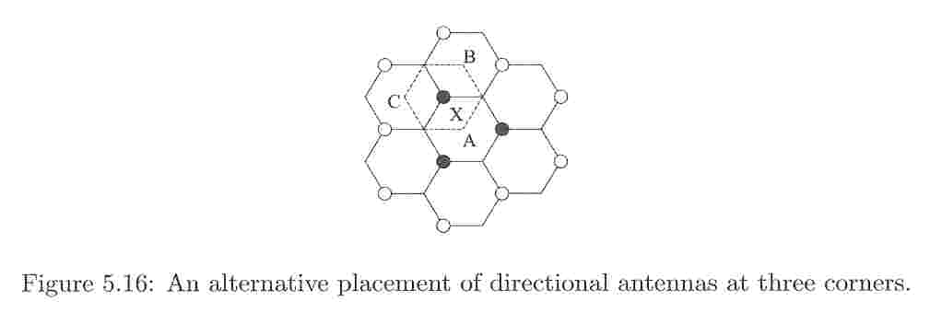
An alternative placement of directional antennas at three corners

