Slide 1
Wireless and Mobile Network Architecture
Chapter 3: Handoff Management Detection and Assignment
Prof. Yuh-Shyan Chen
Department of Computer Science and Information Engineering
National Taipei University
Sep. 2006

Slide 2
Outline
3.1 Handoff Detection
Who initiates the handoff process?
How is the need for handoff detected?
3.2 Strategies for Handoff Detection
MCHO
NCHO
MAHO
3.3 Channel Assignment
Nonprioritized Scheme
Queuing Priority Scheme
Subrating Scheme

Slide 3

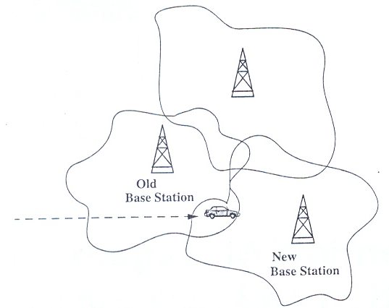
Fig 3.1 Handoff

Slide 4
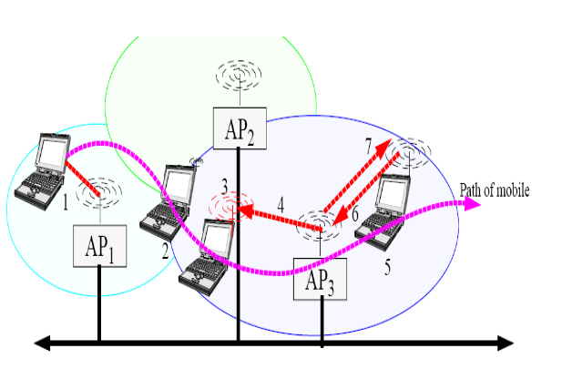
Fig 3.1 Handoff

Slide 5
Introduction
Three issues for handoff management
Handoff detection (ch3)
Channel assignment (ch3)
Radio link transfer (ch4)

Slide 6
3.1 Handoff Detection
To initiate a handoff:
Who initiates the handoff process?
How is the need for handoff detected?
Three measurements are used for handoff management
Word error indicator (WEI)
Received signal strength indicator (RSSI)
80db~100db
Quality indicator (QI)
5db~25db

Slide 7
Three measurements
Three measurements are used for handoff management
Word error indicator (WEI)
Metric that indicates whether the current burst was demodulated properly in the MS.
Received signal strength indicator (RSSI)
Measure of received signal strength.
The RSSI metric has large useful dynamic range 80db~100db
Quality indicator (QI)
Estimate of the “eye opening” of a radio signal, which relates to the signal to interference and noise (S/I) ratio.
The QI metric has narrow range 5db~25db

Slide 8
Cont.
Handoff may depend more reliably on WEI of the current channel than RSSI.
It is necessary to accumulate WEI measurements over a period of time, whereas RSSI is known instantaneously.
To make sure the handoff decision accurately and quickly, it is desirable to use both WEI and RSSI.

Slide 9
Cont.
RSSI measurements are affected by
Distance-depend fading
Lognormal fading
Rayleigh fading (multipath fading)
Ideally, the handoff decision should be based on
Distance-depend fading
Shadow fading
Independent of Rayleigh fading

Slide 10
Cont.
Channel comparison for handoff are based on RSSI and QI metrics.
Filter should be applied on both RSSI and QI metrics.
Window averaging
Leaky-bucket integration

Slide 11
Cont.
Short-term Rayleigh fading is usually handled in mobile system designs by techniques including
Diversity techniques
Multiple receiver
Correlators with variable lines
Antenna diversity
Signal processing techniques
Bit interleaving
Convolutional coding
equalizer

Slide 12
3.2 Strategies for Handoff Detection Mobile-Controlled Handoff (MCHO)
MCHO is employed by lower-tier DECT and PACS.
The MS continuously monitors the signal of the surrounding BSs
When some handoff criteria are met, the MS checks the “best” candidate BS for an available traffic channel and launches a handoff request
Automatic link transfer (ALT)
Handoff between two BSs
Time slot transfer (TST)
Handoff between channels on the same BS

Slide 13
Cont.
The MS receiver generally obtains twp pieces of information: RSSI and QI.
The required handoff time for
DECT is 100 msec to 500 msec.
PACS is 20 msec to 50 msec.

Slide 14
Measurement
process
yes
no
Link-quality
acceptable?
Select new
channel or
time slot
Execute
ALT or TST
Fig 3.2 MS-quality maintenance processing

Slide 15
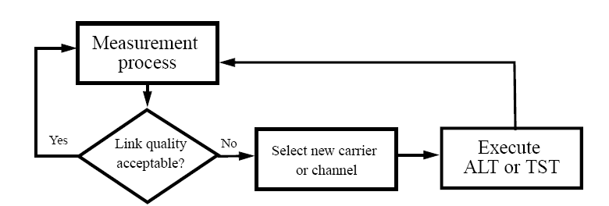
Fig 3.2 MS-quality maintenance processing
Fig 3.2 MS-quality maintenance processing

Slide 16
Network-Controlled Handoff (NCHO)
NCHO is employed by the lower –tier CT-2 plus and high-tier AMPS
The network (MSC) asks all surrounding BSs to measure the signal (RSSI) from the MS and report the measurement results back the network.
The MSs supervise the quality of all current connections by making measurements of RSSI.
The required handoff time can be up to 10 seconds or more.

Slide 17
Mobile-Assisted Handoff (MAHO)
NAHO is employed by the lower –tier CT-2 plus and high-tier GSM, IS-95 CDMA, and IS-136 TDMA
Both the MS and BS supervise the quality of the link
RSSI and WEI values
In GSM, the MS transmits the measurement results to BS twice a second.
When and where to execute handoff is made by the network
BS, MSC or BSC

Slide 18
The GSM handoff execution time is approximately 1 second.

Slide 19
3.2.4 Handoff Failures
Handoff Failures
No channel is available
Handoff is denied by the network
It takes the network too long to set up the handoff
The target link fails in some way during the execution of handoff

Slide 20
3.3 Channel Assignment
Channel assignment schemes attempt to achieve
high degree of spectrum utilization,
least number of database lookups,
simplest algorithm employed in both the MS and network

Slide 21
Cont.
Some trade-offs:
Service quality
Implementation complexity of the channel assignment algorithm
Number of database lookups
Spectrum utilization

Slide 22
Cout.
Successful handoff access is intimately tied to the radio technology of the channel assignment process, which may be
Dynamic channel assignment (DCA)
Fixed channel assignment (FCA)
Quasi-static autonomous frequency assignment (QSAFA)
Blocked call
There are no available channels at a busy BS

Slide 23
3.3.1 Nonpriority Scheme and the Reserved Channel Scheme
Nonprioritized Scheme
The networks handle a handoff in the same manner as a new call attempt
Fig 3.3
Reserved Channel Scheme
Similar to the nonprioritized scheme, except that some channels in each BS are reserved for handoff calls
Fig 3.4

Slide 24
New or
handoff call
arrival
Channel
available?
no
Call blocked
yes
Channel
assigned
Ongoing
call
Channel
released
Fig 3.3 Flowchart for nonprioritized scheme

Slide 25
New
call
arrival
no
Call
blocked
Normal
channel
available?
yes
Channel
assigned
Ongoing
call
Channel
released
yes
yes
Handoff
call
arrival
Normal
channel
available?
no
Reserved
channel
available?
no
no
Fig 3.4 Flowchart for reserved channel scheme

Slide 26
3.3.2 Queuing priority Scheme
Queuing Priority Scheme (Fig 3.5 )
Based on the fact that adjacent coverage areas of BSs overlap
There is a considerable area where a call can be handled by either BS, which is called the handoff area
If no new channel is available in the new BS during handoff, the new BS buffers the handoff request in a waiting queue.
The MS continues to use the channel with the old BS until either a channel in the new BS becomes available

Slide 27
Handoff call
arrival
Ongoing
call
Channel
available?
yes
Channel
assigned
no
Insert the
call into the
waiting queue
Channel
released
New
call
channel
released
Is
a channel
available before
the call
expires
?
Is
the waiting
queue
empty
?
yes
no
no
yes
Call blocked
The channel is idle
Fig 3.5 Flowchart for queuing priority scheme

Slide 28
3.3.3 Subrating Scheme
Subrating Scheme
Creates a new channel on a blocked BS for a handoff access attempt by subrating a existing call.
Fig 3.6

Slide 29
yes
Handoff call
arrival
Channel
available?
Channel
assigned
Ongoing
call
no
Channel
available for subrating
?
yes
Channel
released
Is there a
subrated chan-
nel pair ?
Is
The release
Channel
subrated
?
New
call
channel
released
no
no
yes
no
yes
Call
blocked
Each channel
of the subrated
pair is upgraded
to full-rate channels
The
channel
is idle
The other channel
of the subrated
pair is upgraded
no
yes
Fig 3.6 Flowchart for SRS scheme

Slide 30
3.4 Summary
This chapter described two major issues for PCS handoff management
Handoff detection
Who initiates the handoff process?
How is the need for handoff detected?
Channel assignment
Nonpriority Scheme
Reserved Channel Scheme
Queuing Priority Scheme
Subrating scheme
MBPS scheme

