Slide 1
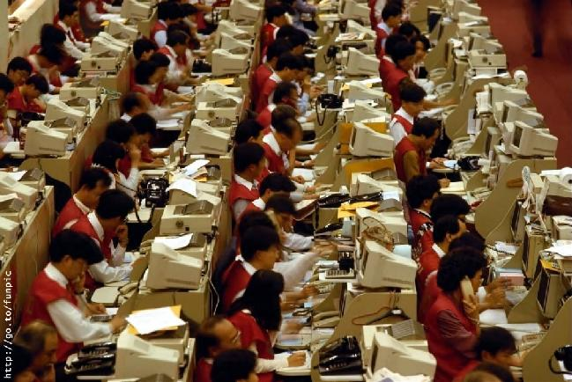
If you are really tired of the daily stress which you have to go through…

Slide 2
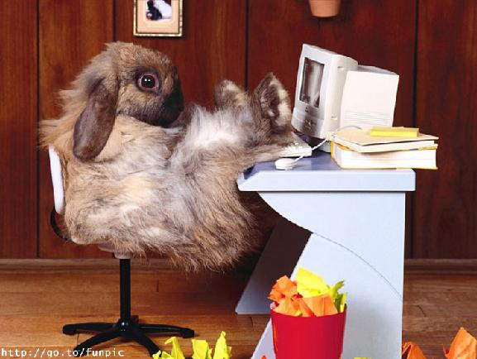

...Relax...
Notes:
HJGHK

Slide 3
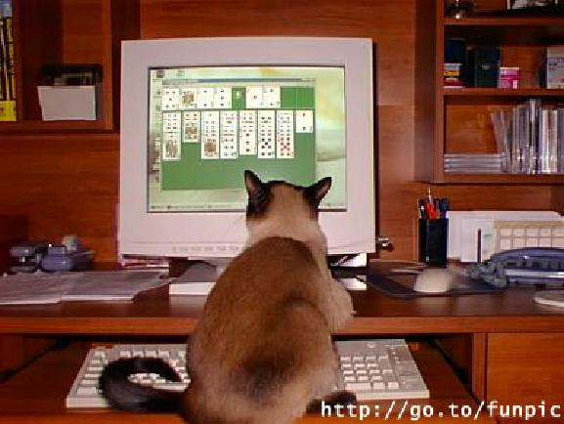
… Play solitaire...

Slide 4
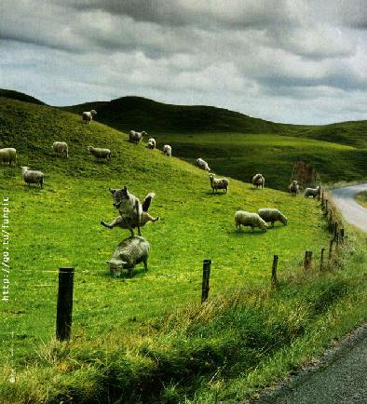
...Enjoy the fields...

Slide 5
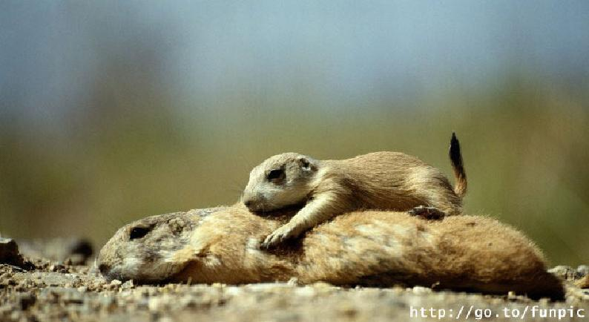
… Get some sun...

Slide 6
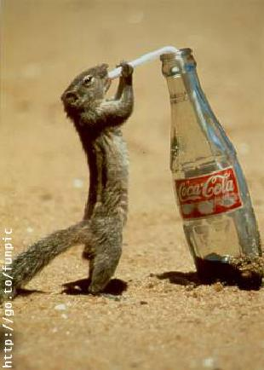
… refresh...

Slide 7
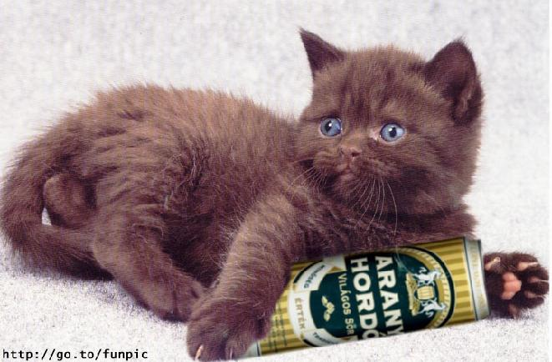
… Have a beer…

Slide 8
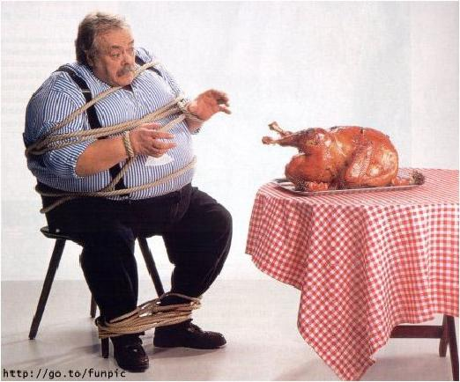
… Get rid of the horrible diets
(after all you are not so fat)...

Slide 9
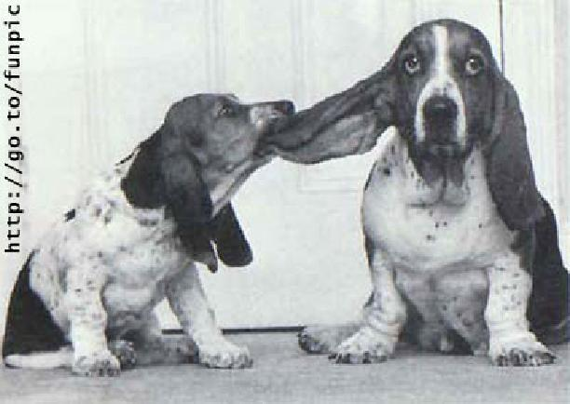
...Don’t unload your anger on others...

Slide 10
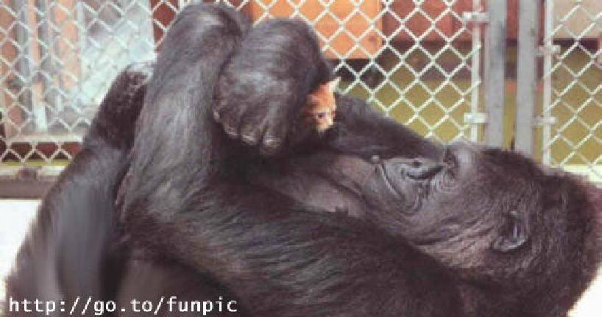
...Never stop loving...

Slide 11
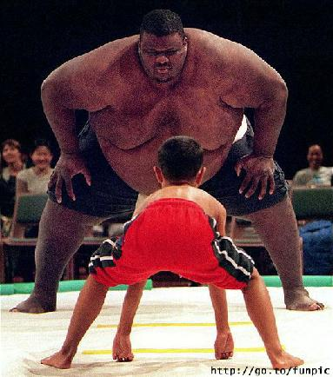
…Don’t be afraid of others, because they are bigger than you.
The real size could be measured in the wisdom.

Slide 12
And finally look in the mirror and think
“I’m beautiful”

Slide 13
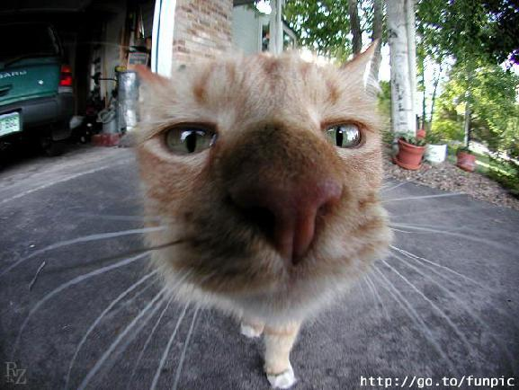
S.R.
Now, enjoy your day !!!

