Slide 1
ILLUSION D’OPTIQUE
1.- Tilt your head onto your right shoulder
2.- Move your face closer to the screen (about 12-15cm) and look closely
3.- If you still cannot see anything, click the mouse again.
====]]\\\\\///////*****<<<<<<<{}{}{}{}{}{}{}{}{}%%%%~~~~~~~~
////////^^!~~~~~::---))))*****+++@@@@@@@@<%||||||@@@@@444
+=+=****&^"""""""}}}}}}}]]]]]]]<<<<<<<%%{{{{{{===**++++**
***++++++++++++++?????????????/////////////%||||||@@@@@444+=+=
****&^"""""""}}}}}}}]]]]]]]<<<<<<<%%////////^^!~~~~~::---))))*****
+++@@@@@@@@<%||||||@@@@@444+=+=****&^"""""""}}}}}}
}]]]]]]]<<<<<<<%%////////^^!~~~~~::---))))*****+++@@@@@@@@
<%/%||||||@@@@@444+=+=****&^"""""""}}}}}}}]]]]]]]<<<<<<<%
%{{{{{{===**++++*****++++++++++++++?????????????/////////////
====]]\\\\\///////*****<<<<<<<{}{}{}{}{}{}{}{}{}%%%%~~~~~~~~
////////^^!~~~~~::---))))*****+++@@@@@@@@<%||||||@@@@@444
+=+=****&^"""""""}}}}}}}]]]]]]]<<<<<<<%%{{{{{{===**++++**
***++++++++++++++?????????????/////////////%||||||@@@@@444+=+=
****&^"""""""}}}}}}}]]]]]]]<<<<<<<%%////////^^!~~~~~::---))))*****
+++@@@@@@@@<%||||||@@@@@444+=+=****&^"""""""}}}}}}
}]]]]]]]<<<<<<<%%////////^^!~~~~~::---))))*****+++@@@@@@@@
<%/%||||||@@@@@444+=+=****&^"""""""}}}}}}}]]]]]]]<<<<<<<%
%{{{{{{===**++++*****++++++++++++++?????????????/////////////

Slide 2
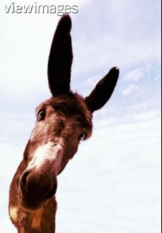
Stop being an idiot and get back to work …!

