Slide 1

Java Regex (Regular Expressions)

Slide 2
Contents
What is Java Regex(Regular expression)
Java Regex Matching
Java Regex Finding
Java Regex Replacing

Slide 3
What is Java Regex(Regular expressions)
Java Regex is used to check pattern matching and perform manipulation on a specific pattern.
For example, this is useful to check number of mobile numbers or email ids in a given text, and replace email ids with some other text, etc…
Java Regex processing is performed by using Pattern, Matcher classes available in java.util.regex package

Slide 4
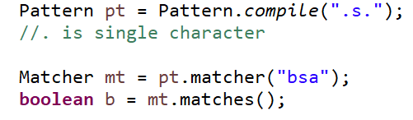
2. Java Regex Matching
This is used to check if a given regex pattern matches with the given full string

Slide 5
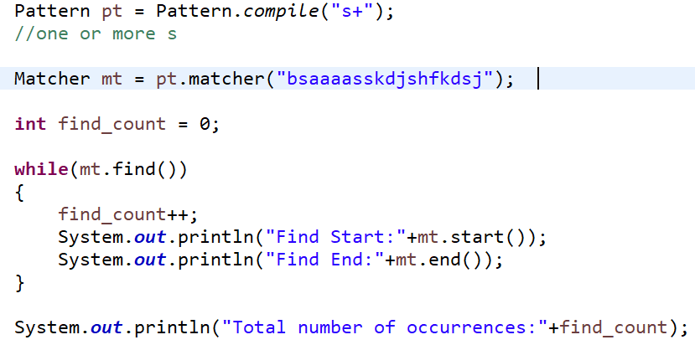
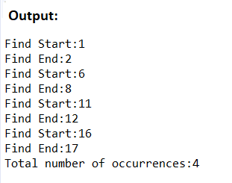
3. Java Regex Finding

Slide 6
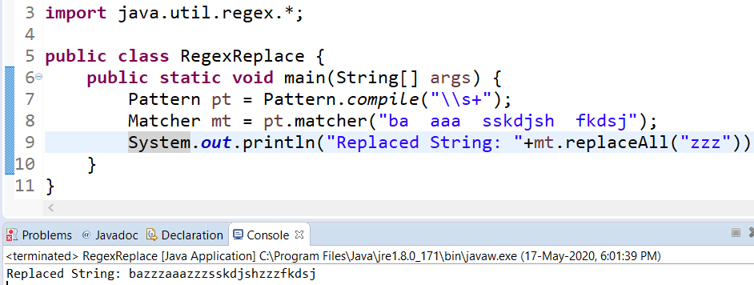
4. Java Regex Replacing
This is used to replace a given pattern with some other string

Slide 7
Thank You!

