Slide 1
Pet Care Demand & Customer Insights
Power BI Analytics Project
Customer engagement • segmentation • pet food demand • subscriptions
11,168
13,087
49,042
60.43%
Customers
Pets
Orders
Active subscription
1

Slide 2
Executive Snapshot
Portfolio-ready summary
11,168
13,087
49,042
1.02bn
60.43%
Total customers
Total pets
Total orders
Total order calories
Active subscription
What the dashboards tell us
• Mature pets generate the largest share of orders, calories, web sessions and wet-food updates.
• Regular and high-frequency customers together account for most orders, indicating a strong repeat-purchase base.
• Superpremium is the largest food-tier contributor, representing 58.18% of orders shown on the overview page.
• Active subscriptions cover 60.43% of customers/pets shown in the dashboard, while 39.57% are non-subscribers.
• Order activity rises strongly over the displayed period, with the highest daily values appearing around late 2019 / early 2020.
Largest demand driver
Mature life stage: about 29K orders and ~0.61bn calories.
Customer behavior
High-frequency and regular segments show the strongest order and engagement volumes.
Commercial opportunity
A 39.57% non-subscriber share leaves a visible audience for subscription conversion campaigns.
2

Slide 3
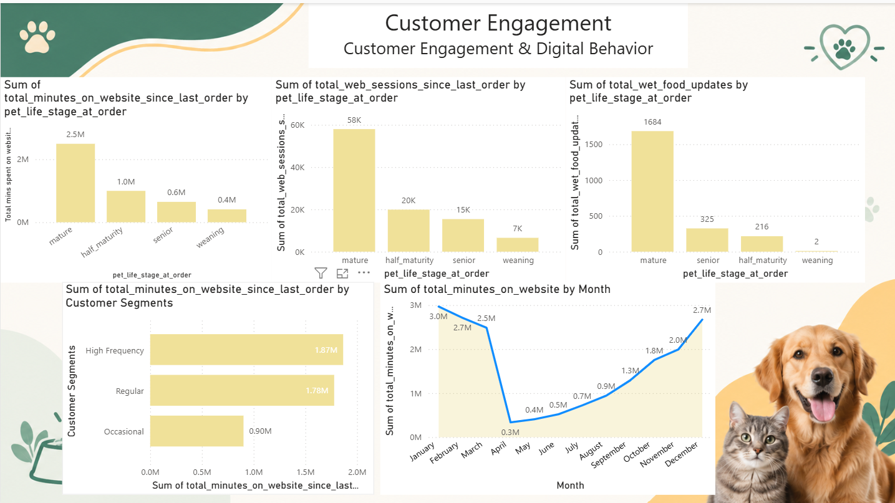
Dashboard 1 — Customer Engagement
Digital behavior & engagement
Key insights
• Mature customers show the highest website engagement: roughly 2.3M minutes and 58K web sessions.
• Half-maturity follows at about 1.0M website minutes and 20K sessions.
• Wet-food updates are concentrated in the mature stage (1,684), far above other life stages.
• High Frequency customers lead website time at about 1.87M minutes, slightly above Regular at 1.78M.
• Engagement dips sharply around April and then climbs through the later months, reaching about 2.7M minutes in December.
3

Slide 4
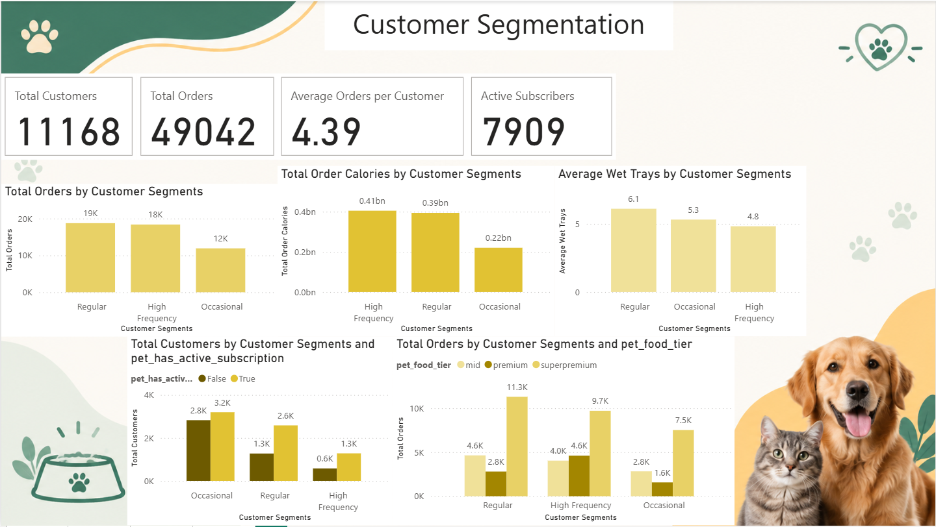
Dashboard 2 — Customer Segmentation
Frequency & value behavior
Key insights
• Regular customers contribute about 19K orders, followed closely by High Frequency at about 18K.
• High Frequency produces the highest total order calories at ~0.41bn, slightly above Regular at ~0.39bn.
• Regular customers have the highest average wet trays (6.1), versus 5.3 for Occasional and 4.8 for High Frequency.
• Subscription penetration is visible across every segment, with the largest customer counts in Occasional and Regular.
• Across food tiers, Regular customers generate the highest order volume; High Frequency customers also show strong premium-tier demand.
4

Slide 5
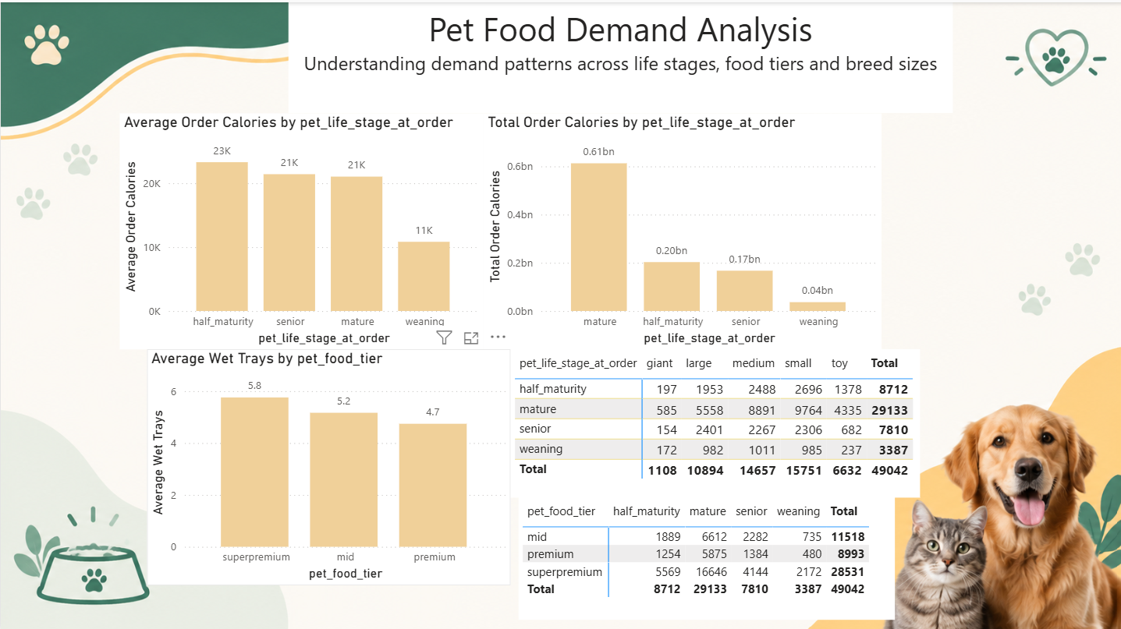
Dashboard 3 — Pet Food Demand Analysis
Life stage • food tier • breed size
Key insights
• Mature pets dominate total order calories at roughly 0.61bn, versus ~0.20bn for half-maturity.
• Average calories per order are highest for half-maturity (~23K), followed by senior and mature (~21K each).
• Superpremium is the largest food tier by orders, with 28,531 orders (58.18%).
• The mature life stage has the highest order volume across breed sizes, especially medium and small pets.
• Wet-tray averages are highest for superpremium (5.8), followed by mid (5.2) and premium (4.7).
5

Slide 6
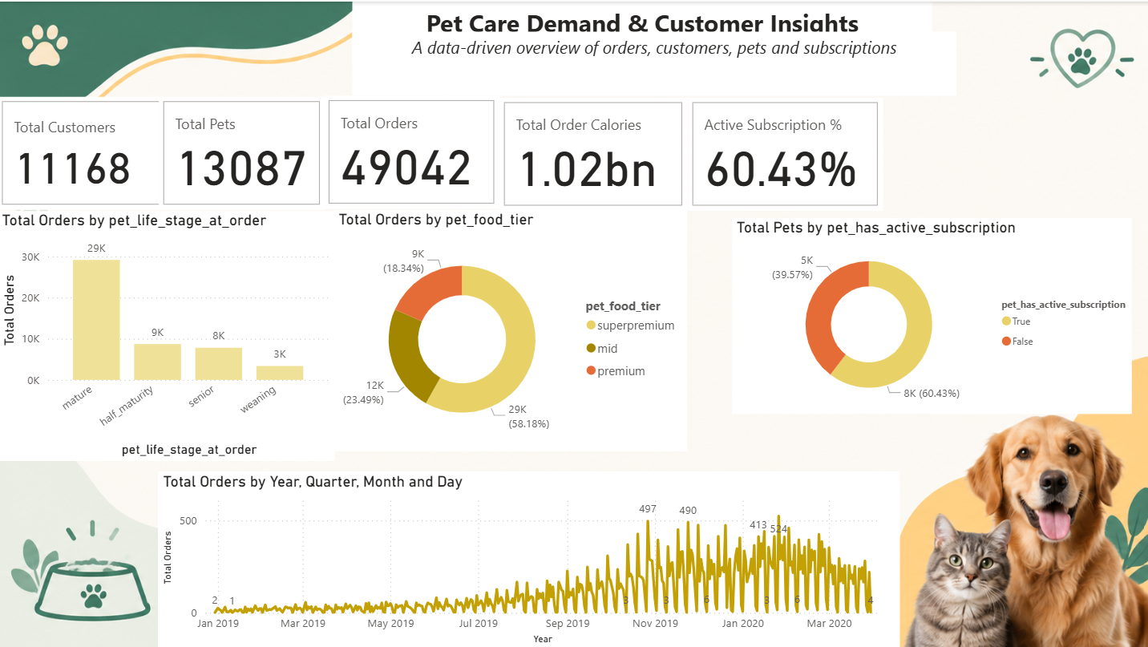
Dashboard 4 — Executive Overview
Orders, customers & subscriptions
Key insights
• The dashboard combines 11,168 customers, 13,087 pets and 49,042 orders into a single management view.
• Active subscription share is 60.43%, while the non-active share is 39.57%.
• Superpremium accounts for 29K orders and 58.18% of the food-tier mix shown.
• Mature pets contribute 29K orders, making life stage a major demand dimension.
• Order activity increases substantially across the displayed timeline, with several late-period daily peaks above 400 orders.
6

Slide 7
Cross-Dashboard Findings
Connecting customer behavior to demand
1 Mature = core demand base
2 Repeat behavior matters
3 Premium mix is strong
Mature life stage leads orders, calories, web sessions, website minutes and wet-food updates.
Regular and High Frequency customers together generate the majority of observed orders.
Superpremium contributes 28,531 orders, or 58.18% of the displayed food-tier mix.
4 Subscription penetration
5 Engagement rebounds
6 Demand is concentrated
60.43% active subscription share indicates subscriptions are already a meaningful part of the customer base.
Website minutes fall sharply around April, then rise steadily toward year-end.
A small number of life-stage and food-tier combinations account for a large share of activity.
Overall analytical takeaway
• Analytical takeaway: segment customers by life stage × frequency × subscription status, then tailor product and retention actions to each combination.
7

Slide 8
Business Recommendations
From dashboard findings to actions
Subscription conversion
Retention of high-value users
Target the 39.57% non-subscriber audience with trials, flexible plans and reorder reminders.
Create loyalty benefits for High Frequency and Regular customers, using order frequency and spend/value signals.
Life-stage personalization
Premium-tier strategy
Prioritize mature-stage product recommendations while building stage-specific bundles for half-maturity and senior pets.
Use the strong superpremium demand to test bundles, cross-sell complementary products and monitor repeat purchase.
Engagement campaigns
Segment-based reporting
Investigate the April engagement dip and replicate the stronger engagement pattern observed later in the year.
Track KPIs by frequency, subscription, life stage, food tier and breed size rather than relying only on overall totals.
8

Slide 9
Conclusion
Final project story
• The dashboards show a strong repeat-order customer base with meaningful subscription penetration.
• Mature pets are the dominant demand and engagement segment across multiple measures.
• Superpremium is the largest food-tier category by order volume.
• Customer frequency and subscription status provide useful dimensions for retention and conversion strategies.
• The Power BI report converts raw transactional data into an actionable view of customers, pets, products and demand trends.
Portfolio positioning
Demonstrates KPI design, segmentation, trend analysis, cross-filtered reporting and business insight generation.
Interview talking point
“I used customer frequency, pet life stage, subscription and food-tier dimensions to identify demand concentration and opportunities for retention and conversion.”
Thank You
9

