Slide 1
C Program Structure: Statements, If else, Looping
IC100
7th November
Lecture 4

Slide 2
Formatting Output of a Program (int)
When displaying an int value, place a number between the % and d which will specify the number of columns to use for displaying the int value (such as %5d).
Output
2345
2345
123
2345
int x = 2345, y=123;
printf("%d\n",x); //Usual
printf("%6d\n",x); //Display using 6 columns
printf("%6d\n",y); //Note: Right aligned
printf("%2d\n",x); //Less columns, same as %d

Slide 3
Formatting Output of a Program (float)
Format placeholder id is %n.mf where
n is the total field width (both before and after the decimal point), and
m is the number of digits to be displayed after the decimal point
Output
3.141592
3.14
3.1416
float pi = 3.141592;
printf("%f\n",pi); //Usual
printf("%6.2f\n", pi); //2 decimal
printf("%.4f\n",pi); //4 decimal
// Note rounding off!

Slide 4

Good and Not so good printf’s
# include <stdio.h>
int main() {
float x;
x=5.67123;
printf(“%f”, x);
return 0;
}
Output
Compiles ok
5.671230
# include <stdio.h>
int main() {
float x;
x=5.67123;
printf(“%d”, x);
return 0;
}
Compiles ok
-14227741
Printing a float using %d option is undefined. Result is machine dependent and can be unexpected. AVOID!
C often does not give compilation errors even when operations are undefined. But output may be unexpected!

Slide 5
Symbolic Constants
#define name text
#include<stdio.h>
#define PI 3.141593
Int main (void){
int radius = 4;
float area;
area = PI * radius * radius;
printf(“area = %f\n”, area);
return 0;
}

Slide 6


Likely printf Exam Questions
Print some pattern we give you, not necessarily these ones

Slide 7
Scanf Review
Note the & before the variable name. DO NOT FORGET IT.
scanf("%d", &km);
String in " " contains only the placeholders corresponding to the list of variables after it.
Best to use one scanf statement at a time to input value into one variable.

Slide 8
Scanf Addendum
Can input mutliple fields with one scanf
scanf("%d %d", &month, &day);
But can be frustrating to debug
White space is skipped for consecutive numeric reads
But not skipped for character inputs
printf("Enter an integer and a float, then Y or N\n> ");
scanf("%d%f%c", &i, &f, &c);
Enter 12 23.4 N
i = 12, f = 23.4, c =
Enter 12 23.4N to get it right
Can input mutliple fields with one scanf
scanf("%d %d", &month, &day);
But can be frustrating to debug
White space is skipped for consecutive numeric reads
But not skipped for character inputs
printf("Enter an integer and a float, then Y or N\n> ");
scanf("%d%f%c", &i, &f, &c);
Enter 12 23.4 N
i = 12, f = 23.4, c =
Enter 12 23.4N to get it right
Easier to use separate inputs for different variables

Slide 9
Other basic I/O commands
getchar()
Command to accept a single character as input
Syntax: variable = getchar();
Useful as an interactivity device
User prompt
Conditional behaviour
putchar()
Command to print a single character as output
Syntax: putchar(variable);
Not as useful, limited applications

Slide 10
Reading and Writing Strings
A string is an array of characters
E.g. “Hello, how are you?”
Declared with syntax
char x[LENGTH_OF_STRING];
C has special I/O functions for strings
Use gets() for string input
Use puts() for string output
int main(){
char line[80];
gets(line);
puts(line);
}

Slide 11
Writing strings with printf
Straightforward
Use %s instead of %c as a placeholder
printf(“%s”, line)

Slide 12
Reading strings with scanf
Not straightforward
Has trouble handling white spaces
Remember to leave white space in format string for character inputs
scanf(“ %s”, line)
Input “This is a line”
Stores “This”
Fixes
Use a custom placeholder
Defined using syntax %[^\n]

Slide 13
Debugging Workflow
Fix syntax errors
Fix execution errors
Fix logic errors

Slide 14
Fixing Syntax Errors
Two kinds
That break the compiler
Compiler will tell you what to fix
Compilation failed. 03de8b00-63e2-11e7-9c5c-0242ac110004.c:11:12: warning: missing terminating '"' character [-Winvalid-pp-token] printf("Input amount: Rs %d/n/n, amount);
That don’t
You see where the error is in the output
Input amount: Rs 4324/n/n2 notes of Rs. 2000
#include <stdio.h>
int main(){
// declarations
scanf("%d",&amount);
printf("Input amount: Rs %d/n, amount);
printf("%d notes of Rs. %d/n", notes_1, N1); // likewise for others
// calculations
return 0;
}

Slide 15
Fixing Syntax Errors
Caught by the compiler
Compiler will tell you what to fix
error.c:3:26: error: expected ';' after expression
Examples:
Missing a semicolon
Missing a closing quotation mark
Unbalanced bracket
Comment closes inappropriately
Etc.

Slide 16
Fixing Execution Errors
Runtime errors
Usually caused by bad syntax or poor exception handling
Compiler not helpful
No output to look at (Segmentation fault ☹)
Examples
Numerical overflow or underflow
Division by zero
Attempting to compute logarithm or square root of a negative number
Array buffer overflow
Etc.

Slide 17
Use Comments
Comment out all but the most innocuous code
Program will now execute normally
Without accomplishing anything
#include <stdio.h>
int main(){
// declarations
//scanf("%d",amount);
//printf("Input amount: Rs %d\n”, amount);
//printf("%d notes of Rs. %d\n", notes_1, N1); // likewise for others
// calculations
return 0;
}

Slide 18
Uncomment Statements One by One
The statement that triggers the execution error is the problem
Focus on that statement’s syntax and fix it
#include <stdio.h>
int main(){
// declarations
scanf("%d",&amount);
//printf("Input amount: Rs %d\n”, amount);
//printf("%d notes of Rs. %d\n", notes_1, N1); // likewise for others
// calculations
return 0;
}

Slide 19
Use Bisection Method
Comment out the second half of the code
An execution error indicates an error in the first half
Successful execution indicates an error in the second half

Slide 20
Fixing Logical Error: Tracing
Print out intermediate outputs where they are computed
Differences from expected values show errors in logic
#include <stdio.h>
int main(){
// declarations
// I/O
notes_1 = amount/N1;
printf(“%d”, notes_1);
amount = amount%N1;
return 0;
}

Slide 21
Other Techniques
Watch variables
Useful for programs with loops
Help identify when in the execution problems are occurring
Breakpoints
Temporary stopping point within a program
Stepping
Execution of one instruction at a time
Read about gdb
https://www.gnu.org/software/gdb/

Slide 22
Operators
Operators are the building blocks of expressions
Have their own syntax
We will learn this syntax the next few lectures

Slide 23
Types of operators
Arithmetic
Unary
Relational and logical
Assignment
Conditional

Slide 24
Arithmetic Operators
Operate on int, float, double (and char)
Op | Meaning | Example | Remarks
+ | Addition | 9+2 is 11
 |  | 9.1+2.0 is 11.1
- | Subtraction | 9-2 is 7
 |  | 9.1-2.0 is 7.1
* | Multiplication | 9*2 is 18
 |  | 9.1*2.0 is 18.2
/ | Division | 9/2 is 4 | Integer division
 |  | 9.1/2.0 is 4.55 | Real division
% | Remainder | 9%2 is 1 | Only for int
Notes:
- -9%10 = -9; -10%10=0; So % computes the remainder with the positive part and then adds the negative sign.

Slide 25
The % operator
The remainder operator % returns the integer remainder of the result of dividing its first operand by its second.
Both operands must be integers.
Defined only for integers (int and long)
4%2 is 0
31%4 is 3

Slide 26
Implicit Type Casting in C Arithmetic
General rule for mixed type arithmetic
Final result will have highest possible precision consistent with operand types
Small boxes 🡪 big boxes
Examples
float + double = double
float + long double = long double
int + float = float
char + float = float
...

Slide 27
Explicit Type Casting in C Arithmetic
Can cast an arithmetic expression to a specific data type
Syntax (data type) expression;
E.g. ((int) f) % 2

Slide 28
Precedence and Associativity for Arithmetic Expressions
Precedence | Operators
High | * / %
Low | + -
e.g. a – b / c * d = a – ((b/c)*d)
Like in regular arithmetic, can use brackets to clarify correct order of operations, e.g. (a-b)/(c*d)
Associativity goes left 🡪 right for arithmetic expressions

Slide 29
Types of operators
Arithmetic
Unary
Relational and logical
Assignment
Conditional

Slide 30
Unary operators
Operator | Description
- | Negative of an expression
++/-- | Increment/decrement a variable
sizeof | Output memory box size for a variable
type | Type-casting

Slide 31
Unary Operators - Negative
Operators that take only one argument (or operand)
-5
-b
Observe that – is both an arithmetic and unary operator
Meaning depends on context
This is called overloading

Slide 32
Unary Operators – Increment and Decrement
Increment (++) increases a variable by 1
Decrement (--) – decreases a variable by 1
Both work on all variable types
Syntax
++variable is the pre-increment operator
Means increment, then use
variable++ is the post-increment operator
Means use, then increment
int main(){
char a = ‘A’; float b = 3.31;
printf("%c\t%f\n",++a,b++);
printf("%c\t%f",--a,b--);
return 0;
}
B 3.31
A 4.31

Slide 33
Unary operators - sizeof
Syntax
sizeof var
sizeof(type)
Returns size of the operand in bytes
sizeof(char) will return 1
sizeof(float) will (mostly) return 4
Very useful when you are porting programs across computers

Slide 34
Unary Operators - typecast
Syntax
(type) var
We have already seen this
What will be the output of this program?
int main(){
double a = 67.2;
printf("size is %d\n", sizeof a); printf("size is %d\n", sizeof((char) a)); printf("%c", (char) a);
return 0;
}
Size is 8
Size is 1
C

Slide 35
Precedence
Above arithmetic operators, only below brackets
If a is 1 and b is 2, what will a + -b be evaluated as?
-1

Slide 36
Associativity
From right to left
Important to remember this
Most other operators’ associativity is left to right
What will this program print?
int main(){
int a = 1;
printf("%d", - ++a);
return 0;
}
-2

Slide 37
Types of operators
Arithmetic
Unary
Relational and logical
Assignment
Conditional

Slide 38

Relational Operators
Compare two quantities
Work on int, char, float, double…
Operator | Function
> | Strictly greater than
>= | Greater than or equal to
< | Strictly less than
<= | Less than or equal to
== | Equal to
!= | Not equal to

Slide 39
Examples
Rel. Expr. | Result | Remark
3>2 | 1
3>3 | 0
‘z’ > ‘a’ | 1 | ASCII values used for char
2 == 3 | 0
‘A’ <= 65 | 1 | 'A' has ASCII value 65
‘A’ == ‘a’ | 0 | Different ASCII values
(‘a’ – 32) == ‘A’ | 1
5 != 10 | 1
1.0 == 1 | AVOID | May give unexpected result due to approximation
Avoid mixing int and float values while comparing. Comparison with floats is not exact!

Slide 40
Example
Problem: Input 3 positive integers. Print the count of inputs that are even and odd.
Do not use if-then-else
INPUT
10
5
3
OUTPUT
Even=1
Odd=2
int a; int b; int c;
int cEven; // count of even inputs
scanf(“%d%d%d”, &a,&b,&c); // input a,b,c
// (x%2 == 0) evaluates to 1 if x is Even,
// 0 if x is Odd
cEven = (a%2 == 0) + (b%2 == 0) + (c%2 == 0);
printf(“Even=%d\nOdd=%d”, cEven, 3236+
-cEven);
0

Slide 41
Logical Operators
Logical Op | Function | Allowed Types
&& | Logical AND | char, int, float, double
|| | Logical OR | char, int, float, double
! | Logical NOT | char, int, float, double
Remember
value 0 represents false.
any other value represents true. Compiler returns 1 by default

Slide 42
Truth Tables
E1 | E2 | E1 && E2 | E1 || E2
0 | 0 | 0 | 0
0 | Non-0 | 0 | 1
Non-0 | 0 | 0 | 1
Non-0 | Non-0 | 1 | 1
E | !E
0 | 1
Non-0 | 0

Slide 43
Examples
Expr | Result | Remark
2 && 3
2 || 0
‘A’ && ‘0’
‘A’ && 0
‘A’ && ‘b’
! 0.0
! 10.05
(2<5) && (6>5)

Slide 44
Examples
Expr | Result | Remark
2 && 3 | 1
2 || 0 | 1
‘A’ && ‘0’ | 1 | ASCII value of ‘0’≠0
‘A’ && 0 | 0
‘A’ && ‘b’ | 1
! 0.0 | 1 | 0.0 == 0 is guaranteed
! 10.05 | 0 | Any real ≠ 0.0
(2<5) && (6>5) | 1 | Compound expr

Slide 45
Precedence and associativity
Not has same precedence as equality operator
And and Or are lower than relational operators
Or has lower precedence than And
Associativity goes left to right
2 == 2 && 3 == 1 || 1==1 || 5==4 is true

Slide 46
Operator Precedence
Operators | Description | Associativity
(unary) + - ++ -- (type) sizeof ! | Unary operators (e.g. unary plus/minus), logical Not | Right to left
* / % | Multiply, divide, remainder | Left to right
+ - | Add, subtract | Left to right
< > >= <= | Relational operators | Left to right
== != | Equal, not equal | Left to right
&& | And | Left to right
|| | Or | Left to right
HIGH
INCREASING
LOW
Notes:
Operators on the same line have the same PRECEDENCE (relative ranking).
Associativity= direction of processing.
Unary ops have higher precedence than binary.

Slide 47
Practice Questions
int main(){
int a = 7;
printf("%d\n", a++ * a++);
return 0;
}
56
int main(){
int a = 10;
printf("%d\n", ++a + ++a);
return 0;
}
23
int main(){
int a = 10;
a = a++;
printf("%d\n", a);
return 0;
}
10

Slide 48
Types of Operators
Arithmetic
Unary
Relational and logical
Assignment
Conditional

Slide 49
Assignment Operator
Basic assignment
variable = expression
Variant | Meaning
Var += a | Var = Var + a
Var -= a | Var = Var – a
Var *=a | Var = Var *a
Var /=a | Var = Var/a
Var %=a | Var = Var%a

Slide 50
Precedence
Always the last to be evaluated
x *= -2 *(y+z)/3
x = x*(-2*(y+z)/3)
Seldom need to worry about it

Slide 51
Operator Precedence
Operators | Description | Associativity
(unary) + - … ! | Unary plus/minus etc, logical Not | Right to left
* / % | Multiply, divide, remainder | Left to right
+ - | Add, subtract | Left to right
< > >= <= | Relational operators | Left to right
== != | Equal, not equal | Left to right
&& | And | Left to right
|| | Or | Left to right
= | Assignment | Right to left
HIGH
INCREASING
LOW
Notes:
Operators on the same line have the same PRECEDENCE (relative ranking).
Associativity= direction of processing.
Unary ops have higher precedence than binary.

Slide 52

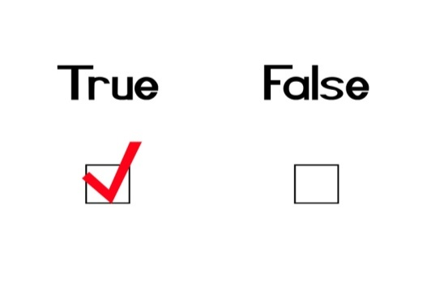
Class Quiz
What is the value of expression:
Compile time error
Run time crash
False (0)
True (1)
0 <= 10 <= 4
The correct answer is

Slide 53
Types of Operators
Arithmetic
Unary
Relational and logical
Assignment
Conditional

Slide 54
Conditional Operator
Special form of assignment
Syntax
expression 1? expression 2 : expression 3
2 is executed if 1 is true, 3 is executed if 1 is false
Typically paired with assignment
var min = (f<g) ? f : g
Precedence right above assignment
Associativity is right to left
Read two integer number print user and show him the bigger number ?

Slide 55
Operator Precedence
Operators | Description | Associativity
(unary) + - … ! | Unary plus/minus etc., logical Not | Right to left
* / % | Multiply, divide, remainder | Left to right
+ - | Add, subtract | Left to right
< > >= <= | Relational operators | Left to right
== != | Equal, not equal | Left to right
&& | And | Left to right
|| | Or | Left to right
? : | Conditional | Right to left
= | Assignment | Right to left
HIGH
INCREASING
LOW
Notes:
Operators on the same line have the same PRECEDENCE (relative ranking).
Associativity= direction of processing.
Unary ops have higher precedence than binary.

Slide 56
Types of Operators
Arithmetic
Unary
Relational and logical
Assignment
Conditional
Combine operators to form expressions

Slide 57
Arithmetic library functions
Function | Type | Purpose
abs(i) | int | Return the absolute value of an integer
ceil(d) | double | Round up to closest higher integer value
floor(d) | double | Round down to closest lower integer value
log(d) | double | Return natural log of a number
pow(d1,d2) | double | Return d1 raised to the power d2
rand() | int | Return a random integer
sqrt(d) | double | Return the square root of a number
Have to include the header files stdlib.h and/or math.h for several of these
Typical syntax : variable = function(variable, variable ....);
Compile the code as $ cc filec.c -lm

Slide 58
Sample Usage
#include <stdio.h>
#include <stdlib.h>
int main() {
int n;
double m;
n = rand() % 10 + 1; // random number
printf("%d\n", n);
m = pow(n,2); // raised to 2
printf("%f\n", m);
m = sqrt(n); // natural log
printf("%f\n", m);
return 0;
}
4
16.00
2.00

Slide 59
Practice Program
Write a C program to read a rupee amount (integer value) and break it up into the smallest possible number of bank notes
Assume bank notes are in the denominations 2000, 500, 100, 50, 20, 10 and 5
Do not use if else

Slide 60
Final Program
#include <stdio.h>
int main(){
const int N1 = 2000, N2 = 500, N3 = 100, N4 = 50, N5 = 20, N6 = 10, N7 = 5;
int notes_1, notes_2, notes_3, notes_4, notes_5, notes_6, notes_7;
int amount; // input amount
scanf("%d",&amount);
printf("Input amount: Rs %d\n\n", amount);
// calculations
notes_1 = amount/N1; amount = amount%N1;
notes_2 = amount/N2; amount = amount%N2;
notes_3 = amount/N3; amount = amount%N3;
notes_4 = amount/N4; amount = amount%N4;
notes_5 = amount/N5; amount = amount%N5;
notes_6 = amount/N6; amount = amount%N6;
notes_7 = amount/N7; amount = amount%N7;
printf("%d notes of Rs. %d\n", notes_1, N1);
printf("%d notes of Rs. %d\n", notes_2, N2);
printf("%d notes of Rs. %d\n", notes_3, N3);
printf("%d notes of Rs. %d\n", notes_4, N4);
printf("%d notes of Rs. %d\n", notes_5, N5);
printf("%d notes of Rs. %d\n", notes_6, N6);
printf("%d notes of Rs. %d\n", notes_7, N7);
return 0;
}

Slide 61
Output
Input amount: Rs 4234
2 notes of Rs. 2000
0 notes of Rs. 500
2 notes of Rs. 100
0 notes of Rs. 50
1 notes of Rs. 20
1 notes of Rs. 10
0 notes of Rs. 5

Slide 62
Limitations
Using only arithmetic expressions
Can’t handle exceptions
Can’t handle cases
Can’t run the program over and over
Solutions
Conditional statements
Switch-case
Loops
Using only unitary variable declarations
Have to write out expressions for all variables individually
Solution
Arrays

Slide 63
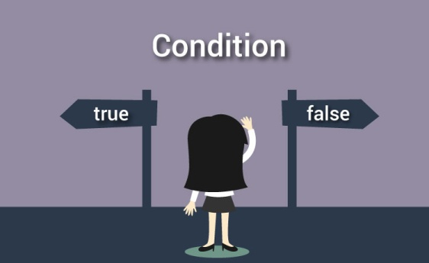
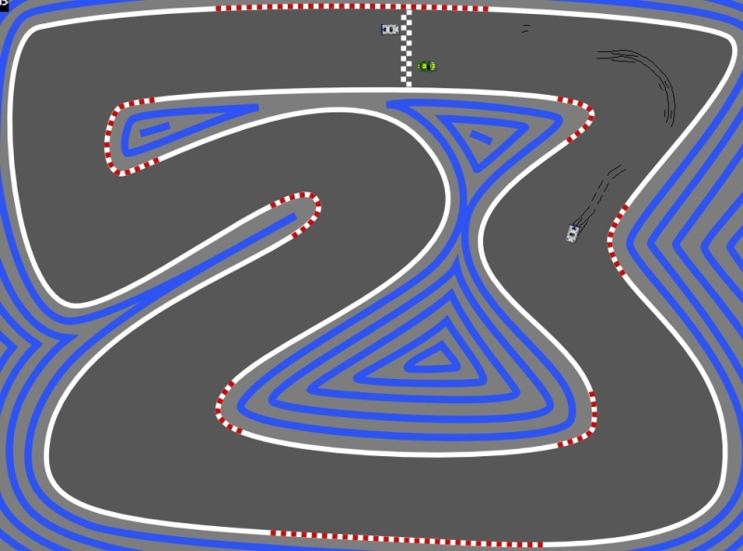

Control Statements
Branching
Looping

Slide 64
Control Statements
Flow of control so far
Top to bottom
#include <stdio.h>
#include <stdlib.h>
int main() {
int n;
double m;
scanf(“%d”,&n);
m = log(n); // natural log
printf("%f\n", m);
return 0;
}

Slide 65
Branching: Use Case
What happens when n is negative?
#include <stdio.h>
#include <stdlib.h>
int main() {
int n;
double m;
scanf(“%d”,&n);
m = log(n); // natural log
printf("%f\n", m);
return 0;
}

Slide 66
Goto Statement
Can ask program to skip to a particular arbitrary location in your code
Syntax –
goto label;
label: expression;
Program control goes to the statement beginning with the label in the goto statement

Slide 67
Solving the Use Case
#include <stdio.h>
#include <stdlib.h>
int main() {
int n;
double m;
printf(“Please enter a positive number: ”);
scanf(“%d”,&n);
if (n<0)
goto error;
m = log(n); // natural log
printf("%f\n", m);
error: printf(“Why can’t you follow instructions?");
return 0;
}

Slide 68
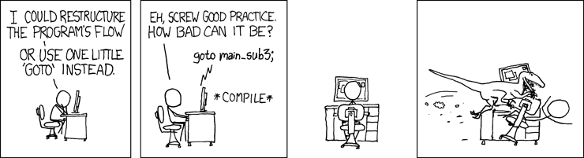
Goto Statement
A computer programmer is someone who, when asked to go to hell, objects to the use of the word ‘goto’
(Almost) never use goto
Too arbitrary, makes code hard to understand

Slide 69
Branching Statements in C
3 types of conditional statements in C
if (cond) action
if (cond) action
else some-other-action
switch-case
Each action is a sequence of one or more statements!

Slide 70
If Statement
General form of the if statement
true
false
if (expression)
statement S1
statement S2
S1
S2
Execution of if statement
First the expression is evaluated.
If it evaluates to a non-zero value, then S1 is executed and then control (program counter) moves to the statement S2.
If expression evaluates to 0, then S2 is executed.

Slide 71
if-else Statement
General form of the if-else statement
Execution of if-else statement
First the expression is evaluated.
If it evaluates to a non-zero value, then S1 is executed and then control (program counter) moves to S3.
If expression evaluates to 0, then S2 is executed and then control moves to S3.
S1/S2 can be block of statements!
if (expression)
statement S1
else
statement S2
statement S3
true
false
S1
S2
S3

Slide 72
print “Passed”
print “Good luck”
true
marks >= 40
false
if (marks >= 40) {
printf(“Passed \n”);
printf(“Good luck\n”);
}
printf (“End\n”) ;

Slide 73
Solving the Use Case with if-else
#include <stdio.h>
#include <stdlib.h>
int main() {
int n;
double m;
printf(“Please enter a positive number: ”);
scanf(“%d”,&n);
if (n>0)
m = log(n); // natural log
printf("%f\n", m);
else
printf(“Why can’t you follow instructions?");
return 0;
}
Something’s not quite right in this code

Slide 74
Compound Statements
A block of code containing zero or more statements
Contained between { and }
Format:
{
Local Declarations
Statements
}

Slide 75
Getting it Right
#include <stdio.h>
#include <stdlib.h>
int main() {
int n;
double m;
printf(“Please enter a positive number: ”);
scanf(“%d”,&n);
if (n>0){
m = log(n); // natural log
printf("%f\n", m);
}
else
printf(“Why can’t you follow instructions?");
return 0;
}

Slide 76
Good Indentation Practice
This is a main statement
This is a dependent statement
Main statements are statements in the main control flow of your program
Dependent statements branch off from the main flow
Indent them, for easier understanding of code
Matters more in some languages, like python
Pro-tip: use 4 spaces instead of tab to indent

Slide 77
if-else Statement
Read two integers and print the min.
# include <stdio.h>
int main() {
int x, y;
scanf(“%d%d”, &x,&y);
if (x < y) {
printf(“%d”, x);
} else {
printf(“%d”, y);
}
return 0;
}
Check if x is less than y.
If so, print x
Otherwise, print y.

Slide 78
Tracing Execution of if-else
Run the program
# include <stdio.h>
int main() {
int x; int y;
scanf(“%d%d”, &x,&y);
if (x < y) {
printf(“%d\n”,x);
}
else {
printf(“%d\n”,y);
}
return 0;
}
Input
6 10
x
y
6
10
Output
6
6 < 10 so the if-branch is taken

Slide 79
Nested if-else
#include <stdio.h>
#include <stdlib.h>
int main() {
int c,d;
printf(“Do you like C? (0/1) ”);
scanf(“%d”,&c);
if(c){
printf(“Do you really like C? (0/1) ”);
scanf(“%d”,&d);
if(d)
printf(“You really like C!!”);
else
printf(“Not really”);
}
else{
printf(“Ohh, You hate C!!”);
}
return 0;
}

Slide 80
Nested if-else
If e1 s1 else if e2 s2
If e1 s1 else if e2 s2 else s3
If e1 if e2 s1 else s2 else s3
If e1 if e2 s1 else s2
Rule of thumb: else clause looks for the closest previous if without an else

Slide 81
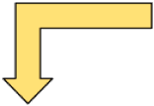
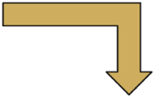


Finding min of 3 numbers
Input a,b,c
TRUE
a<=b
FALSE
TRUE
a<=c
FALSE
TRUE
b<=c
FALSE
Print
a
Print c
Print b
Print
c

Slide 82




Input a,b,c
int a,b,c;
scanf(“%d%d%d”,&a,&b,&c);
if (a <= b) {
if (a <= c) {
printf(“min = %d”,a);
}
else {
printf(“min = %d”, c);
}
}
else {
if (b <= c) {
printf(“min = %d”, b);
}
else {
printf(“min =%d”, c);
}
}
a<=b
TRUE
FALSE
a<=c
b<=c
TRUE
FALSE
TRUE
FALSE
Print
a
Print c
Print b
Print
c
Each branch translates to an if-else statement
Hierarchical branches result in nested if-s

Slide 83
More Conditionals
Sorting a sequence of numbers (i.e., arranging the numbers in ascending or descending order) is a basic primitive.
Problem: read three numbers into a, b and c and print them in ascending order.
Start with the flowchart for finding minimum of three numbers and add one more level of conditional check.
Then translate the flowchart into C program.

Slide 84
Finding min of 3 numbers
Input a,b,c
Replace print by more comparisons and then print.
TRUE
a<=b
FALSE
TRUE
a<=c
FALSE
TRUE
b<=c
FALSE
Print
a
Print c
Print b
Print
c

Slide 85



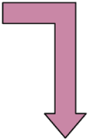
Ascending order of 3 numbers
Input a,b,c
TRUE
a<=b
FALSE
TRUE
a<=c
FALSE
TRUE
b<=c
FALSE
Print
a
Print c
Print b
Print
c
TRUE
b<=c
FALSE
print
TRUE
a<=c
FALSE
print
c a b
c b a
print
print
print
print
a b c
a c b
b a c
b c a

Slide 86
if (a <= b) {
if (a <= c) { /* a <= b and a <= c */
if (b <= c) { /* a <= b, a <= c, b <= c */
printf(“%d %d %d \n”, a, b, c);
} else { /* a <= b, a <= c, c < b */
printf(“%d %d %d \n”, a, c, b);
}
} else { /* a <= b, c < a*/
printf(“%d %d %d \n”, c, a, b) ;
}
} else { /* b < a */
if (b <= c) { /* b < a and b <= c */
if (a <= c) { /* b < a, b <= c, a <= c */
printf(“%d %d %d\n”, b, a, c);
} else { /* b < a, b <= c, c < a */
printf(“%d %d %d\n”, b, c, a); }
}
} else { /* b < a, c < b */
printf(“%d %d %d\n”, c, b, a); }
}
}
Notes:
‹#›

Slide 87
Nested if, if-else
Earlier examples showed us nested if-else statements
Because if and if-else are also statements, they can be used anywhere a statement or block can be used.
if (a <= b) {
if (a <= c) { … } else {…}
} else {
if (b <= c) { … } else { … }
}

Slide 88
Confusing Equality (==) and Assignment (=) Operators
Dangerous error
Does not ordinarily cause syntax errors
Any expression that produces a value can be used in control structures
Nonzero values are true, zero values are false
Example:
if ( payCode = 4 ) printf( "You get a bonus!\n" );

Slide 89
If-else Review
#include<stdio.h>
int main() {
int i = 5, j = 6, k = 7;
if(i > j == k)
printf("%d %d %d", i++, ++j, --k);
else
printf("%d %d %d", i, j, k);
return 0;
}
5 6 7
#include<stdio.h>
int main() {
int i = 5;
if(i = i - 5 > 4)
printf("inside if block");
else
printf("inside else block");
return 0;
}
Inside else block

Slide 90
If-else Review
#include<stdio.h>
int main() {
if(sizeof(0))
printf(“Yes");
else
printf(“No");
return 0;
}
Yes
#include <stdio.h>
int main()
{
char val=1;
if(val--==0)
printf("TRUE");
else
printf("FALSE");
return 0;
}
FALSE

Slide 91
Unmatched if and else
X
if ((a != 0) && (b != 0))
if (a * b >= 0)
printf (“positive”);
else
printf(“zero”);
OUTPUT for a = 5, b = 0
NO OUTPUT!!
OUTPUT for a = 5, b = -5
zero
if ((a != 0) && (b != 0))
if (a * b >= 0)
printf (“positive”);
else
printf(“negative”);
OUTPUT for a = 5, b = 0
NO OUTPUT!!
OUTPUT for a = 5, b = -5
negative

Slide 92
Unmatched if and else
An else always matches closest unmatched if
Unless forced otherwise using { … }
if (cond1)
if (cond2)
…
else
…
if (cond1) {
if (cond2)
…
else
…
}

Slide 93
Unmatched if and else
An else always matches closest unmatched if
Unless forced otherwise using { … }
if (cond1)
if (cond2)
…
else
…
if (cond1) {
if (cond2)
…
}
else
…
IS NOT SAME AS

Slide 94
Else if
A special kind of nesting is the chain of if-else-if-else-… statements
if (cond1) {
stmt1
} else {
if (cond2) {
stmt2
} else {
if (cond3) {
….
}
}
}
if (cond1)
stmt-block1
else if (cond2)
stmt-block2
else if (cond3)
stmt-block3
else if (cond4)
stmt-block4
else if …
else
last-block-of-stmt
General form of if-else-if-else…

Slide 95
Example
Given an integer , where , print the name of the weekday corresponding to .
1: Sunday
2: Monday
…
7: Saturday

Slide 96
Printing the day
int day;
scanf (“%d”, &day);
if (day == 1) { printf(“Sunday”); }
else if (day == 2) { printf (“Monday”); }
else if (day == 3) { printf (“Tuesday”); }
else if (day == 4) { printf (“Wednesday”); }
else if (day == 5) { printf (“Thursday”); }
else if (day == 6) { printf (“Friday”); }
else if (day == 7) { printf (“Saturday”); }
else { printf (“ Illegal day %d”, day); }

Slide 97
Example 2
Given an integer , where , print Weekday, if the corresponds to weekday, print Weekend otherwise.
1, 7: Weekend
2,3,4,5,6: Weekday

Slide 98
Weekday - version 1
int day;
scanf (“%d”, &day);
if (day == 1) { printf(“Weekend”); }
else if (day == 2) { printf (“Weekday”); }
else if (day == 3) { printf (“Weekday”); }
else if (day == 4) { printf (“Weekday”); }
else if (day == 5) { printf (“Weekday”); }
else if (day == 6) { printf (“Weekday”); }
else if (day == 7) { printf (“Weekend”); }
else { printf (“ Illegal day %d”, day); }

Slide 99
Weekday - version 2
int day;
scanf (“%d”, &day);
if ((day == 1) || (day == 7)) {
printf(“Weekend”);
} else if ( (day == 2) || (day == 3)
|| (day == 4) || (day == 5)
|| (day == 6)) {
printf (“Weekday”);
} else {
printf (“ Illegal day %d”, day);
}

Slide 100
Weekday - version 3
int day;
scanf (“%d”, &day);
if ((day == 1) || (day == 7)) {
printf(“Weekend”);
} else if ( (day >= 2) && (day <= 6) ) {
printf (“Weekday”);
} else {
printf (“ Illegal day %d”, day);
}

Slide 101
The Conditional Operator ?:
This makes use of an expression that is either non-0 or 0. An appropriate value is selected, depending on the value of the expression
Example: instead of writing
if (balance > 5000)
interest = balance * 0.2;
else interest = balance * 0.1;
We can just write
interest = (balance > 5000) ? balance * 0.2 : balance * 0.1;

Slide 102
The Conditional Operator ?:
This makes use of an expression that is either non-0 or 0. An appropriate value is selected, depending on the value of the expression
Example: instead of writing
if (balance > 5000)
interest = balance * 0.2;
else interest = balance * 0.1;
We can just write
interest = (balance > 5000) ? balance * 0.2 : balance * 0.1;

Slide 103
Switch-Case Statement
Multi-way decision
Checks whether an expression matches one out of a number of constant integer values
Execution branches based on the match found

Slide 104
Printing the day, version 2
switch (day) {
case 1: printf(“Sunday”); break;
case 2: printf (“Monday”); break;
case 3: printf (“Tuesday”); break;
case 4: printf (“Wednesday”); break;
case 5: printf (“Thursday”); break;
case 6: printf (“Friday”); break;
case 7: printf (“Saturday”); break;
default: printf (“ Illegal day %d”, day);
}

Slide 105
Weekday, version 4
switch (day) {
case 1:
case 7: printf (“Weekend”); break;
case 2:
case 3:
case 4:
case 5:
case 6: printf (“Weekday”); break;
default: printf (“ Illegal day %d”, day);
}

Slide 106
The break Statement
Syntax –
break;
Used to break out of current code branch
Not to end the program

Slide 107
General Form of switch-case
switch (selector-expr) {
case label1: s1; break;
case label2: s2; break;
...
case labelN: sN; break;
default : sD;
}
Expr only of type INT
Execution starts at the matching case.
default is optional. (= remaining cases)
The location of default does not matter.
The statements following a case label are executed one after other until a break is encountered (Fall Through)
Notes:
Expr can be int, char, conditional. NOT float.
Once the execution begins the subsequent case-conditions get executed too!

Slide 108
Example
Switch expressions can only be of type int
#include<stdio.h>
int main() {
char ch = 65;
switch(ch) {
case 'A': printf("Apple");
break;
case 'B': printf("Bing");
break;
default: printf("Bye");
break;
}
return 0;
}
Apple

Slide 109
General Form of switch-case
switch (selector-expr) {
case label1: s1; break;
case label2: s2; break;
...
case labelN: sN; break;
default : sD;
}
Expr only of type INT
Execution starts at the matching case.
default is optional. (= remaining cases)
The location of default does not matter.
The statements following a case label are executed one after other until a break is encountered (Fall Through)
Notes:
Expr can be int, char, conditional. NOT float.
Once the execution begins the subsequent case-conditions get executed too!

Slide 110
Fall Through…
int n = 100;
int digit = n%10; // last digit
switch (digit) {
default : printf(“Not divisible by 5\n”);
break;
case 0: printf(“Even\n”);
case 5: printf(“Divisible by 5\n”);
break;
}
What is printed by the program fragment?
Answer:
Even
Divisible by 5;

Slide 111






Class Quiz
What is the value of expression:
Compile time error
Run time crash
I don’t know / I don’t care
0
1
(5<2) && (3/0)
The correct answer is

Slide 112
Short-Circuit Evaluation
Do not evaluate the second operand of binary logical operator if result can be deduced from first operand
Arguments of && and || are evaluated from left to right (in sequence)
Also applies to nested logical operators
!( (2>5) && (3/0) ) || (4/0)
Evaluates to 1
1
0
0
1

Slide 113
3 Factors for Expr Evaluation
Precedence
Applied to two different class of operators
+ and *, - and *, && and >, + and &&, …
Associativity
Applied to operators of same class
* and *, + and -, * and /, …
Order of evaluation
Precedence and associativity identify the operands for each operator (Parenthesization)
Not which operand/expr is evaluated first
In C, order of evaluation of operands is defined only for && and ||

Slide 114
Value Computation and Side Effect
int main(){
int a = 10;
a = a++;
printf("%d\n", a);
return 0;
}
10
int main(){
int a = 10;
int temp;
temp = a;
a = a + 1
a = temp;
printf("%d\n", a);
return 0;
}

Slide 115
Control Statements
✔
Branching
Looping

Slide 116

The Computer’s BIG Advantage
Once you’ve told a computer how to do something once, it can reproduce the exact same process a trillion times.

Slide 117
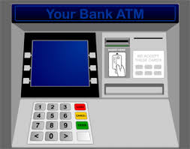
ATM

Slide 118
Printing Multiplication Table
5 | X | 1 | = | 5
5 | X | 2 | = | 10
5 | X | 3 | = | 15
5 | X | 4 | = | 20
5 | X | 5 | = | 25
5 | X | 6 | = | 30
5 | X | 7 | = | 35
5 | X | 8 | = | 40
5 | X | 9 | = | 45
5 | X | 10 | = | 50

Slide 119

Program…
int n;
scanf(“%d”, &n);
printf(“%d X %d = %d”, n, 1, n*1);
printf(“%d X %d = %d”, n, 2, n*2);
printf(“%d X %d = %d”, n, 3, n*3);
printf(“%d X %d = %d”, n, 4, n*4);
….
Too much
repetition!
Can I avoid
it?

Slide 120
Printing Multiplication Table
Loop Entry
Input n
i = 1
Loop Exit
i <=10
TRUE
FALSE
Print n x i = ni
i = i+1
Stop
Loop

Slide 121
Printing Multiplication Table
Input n
i = 1
scanf(“%d”, &n);
int i = 1;
while (i <= 10) {
printf(“%d X %d = %d”,
n, i, n*i);
i = i + 1;
}
// loop exited!
TRUE
i <=10
FALSE
Print n x i = ni
i = i+1
Stop

Slide 122
While Statement
while (expression)
statement1;
statement2;
FALSE
expression
TRUE
statement1
statement2
Read in English as:
As long as expression is TRUE execute statement1.
when expression becomes FALSE execute statement 2.

Slide 123
While Statement
while (expression)
statement1;
statement2;
FALSE
expression
TRUE
statement1
statement2
Evaluate expression
If TRUE then
execute statement1
goto step 1.
If FALSE then execute statement2.

Slide 124
Example 1
Read a sequence of integers from the terminal until -1 is read
Output sum of numbers read, not including the -1
First, let us write the loop, then add code for sum
int a;
scanf(“%d”, &a); /* read into a */
while ( a != -1) {
scanf(“%d”, &a); /* read into a inside loop*/
}

Slide 125
Tracing the Loop
int a;
scanf(“%d”, &a); /* read into a */
while ( a != -1) {
scanf(“%d”, &a); /*read into a inside loop*/
}
INPUT
4
15
-5
-1
??
4
15
-5
-1
Trace of memory
location a
One scanf is executed every time body of the loop is executed.
Every scanf execution reads one integer.

Slide 126
Add Numbers Until -1
Keep an integer variable s.
s is the sum of the numbers seen so far (except the -1).
int a;
int s;
s = 0; // not seen any a yet
scanf(“%d”, &a); // read into a
while (a != -1) {
s = s + a; // last a is not -1
scanf(“%d”, &a); // read into a inside loop
}
// one could print s here etc.

Slide 127
Terminology
Iteration: Each run of the loop is called an iteration.
In example, the loop runs for 3 iterations, corresponding to inputs 4, 15 and -5.
For input -1, the loop is exited, so there is no iteration for input -1.
3 components of a while loop
Initialization
first reading of a in example
Condition (evaluates to a Boolean value)
a != -1
Update
another reading of a
scanf(“%d”, &a); /* read into a */
while (a != -1) {
s = s + a;
scanf(“%d”, &a); /*read into a inside loop*/
}
// INPUTS: 4 15 -5 -1

Slide 128
Common Mistakes
Initialization is not done
Incorrect results. Might give error.
Update step is skipped
Infinite loop: The loop goes on forever. Never terminates.
The update step must take the program towards the condition evaluating to false.
Incorrect termination condition
Early or Late exit (even infinite loop).

Slide 129
Practice Problem
Given a positive integer n, print all the integers less than or equal to n that are divisible by 3 or divisible by 5
Hint: Two conditions will be used:
x <= n
(x%3 == 0) || (x%5 == 0)

Slide 130
Program
int main ( )
{
int n; int x;
scanf(“%d”, &n); // input n
x = 1; // [while] initialization
while ( x <= n) { // [while] condition
if ((x%3 == 0) || (x%5 == 0)) { // [if] condition
printf(“%d\n”, x);
}
x = x+1; // [while] update
}
return 0;
}

Slide 131
do-while Loops
do-while statement is a variant of while.
General form:
Execution:
First execute statement.
Then evaluate expr.
If expr is TRUE then go to step 1.
If expr is FALSE then break from loop
Continuation of loop is tested after the statement.
do
statement
while (expr);
statement
expr
TRUE
FALSE

Slide 132
Comparing while and do-while
In a while loop the body of the loop may not get executed even once, whereas, in a do-while loop the body of the loop gets executed at least once.
In the do-while loop structure, there is a semicolon after the condition of the loop.
Rest is similar to a while loop.

Slide 133
Comparative Example
Problem: Read integers and output each integer until -1 is seen (include -1 in output).
The program fragments using while and do-while.
Using while
int a;/*current int*/
scanf(“%d”,&a);
while (a != -1) {
printf(“%d\n”, a);
scanf(“%d”, &a);
}
printf(“%d\n”, a);
Using do-while
int a; /*current int*/
do {
scanf(“%d”, &a);
printf(“%d\n”, a);
} while (a != -1);

Slide 134
For loop in C
General form
init_expr is the initialization expression.
update_expr is the update expression.
test_expr is the expression that evaluates to either TRUE (non-zero) or FALSE (zero).
statement is the work to repeat (can be multiple statements in {…} )
for (init_expr; test_expr; update_expr)
statement;

Slide 135
For Loop in C
init_expr
for (init_expr; test_expr; update_expr)
statement;
First evaluate init_expr;
Evaluate test_expr;
If test_expr is TRUE then
execute statement;
execute update_expr;
go to Step 2.
if test_expr is FALSE then break from the loop
test_expr
TRUE
FALSE
statement
update_expr

Slide 136
For Loop
Print the sum of the reciprocals of the first 100 natural numbers.
int i; // counter from 1..100
float rsum = 0.0;// the sum
// the for loop
for ( i=1; i<=100; i=i+1 ) {
rsum = rsum + (1.0/i);
}
printf(“sum is %f “, rsum);

Slide 137
int i;
float rsum = 0.0;
for (i=1; i<=4; i=i+1) {
rsum = rsum + (1.0/i);
}
printf(“sum is %f”, rsum);
i
rsum
1
0.0
2
3
4
5
2.0833333..
1.833333..
1.0
1.5
Evaluate init_expr; i.e., i=1;
Evaluate test_expr i.e., i<=4 TRUE
Enter body of loop and execute.
Execute update_expr; i=i+1; i is 2
Evaluate test_expr i<=4: TRUE
Enter body of loop and execute.
Execute i=i+1; i is 3
Evaluate test_expr i<=4: TRUE
Enter body of loop and execute.
Execute i=i+1; i is 4
Evaluate test_expr i<=4: TRUE
Enter body of loop and execute.
Execute i=i+1; i is 5
Evaluate test_expr i<=4: FALSE
Exit loop & jump to printf
sum is 2.083333
sum of reciprocals of 1 to 4 is 2.083333 $

Slide 138
for Loop in Terms of while Loop
for (init_expr; test_expr; update_expr)
statement;
Execution is (almost) equivalent to
Almost? Exception if there is a continue; inside statement– this will be covered later.
Both are (almost) equivalent in power.
Which loop structure to use, depends on the convenience of the programmer.
init_expr;
while (test_expr) {
statement;
update_expr;
}

Slide 139
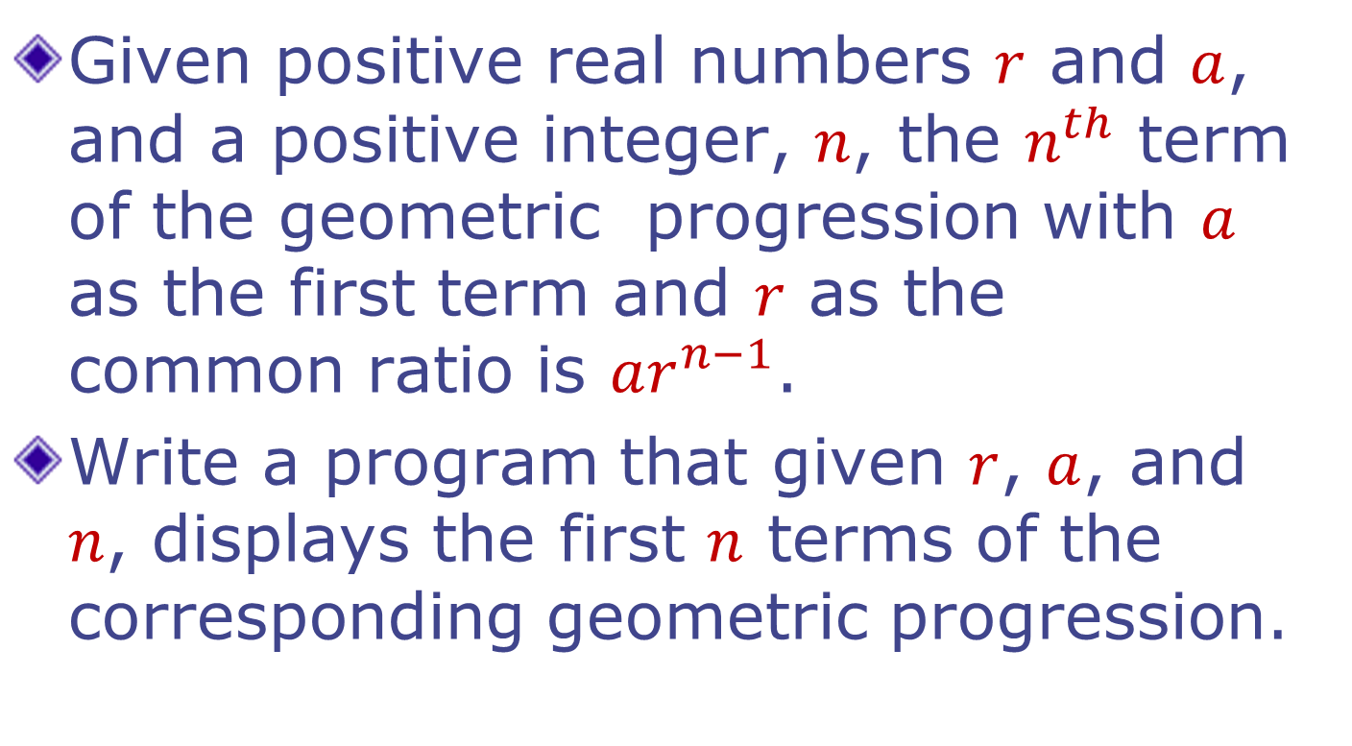
Example: Geometric Progression

Slide 140
Program: Geometric Progression
#include <stdio.h>
int main(void) {
int n, i;
float r, a, term;
// Reading inputs from the user
scanf(“%f”, &r);
scanf(“%f”, &a);
scanf(“%d”, &n);
term = a;
for (i = 1; i <= n; i++)
{
printf(%f\n, term); // Displaying the i-th term
term = term * r; // Computing the (i+1)-th term
}
return 0;
}

Slide 141
Program: Geometric Progression
#include <stdio.h>
int main(void) {
int n, i;
float r, a, term;
// Reading inputs from the user
scanf(“%f”, &r);
scanf(“%f”, &a);
scanf(“%d”, &n);
term = a;
for (i = 1; i <= n; i++)
{
term = term * r; // Computing the (i+1)-th term
printf(%f\n, term); // Displaying the (i+1)-th term
}
return 0;
Careful: Changing the order of the statements will change the meaning of the program.
a ar ar^2 ar^3 …. Vs
ar ar^2 ar^3 ar^4 ….

Slide 142
For loop in C
General form
init_expr is the initialization expression.
update_expr is the update expression.
test_expr is the expression that evaluates to either TRUE (non-zero) or FALSE (zero).
statement is the work to repeat (can be multiple statements in {…} )
for (init_expr; test_expr; update_expr)
statement;

Slide 143
For loop in C
init_expr
for (init_expr; test_expr; update_expr)
statement;
First evaluate init_expr;
Evaluate test_expr;
If test_expr is TRUE then
execute statement;
execute update_expr;
go to Step 2.
if test_expr is FALSE then break from the loop
test_expr
TRUE
FALSE
statement
update_expr

Slide 144
For loop in Action
#include <stdio.h>
int main() {
int i;
for (i=1;i<=3; i++) {
printf("%d\t",i)
}
printf("\n%d\t",i);
return 0;
}
#include <stdio.h>
int main() {
int i;
for (i=1;i<=3; ++i) {
printf("%d\t",i);
}
printf("\n%d\t",i);
return 0;
}
1 2 3
4
1 2 3
4

Slide 145
Important Consideration: Scope
#include <stdio.h>
int main(){
for (int i=1;i<=2;i++)
printf("%d\n",i);
return 0;
}
Output?
1
2

Slide 146
Important consideration: Scope
#include <stdio.h>
int main(){
for (int i=1;i<=2;i++)
printf("%d\n",i);
printf(“%d\n”,i);
return 0;
}
Output?
Compiler error: 'i' undeclared
AVOID

Slide 147
Block Scope of a Variable
#include <stdio.h>
int main(){
{ //start block
int i;
for (i=1;i<=2;i++)
printf("%d\n",i);
} //end block
return 0;
}
Output?
1
2

Slide 148
Block Scope of a Variable
#include <stdio.h>
int main(){
{
int i;
for (i=1;i<=2;i++)
printf("%d\n",i);
}
printf("outside %d\n",i);
return 0;
}
Output?
Compiler error: 'i' undeclared

Slide 149
Block scope of a Variable
#include <stdio.h>
int main(){
int i;
for (i=1;i<=2;i++){
printf("%d\n",i);
int j=0;
printf(“j=%d\n",j+1);
}
return 0;
}
Output?
1
j=1
2
j=1

Slide 150
Flexibility in Expression Checking
#include <stdio.h>
int main() {
int i, j = -1;
for (i=1; j<=2; i++) {
printf("%d\t",i);
j = i;
}
printf("\n%d\t",i);
printf("\n%d\t",j);
return 0;
}
#include <stdio.h>
int main() {
int i,j;
for (i=1; j<=2;++i){
printf("%d\t",i);
j = i;
}
printf("\n%d\t",i);
printf("\n%d\t",j);
return 0;
}
1 2 3
4 3
1 gbg

Slide 151
Undesirable Flexibility
#include <stdio.h>
int main() {
int i=1, j;
for (;j<=2;i++){
printf("%d\t",i);
j = i;
}
printf("\n%d\t",i);
printf("%d\n",j);
return 0;
}
#include <stdio.h>
int main() {
int i=1, j;
for (;j<=2;i++){
printf("%d\t",i);
j = i;
}
printf("\n%d\t",i);
printf("%d\n",j);
return 0;
}
1 4200288
2 3
4 3

Slide 152
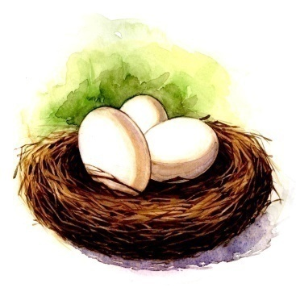

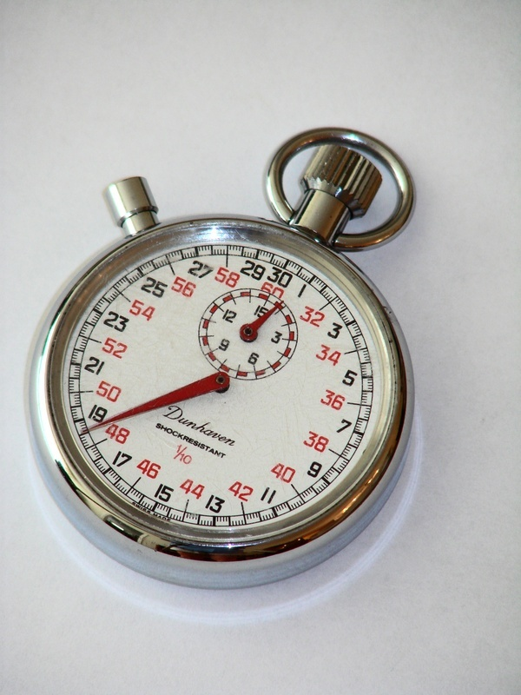
Nested Loops
Loop with in a loop
Many iterations of inner loop One iteration of outer loop

Slide 153
Example
Write a program that displays the following pattern
1 | 2 | 3 | 4 | 5
2 | 4 | 6 | 8 | 10
3 | 6 | 9 | 12 | 15
4 | 8 | 12 | 16 | 20
5 | 10 | 15 | 20 | 25
6 | 12 | 18 | 24 | 30
7 | 14 | 21 | 28 | 35
8 | 16 | 24 | 32 | 40
integers are printed in 5 columns each

Slide 154
#include<stdio.h>
int main(){
int i, j;
for (i=1; i<=8; i=i+1) {
for (j=1; j<=5; j=j+1) {
printf("%4d", i*j); // Displaying i, 2i, …, 5i
}
printf(“\n”); // Move to the next line
}
return 0;
}

Slide 155
Displaying a Pattern
#include <stdio.h>
int main(){
int i,j;
for (i=1; i<=5; i=i+1){
for (j=i; j<2*i; j=j+1){
printf("%d ",j);
}
printf("\n");
}
return 0;
}
Output?
1
2 3
3 4 5
4 5 6 7
5 6 7 8 9

Slide 156

Back to Break
Used for exiting a loop forcefully
Example Program:
Read 100 integer inputs from a user. Print the sum of inputs until a negative input is found (Excluding the negative number) or all 100 inputs are exhausted.

Slide 157
int value;
int sum = 0;
int i;
for (i = 0; i < 100; i++) {
scanf(“%d”, &value);
if (value < 0) {
//-ve number: no need to go
// around the loop any more!!
break;
}
sum = sum + value;
}
printf(“%d”, sum);

Slide 158
When to Break?
Use of break sometimes can simplify exit condition from loop.
However, it can make the code a bit harder to read and understand.
Tip: if the loop terminates in at least two ways which are sufficiently different and requires substantially different processing then consider the use of termination via break for one of them.

Slide 159

Continue
Used for skipping an iteration of a loop
The loop is NOT exited.
Example Program:
Read 100 integer inputs from a user. Print the sum of only positive inputs.

Slide 160
int sum = 0;
int i, value;
for (i = 0; i < 100; i++) {
scanf(“%d”, &value);
if (value < 0) {
//-ve number: no need to add it
// to the sum. Go ahead and
// check the next input.
continue;
}
sum = sum + value;
}
printf(“%d”, sum);

Slide 161
Break and Continue
if there are nested loop: break and continue apply to the nearest enclosing loop only.
for (i = 0; i < 100; i++) {
for (j = 0; j < 100; j++) {
if (…) break;
}
…
}

Slide 162

Continue and Update Expr
Make sure continue does not bypass update-expression for loops
Specially for while and do-while loops
i = 0;
while (i < 100) {
scanf(“%d”, &value);
if (value < 0) continue;
sum = sum + value;
i++;
}
i is never incremented
potentially infinite loop!!

Slide 163
Continue and Update Expr
Correct Code:
i = 0;
while (i < 100) {
scanf(“%d”, &value);
if (value < 0) {
i++;
continue;
}
sum = sum + value;
i++;
}

Slide 164
Continue and Update Expr
Correct Code:
i = 0;
while (i < 100) {
i++;
scanf(“%d”, &value);
if (value < 0) continue;
sum = sum + value;
}

Slide 165
Big difference between for and while
#include <stdio.h>
int main() {
int i = 0;
for(i = 0; i < 10; i++) {
if(i == 5) continue;
printf("%d\n", i);
}
return 0;
}
#include <stdio.h>
int main() {
int i = 0;
while(i < 10) {
if(i == 5) continue;
printf("%d\t", i);
i++;
}
return 0;
}
0 1 2 3 4 6 7 8 9
0 1 2 3 4 .....................

Slide 166
For loop in Terms of while Loop
for (init_expr; test_expr; update_expr)
statement;
Execution is (almost) equivalent to
Almost? Exception if there is a continue; inside statement
Both are equivalent in power.
Which loop structure to use?
init_expr;
while (test_expr) {
statement;
update_expr;
}

Slide 167
Loop Best Practices
I want to do something a times
for(i = 0; i < N; i++)
I want to do something an indeterminate number of times until a condition is true
while (condition)

Slide 168
Loop Best Practices
I want to do something a times
for(i = 0; i < a; i++)
I want to do something an indeterminate number of times until a condition is true
while (condition)
Always remember to initialize values in for expressions to some value
Then don’t need to worry about scope
But have to, for larger programs

Slide 169

How Many Times is the Loop Executed?
Probable intention:
int a = 10 - 6;
while (a < 10) {
if (a = 5) {
printf(“%d\n“, a);
}
a=a+1;
}
int a =10 - 6;
while (a < 10) {
if (a == 5) {
printf(“%d“, a);
}
a=a+1;
}
Output5
5
5
…
Output
5
A common bug

Slide 170
ACKNOWLEDGEMENTS
Slides were inspired from Prof Rajat Moona and Prof. Amey Karkare for the course ESC101 in IIT Kanpur.
IC100, Programming

