Slide 1
Advanced Computer Network
(4350706)
Unit-4
Transport Layer Protocols
Prepared By :
Mr. Chetan C. Kamani
Lecturer, Computer Engineering Department
Government Polytechnic, Jamnagar

Slide 2
Topics to be discussed
Introduction
  Services
  Port Numbers
User Datagram Protocols
  User Datagram
  UDP services
Comparison between UDP and Generic Simple Protocol
UDP Applications

Slide 3
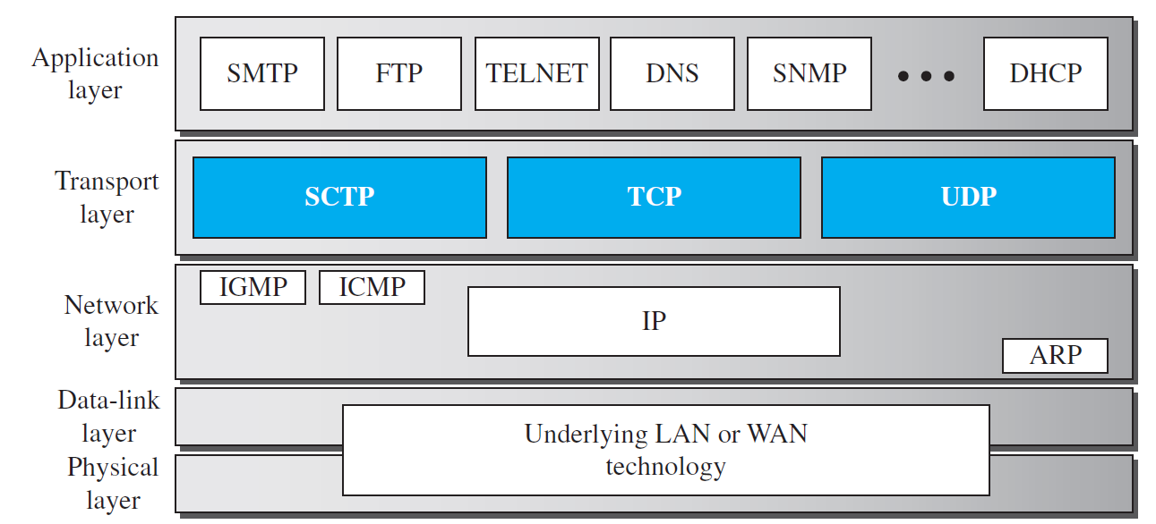
Introduction
Position of transport-layer protocols in the TCP/IP protocol suite

Slide 4
Services
Each Transport Layer Protocol provides a different type of service and should be used appropriately.
UDP
  UDP is an unreliable connectionless transport-layer protocol used for its simplicity and efficiency in applications where error control can be provided by the application-layer process.
TCP
  TCP is a reliable connection-oriented protocol that can be used in any application where reliability is important.
SCTP
  SCTP is a new transport-layer protocol that combines the features of UDP and TCP.

Slide 5
Port Numbers
A Transport-layer protocol usually has several responsibilities. One is to create a process-to-process communication; these protocols use port numbers to accomplish this.
Port numbers provide end-to-end addresses at the transport layer and allow multiplexing and demultiplexing at this layer, just as IP addresses do at the network layer.

Slide 6
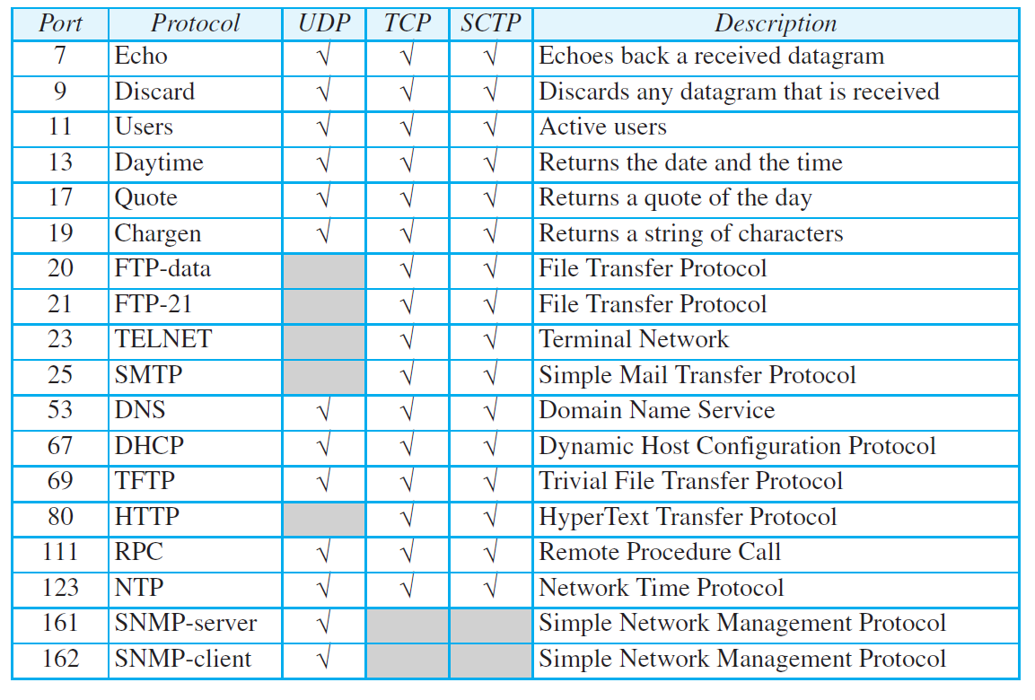
Port Numbers
Some well-known ports used with UDP and TCP

Slide 7
User Datagram Protocol
The User Datagram Protocol (UDP) is a connectionless, unreliable transport protocol.
It does not add anything to the services of IP except for providing process-to-process communication instead of host-to-host communication.
If UDP is so powerless, why would a process want to use it? With the disadvantages come some advantages.
UDP is a very simple protocol using a minimum of overhead. If a process wants to send a small message and does not care much about reliability, it can use UDP. Sending a small message using UDP takes much less interaction between the sender and receiver than using TCP.

Slide 8
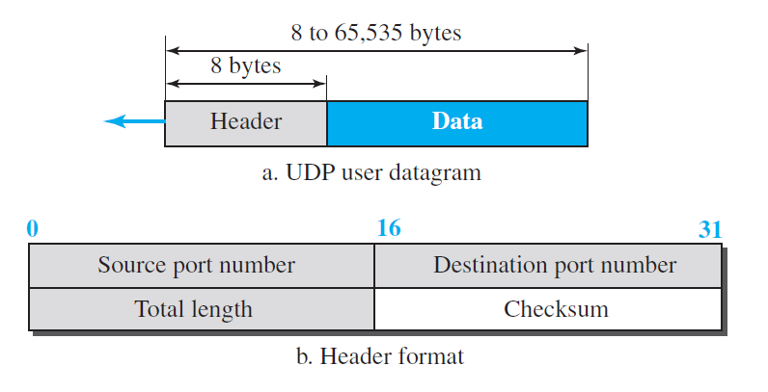
User Datagram

Slide 9
User Datagram
UDP packets, called user datagrams, have a fixed-size header of 8 bytes made of four fields, each of 2 bytes (16 bits).
The first two fields define the source and destination port numbers.
The third field defines the total length of the user datagram, header plus data.
Total Length = Header Length + Data Length
The 16 bits can define a total length of 0 to 65,535 bytes. However, the total length needs to be less because a UDP user datagram is stored in an IP datagram with the total length of 65,535 bytes.
The last field can carry the optional checksum.

Slide 10
Example
The following is the content of a UDP header in hexadecimal format.
  CB84000D001C001C
  a. What is the source port number?
  b. What is the destination port number?
  c. What is the total length of the user datagram?
  d. What is the length of the data?
  e. Is the packet directed from a client to a server or vice versa?
  f. What is the client process?

Slide 11
Solution
a. The source port number is the first four hexadecimal digits (CB84)16, which means that the source port number is 52100.
b. The destination port number is the second four hexadecimal digits (000D)16, which means that the destination port number is 13.
c. The third four hexadecimal digits (001C)16 define the length of the whole UDP packet as 28 bytes.
d. The length of the data is the length of the whole packet minus the length of the header, or 28 − 8 = 20 bytes.
e. Since the destination port number is 13 (well-known port), the packet is from the client to the server.
f. The client process is the Daytime

Slide 12
UDP Services
Process-to-Process Communication
Connectionless Service
Flow Control
Error Control
Checksum
Congestion Control
Encapsulation and Decapsulation
Queuing
Multiplexing and Demultiplexing

Slide 13
UDP Services
Process-to-Process Communication
  UDP provides process-to-process communication using socket addresses, a combination of IP addresses and port numbers.

Slide 14
UDP Services
Connectionless Service
  As mentioned previously, UDP provides a connectionless service.
  This means that each user datagram sent by UDP is an independent datagram. There is no relationship between the different user datagrams even if they are coming from the same source process and going to the same destination program.
  The user datagrams are not numbered.
  Also, unlike TCP, there is no connection establishment and no connection termination. This means that each user datagram can travel on a different path.

Slide 15
UDP Services
Connectionless Service
  One of the ramifications of being connectionless is that the process that uses UDP cannot send a stream of data to UDP and expect UDP to chop them into different, related user datagrams.
  Instead, each request must be small enough to fit into one user datagram. Only those processes sending short messages, messages less than 65,507 bytes (65,535 minus 8 bytes for the UDP header and minus 20 bytes for the IP header), can use UDP.

Slide 16
UDP Services
Flow Control
  UDP is a very simple protocol. There is no flow control, and hence no window mechanism.
  The receiver may overflow with incoming messages. The lack of flow control means that the process using UDP should provide for this service, if needed.

Slide 17
UDP Services
Error Control
  There is no error control mechanism in UDP except for the checksum.
  This means that the sender does not know if a message has been lost or duplicated.
  When the receiver detects an error through the checksum, the user datagram is silently discarded.
  The lack of error control means that the process using UDP should provide for this service, if needed.

Slide 18
UDP Services
Error Control
  There is no error control mechanism in UDP except for the checksum.
  This means that the sender does not know if a message has been lost or duplicated.
  When the receiver detects an error through the checksum, the user datagram is silently discarded.
  The lack of error control means that the process using UDP should provide for this service, if needed.

Slide 19
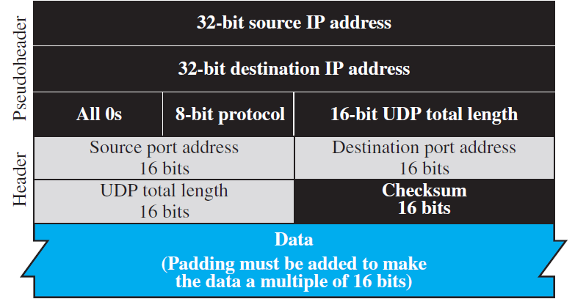
UDP Services
Checksum
  UDP checksum calculation includes three sections:
    a pseudoheader, the UDP header, and the data coming from the application layer.
Pseudoheader for checksum calculation

Slide 20
UDP Services
Checksum
  The pseudoheader is the part of the header of the IP packet in which the user datagram is to be encapsulated with some fields filled with 0s.
  If the checksum does not include the pseudoheader, a user datagram may arrive safe and sound. However, if the IP header is corrupted, it may be delivered to the wrong host.

Slide 21
UDP Services
Checksum
  The protocol field is added to ensure that the packet belongs to UDP, and not to TCP.
  We will see later that if a process can use either UDP or TCP, the destination port number can be the same.
  The value of the protocol field for UDP is 17. If this value is changed during transmission, the checksum calculation at the receiver will detect it and UDP drops the packet. It is not delivered to the wrong protocol.

Slide 22
UDP Services
Optional Inclusion of Checksum
  The sender of a UDP packet can choose not to calculate the checksum. In this case, the checksum field is filled with all 0s before being sent.
  In the situation where the sender decides to calculate the checksum, but it happens that the result is all 0s, the checksum is changed to all 1s before the packet is sent. In other words, the sender complements the sum two times.
  Note that this does not create confusion because the value of the checksum is never all 1s in a normal situation

Slide 23
Example
What value is sent for the checksum in each one of the following hypothetical situations?
  a. The sender decides not to include the checksum.
  b. The sender decides to include the checksum, but the value of the sum is all 1s.
  c. The sender decides to include the checksum, but the value of the sum is all 0s.

Slide 24
UDP Services
Congestion Control
  Since UDP is a connectionless protocol, it does not provide congestion control.
  UDP assumes that the packets sent are small and sporadic and cannot create congestion in the network. This assumption may or may not be true today, when UDP is used for interactive real-time transfer of audio and video.

Slide 25
UDP Services
Encapsulation and Decapsulation
  To send a message from one process to another, the UDP protocol encapsulates and decapsulates messages.

Slide 26
UDP Services
Queuing
  We have talked about ports without discussing the actual implementation of them.
  In UDP, queues are associated with ports. At the client site, when a process starts, it requests a port number from the operating system.
  Some implementations create both an incoming and an outgoing queue associated with each process.
  Other implementations create only an incoming queue associated with each process.

Slide 27
UDP Services
Multiplexing and Demultiplexing
  In a host running a TCP/IP protocol suite, there is only one UDP but possibly several processes that may want to use the services of UDP.
  To handle this situation, UDP multiplexes and demultiplexes.

Slide 28
Comparison between UDP and Generic Simple Protocol
We can compare UDP with the connectionless simple protocol we discussed earlier such as IP.
The only difference is that UDP provides an optional checksum to detect corrupted packets at the receiver site. If the checksum is added to the packet, the receiving UDP can check the packet and discard the packet if it is corrupted. No feedback, however, is sent to the sender.

Slide 29
UDP Applications
Although UDP meets almost none of the criteria we mentioned earlier for a reliable transport-layer protocol, UDP is preferable for some applications.
The reason is that some services may have some side effects that are either unacceptable or not preferable. An application designer sometimes needs to compromise to get the optimum.
For example, in our daily life, we all know that a one-day delivery of a package by a carrier is more expensive than a three-day delivery. Although high speed and low cost are both desirable features in delivery of a parcel, they are in conflict with each other. We need to choose the optimum.
In this section, we first discuss some features of UDP that may need to be considered when we design an application program and then show some typical applications.

Slide 30
UDP Feature(Connectionless Service)
As we mentioned previously, UDP is a connectionless protocol.
Each UDP packet is independent from other packets sent by the same application program. This feature can be considered as an advantage or disadvantage depending on the application requirements.
It is an advantage if, for example, a client application needs to send a short request to a server and to receive a short response. If the request and response can each fit in a single user datagram, a connectionless service may be preferable. The overhead to establish and close a connection may be significant in this case.

Slide 31
UDP Feature(Connectionless Service)
In the connection-oriented service, to achieve the above goal, at least 9 packets are exchanged between the client and the server; in connectionless service only 2 packets are exchanged.
The connectionless service provides less delay; the connection-oriented service creates more delay. If delay is an important issue for the application, the connectionless service is preferred.

Slide 32
UDP Feature(Connectionless Service)
Example
  A client-server application such as DNS uses the services of UDP because a client needs to send a short request to a server and to receive a quick response from it. The request and response can each fit in one user datagram. Since only one message is exchanged in each direction, the connectionless feature is not an issue; the client or server does not worry that messages are delivered out of order.

Slide 33
UDP Feature(Connectionless Service)
Example
  A client-server application such as SMTP , which is used in electronic mail, cannot use the services of UDP because a user might send a long e-mail message, which could include multimedia (images, audio, or video). If the application uses UDP and the message does not fit in one user datagram, the message must be split by the application into different user datagrams. Here the connectionless service may create problems. The user datagrams may arrive and be delivered to the receiver application out of order. The receiver application may not be able to reorder the pieces. This means the connectionless service has a disadvantage for an application program that sends long messages. In SMTP, when we send a message, we do not expect to receive a response quickly (sometimes no response is required). This means that the extra delay inherent in connection-oriented service is not crucial for SMTP.

Slide 34
UDP Feature(Lack of Error Control)
UDP does not provide error control; it provides an unreliable service.
Most applications expect reliable service from a transport-layer protocol.
Although a reliable service is desirable, it may have some side effects that are not acceptable to some applications. When a transport layer provides reliable services, if a part of the message is lost or corrupted, it needs to be resent. This means that the receiving transport layer cannot deliver that part to the application immediately; there is an uneven delay between different parts of the message delivered to the application layer.
Some applications, by nature, do not even notice these uneven delays, but for some they are very problematic.

Slide 35
UDP Feature(Lack of Error Control)
Example
  Assume we are downloading a very large text file from the Internet. We definitely need to use a transport layer that provides reliable service. We don’t want part of the file to be missing or corrupted when we open the file. The delay created between the deliveries of the parts is not an overriding concern for us; we wait until the whole file is composed before looking at it. In this case, UDP is not a suitable transport layer.

Slide 36
UDP Feature(Lack of Error Control)
Example
  Assume we are using a real-time interactive application, such as Skype. Audio and video are divided into frames and sent one after another. If the transport layer is supposed to resend a corrupted or lost frame, the synchronizing of the whole transmission may be lost. The viewer suddenly sees a blank screen and needs to wait until the second transmission arrives. This is not tolerable. However, if each small part of the screen is sent using a single user datagram, the receiving UDP can easily ignore the corrupted or lost packet and deliver the rest to the application program. That part of the screen is blank for a very short period of time, which most viewers do not even notice.

Slide 37
UDP Feature(Lack of Congestion Control)
UDP does not provide congestion control. However, UDP does not create additional traffic in an error-prone network.
TCP may resend a packet several times and thus contribute to the creation of congestion or worsen a congested situation.
Therefore, in some cases, lack of error control in UDP can be considered an advantage when congestion is a big issue.

Slide 38
Typical Applications
The following shows some typical applications that can benefit more from the services of UDP than from those of TCP.
  UDP is suitable for a process that requires simple request-response communication with little concern for flow and error control. It is not usually used for a process such as FTP that needs to send bulk data.
  UDP is suitable for a process with internal flow- and error-control mechanisms. For example, the Trivial File Transfer Protocol (TFTP) process includes flow and error control. It can easily use UDP.

Slide 39
Typical Applications
The following shows some typical applications that can benefit more from the services of UDP than from those of TCP.
  UDP is a suitable transport protocol for multicasting. Multicasting capability is embedded in the UDP software but not in the TCP software.
  UDP is used for management processes such as SNMP.
  UDP is used for some route updating protocols such as Routing Information Protocol (RIP).
  UDP is normally used for interactive real-time applications that cannot tolerate uneven delay between sections of a received message.

Slide 40
References
Data Communication and Networking, Fifth Edition, BEHROUZ A. FOROUZAN
Data Communication and Networking, Fourth Edition, BEHROUZAN A. FOROUZA
https://www.geeksforgeeks.org/introduction-of-classful-ip-addressing/

Slide 41
Thank You

