Slide 1
Advanced Computer Network
(4350706)
Unit-4
Transport Layer Protocols
Prepared By :
Mr. Chetan C. Kamani
Lecturer, Computer Engineering Department
Government Polytechnic, Jamnagar

Slide 2
Topics to be discussed
Stream Control Transmission Protocol
  SCTP Services
  SCTP Features
  Packet Format
  An SCTP Associations

Slide 3
Introduction
Stream Control Transmission Protocol (SCTP) is a new transport-layer protocol designed to combine some features of UDP and TCP in an effort to create a better protocol for multimedia communication.

Slide 4
SCTP Services
Process-to-Process Communication
Multiple Streams
Multihoming
Full-Duplex Communication
Connection-Oriented Service
Reliable Service

Slide 5
Process-to-Process Communication
SCTP, like UDP or TCP, provides process-to-process communication.

Slide 6
Multiple Streams
We learned that TCP is a stream-oriented protocol.
Each connection between a TCP client and a TCP server involves a single stream.
The problem with this approach is that a loss at any point in the stream blocks the delivery of the rest of the data.
This can be acceptable when we are transferring text; it is not when we are sending real-time data such as audio or video.
SCTP allows multistream service in each connection, which is called association in SCTP terminology. If one of the streams is blocked, the other streams can still deliver their data.

Slide 7
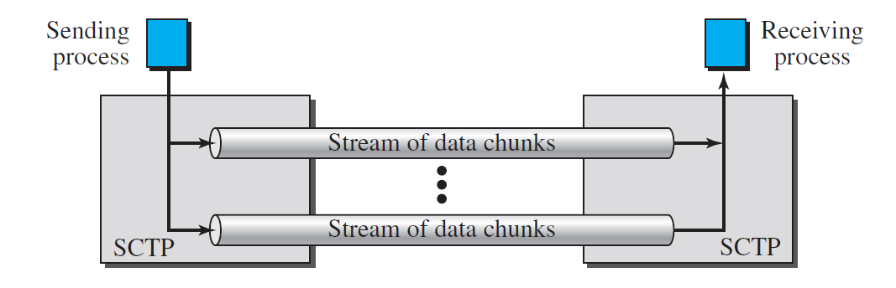
Multiple Streams

Slide 8
Multihoming
A TCP connection involves one source and one destination IP address.
This means that even if the sender or receiver is a multihomed host (connected to more than one physical address with multiple IP addresses), only one of these IP addresses per end can be utilized during the connection.
An SCTP association, on the other hand, supports multihoming service.
The sending and receiving host can define multiple IP addresses in each end for an association. In this fault-tolerant approach, when one path fails, another interface can be used for data delivery without interruption.
This fault-tolerant feature is very helpful when we are sending and receiving a real-time payload such as Internet telephony.

Slide 9
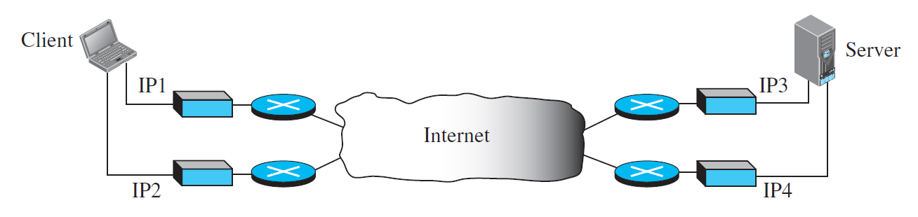
Multihoming

Slide 10
Multihoming
In the figure, the client is connected to two local networks with two IP addresses.
The server is also connected to two networks with two IP addresses.
The client and the server can make an association using four different pairs of IP addresses. However, note that in the current implementations of SCTP, only one pair of IP addresses can be chosen for normal communication; the alternative is used if the main choice fails. In other words, at present, SCTP does not allow load sharing between different paths.

Slide 11
Full Duplex Communication
Like TCP, SCTP offers full-duplex service, where data can flow in both directions at the same time.
Each SCTP then has a sending and receiving buffer and packets are sent in both directions.

Slide 12
Connection Oriented Service
Like TCP, SCTP is a connection-oriented protocol. However, in SCTP, a connection is called an association.

Slide 13
Reliable Service
SCTP, like TCP, is a reliable transport protocol.
It uses an acknowledgment mechanism to check the safe and sound arrival of data.

Slide 14
SCTP Features
Transmission Sequence Number (TSN)
Stream Identifier
Stream Sequence Number (SSN)
Packets
Acknowledgement Number

Slide 15
Transmission Sequence Number
The unit of data in SCTP is a data chunk, which may or may not have a one-to-one relationship with the message coming from the process because of fragmentation (discussed later).
Data transfer in SCTP is controlled by numbering the data chunks.
SCTP uses a transmission sequence number (TSN) to number the data chunks.
In other words, the TSN in SCTP plays a role analogous to the sequence number in TCP.
TSNs are 32 bits long and randomly initialized between 0 and 2³² − 1.
Each data chunk must carry the corresponding TSN in its header.

Slide 16
Stream Identifier
In SCTP, there may be several streams in each association.
Each stream in SCTP needs to be identified using a stream identifier (SI).
Each data chunk must carry the SI in its header so that when it arrives at the destination, it can be properly placed in its stream.
The SI is a 16-bit number starting from 0.

Slide 17
Stream Sequence Number (SSN)
When a data chunk arrives at the destination SCTP, it is delivered to the appropriate stream and in the proper order.
This means that, in addition to an SI, SCTP defines each data chunk in each stream with a stream sequence number (SSN).

Slide 18
Packets
In TCP, a segment carries data and control information. Data are carried as a collection of bytes; control information is defined by six control flags in the header.
The design of SCTP is totally different: data are carried as data chunks, control information as control chunks. Several control chunks and data chunks can be packed together in a packet.
A packet in SCTP plays the same role as a segment in TCP.

Slide 19
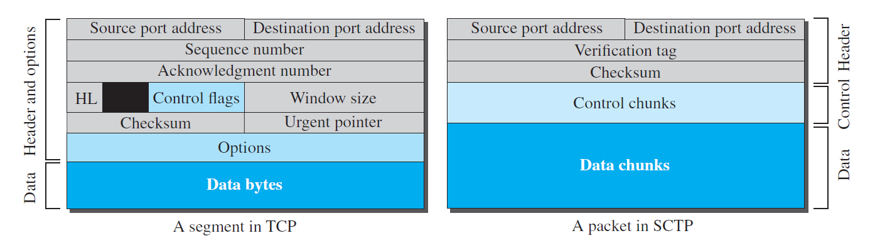
Packets
Comparison between a TCP segment and an SCTP packet

Slide 20
Packets
In SCTP, we have data chunks, streams, and packets.
An association may send many packets, a packet may contain several chunks, and chunks may belong to different streams.
To make the definitions of these terms clear, let us suppose that process A needs to send 11 messages to process B in three streams.
The first four messages are in the first stream, the second three messages are in the second stream, and the last four messages are in the third stream.
Although a message, if long, can be carried by several data chunks, we assume that each message fits into one data chunk. Therefore, we have 11 data chunks in three streams.

Slide 21
Packets
The application process delivers 11 messages to SCTP, where each message is earmarked for the appropriate stream.
Although the process could deliver one message from the first stream and then another from the second, we assume that it delivers all messages belonging to the first stream first, all messages belonging to the second stream next, and finally, all messages belonging to the last stream.

Slide 22
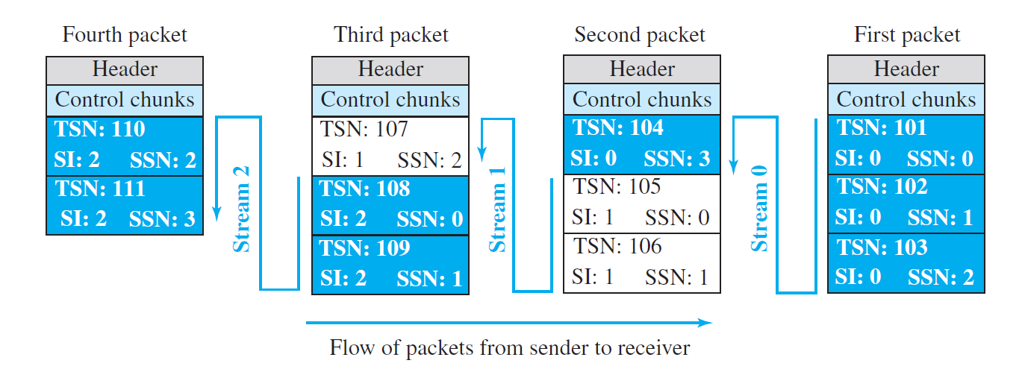
Packets
We also assume that the network allows only three data chunks per packet, which means that we need four packets, as shown in Figure.

Slide 23
Packets
Note that each data chunk needs three identifiers: TSN, SI, and SSN. TSN is a cumulative number and is used, as we will see later, for flow control and error control. SI defines the stream to which the chunk belongs. SSN defines the chunk’s order in a particular stream. In our example, SSN starts from 0 for each stream.

Slide 24
Acknowledgement Number
TCP acknowledgment numbers are byte-oriented and refer to the sequence numbers.
SCTP acknowledgment numbers are chunk-oriented. They refer to the TSN.
A second difference between TCP and SCTP acknowledgments is the control information. Recall that this information is part of the segment header in TCP.

Slide 25
Acknowledgement Number
To acknowledge segments that carry only control information, TCP uses a sequence number and acknowledgment number (for example, a SYN segment needs to be acknowledged by an ACK segment).
In SCTP, however, the control information is carried by control chunks, which do not need a TSN. These control chunks are acknowledged by another control chunk of the appropriate type (some need no acknowledgment).
For example, an INIT control chunk is acknowledged by an INIT-ACK chunk. There is no need for a sequence number or an acknowledgment number.

Slide 26
A Packet Format
An SCTP packet has a mandatory general header and a set of blocks called chunks.
There are two types of chunks: control chunks and data chunks.
A control chunk controls and maintains the association
a data chunk carries user data.
In a packet, the control chunks come before the data chunks.

Slide 27
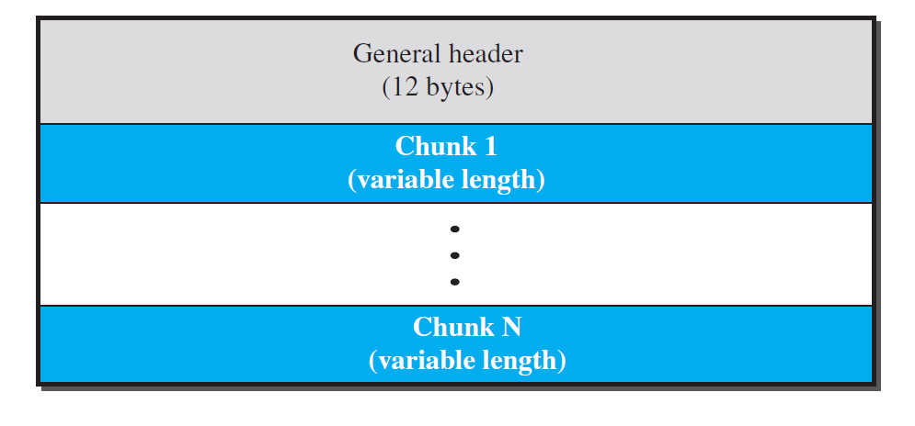
A Packet Format
General format of SCTP packet

Slide 28
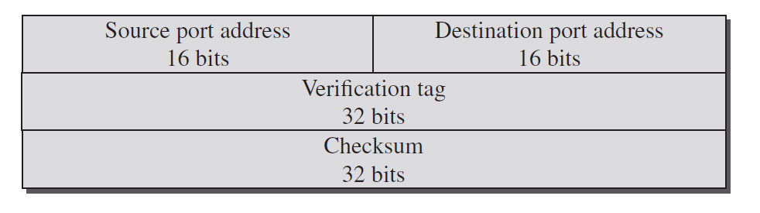
A Packet Format
The general header (packet header) defines the end points of each association to which the packet belongs, guarantees that the packet belongs to a particular association, and preserves the integrity of the contents of the packet including the header itself.
The format of the general header is shown below.
General header

Slide 29
A Packet Format
There are four fields in the general header.
The source and destination port numbers are the same as in UDP or TCP.
The verification tag is a 32-bit field that matches a packet to an association. This prevents a packet from a previous association from being mistaken as a packet in this association.
It serves as an identifier for the association; it is repeated in every packet during the association.
The next field is a checksum. However, the size of the checksum is increased from 16 bits (in UDP, TCP, and IP) to 32 bits in SCTP to allow the use of the CRC-32 checksum.

Slide 30
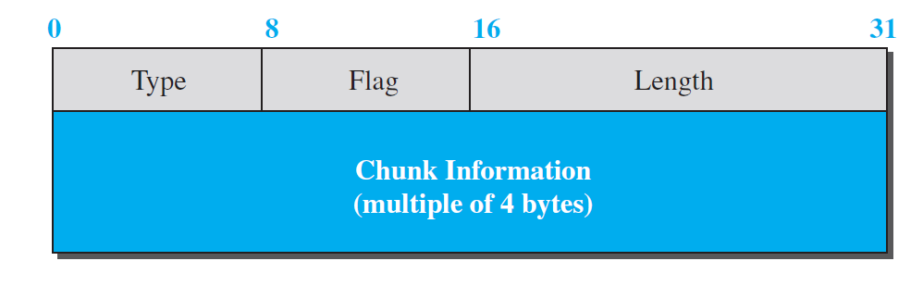
A Packet Format
Control information or user data are carried in chunks. Chunks have a common layout, as shown in Figure.

Slide 31
A Packet Format
Chunks
The first three fields are common to all chunks; the information field depends on the type of chunk.
The type field can define up to 256 types of chunks. Only a few have been defined so far; the rest are reserved for future use.
The flag field defines special flags that a particular chunk may need. Each bit has a different meaning depending on the type of chunk.

Slide 32
A Packet Format
Chunks
The length field defines the total size of the chunk, in bytes, including the type, flag, and length fields. Since the size of the information section is dependent on the type of chunk, we need to define the chunk boundaries. If a chunk carries no information, the value of the length field is 4 (4 bytes).
Note that the length of the padding, if any, is not included in the calculation of the length field. This helps the receiver find out how many useful bytes a chunk carries. If the value is not a multiple of 4, the receiver knows there is padding.

Slide 33
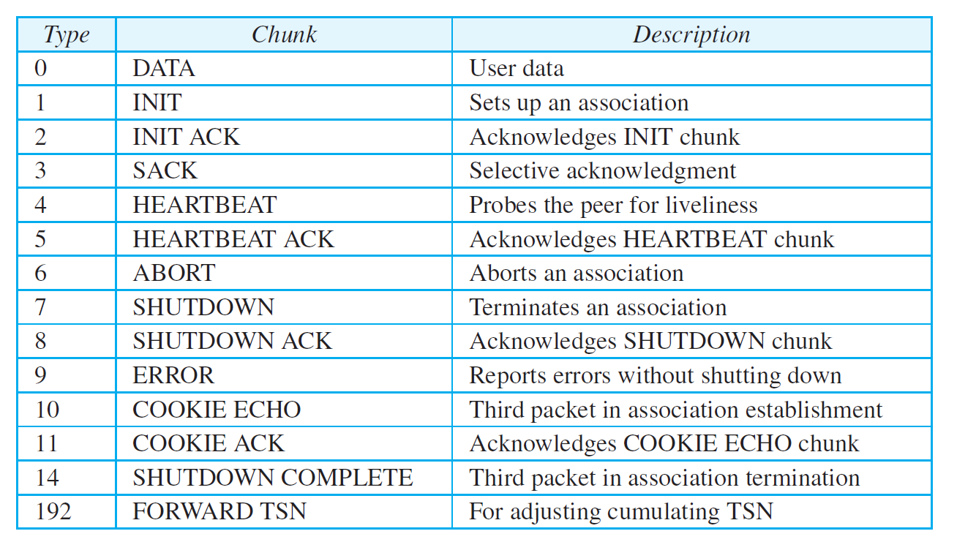
A Packet Format
Types of Chunks

Slide 34
An SCTP Associations
SCTP, like TCP, is a connection-oriented protocol.
However, a connection in SCTP is called an association to emphasize multihoming.
In this section, we will discuss the following points.
  Association Establishment
  Data Transfer
  Association Termination

Slide 35
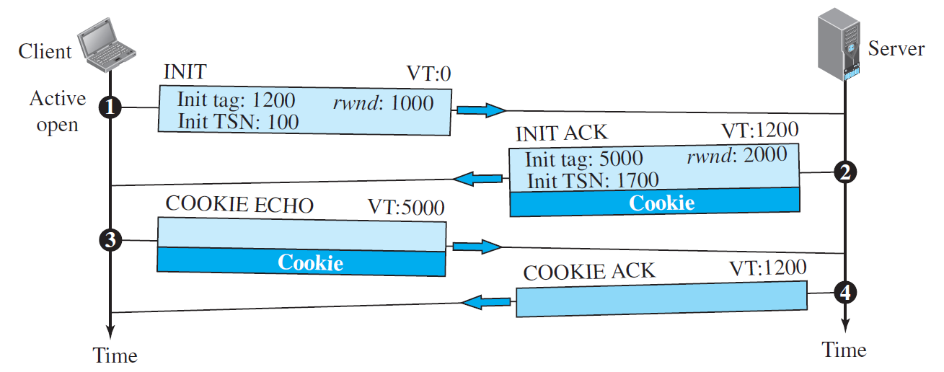
Association Establishment

Slide 36
Association Establishment
Association establishment in SCTP requires a four-way handshake.
In this procedure, a process, normally a client, wants to establish an association with another process, normally a server, using SCTP as the transport-layer protocol.
Similar to TCP, the SCTP server needs to be prepared to receive any association (passive open). Association establishment, however, is initiated by the client (active open).
SCTP association establishment is shown in Figure(Previous Slides).

Slide 37
Association Establishment (Step – 1)
The client sends the first packet, which contains an INIT chunk. The verification tag (VT) of this packet (defined in the general header) is 0 because no verification tag has yet been defined for this direction (client to server).
The INIT tag includes an initiation tag to be used for packets from the other direction (server to client).
The chunk also defines the initial TSN for this direction and advertises a value for rwnd.
The value of rwnd is normally advertised in a SACK chunk; it is done here because SCTP allows the inclusion of a DATA chunk in the third and fourth packets; the server must be aware of the available client buffer size. Note that no other chunks can be sent with the first packet.

Slide 38
Association Establishment (Step – 2)
The server sends the second packet, which contains an INIT ACK chunk.
The verification tag is the value of the initial tag field in the INIT chunk.
This chunk initiates the tag to be used in the other direction, defines the initial TSN, for data flow from server to client, and sets the server’s rwnd.
The value of rwnd is defined to allow the client to send a DATA chunk with the third packet.
The INIT ACK also sends a cookie that defines the state of the server at this moment.

Slide 39
Association Establishment (Step – 3)
The client sends the third packet, which includes a COOKIE ECHO chunk.
This is a very simple chunk that echoes, without change, the cookie sent by the server.
SCTP allows the inclusion of data chunks in this packet.

Slide 40
Association Establishment (Step – 4)
The server sends the fourth packet, which includes the COOKIE ACK chunk that acknowledges the receipt of the COOKIE ECHO chunk.
SCTP allows the inclusion of data chunks with this packet.

Slide 41
Data Transfer
The whole purpose of an association is to transfer data between two ends.
After the association is established, bidirectional data transfer can take place.
The client and the server can both send data. Like TCP, SCTP supports piggybacking.

Slide 42
Data Transfer
There is a major difference, however, between data transfer in TCP and SCTP.
TCP receives messages from a process as a stream of bytes without recognizing any boundary between them. The process may insert some boundaries for its peer use, but TCP treats that mark as part of the text. In other words, TCP takes each message and appends it to its buffer. A segment can carry parts of two different messages. The only ordering system imposed by TCP is the byte numbers.

Slide 43
Data Transfer
SCTP, on the other hand, recognizes and maintains boundaries.
Each message coming from the process is treated as one unit and inserted into a DATA chunk unless it is fragmented (discussed later).
In this sense, SCTP is like UDP, with one big advantage: data chunks are related to each other.
A message received from a process becomes a DATA chunk, or chunks if fragmented, by adding a DATA chunk header to the message.
Each DATA chunk formed by a message or a fragment of a message has one TSN.
We need to remember that only DATA chunks use TSNs and only DATA chunks are acknowledged by SACK chunks.

Slide 44
Data Transfer(Multihoming Data Transfer)
We discussed the multihoming capability of SCTP, a feature that distinguishes SCTP from UDP and TCP.
Multihoming allows both ends to define multiple IP addresses for communication.
However, only one of these addresses can be defined as the primary address; the rest are alternative addresses.
The primary address is defined during association establishment.
The interesting point is that the primary address of an end is determined by the other end.
In other words, a source defines the primary address for a destination.

Slide 45
Data Transfer(Multihoming Data Transfer)
Data transfer, by default, uses the primary address of the destination.
If the primary is not available, one of the alternative addresses is used.
The process, however, can always override the primary address and explicitly request that a message be sent to one of the alternative addresses.
A process can also explicitly change the primary address of the current association.
A logical question that arises is where to send a SACK. SCTP dictates that a SACK be sent to the address from which the corresponding SCTP packet originated.

Slide 46
Multistream Delivery
Another interesting feature of SCTP is the distinction between data transfer and data delivery.
SCTP uses TSN numbers to handle data transfer, movement of data chunks between the source and destination.
The delivery of the data chunks is controlled by SIs and SSNs.
SCTP can support multiple streams, which means that the sender process can define different streams and a message can belong to one of these streams.
Each stream is assigned a stream identifier (SI) which uniquely defines that stream.

Slide 47
Multistream Delivery
However, SCTP supports two types of data delivery in each stream:
  ordered (default)
  and unordered.
In ordered data delivery, data chunks in a stream use stream sequence numbers (SSNs) to define their order in the stream. When the chunks arrive at the destination, SCTP is responsible for message delivery according to the SSN defined in the chunk. This may delay the delivery because some chunks may arrive out of order.
In unordered data delivery, the data chunks in a stream have the U flag set, but their SSN field value is ignored.

Slide 48
Multistream Delivery
In unordered data delivery, the data chunks in a stream have the U flag set, but their SSN field value is ignored. They do not consume SSNs.
When an unordered data chunk arrives at the destination SCTP, it delivers the message carrying the chunk to the application without waiting for the other messages.
Most of the time, applications use the ordered-delivery service, but occasionally some applications need to send urgent data that must be delivered out of order (recall the urgent data and urgent pointer facility of TCP). In these cases, the application can define the delivery as unordered.

Slide 49
Fragmentation
Another issue in data transfer is fragmentation.
Although SCTP shares this term with IP , fragmentation in IP and SCTP belong to different levels: the former at the network layer, the latter at the transport layer.
SCTP preserves the boundaries of the message from process to process when creating a DATA chunk from a message if the size of the message (when encapsulated in an IP datagram) does not exceed the MTU of the path. The size of an IP datagram carrying a message can be determined by adding the size of the message, in bytes, to the four overheads: data chunk header, necessary SACK chunks, SCTP general header, and IP header. If the total size exceeds the MTU, the message needs to be fragmented.

Slide 50
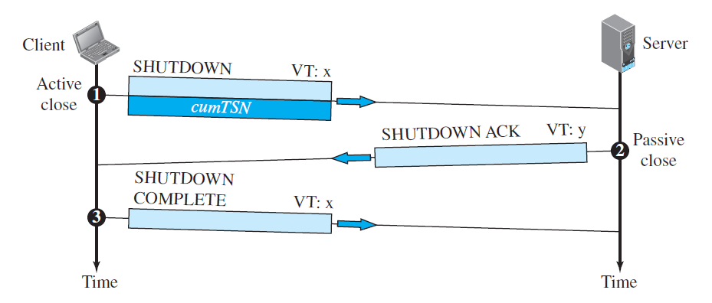
Association Termination

Slide 51
Association Termination
In SCTP, like TCP, either of the two parties involved in exchanging data (client or server) can close the connection.
However, unlike TCP, SCTP does not allow a “halfclosed” association.
If one end closes the association, the other end must stop sending new data. If any data are left over in the queue of the recipient of the termination request, they are sent and the association is closed.
Association termination uses three packets, as shown in Figure(Previous Slides).
Note that although the figure shows the case in which termination is initiated by the client, it can also be initiated by the server.

Slide 52
References
Data Communication and Networking, Fifth Edition, BEHROUZ A. FOROUZAN
Data Communication and Networking, Fourth Edition, BEHROUZAN A. FOROUZA
https://www.geeksforgeeks.org/introduction-of-classful-ip-addressing/

Slide 53
Thank You

