Slide 1
Advanced Computer Network
(4350706)
Unit-1
Network Layer Protocols
Prepared By :
Mr. Chetan C. Kamani
Lecturer, Computer Engineering Department
Government Polytechnic, Jamnagar

Slide 2
Topics to be discussed
Introduction to Network Layer protocols
IPv4 Address
  Address space
  Classful addressing
  Classless addressing
  Network Address Translation (NAT)

Slide 3
Introduction to Network Layer Protocols
The network layer is placed between data link layer and transport layer in the TCP/IP network reference model.
The responsibilities of the network layer are listed below.
  Logical Addressing
  Routing
  Fragmentation and reassembly
  Error detection and correction
  Flow Control
The different protocols defined at this layer are listed below.
  IPv4, ICMPv4, IGMP, ARP, IPv6, RARP

Slide 4
Write the full form…..
IPv4
ICMPv4
IGMP
ARP
IPv6
RARP

Slide 5
IPv4 Address
The identifier used in the network layer (IP layer) of the TCP/IP protocol suite to identify the connection of each device to the Internet is called the Internet address or IP address.
An IPv4 address is a 32-bit address that uniquely and universally defines the connection of a host or a router to the Internet.
The IP address is the address of the connection, not the host or the router, because if the device is moved to another network, the IP address may be changed.
An IPv4 address is unique to a single connection to the Internet. A device with two connections to the Internet, via two networks, will have two IPv4 addresses.
All hosts that want to connect to the Internet must use the IPv4 addressing system.

Slide 6
Address Space
A protocol like IPv4 that defines addresses has an address space.
An address space is the total number of addresses that can be used by a protocol.
The number of bits used to define an address determines the size of the address space.
For example, IPv4 uses 32 bits to define an address, so its address space is 232, which is equal to 4,294,967,296 addresses. This means that, in theory, more than 4 billion devices could be connected to the Internet using IPv4 addresses.

Slide 7
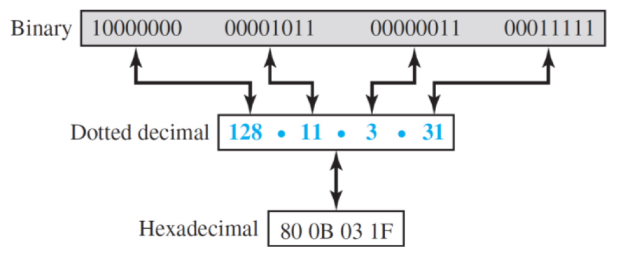
Address Space
Notations
  There are three common notations to represent an IPv4 address:
    binary notation (base 2)
    dotted-decimal notation (base 256)
    hexadecimal notation (base 16)

Slide 8
Example
Change the following IPv4 addresses from binary notation to dotted-decimal notation.
  10000001 00001011 00001011 11101111
  11000001 10000011 00011011 11111111.
Change the following IPv4 addresses from dotted-decimal notations to binary notations.
  111.56.45.78
  221.34.7.82

Slide 9
Example
Find the error, if any, in the following IPv4 addresses.
  111.56.045.78
  221.34.7.8.20
  75.45.301.14
  11100010.23.14.67

Slide 10
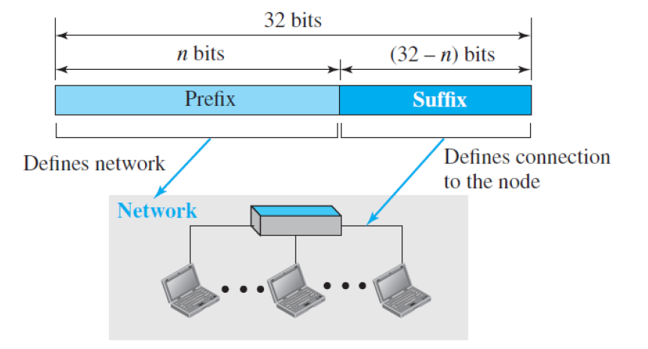
Address Space
Hierarchy in Addressing
  In any communication network that involves delivery, such as a telephone network or a postal network, the addressing system is hierarchical.
  Similarly, a 32-bit IPv4 address is also hierarchical, but divided only into two parts.
    The first part of the address, called the prefix (Net ID), defines the network.
    The second part of the address, called the suffix (Host ID), defines the node (connection of a device to the Internet).

Slide 11
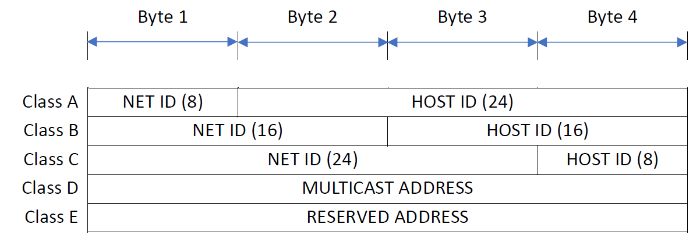
Classful Addressing
Classful addressing is an IPv4 addressing architecture that divides the address space into five classes:
  A, B, C, D, and E.
  The first three classes (A, B, and C) are used for network hosts, while class D is reserved for multicasting and class E is reserved for future use. Each class occupies some part of the address space.
The IPv4 address is divided into two parts:
  Net ID (Prefix)
  Host ID (Suffix)

Slide 12
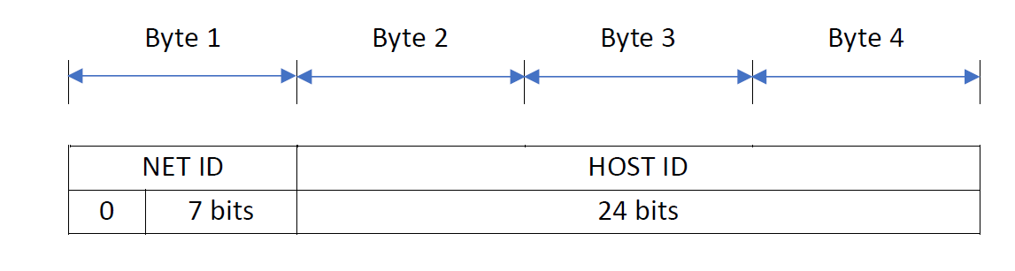
Class A (classful addressing)
IP addresses belonging to class A are assigned to the networks that contain a large number of hosts.
The Net ID is 8 bits long.
The Host ID is 24 bits long.
The higher-order bit of the first octet in class A is always set to 0. The remaining 7 bits in the first octet are used to determine network ID. The 24 bits of host ID are used to determine the host within the network.
The default subnet mask for Class A is 255.0.0.0.
class A has a total of
  2⁷-2= 126 network ID (Here 2 address is subtracted because 0.0.0.0 and 127.255.255.255 are special address.)
  2²⁴ – 2 = 16,777,214 host ID
IP addresses belonging to class A ranges from 1.0.0.0 – 126.255.255.255

Slide 13
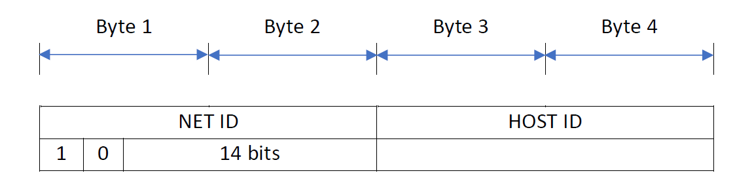
Class B (classful addressing)
IP address belonging to class B is assigned to networks that range from medium-sized to large-sized networks.
The Net ID is 16 bits long.
The Host ID is 16 bits long.
The higher-order bits of the first octet of IP addresses of class B are always set to 10. The remaining 14 bits are used to determine the network ID. The 16 bits of host ID are used to determine the host in any network.
The default subnet mask for class B is 255.255.0.0.
Class B has a total of:
  2¹⁴ = 16384 network address
  2¹⁶ – 2 = 65534 host address
IP addresses belonging to class B ranges from 128.0.0.0 – 191.255.255.255.

Slide 14
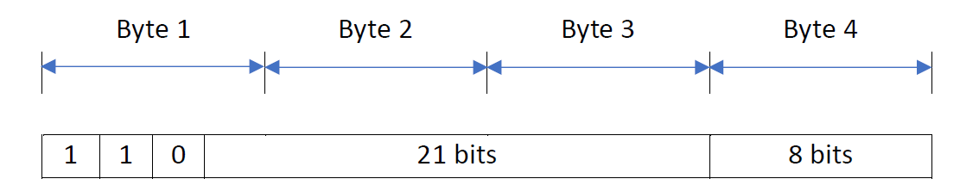
Class C (classful addressing)
IP addresses belonging to class C are assigned to small-sized networks.
The Net ID is 24 bits long.
The Host ID is 8 bits long.
The higher-order bits of the first octet of IP addresses of class C are always set to 110. The remaining 21 bits are used to determine the network ID. The 8 bits of host ID are used to determine the host in any network.
The default subnet mask for class C is 255.255.255.0.
Class C has a total of:
  2²¹ = 2097152 network address
  2⁸ – 2 = 254 host address
oIP addresses belonging to class C range from 192.0.0.0 – 223.255.255.255.

Slide 15
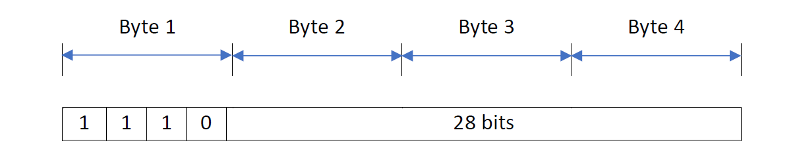
Class D (classful addressing)
IP address belonging to class D is reserved for multi-casting.
The higher-order bits of the first octet of IP addresses belonging to class D are always set to 1110. The remaining bits are for the address that interested hosts recognize.
Class D does not possess any subnet mask.
IP addresses belonging to class D range from 224.0.0.0 – 239.255.255.255.

Slide 16
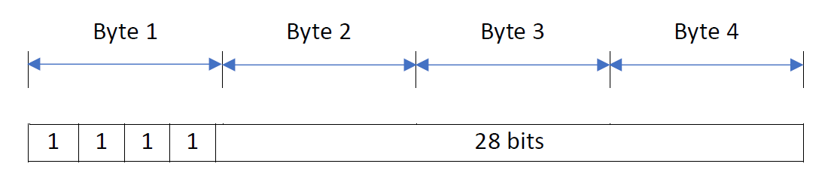
Class E (classful addressing)
IP addresses belonging to class E are reserved for experimental and research purposes.
The higher-order bits of the first octet of IP addresses belonging to class E are always set to 1111.
Class E does not possess any subnet mask.
IP addresses of class E range from 240.0.0.0 – 255.255.255.254.

Slide 17
Example
Find the class of each address.
  00000001 00001011 00001011 11101111
  11000001 10000011 00011011 11111111
  14.23.120.8
  252.5.15.111

Slide 18


Slide 19


Slide 21
Address depletion (classful addressing)
The reason that classful addressing has become obsolete is address depletion.
Since the addresses were not distributed properly, the Internet was faced with the problem of the addresses being rapidly used up, resulting in no more addresses available for organizations and individuals that needed to be connected to the Internet.
To alleviate address depletion, two strategies were proposed and, to some extent, implemented: subnetting and supernetting.

Slide 22
Advantage (classful addressing)
Although classful addressing had several problems and became obsolete, it had one advantage: Given an address, we can easily find the class of the address and, since the prefix length (Net ID) for each class is fixed, we can find the prefix length (Net ID) immediately.
In other words, the prefix length (Net ID) in classful addressing is inherent in the address; no extra information is needed to extract the prefix Net ID) and the suffix (Host ID).

Slide 23
Classless addressing
A called classless addressing, uses the same address space as IPv4 but distributes the addresses more efficiently.
Classless addressing does not assign addresses based on classes, but instead allows organizations to get the exact amount of address space they need.
In other words, classless addressing removes the "class privilege" from the distribution of addresses. This helps to compensate for the address depletion problem and allows more organizations to get the addresses they need.

Slide 24
Classless addressing
In classless addressing, the whole address space is divided into variable length blocks.
The prefix in an address defines the block (network); the suffix defines the node (device).
Theoretically, we can have a block of 2⁰, 2¹, 2², . . . , 2³² addresses. One of the restrictions is that the number of addresses in a block needs to be a power of 2. An organization can be granted one block of addresses.
Unlike classful addressing, the prefix length in classless addressing is variable. We can have a prefix length that ranges from 0 to 32.
The size of the network is inversely proportional to the length of the prefix. A small prefix means a larger network; a large prefix means a smaller network.

Slide 25
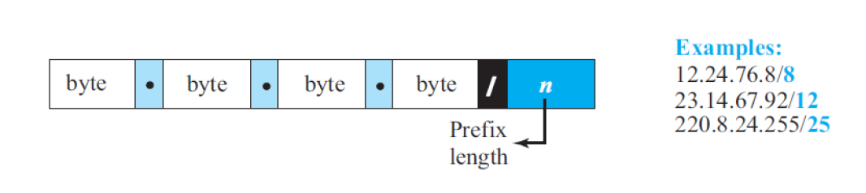
Prefix Length : Slash(CIDR) Notation
the prefix length, n, is added to the address, separated by a slash. The notation is informally referred to as slash notation and formally as classless interdomain routing or CIDR (pronounced cider) strategy.
An address in classless addressing can then be represented as shown in Figure below.

Slide 26
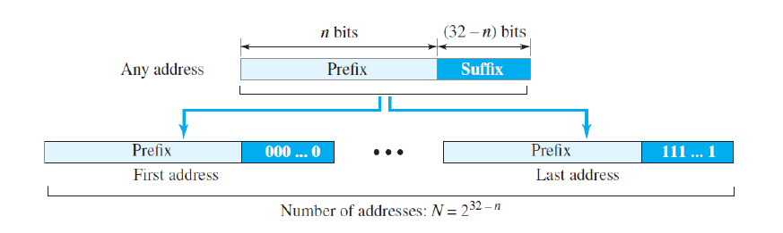
Extracting Information from Address
Given any address in the block, we normally like to know three pieces of information about the block to which the address belongs:
  The number of addresses,
  The first address in the block,
  The last address.
Since the value of prefix length, n, is given, we can easily find these three pieces of information.
  The number of addresses in the block is found as N = 2³²−n.
  To find the first address, we keep the n leftmost bits and set the (32 − n) rightmost bits all to 0s.
  To find the last address, we keep the n leftmost bits and set the (32 − n) rightmost bits all to 1s.

Slide 27


Slide 28


Slide 29
Example
A classless address is given as 167.199.170.82/27. Find the number of addresses, the first and last address of the network.

Slide 30
Address Mask
Another way to find the first and last addresses in the block is to use the address mask.
The address mask is a 32-bit number in which the n leftmost bits are set to 1s and the rest of the bits (32 − n) are set to 0s.
A computer can easily find the address mask because it is the complement of (2^{32 − n} − 1).
The reason for defining a mask in this way is that it can be used by a computer program to extract the information in a block, using the three bit-wise operations NOT, AND, and OR.
  The number of addresses in the block N = NOT (mask) + 1.
  The first address in the block = (Any address in the block) AND (mask).
  The last address in the block = (Any address in the block) OR [(NOT (mask)].

Slide 31
Example
A classless address is given as 167.199.170.82/27. Find the address mask, number of addresses, the first and last address of the network.

Slide 32
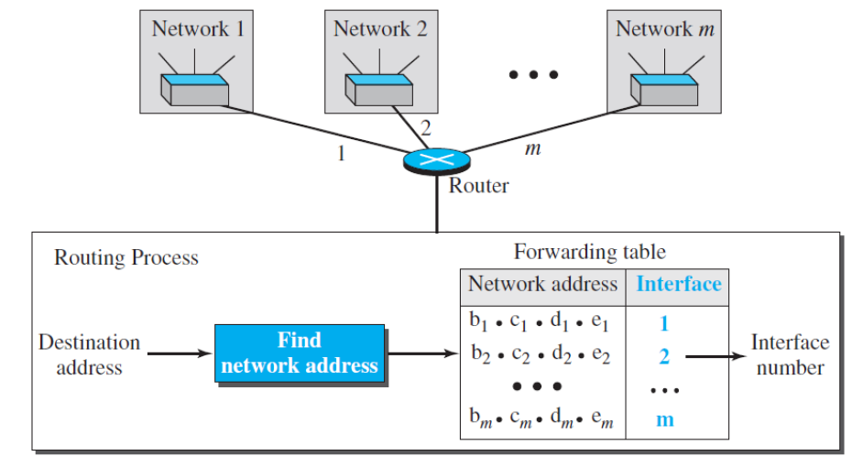
Network Address
The first address, the network address, is particularly important because it is used in routing a packet to its destination network.
For the moment, let us assume that an internet is made of m networks and a router with m interfaces. When a packet arrives at the router from any source host, the router needs to know to which network the packet should be sent: from which interface the packet should be sent out. When the packet arrives at the network, it reaches its destination host using another strategy.
After the network address has been found, the router consults its forwarding table to find the corresponding interface from which the packet should be sent out.
The network address is actually the identifier of the network; each network is identified by its network address.

Slide 33
Block Allocation
The ultimate responsibility of block allocation is given to a global authority called the Internet Corporation for Assigned Names and Numbers (ICANN). However, ICANN does not normally allocate addresses to individual Internet users. It assigns a large block of addresses to an ISP (or a larger organization that is considered an ISP in this case).
For the proper operation of the CIDR, two restrictions need to be applied to the allocated block.
First, The number of requested addresses, N, needs to be a power of 2. The reason is that N = 232 – n or n = 32 – log2N. If N is not a power of 2, we cannot have an integer value for n.
Second, The requested block needs to be allocated where there is an adequate number of contiguous addresses available in the address space. However, there is a restriction on choosing the first address in the block. The first address needs to be divisible by the number of addresses in the block. The reason is that the first address needs to be the prefix followed by (32 – n) number of 0s. The decimal value of the first address is then
first address = (prefix in decimal) × 2^{32 – n} = (prefix in decimal) × N.

Slide 34
Example
Consider the classless address 230.8.24.56 and find block size for the following different prefixes.
  /16
  /20
  /26
  /27
  /29
  /31

Slide 35
Subnetting
Subnetting is the process of dividing a single IP network into smaller subnetworks, or subnets.
More levels of hierarchy can be created using subnetting. An organization (or an ISP) that is granted a range of addresses may divide the range into several subranges and assign each subrange to a subnetwork (or subnet).
Note that nothing stops the organization from creating more levels. A subnetwork can be divided into several sub-subnetworks. A sub-subnetwork can be divided into several sub-sub-subnetworks, and so on.

Slide 36
Subnetting
Designing Subnets
The subnetworks in a network should be carefully designed to enable the routing of packets.
We assume the total number of addresses granted to the organization is N, the prefix length is n, the assigned number of addresses to each subnetwork is N_{sub}, and the prefix length for each subnetwork is n_{sub}. Then the following steps need to be carefully followed to guarantee the proper operation of the subnetworks.
  The number of addresses in each subnetwork should be a power of 2.
  The prefix length for each subnetwork should be found using the following formula: n_{sub} = 32 − log₂N_{sub}
  The starting address in each subnetwork should be divisible by the number of addresses in that subnetwork. This can be achieved if we first assign addresses to larger subnetworks.

Slide 37
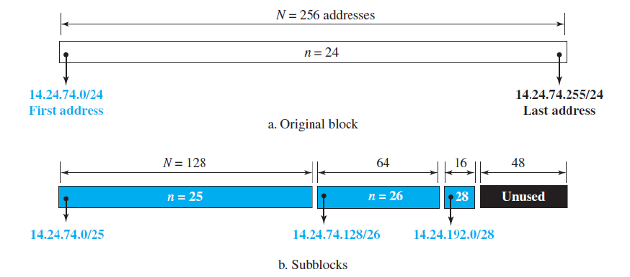
Subnetting
Finding information about each subnetwork
After designing the subnetworks, the information about each subnetwork, such as first and last address, can be found using the process we described to find the information about each network in the Internet.

Slide 38
Example
An organization is granted a block of addresses with the beginning address 14.24.74.0/24. The organization needs to have 3 subblocks of addresses to use in its three subnets: one subblock of 10 addresses, one subblock of 60 addresses, and one subblock of 120 addresses. Design the subblocks. Find First and last address of each subblock.

Slide 39
Address Aggregation
One of the advantages of the CIDR strategy is address aggregation (sometimes called address summarization or route summarization).
When blocks of addresses are combined to create a larger block, routing can be done based on the prefix of the larger block.
ICANN assigns a large block of addresses to an ISP. Each ISP in turn divides its assigned block into smaller subblocks and grants the subblocks to its customers.

Slide 40
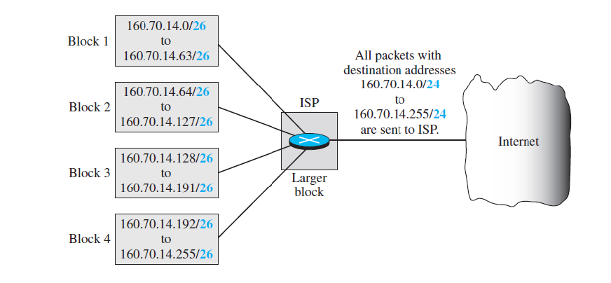
Address Aggregation

Slide 41
Special Addresses
Special Addresses
This Host Address
Limited Broadcast Address
Loopback Address
Private Address
Multicast Address

Slide 42
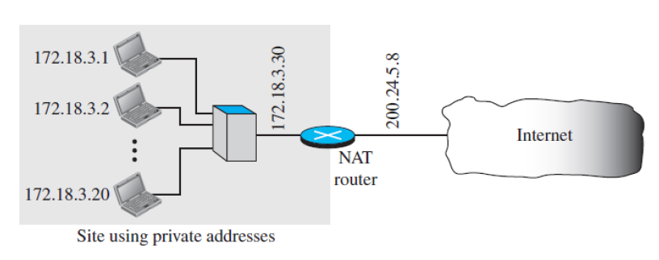
Network Address Translation
A technology that can provide the mapping between the private and universal addresses is known as Network Address Translation (NAT).
The technology allows a site to use a set of private addresses for internal communication and a set of global Internet addresses (at least one) for communication with the rest of the world.
The site must have only one connection to the global Internet through a NAT-capable router that runs NAT software.

Slide 43
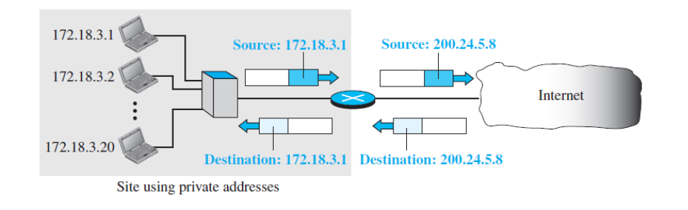
Address Translation (NAT)
All of the outgoing packets go through the NAT router, which replaces the source address in the packet with the global NAT address.
All incoming packets also pass through the NAT router, which replaces the destination address in the packet (the NAT router global address) with the appropriate private address.

Slide 44
Translation Table (NAT)
The reader may have noticed that translating the source addresses for an outgoing packet is straightforward. But how does the NAT router know the destination address for a packet coming from the Internet?
There may be tens or hundreds of private IP addresses, each belonging to one specific host. The problem is solved if the NAT router has a translation table.

Slide 45
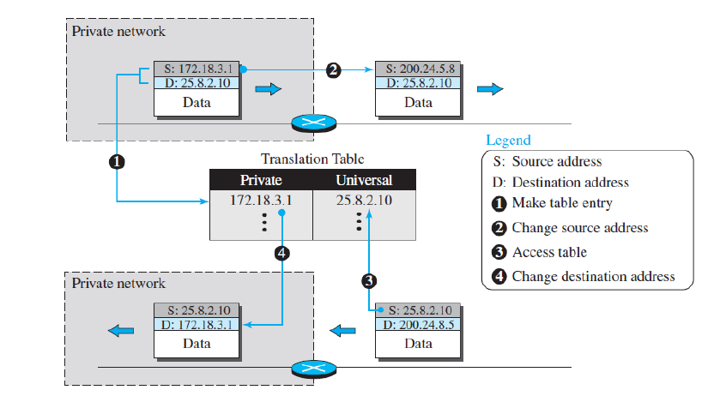
Using One IP Address (NAT)

Slide 46
Using One IP Address (NAT)
In its simplest form, a translation table has only two columns:
  the private address
  and the external address (destination address of the packet).
When the router translates the source address of the outgoing packet, it also makes note of the destination address— where the packet is going.
When the response comes back from the destination, the router uses the source address of the packet (as the external address) to find the private address of the packet.

Slide 47
Using a pool of IP Address (NAT)
The use of only one global address by the NAT router allows only one private-network host to access a given external host.
To remove this restriction, the NAT router can use a pool of global addresses. For example, instead of using only one global address (200.24.5.8), the NAT router can use four addresses (200.24.5.8, 200.24.5.9, 200.24.5.10, and 200.24.5.11).
In this case, four private-network hosts can communicate with the same external host at the same time because each pair of addresses defines a separate connection.
However, there are still some drawbacks. No more than four connections can be made to the same destination. No private-network host can access two external server
programs (e.g., HTTP and TELNET) at the same time. And, likewise, two private-network hosts cannot access the same external server program (e.g., HTTP or TELNET) at the same time.

Slide 48
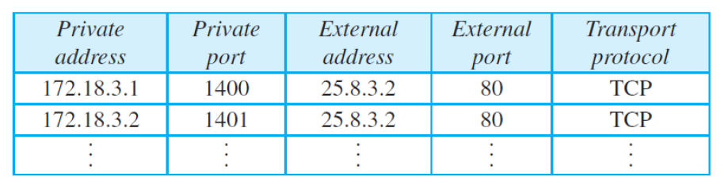
Using both IP Addresses & PORT addresses (NAT)
To allow a many-to-many relationship between private-network hosts and external server programs, we need more information in the translation table.
For example, suppose two hosts inside a private network with addresses 172.18.3.1 and 172.18.3.2 need to access the HTTP server on external host 25.8.3.2. If the translation table has five columns, instead of two, that include the source and destination port addresses and the transport-layer protocol, the ambiguity is eliminated.

Slide 49
Questions
Explain different notations to represent IPv4 address.
Explain classful addressing.
Explain classless addressing.
What is address depletion?
Write the advantage of classful addressing.
Explain prefix length: slash notation or CIDR notation.
List out types of special addresses.
Explain network address translation.
Explain subnetting with suitable example
Explain address aggregation with suitable example.

Slide 50
References
Data Communication and Networking, Fifth Edition, BEHROUZ A. FOROUZAN
Data Communication and Networking, Fourth Edition, BEHROUZAN A. FOROUZA
https://www.geeksforgeeks.org/introduction-of-classful-ip-addressing/

Slide 51
Thank You

