Slide 1
Advanced Computer Network
(4350706)
Unit-1
Network Layer Protocols
Prepared By :
Mr. Chetan C. Kamani
Lecturer, Computer Engineering Department
Government Polytechnic, Jamnagar

Slide 2
Topics to be discussed
Forwarding of IP packets
  Forwarding based on destination address
    Address Aggregation
    Longest Match Making
    Hierarchical Routing
    Geographical Routing
    Forwarding table search algorithm

Slide 3
Forwarding of IP packets
A forwarding means to place the packet in its route to its destination.
Since the Internet today is made of a combination of links (networks), forwarding means to deliver the packet to the next hop (which can be the final destination or the intermediate connecting device).
Although the IP protocol was originally designed as a connectionless protocol, today the tendency is to change it to a connection-oriented protocol.
When IP is used as a connectionless protocol, forwarding is based on the destination address of the IP datagram; when the IP is used as a connection-oriented protocol, forwarding is based on the label attached to an IP datagram.
We will discuss only forwarding based on the destination address here

Slide 4
Forwarding based on destination address
This is a traditional approach, which is prevalent today.
In this case, forwarding requires a host or a router to have a forwarding table.
When a host has a packet to send or when a router has received a packet to be forwarded, it looks at this table to find the next hop to deliver the packet to.
In classless addressing, the whole address space is one entity; there are no classes. This means that forwarding requires one row of information for each block involved. The table needs to be searched based on the network address (first address in the block). Unfortunately, the destination address in the packet gives no clue about the network address. To solve the problem, we need to include the mask (/n) in the table.

Slide 5
Forwarding based on destination address
In other words, a classless forwarding table needs to include four pieces of information: the mask, the network address, the interface number, and the IP address of the next router.
However, we often see in the literature that the first two pieces are combined. For example, if n is 26 and the network address is 180.70.65.192, then one can combine the two as one piece of information: 180.70.65.192/26.

Slide 6
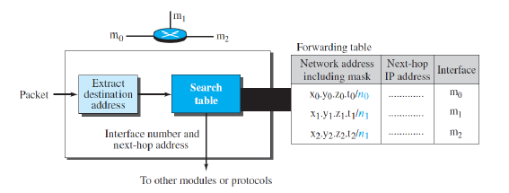
Forwarding based on destination address

Slide 7
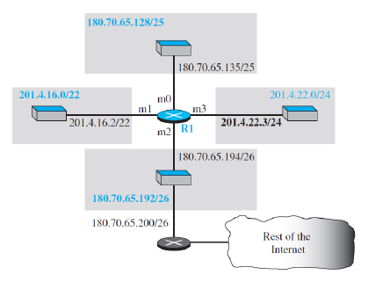
Example
Make a forwarding table for router R1 using the configuration as shown in the following figure
Design forwarding table in dotted-decimal notation.
Design forwarding table in binary notation.

Slide 8
Example
Show the forwarding process if a packet arrives at R1 as shown in the figure with the destination address 180.70.65.140.

Slide 9
Address Aggregation
When we use classful addressing, there is only one entry in the forwarding table for each site outside the organization. The entry defines the site even if that site is subnetted. When a packet arrives at the router, the router checks the corresponding entry and forwards the packet accordingly.
When we use classless addressing, it is likely that the number of forwarding table entries will increase. This is because the intent of classless addressing is to divide up the whole address space into manageable blocks. The increased size of the table results in an increase in the amount of time needed to search the table.
To alleviate the problem, the idea of address aggregation was designed.

Slide 10
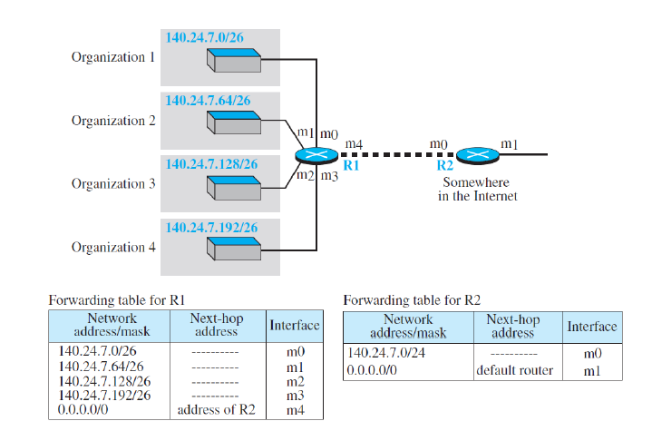
Address Aggregation

Slide 11
Longest Match Making
What happens if one of the organizations in the previous figure(Address Aggregation) is not geographically close to the other three?
For example, if organization 4 cannot be connected to router R1 for some reason, can we still use the idea of address aggregation and still assign block 140.24.7.192/26 to organization 4?
The answer is yes, because routing in classless addressing uses another principle, longest mask matching.
This principle states that the forwarding table is sorted from the longest mask to the shortest mask. In other words, if there are three masks, /27, /26, and /24, the mask /27 must be the first entry and /24 must be the last.

Slide 12
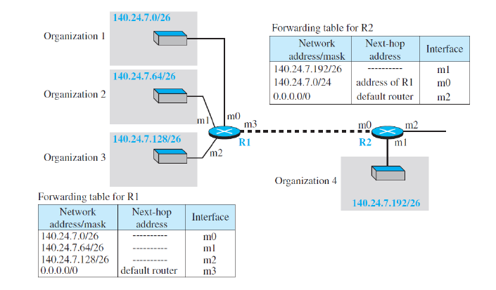
Longest Match Making

Slide 13
Hierarchical Routing
To solve the problem of gigantic forwarding tables, we can create a sense of hierarchy in the forwarding tables.
The Internet today has a sense of hierarchy. That the Internet is divided into backbone and national ISPs. National ISPs are divided into regional ISPs, and regional ISPs are divided into local ISPs.
If the forwarding table has a sense of hierarchy like the Internet architecture, the forwarding table can decrease in size.
Let us take the case of a local ISP. A local ISP can be assigned a single, but large, block of addresses with a certain prefix length. The local ISP can divide this block into smaller blocks of different sizes, and assign these to individual users and organizations, both large and small.

Slide 14
Hierarchical Routing
If the block assigned to the local ISP starts with a.b.c.d/n, the ISP can create blocks starting with e.f.g.h/m, where m may vary for each customer and is greater than n. How does this reduce the size of the forwarding table?
The rest of the Internet does not have to be aware of this division. All customers of the local ISP are defined as a.b.c.d/n to the rest of the Internet.
Every packet destined for one of the addresses in this large block is routed to the local ISP.

Slide 15
Hierarchical Routing
There is only one entry in every router in the world for all of these customers. They all belong to the same group. Of course, inside the local ISP, the router must recognize the subblocks and route the packet to the destined customer. If one of the customers is a large organization, it also can create another level of hierarchy by subnetting and dividing its subblock into smaller subblocks (or sub-subblocks).
In classless routing, the levels of hierarchy are unlimited as long as we follow the rules of classless addressing.

Slide 16
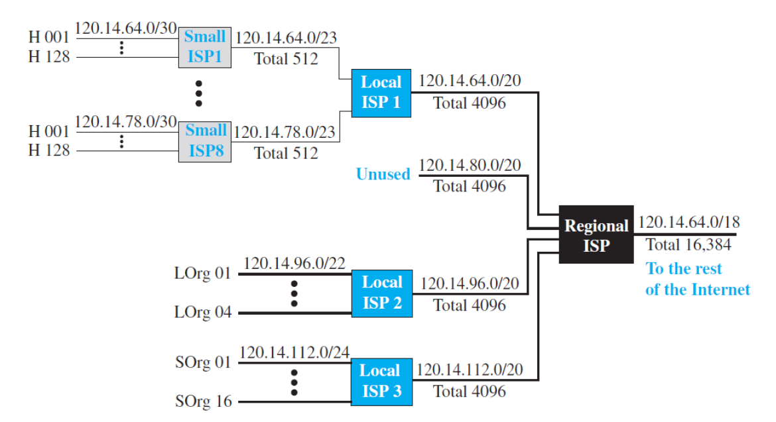
Hierarchical Routing

Slide 17
Geographical Routing
To decrease the size of the forwarding table even further, we need to extend hierarchical routing to include geographical routing.
We must divide the entire address space into a few large blocks.
We assign a block to America, a block to Europe, a block to Asia, a block to Africa, and so on.
The routers of ISPs outside of Europe will have only one entry for packets to Europe in their forwarding tables.
The routers of ISPs outside of America will have only one entry for packets to America in their forwarding tables, and so on.

Slide 18
Forwarding Table Search Algorithm
In classless addressing, there is no network information in the destination address.
The simplest, but not the most efficient, search method is called the longest prefix match (as we discussed before).
The forwarding table can be divided into buckets, one for each prefix.
The router first tries the longest prefix. If the destination address is found in this bucket, the search is complete. If the address is not found, the next prefix is searched, and so on.
It is obvious that this type of search takes a long time. One solution is to change the data structure used for searching. Instead of a list, other data structures (such as a tree or a binary tree) can be used. One candidate is a tree (a special kind of tree).

Slide 19
Questions
Explain forwarding of IP packet based on destination address.

Slide 20
References
Data Communication and Networking, Fifth Edition, BEHROUZ A. FOROUZAN
Data Communication and Networking, Fourth Edition, BEHROUZAN A. FOROUZA
https://www.geeksforgeeks.org/introduction-of-classful-ip-addressing/

Slide 21
Thank You

