Slide 1
Advanced Computer Network
(4350706)
Unit-1
Network Layer Protocols
Prepared By :
Mr. Chetan C. Kamani
Lecturer, Computer Engineering Department
Government Polytechnic, Jamnagar

Slide 2
Topics to be discussed
Internet Protocol
  Datagram Format
  Fragmentation
  Options
  Security of IPv4 datagrams

Slide 3
Topics to be discussed
Internet Protocol Version 4
  Datagram Format
  Fragmentation
  Options
  Security of IPv4 datagrams

Slide 4
Internet Protocol Version 4
The network layer in version 4 can be thought of as one main protocol and three auxiliary ones.
The main protocol, Internet Protocol version 4 (IPv4), is responsible for packetizing, forwarding, and delivery of a packet at the network layer.
The Internet Control Message Protocol version 4 (ICMPv4) helps IPv4 to handle some errors that may occur in the network-layer delivery.
The Internet Group Management Protocol (IGMP) is used to help IPv4 in multicasting.
• The Address Resolution Protocol (ARP) is used to glue the network and data-link layers in mapping network-layer addresses to link-layer addresses.

Slide 5
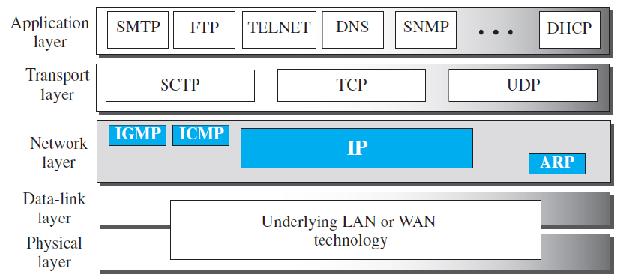
Internet Protocol Version 4

Slide 6
Internet Protocol Version 4
IPv4 is an unreliable datagram protocol—a best-effort delivery service. The term best-effort means that IPv4 packets can be corrupted, be lost, arrive out of order, or be delayed, and may create congestion for the network. If reliability is important, IPv4 must be paired with a reliable transport-layer protocol such as TCP.
An example of a more commonly understood best-effort delivery service is the post office. The post office does its best to deliver the regular mail but does not always succeed. If an unregistered letter is lost or damaged, it is up to the sender or would-be recipient to discover this.
The post office itself does not keep track of every letter and cannot notify a sender of loss or damage of one.

Slide 7
Internet Protocol Version 4
IPv4 is also a connectionless protocol that uses the datagram approach. This means that each datagram is handled independently, and each datagram can follow a different route to the destination. This implies that datagrams sent by the same source to the same destination could arrive out of order.
Again, IPv4 relies on a higher-level protocol to take care of all these problems.

Slide 8
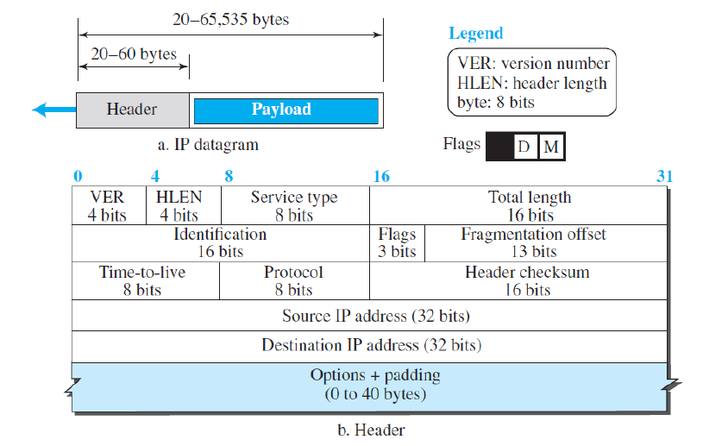
Datagram Format

Slide 9
Datagram Format
A datagram is a variable-length packet consisting of two parts: header and payload (data).
The header is 20 to 60 bytes in length and contains information essential to routing and delivery.
It is customary in TCP/IP to show the header in byte sections.

Slide 10
Datagram Format
Version Number
  The 4-bit version number (VER) field defines the version of the IPv4 protocol, which, obviously, has the value of 4.
  This field tells the IPv4 software running in the processing machine that datagram has the format of version 4. All fields must be interpreted as specified in the fourth version of the protocol.
Header Length.
  This 4-bit header length (HLEN) field defines the total length of the datagram header in 4-byte words.
  This field is needed because the length of the header is variable (between 20 bytes and 60 bytes).
  When there are no options, the header length is 20 bytes, and the value of this field is 5 (5 x 4 = 20).
  When the option field is as its maximum size, the value of this field is 15 (15 x 4 = 60).

Slide 11
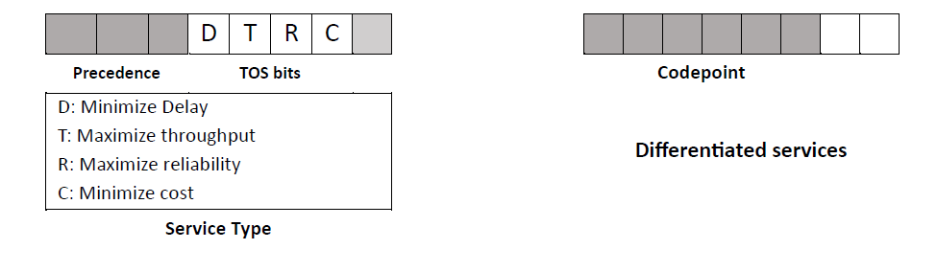
Datagram Format
Service Type
  IETF has changed the interpretation and name of this 8-bit field. This field, previously called service type, is now called differentiated services.
  Both interpretations are shown in the figure below.

Slide 12
Datagram Format
Total Length
  This 16-bit field defines the total length (header plus data) of the IP datagram in bytes
Identification, Flags, and Fragmentation Offset.
  These three fields are related to the fragmentation of the IP datagram when the size of the datagram is larger than the underlying network can carry.
Time-to-live.
  A datagram has limited lifetime in its travel through an internet. So, this field is used to set the lifetime of the packet.
Protocol.
  This field is used to indicate the higher layer protocol which uses an IP as the delivery protocol.

Slide 13
Datagram Format
Header Checksum
  IP adds a header checksum field to check the correctness of the header at the intermediate router or the destination host.
Source and Destination address
  These 32-bit source and destination address fields define the IP address of the source and destination respectively.
Options
  A datagram header can have up to 40 bytes of options.
  An Options can be used for network testing and debugging.

Slide 14
Datagram Format
Payload
  Payload, or data, is the main reason for creating a datagram.
  Payload is the packet coming from other protocols that use the service of IP.
  Comparing a datagram to a postal package, payload is the content of the package; the header is only the information written on the package.

Slide 15
Example
An IPv4 packet has arrived with the first 8 bits as (01000010)₂ The receiver discards the packet. Why?

Slide 16
Example
In an IPv4 packet, the value of HLEN is (1000)₂. How many bytes of options are being carried by this packet?

Slide 17
Example
In an IPv4 packet, the value of HLEN is 5, and the value of the total length field is (0028)₁₆. How many bytes of data are being carried by this packet?

Slide 18
Example
An IPv4 packet has arrived with the first few hexadecimal digits as shown.
(45000028000100000102…)₁₆
How many hops can this packet travel before being dropped? The data belong to what upper-layer protocol?

Slide 19
Fragmentation
A datagram can travel through different networks.
Each router decapsulates the IP datagram from the frame it receives, processes it, and then encapsulates it in another frame.
The format and size of the received frame depend on the protocol used by the physical network through which the frame has just travelled.
The format and size of the sent frame depend on the protocol used by the physical network through which the frame is going to travel.
For example, if a router connects a LAN to a WAN, it receives a frame in the LAN format and sends a frame in the WAN format.

Slide 20
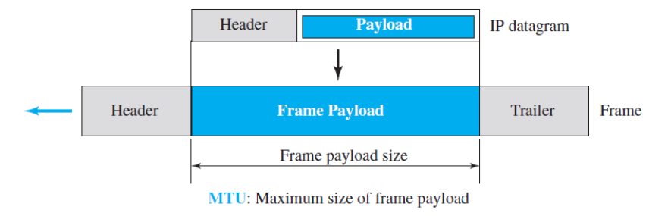
Maximum Transfer Unit
Each link-layer protocol has its own frame format. One of the features of each format is the maximum size of the payload that can be encapsulated.
In other words, when a datagram is encapsulated in a frame, the total size of the datagram must be less than this maximum size, which is defined by the restrictions imposed by the hardware and software used in the network .

Slide 21
Maximum Transfer Unit
The value of the MTU differs from one physical network protocol to another.
For example, the value for a LAN is normally 1500 bytes, but for a WAN it can be larger or smaller.
In order to make the IP protocol independent of the physical network, the designers decided to make the maximum length of the IP datagram equal to 65,535 bytes. This makes transmission more efficient if one day we use a link-layer protocol with an MTU of this size.

Slide 22
Maximum Transfer Unit
However, for other physical networks, we must divide the datagram to make it possible for it to pass through these networks. This is called fragmentation.
When a datagram is fragmented, each fragment has its own header with most of the fields repeated, but some have been changed.
A fragmented datagram may itself be fragmented if it encounters a network with an even smaller MTU.
In other words, a datagram may be fragmented several times before it reaches the final destination.

Slide 23
Maximum Transfer Unit
datagram can be fragmented by the source host or any router in the path. The reassembly of the datagram, however, is done only by the destination host, because each fragment becomes an independent datagram.
Whereas the fragmented datagram can travel through different routes, and we can never control or guarantee which route a fragmented datagram may take, all of the fragments belonging to the same datagram should finally arrive at the destination host.
So it is logical to do the reassembly at the final destination.

Slide 24
Maximum Transfer Unit
An even stronger objection for reassembling packets during the transmission is the loss of efficiency it incurs.
When we talk about fragmentation, we mean that the payload of the IP datagram is fragmented.
However, most parts of the header, with the exception of some options, must be copied by all fragments.
The host or router that fragments a datagram must change the values of three fields: flags, fragmentation offset, and total length. The rest of the fields must be copied. Of course, the value of the checksum must be recalculated regardless of fragmentation.

Slide 25
Fields related to fragmentation
three fields in an IP datagram are related to fragmentation:
  identification,
  flags,
  fragmentation offset.

Slide 26
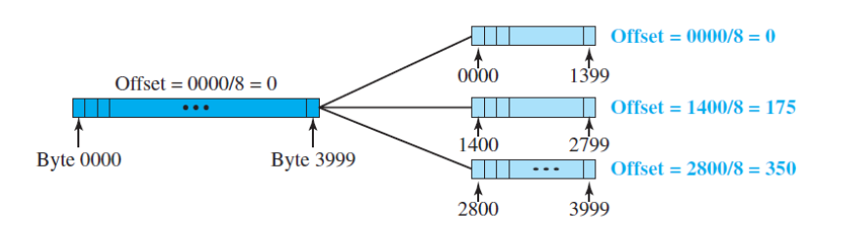
Fields related to fragmentation

Slide 27
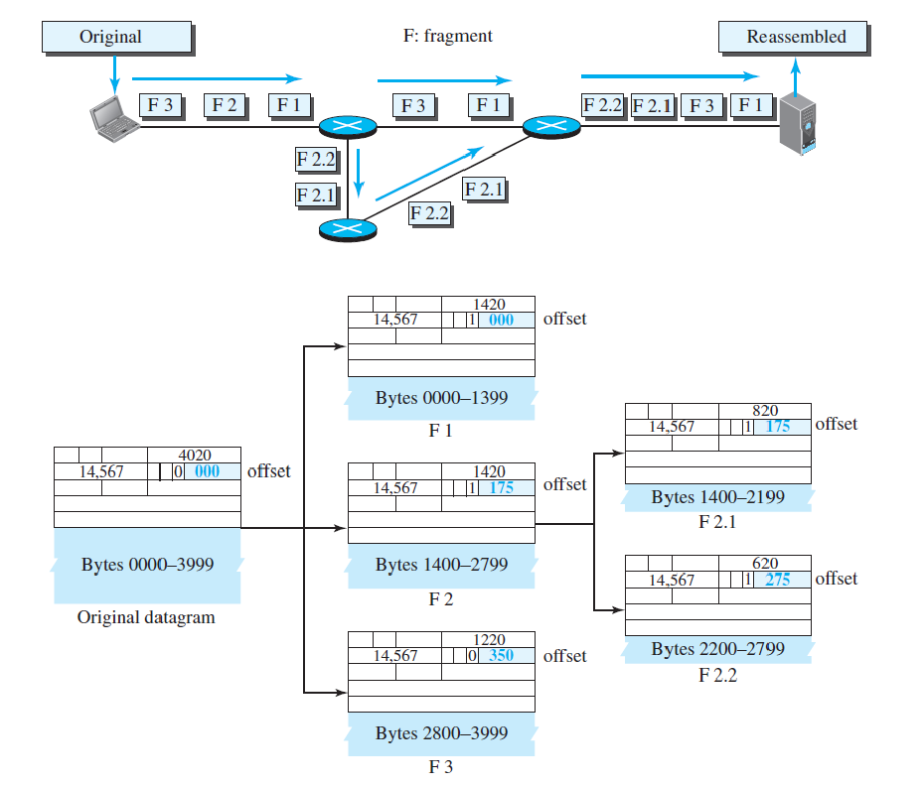
Fields related to fragmentation

Slide 28
Example
A packet has arrived with an M bit value of 0(zero). Is this the first fragment, the last fragment, or a middle fragment? Do we know if the packet was fragmented?

Slide 29
Example
A packet has arrived with an M bit value of 1. Is this the first fragment, the last fragment, or a middle fragment? Do we know if the packet was fragmented?

Slide 30
Example
A packet has arrived with an M bit value of 1 and a fragmentation offset value of 0. Is this the first fragment, the last fragment, or a middle fragment?

Slide 31
Example
A packet has arrived in which the offset value is 100. What is the number of the first byte? Do we know the number of the last byte?

Slide 32
Example
A packet has arrived in which the offset value is 100, the value of HLEN is 5, and the value of the total length field is 100. What are the numbers of the first byte and the last byte?

Slide 33
Options
The header of the IPv4 datagram is made of two parts: a fixed part and a variable part.
The fixed part is 20 bytes long and was discussed in the previous section.
The variable part comprises the options that can be a maximum of 40 bytes (in multiples of 4-bytes) to preserve the boundary of the header.
Options, as the name implies, are not required for a datagram. They can be used for network testing and debugging. Although options are not a required part of the IPv4 header, option processing is required of the IPv4 software. This means that all implementations must be able to handle options if they are present in the header.
Options are divided into two broad categories: single-byte options and multiple-byte options.

Slide 34
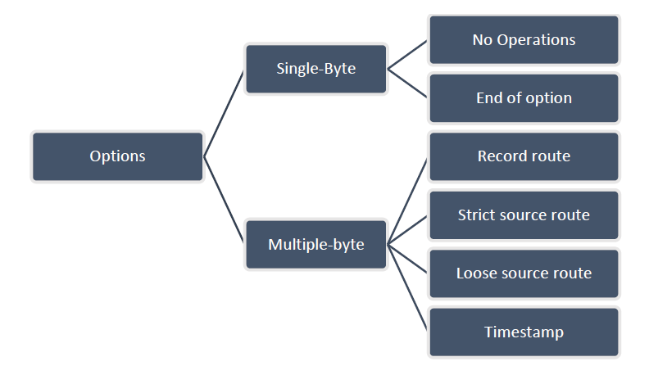
Options

Slide 35
Security of IPv4 Datagram
The IPv4 protocol, as well as the whole Internet, was started when the Internet users trusted each other. No security was provided for the IPv4 protocol.
Today, however, the situation is different; the Internet is not secure anymore.
There are three security issues that are particularly applicable to the IP protocol:
  packet sniffing,
  packet modification,
  IP spoofing.
The IP packets today can be protected from the previously mentioned attacks using a protocol called IPSec (IP Security).

Slide 36
Questions
Explain IPv4 Datagram format
Explain Fragmentation with example.
Explain Options field of the IPv4 Datagram.
Write a short note on security of IPv4 Datagram

Slide 37
References
Data Communication and Networking, Fifth Edition, BEHROUZ A. FOROUZAN
Data Communication and Networking, Fourth Edition, BEHROUZAN A. FOROUZA
https://www.geeksforgeeks.org/introduction-of-classful-ip-addressing/

Slide 38
Thank You

