Slide 1
Advanced Computer Network
(4350706)
Unit-1
Network Layer Protocols
Prepared By :
Mr. Chetan C. Kamani
Lecturer, Computer Engineering Department
Government Polytechnic, Jamnagar

Slide 2
Topics to be discussed
ICMPv4
  Messages
  Debugging tools
  ICMP Checksum

Slide 3
ICMPv4
The IPv4 has no error-reporting or error-correcting mechanism.
  What happens if something goes wrong?
  What happens if a router must discard a datagram because it cannot find a route to the final destination, or because the time-to-live field has a zero value?
  What happens if the final destination host must discard the received fragments of a datagram because it has not received all fragments within a predetermined time limit?

Slide 4
ICMPv4
These are examples of situations where an error has occurred, and the IP protocol has no built-in mechanism to notify the original host.
The IP protocol also lacks a mechanism for host and management queries.
A host sometimes needs to determine if a router or another host is alive. And sometimes a network manager needs information from another host or router.
The Internet Control Message Protocol version 4 (ICMPv4) has been designed to compensate for the above two deficiencies.

Slide 5
ICMPv4
It is a companion to the IP protocol.
ICMP itself is a network-layer protocol.
However, its messages are not passed directly to the data-link layer as would be expected. Instead, the messages are first encapsulated inside IP datagrams before going to the lower layer. When an IP datagram encapsulates an ICMP message, the value of the protocol field in the IP datagram is set to 1 to indicate that the IP payroll is an ICMP message.

Slide 6
Messages
ICMP messages are divided into two broad categories:
  Error-reporting messages
  Query messages.
The error-reporting messages report problems that a router or a host (destination) may encounter when it processes an IP packet.
The query messages, which occur in pairs, help a host or a network manager get specific information from a router or another host.

Slide 7
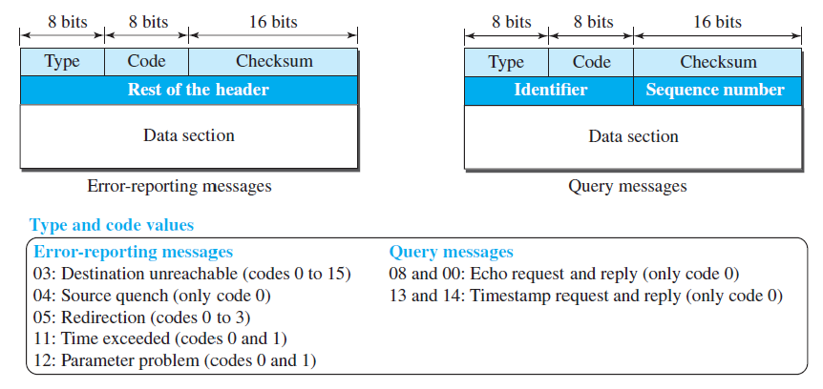
Messages

Slide 8
Error Reporting Messages
Destination Unreachable
Source Quench
Redirection Message
Time Exceed Message
Parameter Problem

Slide 9
Destination Unreachable
The most widely used error message is the destination unreachable (type 3).
This message uses different codes (0 to 15) to define the type of error message and the reason why a datagram has not reached its final destination.
For example, code 0 tells the source that a host is unreachable. This may happen, for example, when we use the HTTP protocol to access a web page, but the server is down. The message “destination host is not reachable” is created and sent back to the source.

Slide 10
Source Quench
The source quench (type 4) message, which informs the sender that the network has encountered congestion and the datagram has been dropped; the source needs to slow down sending more datagrams.
In other words, ICMP adds a kind of congestion control mechanism to the IP protocol by using this type of message.

Slide 11
Redirection Message
The redirection message (type 5) is used when the source uses a wrong router to send out its message.
The router redirects the message to the appropriate router, but informs the source that it needs to change its default router in the future.
The IP address of the default router is sent in the message.

Slide 12
Time Exceed Message
When the TTL value becomes 0, the datagram is dropped by the visiting router and a time exceeded message (type 11) with code 0 is sent to the source to inform it about the situation.
The time-exceeded message (with code 1) can also be sent when not all fragments of a datagram arrive within a predefined period of time.

Slide 13
Parameter Problem
A parameter problem message (type 12) can be sent when either there is a problem in the header of a datagram (code 0) or some options are missing or cannot be interpreted (code 1).

Slide 14
Query Messages
Echo request and echo reply
The timestamp request (type 13) and the timestamp reply (type 14)

Slide 15
Echo request and echo reply
The echo request (type 8) and the echo reply (type 0) pair of messages are used by a host or a router to test the liveliness of another host or router.
A host or router sends an echo request message to another host or router; if the latter is alive, it responds with an echo reply message.

Slide 16
The timestamp request (type 13) and the timestamp reply (type 14)
The timestamp request (type 13) and the timestamp reply (type 14)pair of messages are used to find the round-trip time between two devices or to check whether the clocks in two devices are synchronized.
The timestamp request message sends a 32-bit number, which defines the time the message is sent.
The timestamp reply resends that number, but also includes two new 32-bit numbers representing the time the request was received and the time the response was sent.
If all timestamps represent Universal time, the sender can calculate the one-way and round-trip time.

Slide 17
Deprecated Messages
Three pairs of messages are declared obsolete by IETF:
Information request and replay messages are not used today because their duties are done by the Address Resolution Protocol (ARP).
Address mask request and reply messages are not used today because their duties are done by the Dynamic Host Configuration Protocol (DHCP).
Router solicitation and advertisement messages are not used today because their duties are done by the Dynamic Host Configuration Protocol (DHCP).

Slide 18
Debugging Tools
There are several tools that can be used in the Internet for debugging.
We can determine the viability of a host or router.
We can trace the route of a packet.
We introduce two tools that use ICMP for debugging:
  ping
  Traceroute or tracert.

Slide 19
ICMP Checksum
In ICMP the checksum is calculated over the entire message (header and data).

Slide 20
References
Data Communication and Networking, Fifth Edition, BEHROUZ A. FOROUZAN
Data Communication and Networking, Fourth Edition, BEHROUZAN A. FOROUZA
https://www.geeksforgeeks.org/introduction-of-classful-ip-addressing/

Slide 21
Thank You

