Slide 1
Advanced Computer Network
(4350706)
Unit-2
Next Generation IP
Prepared By :
Mr. Chetan C. Kamani
Lecturer, Computer Engineering Department
Government Polytechnic, Jamnagar

Slide 2
Topics to be discussed
IPv6 Addressing
  Representation
    Abbreviation, Mixed Notation and CIDR notation.
  Address space
    Three address types.
  Address space allocation
  Special Addresses
  Autoconfiguration
  Renumbering

Slide 3
IPv6 Addressing
The main reason for migration from IPv4 to IPv6 is the small size of the address space in IPv4
An IPv6 address is 128 bits or 16 bytes (octets) long, four times the address length in IPv4.

Slide 4
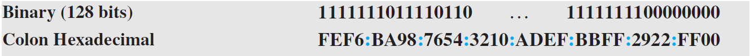
Representation
A computer normally stores the address in binary, but it is clear that 128 bits cannot easily be handled by humans.
Several notations have been proposed to represent IPv6 addresses when they are handled by humans.
The following shows two of these notations:
  binary
  colon hexadecimal

Slide 5
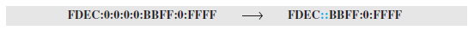
Abbreviation
Although an IPv6 address, even in hexadecimal format, is very long, many of the digits are zeros. In this case, we can abbreviate the address.
The leading zeros of a section can be omitted. Using this form of abbreviation, 0074 can be written as 74, 000F as F, and 0000 as 0. Note that 3210 cannot be abbreviated.
Further abbreviation, often called zero compression, can be applied to colon hex notation if there are consecutive sections consisting of zeros only. We can remove all the zeros and replace them with a double semicolon.
Note that this type of abbreviation is allowed only once per address. If there is more than one run of zero sections, only one of them can be compressed.

Slide 6
Mixed Notation
Sometimes we see a mixed representation of an IPv6 address: colon hex and dotted-decimal notation.
This is appropriate during the transition period in which an IPv4 address is embedded in an IPv6 address (as the rightmost 32 bits).
We can use the colon hex notation for the leftmost six sections and four-byte dotted-decimal notation instead of the rightmost two sections.
However, this happens when all or most of the leftmost sections of the IPv6 address are 0s. For example, the address (::130.24.24.18) is a legitimate address in IPv6, in which the zero compression shows that all 96 leftmost bits of the address are zeros.

Slide 7
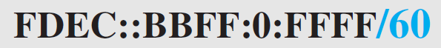
CIDR Notation
IPv6 uses hierarchical addressing. For this reason, IPv6 allows slash or CIDR notation.
For example, the following shows how we can define a prefix of 60 bits using CIDR.

Slide 8
Address Space
The address space of IPv6 contains 2¹²⁸ addresses.
This address space is 2⁹⁶ times the IPv4 address—definitely no address depletion—as shown, the size of the space is as follows
2¹²⁸ = 340, 282, 366, 920, 938, 463, 374, 607, 431, 768, 211, 456.
Address depletion in this version is impossible.

Slide 9
Three Address Types
In IPv6, a destination address can belong to one of three categories:
  Unicast
  Anycast
  Multicast.
  *IPv6 does not support broadcasting.

Slide 10
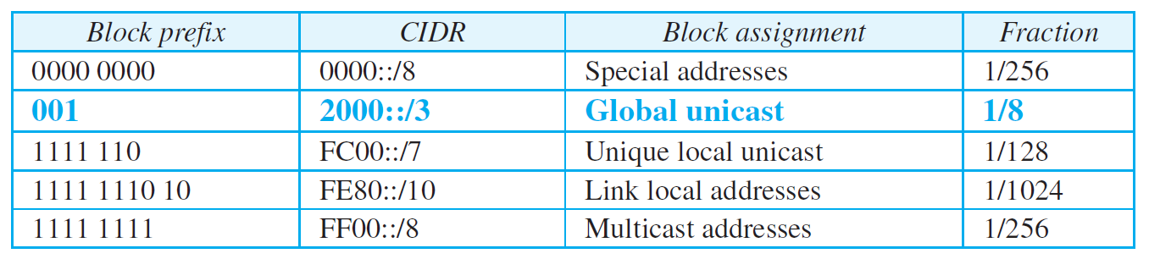
Address space allocation

Slide 11
Global Unicast Address
The block in the address space that is used for unicast (one-to-one) communication between two hosts in the Internet is called the global unicast address block.
CIDR for the block is 2000::/3, which means that the three leftmost bits are the same for all addresses in this block (001).
The size of this block is 2¹²⁵ bits, which is more than enough for Internet expansion for many years to come.
An address in this block is divided into three parts: global routing prefix (n bits), subnet identifier (m bits), and interface identifier (q bits), as shown in Figure

Slide 12
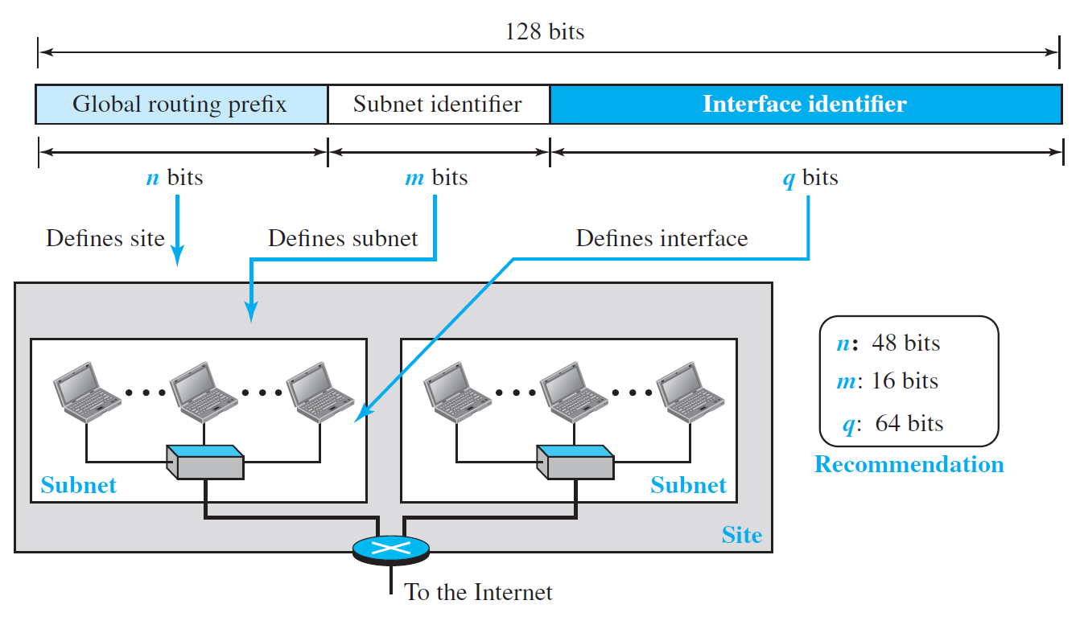
Global Unicast Address

Slide 13
Global Unicast Address
In IPv4 addressing, there is not a specific relation between the hostid (at the IP level) and link-layer address (at the data-link layer) because the link-layer address is normally much longer than the hostid. The IPv6 addressing allows this relationship.
A link-layer address whose length is less than 64 bits can be embedded as the whole or part of the interface identifier, eliminating the mapping process.
Two common linklayer addressing schemes can be considered for this purpose:
  The 64-bit extended unique identifier (EUI-64) defined by IEEE
  The 48-bit link-layer address defined by Ethernet.

Slide 14
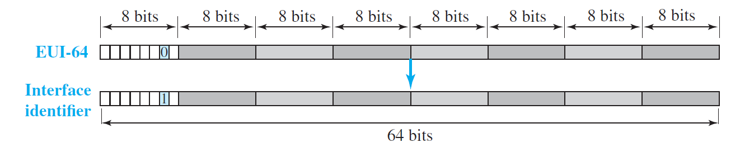
Global Unicast Address(EUI-64)

Slide 15
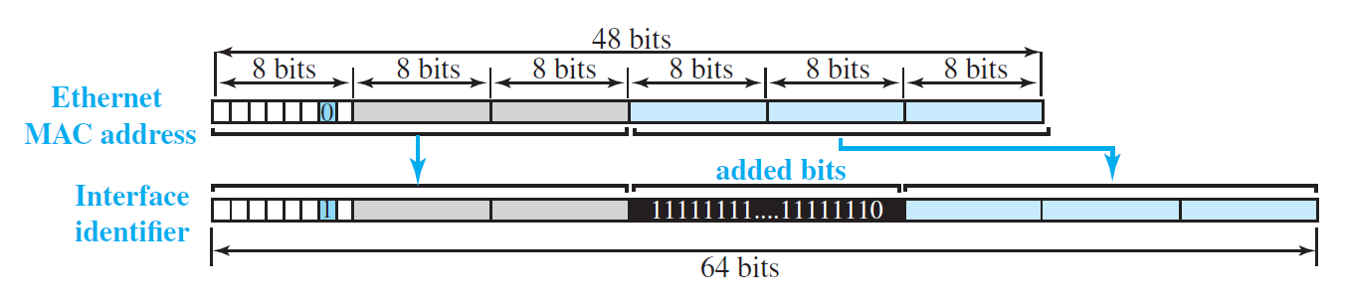
Global Unicast Address(Ethernet MAC)

Slide 16
Global Unicast Address
Example
An organization is assigned the block 2000:1456:2474/48. What is the CIDR notation for the blocks in the first and second subnets in this organization?

Slide 17
Global Unicast Address
Example
Using the format we defined for Ethernet addresses, find the interface identifier if the physical address in the EUI is (F5-A9-23-EF-07-14-7A-D2)₁₆.

Slide 18
Global Unicast Address
Example
Using the format we defined for Ethernet addresses, find the interface identifier if the Ethernet physical address is (F5-A9-23-14-7A-D2)₁₆.

Slide 19
Global Unicast Address
Example
An organization is assigned the block 2000:1456:2474/48. What is the IPv6 address of an interface in the third subnet if the IEEE physical address of the computer is (F5-A9-23-14-7A-D2)₁₆?

Slide 20
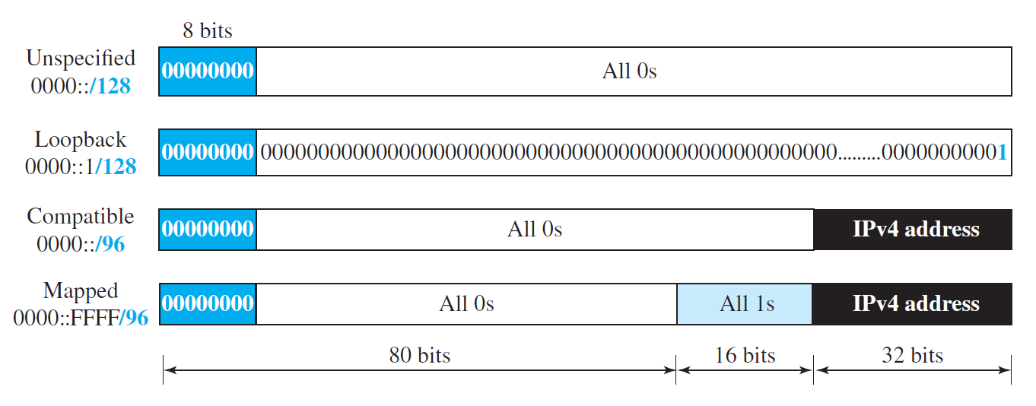
Special Address

Slide 21
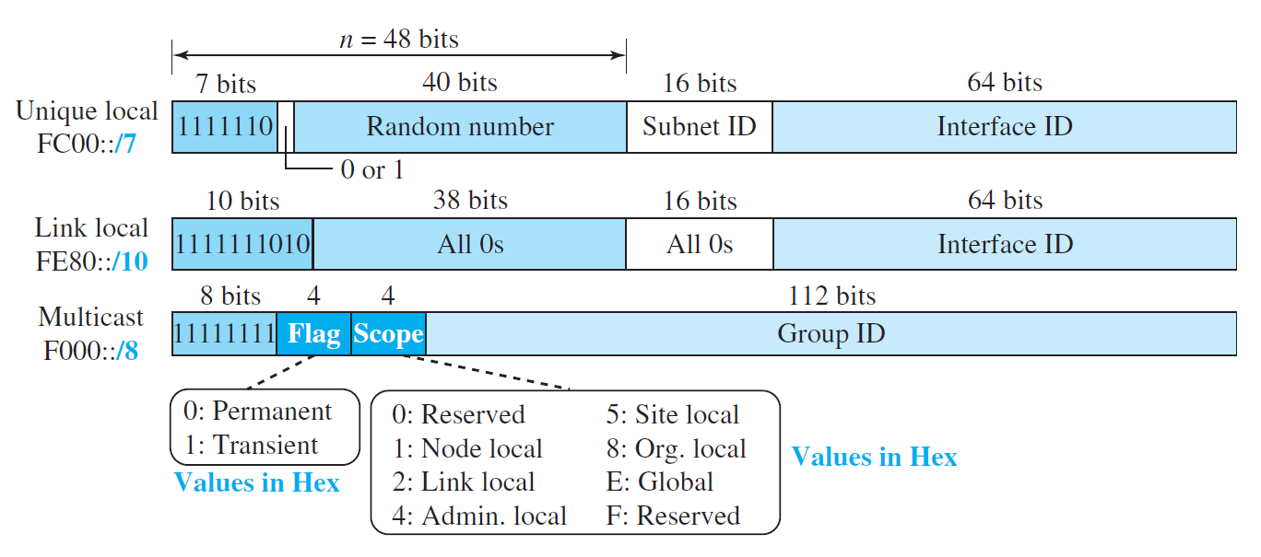
Other Assigned Blocks

Slide 22
Autoconfiguration
One of the interesting features of IPv6 addressing is the autoconfiguration of hosts.
As we discussed in IPv4, the host and routers are originally configured manually by the network manager.
However, the Dynamic Host Configuration Protocol, DHCP, can be used to allocate an IPv4 address to a host that joins the network.
In IPv6, DHCP protocol can still be used to allocate an IPv6 address to a host, but a host can also configure itself.

Slide 23
Autoconfiguration
One of the interesting features of IPv6 addressing is the autoconfiguration of hosts.
As we discussed in IPv4, the host and routers are originally configured manually by the network manager.
However, the Dynamic Host Configuration Protocol, DHCP, can be used to allocate an IPv4 address to a host that joins the network.
In IPv6, DHCP protocol can still be used to allocate an IPv6 address to a host, but a host can also configure itself.

Slide 24
Autoconfiguration(Process)
Link-Local address generation
Check the validity of the generated-link local address
Find the global unicast address

Slide 25
Example
Assume a host with Ethernet address (F5-A9-23-11-9B-E2)₁₆ has joined the network. What would be its global unicast address if the global unicast prefix of the organization is 3A21:1216:2165 and the subnet identifier is A245:1232?

Slide 26
Renumbering
It is the process of changing the IP addresses of devices on a network. This can be done for variety of reasons.
  Changing of ISPs
  Expanding the network
  Merging network
  Improving Security

Slide 27
Questions

Slide 28
References
Data Communication and Networking, Fifth Edition, BEHROUZ A. FOROUZAN
Data Communication and Networking, Fourth Edition, BEHROUZAN A. FOROUZA
https://www.geeksforgeeks.org/introduction-of-classful-ip-addressing/

Slide 29
Thank You

