Slide 1
Advanced Computer Network
(4350706)
Unit-2
Next Generation IP
Prepared By :
Mr. Chetan C. Kamani
Lecturer, Computer Engineering Department
Government Polytechnic, Jamnagar

Slide 2
Topics to be discussed
The IPv6 Protocol
The IPv6 Packet format
Concepts of flow and priority in IPv6
Fragmentation and Reassembly
Extension Headers

Slide 3
The IPv6 Protocol
The change of the IPv6 address size requires the change in the IPv4 packet format.
The designer of IPv6 decided to implement remedies for other shortcomings now that a change is inevitable.
The following shows other changes implemented in the protocol in addition to changing address size and format.
  Better header format
  New options
  Allowance for extension
  Support for resource allocation
  Support for more security

Slide 4
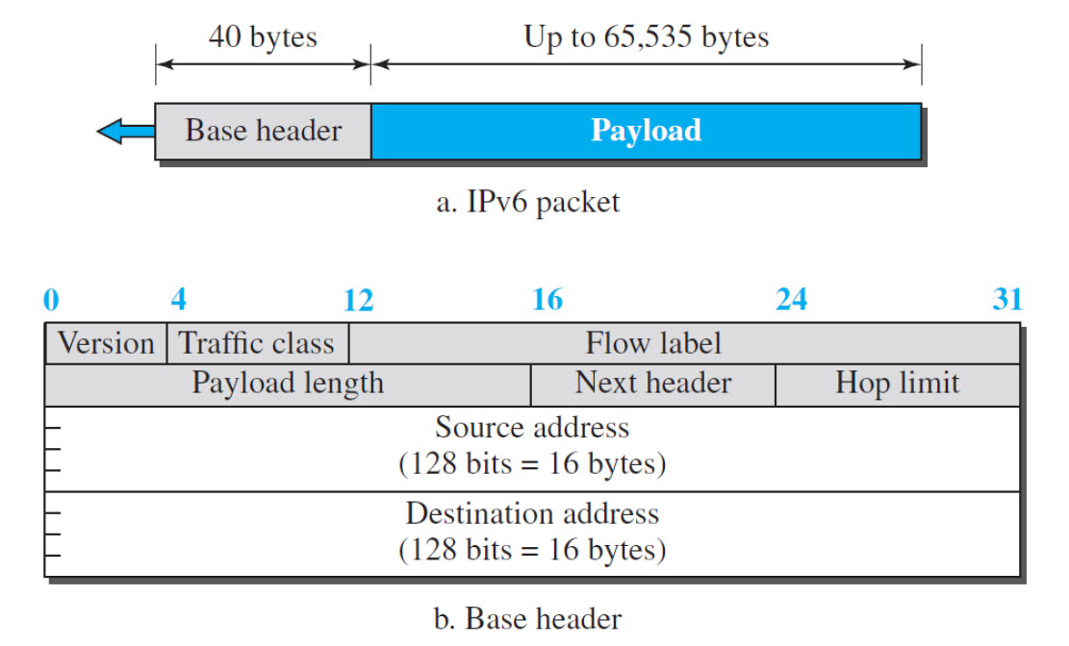
The IPv6 Packet format
Each packet is composed of base header followed by the payload.
The base header occupies 40 bytes, where as payload can be upto 65,535 bytes of information.

Slide 5
The IPv6 Packet format
Version
  The 4-bit version field defines the version number of the IP. For IPv6, the value is 6.
Traffic class.
  The 8-bit traffic class field is used to distinguish different payloads with different delivery requirements.
  It replaces the type-of-service field in IPv4.
Flow label
  The flow label is a 20-bit field that is designed to provide special handling for a particular flow of data.

Slide 6
The IPv6 Packet format
Payload length.
  The 2-byte payload length field defines the length of the IP datagram excluding the header.
  Note that IPv4 defines two fields related to the length: header length and total length.
  In IPv6, the length of the base header is fixed (40 bytes); only the length of the payload needs to be defined.
Next header.
  The next header is an 8-bit field defining the type of the first extension header (if present) or the type of the data that follows the base header in the datagram.
  This field is similar to the protocol field in IPv4.

Slide 7
The IPv6 Packet format
Hop limit.
  The 8-bit hop limit field serves the same purpose as the TTL field in IPv4.
Next header.
  The source address field is a 16-byte (128-bit) Internet address that identifies the original source of the datagram.
  The destination address field is a 16-byte (128-bit) Internet address that identifies the destination of the datagram.

Slide 8
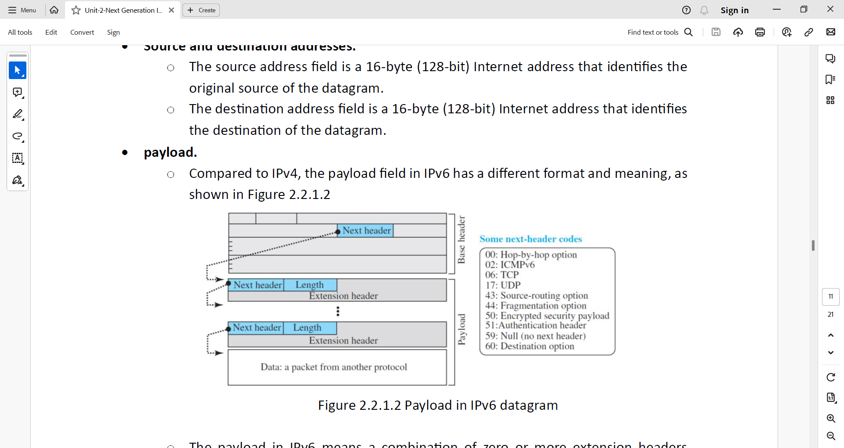
The IPv6 Packet format
Payload
  Compared to IPv4, the payload field in IPv6 has a different format and meaning, as shown in Figure.
  The payload in IPv6 means a combination of zero or more extension headers (options) followed by the data from other protocols (UDP, TCP, and so on).
  In IPv6, options, which are part of the header in IPv4, are designed as extension headers.
  The payload can have as many extension headers as required by the situation.

Slide 9
The IPv6 Packet format
Payload
  Each extension header has two mandatory fields, next header and the length, followed by information related to the particular option.
  Note that each next header field value (code) defines the type of the next header (hop-by-hop option, source routing option, . . .); the last next header field defines the protocol (UDP, TCP, . . .) that is carried by the datagram.

Slide 10
Concepts of flow and priority in IPv6
The IP protocol was originally designed as a connectionless protocol. However, the tendency is to use the IP protocol as a connection-oriented protocol.
The MPLS technology described earlier allows us to encapsulate an IPv4 packet in an MPLS header using a label field.
In version 6, the flow label has been directly added to the format of the IPv6 datagram to allow us to use IPv6 as a connection-oriented protocol.
To a router, a flow is a sequence of packets that share the same characteristics, such as traveling the same path, using the same resources, having the same kind of security, and so on.

Slide 11
Concepts of flow and priority in IPv6
A router that supports the handling of flow labels has a flow label table. The table has an entry for each active flow label; each entry defines the services required by the corresponding flow label.
When the router receives a packet, it consults its flow label table to find the corresponding entry for the flow label value defined in the packet.
It then provides the packet with the services mentioned in the entry.
However, note that the flow label itself does not provide the information for the entries of the flow label table; the information is provided by other means, such as the hop-by-hop options or other protocols.

Slide 12
Concepts of flow and priority in IPv6
In its simplest form, a flow label can be used to speed up the processing of a packet by a router.
When a router receives a packet, instead of consulting the forwarding table and going through a routing algorithm to define the address of the next hop, it can easily look in a flow label table for the next hop.

Slide 13
Concepts of flow and priority in IPv6
In its more sophisticated form, a flow label can be used to support the transmission of real-time audio and video. Real-time audio or video, particularly in digital form, requires resources such as high bandwidth, large buffers, long processing time, and so on. A process can make a reservation for these resources beforehand to guarantee that real-time data will not be delayed due to a lack of resources. The use of real-time data and the reservation of these resources require other protocols such as Real-Time Transport Protocol (RTP) and Resource Reservation Protocol (RSVP) in addition to IPv6.

Slide 14
Fragmentation and Reassembly
There are still fragmentation and reassembly of datagrams in the IPv6 protocol, but there is a major difference in this respect.
IPv6 datagrams can be fragmented only by the source, not by the routers; the reassembly takes place at the destination.
The fragmentation of packets at routers is not allowed to speed up the processing of packets in the router.
The fragmentation of a packet in a router needs a lot of processing. The packet needs to be fragmented, all fields related to the fragmentation need to be recalculated.
In IPv6, the source can check the size of the packet and make the decision to fragment the packet or not.

Slide 15
Fragmentation and Reassembly
When a router receives the packet, it can check the size of the packet and drop it if the size is larger than allowed by the MTU of the network ahead.
The router then sends a packet-too-big ICMPv6 error message (discussed later) to inform the source.

Slide 16
Extension Headers
An IPv6 packet is made of a base header and some extension headers.
The length of the base header is fixed at 40 bytes.
However, to give more functionality to the IP datagram, the base header can be followed by up to six extension headers.
Many of these headers are options in IPv4.

Slide 17
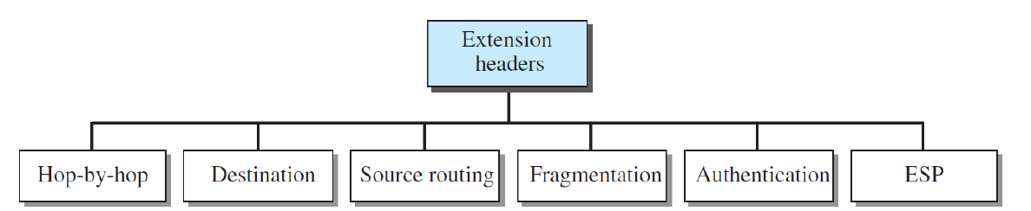
Extension Headers

Slide 18
Hop-By-Hop Extension Header
The hop-by-hop option is used when the source needs to pass information to all routers visited by the datagram.
For example, perhaps routers must be informed about certain management, debugging, or control functions. Or, if the length of the datagram is more than the usual 65,535 bytes, routers must have this information.

Slide 19
Hop-By-Hop Extension Header
So far, only three hop-by- hop options have been defined: Pad1, PadN, and jumbo payload.
Pad1.
    This option is 1 byte long and is designed for alignment purposes.
    Some options need to start at a specific bit of the 32-bit word.
    If an option falls short of this requirement by exactly one byte, Pad1 is added.

Slide 20
Hop-By-Hop Extension Header
PadN.
  PadN is similar in concept to Pad1.
    The difference is that PadN is used when 2 or more bytes are needed for alignment.
.

Slide 21
Hop-By-Hop Extension Header
Jumbo payload.
  Recall that the length of the payload in the IP datagram can be a maximum of 65,535 bytes.
  However, if for any reason a longer payload is required, we can use the jumbo payload option to define this longer length.

Slide 22
Destination Extension Header
The destination option is used when the source needs to pass information to the destination only.
Intermediate routers are not permitted access to this information.
The format of the destination option is the same as the hop-by-hop option.
So far, only the Pad1 and PadN options have been defined.

Slide 23
Source routing Extension Header
The source routing extension header combines the concepts of the strict source route and the loose source route options of IPv4.

Slide 24
Fragmentation Extension Header
The concept of fragmentation in IPv6 is the same as that in IPv4.
However, the place where fragmentation occurs differs. In IPv4, the source or a router is required to fragment if the size of the datagram is larger than the MTU of the network over which the datagram travels. In IPv6, only the original source can fragment.
A source must use a Path MTU Discovery technique to find the smallest MTU supported by any network on the path.
The source then fragments using this knowledge. If the source does not use a Path MTU Discovery technique, it fragments the datagram to a size of 1280 bytes or smaller. This is the minimum size of MTU required for each network connected to the Internet.

Slide 25
Authentication Extension Header
The authentication extension header has a dual purpose:
  it validates the message sender
  and ensures the integrity of data.
The former is needed so the receiver can be sure that a message is from the genuine sender and not from an imposter. The latter is needed to check that the data is not altered in transition by some hacker.

Slide 26
Encrypted security payload Extension Header
The encrypted security payload (ESP) is an extension that provides confidentiality and guards against eavesdropping.

Slide 27
Questions

Slide 28
References
Data Communication and Networking, Fifth Edition, BEHROUZ A. FOROUZAN
Data Communication and Networking, Fourth Edition, BEHROUZAN A. FOROUZA
https://www.geeksforgeeks.org/introduction-of-classful-ip-addressing/

Slide 29
Thank You

