Slide 1
Advanced Computer Network
(4350706)
Unit-2
Next Generation IP
Prepared By :
Mr. Chetan C. Kamani
Lecturer, Computer Engineering Department
Government Polytechnic, Jamnagar

Slide 2
Topics to be discussed
The ICMPv6 Protocol
ICMPv6 Messages
  Error-reporting messages
  Informational messages
  Neighbor Discovery Messages
  Group Membership Messages
Transition from IPv4 to IPv6

Slide 3
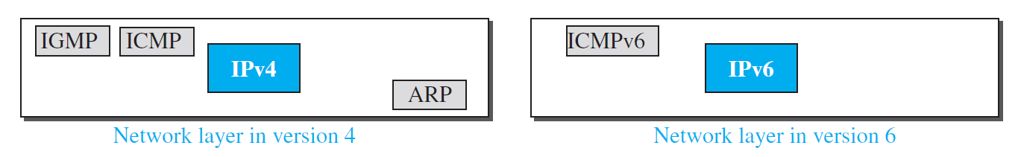
The ICMPv6 Protocol
This new version, Internet Control Message Protocol version 6 (ICMPv6), follows the same strategy and purposes of version 4.
ICMPv6, however, is more complicated than ICMPv4: some protocols that were independent in version 4 are now part of ICMPv6 and some new messages have been added to make it more useful.
Following Figures compares the network layer of version 4 to that of version 6. The ICMP, ARP, and IGMP protocols in version 4 are combined into one single protocol, ICMPv6.

Slide 4
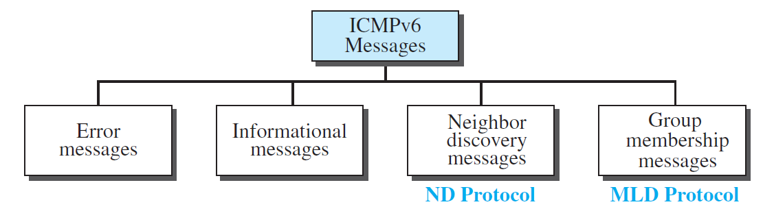
ICMPv6 Messages

Slide 5
Error Reporting Messages
Four types of errors are handled using different types of error-reporting messages:
  destination unreachable,
  packet-too-Big,
  time exceeded,
  and parameter problems.
Source Quench and Redirection message

Slide 6
Informational Messages
Two of the ICMPv6 messages can be categorized as informational messages:
  echo request
  and echo reply messages.

Slide 7
Neighbour Discovery Message
Several messages in ICMPv4 have been redefined in ICMPv6 to handle the issue of neighbor discovery. Some new messages have also been added to provide extension.
The most important issue is the definition of two new protocols that clearly define the functionality of these group messages:
  The Neighbor-Discovery (ND) protocol
  The Inverse-Neighbor-Discovery (IND) protocol.

Slide 8
Neighbour Discovery Message
These two protocols are used by nodes (hosts or routers) on the same link (network) for three main purposes:
  Hosts use the ND protocol to find routers in the neighborhood that will forward packets for them.
  Nodes use the ND protocol to find the link-layer addresses of neighbors (nodes attached to the same network).
  Nodes use the IND protocol to find the IPv6 addresses of neighbors.

Slide 9
Neighbour Discovery Message
Router-Solicitation Message
Router-Advertisement Message
Neighbor-Solicitation Message
Neighbor-Advertisement Message
Redirection Message
Inverse-Neighbor-Solicitation Message
Inverse-Neighbor-Advertisement Message

Slide 10
Group Membership Messages
The management of multicast delivery handling in IPv4 is given to the IGMPv3 protocol.
In IPv6, this responsibility is given to the Multicast Listener Delivery protocol.
MLDv1 is the counterpart to IGMPv2; MLDv2 is the counterpart to IGMPv3.
MLDv2 has two types of messages:
  membership-query message
  and membership-report message.

Slide 11
Group Membership Messages
Membership Query Message
  A membership-query message is sent by a router to find active group members in the network.
Membership Report Message
  A membership report message in ICMPv6 is used by a node to inform routers that it is a member of a particular multicast group.
  This allows routers to build and maintain multicast routing tables.

Slide 12
Transition from IPv4 to IPv6
Although we have a new version of the IP protocol, how can we make the transition to stop using IPv4 and start using IPv6? The first solution that comes to mind is to define a transition day on which every host or router should stop using the old version and start using the new version.
However, this is not practical; because of the huge number of systems in the Internet, the transition from IPv4 to IPv6 cannot happen suddenly. It will take a considerable amount of time before every system in the Internet can move from IPv4 to IPv6. The transition must be smooth to prevent any problems between IPv4 and IPv6 systems.

Slide 13
Transition from IPv4 to IPv6
Three strategies have been devised for transition:
  Dual stack
  Tunneling
  Header translation

Slide 14
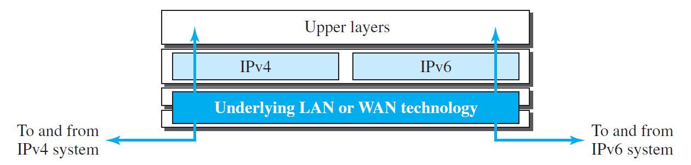
Transition from IPv4 to IPv6
Dual Stack
To determine which version to use when sending a packet to a destination, the source host queries the DNS.
If the DNS returns an IPv4 address, the source host sends an IPv4 packet.
If the DNS returns an IPv6 address, the source host sends an IPv6 packet.

Slide 15
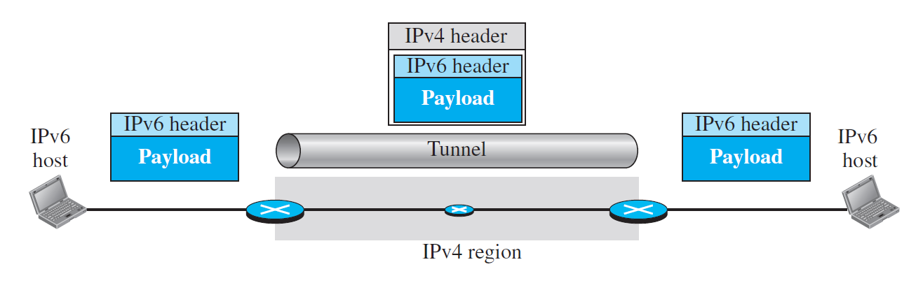
Transition from IPv4 to IPv6
Tunnelling

Slide 16
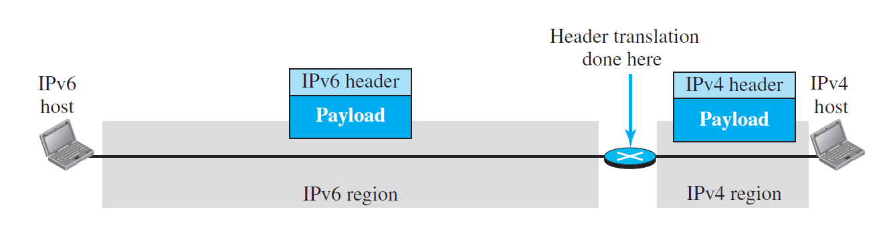
Transition from IPv4 to IPv6
Header Translation

Slide 17
Use of IP addresses
During the transition a host may need to use two addresses, IPv4 and IPv6.
When the transition is complete, IPv4 addresses should disappear.
The DNS servers need to be ready to map a host name to either address type during the transition, but the IPv4 directory will disappear after all hosts in the world have migrated to IPv6.

Slide 18
Questions

Slide 19
References
Data Communication and Networking, Fifth Edition, BEHROUZ A. FOROUZAN
Data Communication and Networking, Fourth Edition, BEHROUZAN A. FOROUZA
https://www.geeksforgeeks.org/introduction-of-classful-ip-addressing/

Slide 20
Thank You

