Slide 1
Job data analysis

Slide 2
Objective:
To analyze and interpret job market trends, identifying key factors such as demand for Role, Skills, Salary ranges, and geographical hotspots, to provide insights that help job seekers and employers make informed decisions.
Goal:
To develop a comprehensive report that visualizes key job market trends, enabling users to efficiently navigate the labor market, optimize hiring processes, or align their skills with market demands for better career opportunities.

Slide 3
1. Descriptive Analysis
Summarize data to understand the overall job market landscape (e.g., total job postings, average salaries, common job titles).
2. Geographical Analysis
Analyze job availability and salary differences across various regions or cities to identify hotspots.
3. Demographic Analysis
Investigate job market trends by demographic factors such as education level and experience.
4. Competitor Analysis
Compare job offerings and salary ranges of similar companies within the same industry.
6. Correlation Analysis
Examine relationships between different variables (e.g., education level and salary) to uncover insights.
7. Visualization
Create charts and dashboards to visually represent the findings, making it easier to communicate insights.

Slide 4
Features which we have selected for the job analysis:
Role – Every job seeker wants to know what role they want and what they are applying for.
Company – The name of the organization offering the job; important for understanding company culture and reputation.
Reviews – Ratings or feedback from current or former employees about the company; provides insights into employee satisfaction.
Location – The geographical area where the job is based; affects commute and living conditions.
Experience – The number of years or type of experience required for the role; guides suitability for the position.
Salary – The compensation offered for the role, typically presented as a range; critical for evaluating financial needs.
Posted On – The date when the job was listed; helps understand the urgency of the application.
Openings – The number of positions available for the role; indicates demand and competition.
Applications – The number of applications received for the job; reflects competitiveness and interest.
Industry Type – The sector in which the job exists (e.g., IT, finance); helps identify alignment with career interests.
Employment Type – The nature of the job contract (e.g., full-time, part-time); important for understanding commitment and security.
Role Category – Classification of the job role (e.g., technical, managerial); helps identify fitting roles.
Education – The educational qualifications required for the job; guides necessary academic background.
Key Skills – Specific skills required or preferred for the job; essential for tailoring applications and highlighting relevant abilities.

Slide 5
ANALYSIS WE HAVE DONE:
UNIVARIATE ANALYSIS
BIVARIATE ANALYSIS
MULTIVARIATE ANALYSIS

Slide 6
UNIVARIATE ANALYSIS
1. Role
The majority of roles are concentrated in a few key categories, with Full Stack Developer and DevOps Engineer accounting for 35.51% of the postings.
2. Company
Job postings are dominated by major companies such as Accenture and IBM, which offer a variety of roles.
3. Location
Companies primarily prefer tech-based locations for job postings, with Bengaluru, Hyderabad, Pune, and Chennai being the most favored.
4. Employment Type
Full Time, Permanent positions dominate the market, comprising 92.90% of postings.
Less common employment types include Full Time, Temporary/Contractual and Part Time, Freelance/Homebased, indicating a clear preference for permanent roles.
5. Education
The most frequently occurring educational background is UG: Any Graduate at 23.40%.
6. Key Skills
Python is the most common skill listed, indicating that many jobs require Python as a primary skill.
7. Dates Posted
High Activity Periods: There is a noticeable peak in job postings around mid-August (16-08-2024), likely linked to end-of-quarter hiring sprees or preparations for upcoming projects in the fall.

Slide 7
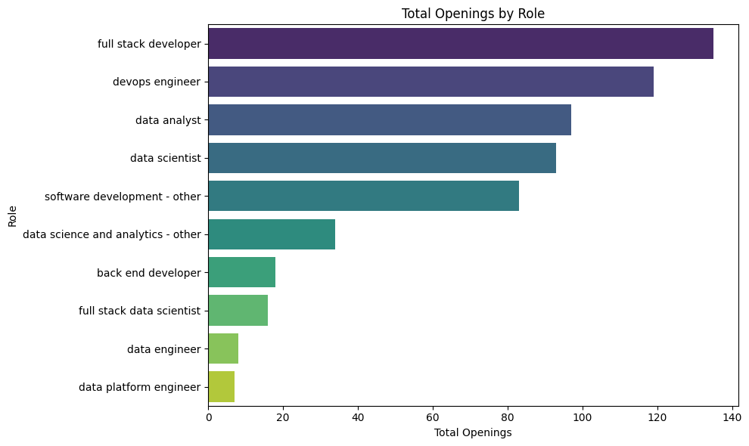
BIVARIATE ANALYSIS
Openings for Top Roles
The analysis of job openings reveals a strong demand for software development roles, with Full Stack Developer positions leading the way, followed by DevOps Engineer roles.
Data-related positions, such as Data Analyst and Data Scientist, also rank among the top 10 roles with the most openings, highlighting the growing importance of data-driven decision-making.
The DevOps Engineer role, with 119 openings, indicates a shift toward integrated operations. Specialized roles like Machine Learning Engineer, which have 6 openings, suggest emerging but limited demand. Conversely, training and R&D positions show minimal openings, indicating a market focus on core technical roles.
Overall, candidates in software development and data analytics are likely to find more opportunities, while specialized skills will be essential for securing niche positions.

Slide 8
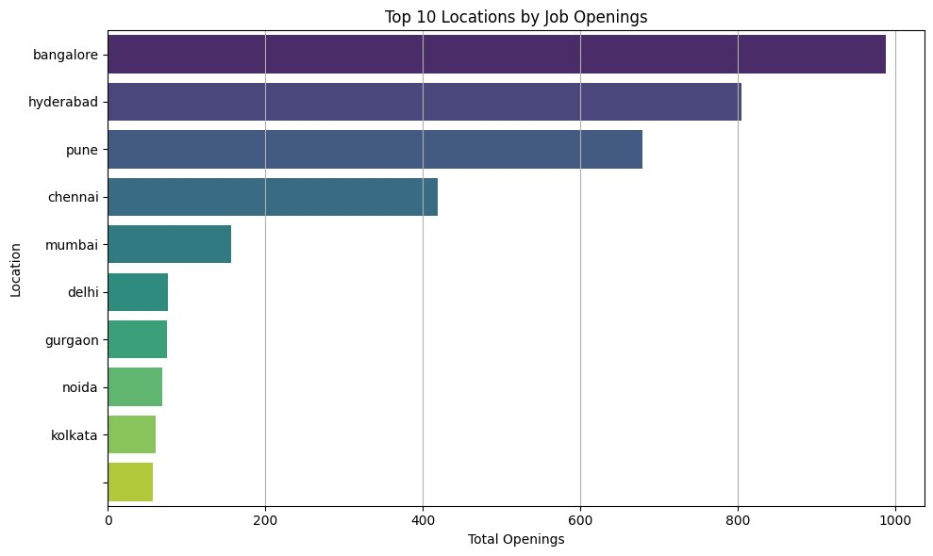
Location and Openings
The analysis of job openings by location reveals a significant concentration in major cities. Bangalore, followed by Hyderabad, indicates a robust tech presence. Pune and Chennai also offer considerable opportunities, while Mumbai shows a declining trend. In contrast, cities like Agra and Chandigarh have minimal openings, suggesting limited industry growth.
This distribution highlights the regional disparities in job availability across India, with a clear focus on tech hubs that attract a majority of the openings.

Slide 9
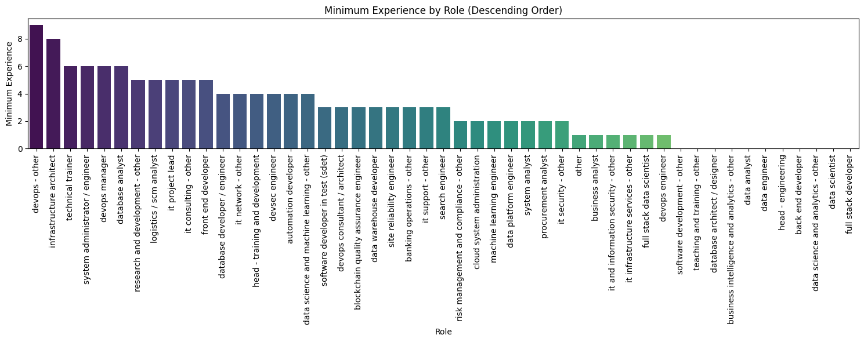
Role and Minimum Experience
The analysis of roles and minimum experience reveals a structured hierarchy in the tech industry. High-experience positions, such as IT Support and DevOps Consultant, require 8 to 10 years of expertise, emphasizing seniority and specialized knowledge. Moderate experience roles, like Technical Trainer and IT Project Lead, call for 5 to 6 years, blending technical skills with some leadership responsibilities. Lower experience roles, including Data Engineer and DevOps Engineer, cater to entry- to mid-level professionals with 2 to 4 years of experience. Finally, numerous entry-level opportunities exist for recent graduates in roles such as Full Stack Developer and Data Scientist, indicating a strong market for new talent. Overall, the landscape shows a healthy demand for both experienced professionals and newcomers in technology.

Slide 10
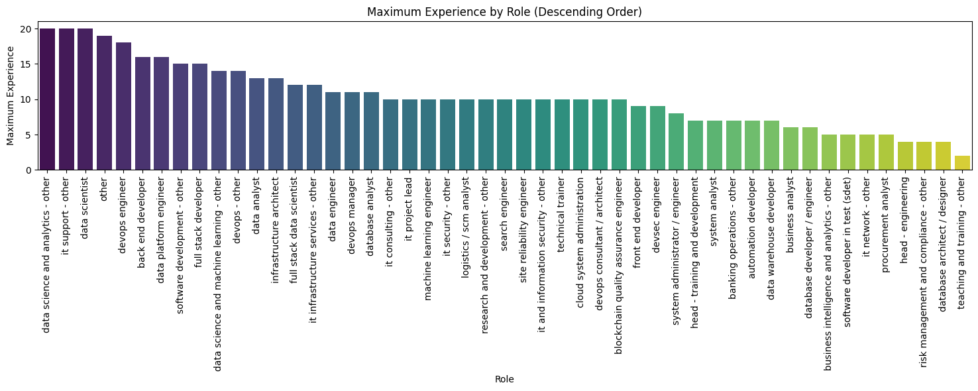
Role and Maximum Experience
DevOps roles, such as DevOps Manager and Infrastructure Architect, demand the highest levels of experience (up to 14 years), highlighting their seniority and specialized skill set.
Positions like Database Analyst, IT Project Lead, and Technical Trainer also require substantial experience, indicating the complexity and responsibility involved.
On the lower end, roles like Data Scientist, Full Stack Developer, and Software Development require minimal experience (1 year), making them more accessible to early-career professionals.

Slide 11
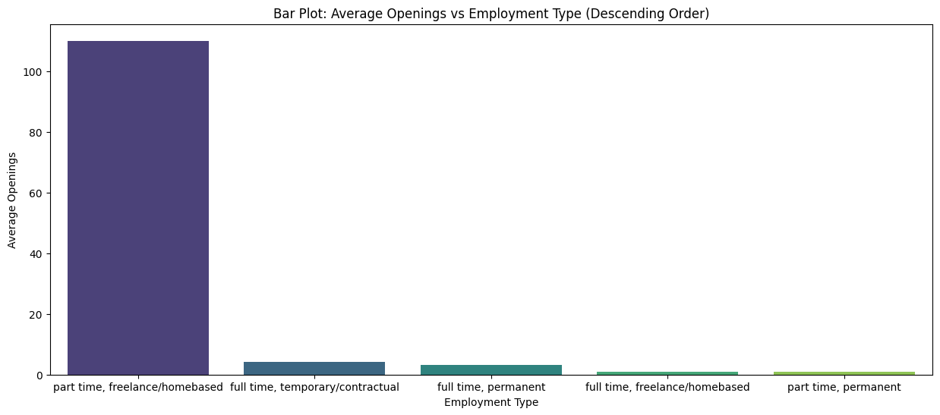
Employment and Openings
Full-Time positions typically offer the highest average number of openings, indicating strong demand for permanent roles. Part-Time and Contract positions follow, with fewer average openings compared to full-time roles, reflecting their more temporary nature. Internship and Freelance roles have the lowest average openings, which is consistent with their more specialized or short-term employment status.

Slide 12
Role vs Key Skills
DevOps Engineer:
This role has the highest value for key skills relating to DevOps practice, especially in CI/CD, Docker, and Kubernetes. Such skills are the basic requirements for efficient application deployment and management within a cloud environment and validate the focus of the role on automation and orchestration.
Data Scientist:
Data Science, AWS, and Docker skills are in high demand. These are required for advanced data analysis, the use of cloud technology, and the smooth deployment of machine learning models. Then there is Python that is the root programming language for doing all the data science work.
Full Stack Developer/Full Stack Data Scientist:
Both of these roles are highly in use in Docker, CI/CD, and Python. The statistics indicate that containerization, continuous integration/continuous deployment, and programming skills are significant areas of interest for modern software development practices and make workflows smooth as well as enable strong application development.
Data Analyst and Backend Developer:
These roles have lesser counts in advanced DevOps tools but have a higher frequency in Data Analysis, Python, and core skills like AWS. The emphasis could be on data handling, statistical analysis, and more of the backend development, keeping in mind that one would require programming skills for manipulating data.

Slide 13
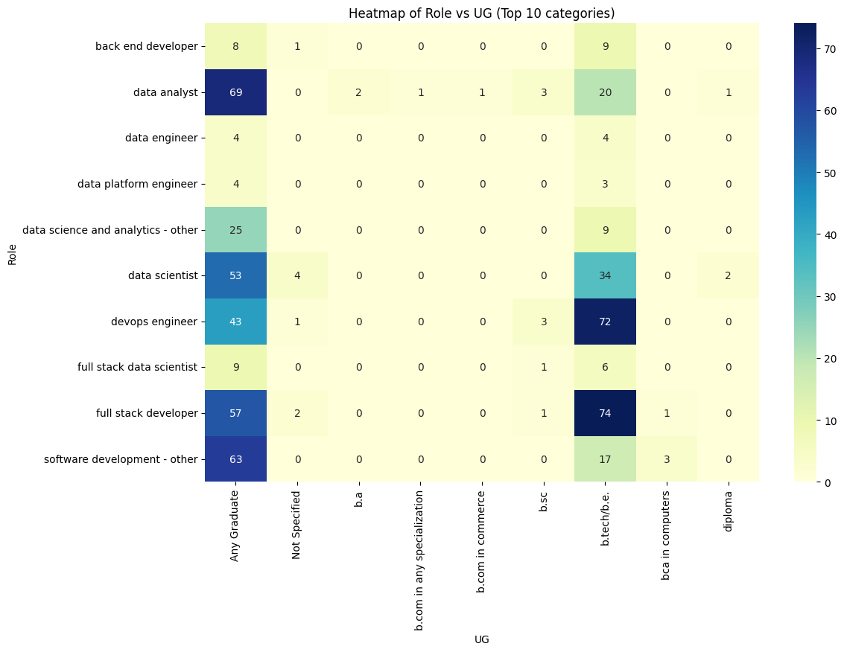
Role vs UG
Data Analyst roles require a broad range of undergraduate qualifications, with a high frequency for Any Graduate (69) and some for B.A. (2).
Software Development - Other roles also show a high frequency for Any Graduate (63), indicating a general requirement for graduate-level education.
Data Scientist and DevOps Engineer roles have notable frequencies for Any Graduate, with Data Scientist also including Not Specified (4), suggesting flexibility in educational requirements.
Specific qualifications like B.Com in Any Specialization and B.A. are less frequently required, with most roles having either Any Graduate or Not Specified.

Slide 14
Role vs PG
Data Analyst roles have a high frequency for Any Postgraduate qualifications (65), reflecting a strong preference for advanced education in this field.
DevOps Engineer roles also show significant demand for Any Postgraduate qualifications (78), indicating a high level of expertise required.
Full Stack Developer roles require an equal frequency of Any Postgraduate qualifications (57), with a noticeable number of Not Specified (57), suggesting flexibility in postgraduate qualifications.
Data Scientist roles feature notable frequencies for M.Tech (15), highlighting a specific requirement for technical expertise.
Other roles such as Data Science and Analytics - Other, Full Stack Data Scientist, and Software Development - Other show varied requirements, with some roles requiring specific postgraduate qualifications like M.Tech or LL.M.

Slide 15
9.ROLE VS PG:
Data Analyst roles have a high frequency for Any Postgraduate qualifications (65), reflecting a strong preference for advanced education in this field.
DevOps Engineer roles also show significant demand for Any Postgraduate qualifications (78), indicating a high level of expertise required.
Full Stack Developer roles require an equal frequency of Any Postgraduate qualifications (57), with a noticeable number of Not Specified (57), suggesting flexibility in postgraduate qualifications.
Data Scientist roles feature notable frequencies for M.Tech (15), highlighting a specific requirement for technical expertise.
Other roles such as Data Science and Analytics - Other, Full Stack Data Scientist, and Software Development - Other show varied requirements, with some roles requiring specific postgraduate qualifications like M.Tech or LL.M.
10.ROLE VS DOCTORATE:
Full Stack Developer roles have the highest frequency of doctorate qualifications, with 20 individuals holding a Ph.D./Doctorate, indicating a significant demand for advanced academic qualifications.
DevOps Engineer and Data Scientist roles also show a notable number of doctorate qualifications, with 8 and 11 respectively, reflecting specialized expertise in these areas.
Data Analyst roles have a substantial number of Ph.D./Doctorate holders (12), though it is lower compared to full stack developers.
Most roles, such as Back End Developer and Data Science and Analytics - Other, show a high frequency of Not Specified, suggesting that a doctorate is not a common requirement or is not typically specified.

Slide 16
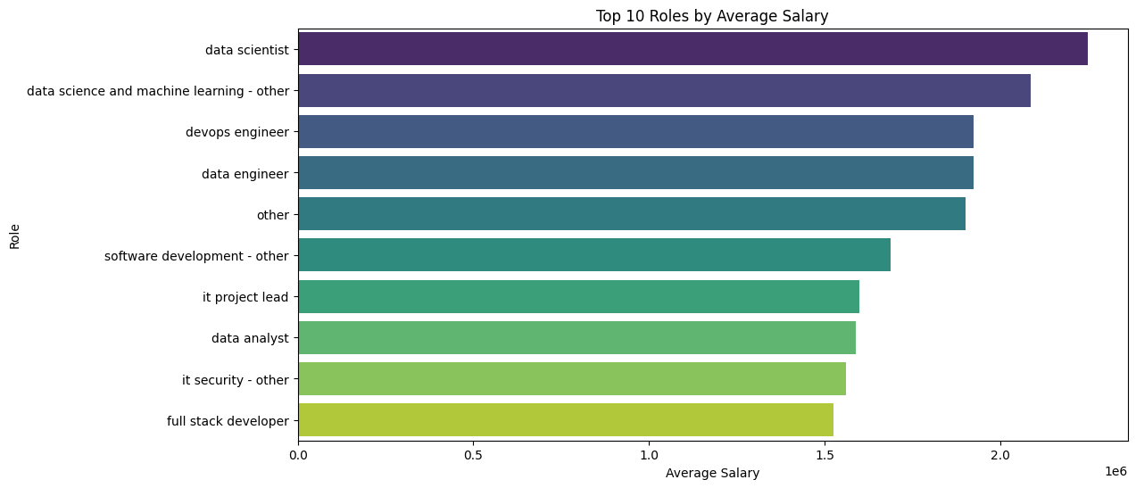
Role and Maximum Salary
Highest Salaries: The role of Data Scientist has the highest average salary with a mean of ₹1,985,714.29. This role also has the highest total salary expenditure of ₹27,800,000.00, highlighting its premium compensation in the market.
Machine Learning Engineer and DevOps Engineer also command high salaries, with mean salaries of ₹2,600,000.00 and ₹2,221,428.57, respectively.
Full Stack Developer and Data Science and Machine Learning - Other roles show competitive salaries with means of ₹1,513,333.33 and ₹2,675,000.00.
Lowest Salaries: Roles like Automation Developer, Blockchain Quality Assurance Engineer, and Business Analyst either have no salary data or significantly lower average salaries compared to top-paying roles.

Slide 17
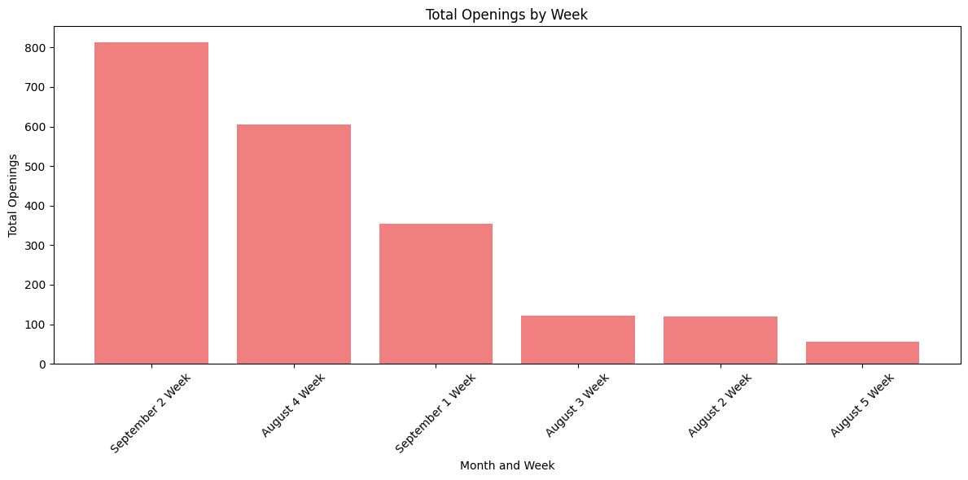
Openings by Week
The openings on September 2nd week are the highest .
And openings on August 3rd week is the lowest.

Slide 18
MULTIVARIATE ANALYSIS
Industries such as Power, Railways, Retail, Telecom / ISP, and TV / Radio have no salary data available, suggesting either a lack of data collection or minimal roles within these sectors
DevOps Engineer: Most frequently listed across all locations, with notable presence in Bangalore and Pune
Software Development - Other: Commonly listed, particularly with Coders Brain Pvt Ltd in Bangalore and Pune
Accenture: Dominates the DevOps Engineer role, especially in Bangalore , though it has minimal presence elsewhere
Bangalore: High activity with multiple roles and companies, especially for DevOps Engineer and Full Stack Developer
High Salaries are observed for specialized roles like DevOps Engineer and Data Scientist in select industries
Bangalore leads in role postings across various positions, especially for DevOps Engineer and Full Stack Developer

Slide 19
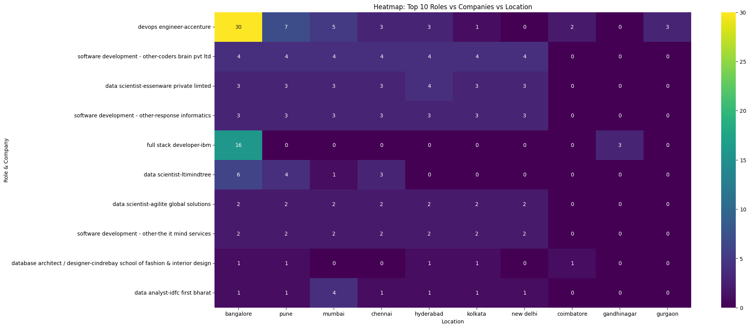
Devops Engineer in Accenture company has more number of openings than any other company

Slide 20
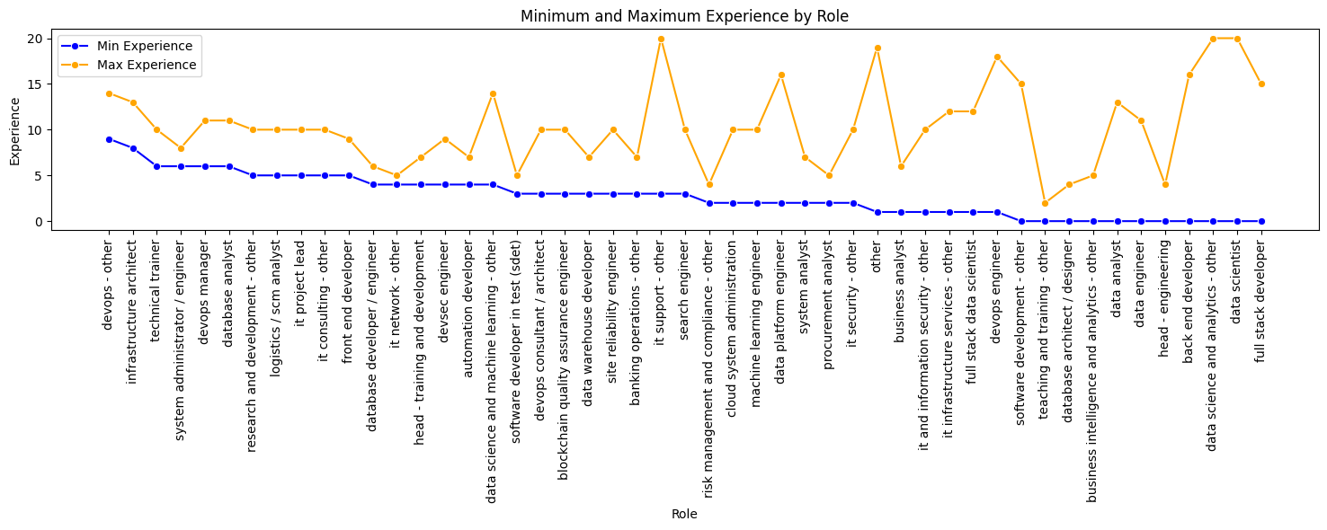
Role and Experience
Roles such as DevOps Manager, Infrastructure Architect, and Technical Trainer-to name a few are very demanding in terms of experience, which is about 6 to 14 years. Such work usually deals with complex systems management, requiring technical savvy professionals who have great experience. There is an immense pull for entry-level candidates in the junior ranks of Data Analyst, Software Development - Other, and Business Intelligence and Analytics, which requires no experience on average. This gives enough scope for introducing fresh graduates into the work force to gain experience. While this happens, the companies can add more focus to the development of the junior ranks while filling up their respective senior ranks with older, more seasoned talent.

Slide 21
CONCLUSION
Based on the analysis, we can conclude that Full Stack Developer, DevOps Engineer, Data Analyst, and Data Scientist are the top roles with the most openings.
Accenture and IBM are leading in job postings, reflecting their strong presence in the market.
The cities with the highest number of job openings are Bangalore, Hyderabad, Pune, and Chennai.
Python emerges as the most frequently required skill across many companies, highlighting its importance in the tech industry.
Roles such as Full Stack Developer, Data Scientist, and Data Analyst are accessible for freshers, providing them with ample opportunities to enter the workforce.
Additionally, the Data Scientist, Devops role offers the highest salary based on our analysis, indicating a strong demand for this specialization.

Slide 22
Thank you

