Slide 1
Lending Club Analysis
Submitter: Atantra Das Gupta Chetan Karnik

Slide 2
Problem Statement
Lending club is a online loan marketplace, facilitating personal loans, business loans, and financing of medical procedures. Borrowers can easily access lower interest rate loans through a fast online interface.
Lending Club has few constraints :
Lending loans to ‘risky’ applicants is the largest source of financial loss (called credit loss).
Borrowers who default cause the largest amount of loss to the lenders.
Lending facilitating company also face two types of risks that are associated with the bank’s decision:
If the applicant is likely to repay the loan, then not approving the loan results in a loss of business to the company
If the applicant is not likely to repay the loan, i.e. he/she is likely to default, then approving the loan may lead to a financial loss for the company

Slide 3
Business Objective/ End Expectation from Lending club
Goal of the Data Analysis:
Driving factors: The company wants to understand the driving factors (or driver variables) behind loan default, i.e. the variables which are strong indicators of default
Insight from Driving Factors: The company can utilise this knowledge for its portfolio and risk assessment
Broader Strategy :
Make a Informed decision: Based on the insights one is able to identify these risky loan applicants, then such loans can be reduced thereby cutting down the amount of credit loss
Key outcome
Based on the type of Loan application de-risk the loan approval at the time of approval
Identify the pattern of "defaulters" early based on the given data set

Slide 4
The Approach
Start
Drop unwanted columns
Data Analysis – Segmented Univariate
Term vs Public Record
Grade vs Public Record
Verification vs Public Record
Interest Rate vs Loan Status
Interest Rate vs Grade
Loan Amount vs Grade
Dti vs Grade
Dti vs Loan Status
Dti vs Purpose
Loan Status vs Exp Level
Loan Status vs Loan to Income ratio
Annual Income vs Verification
Loan Amount Bucket vs Loan Status
Dti Bucket vs Loan Status
Data Analysis – Bivariate
Term vs Loan Status
Term vs Interest Rate vs Default Status
Grade vs Loan Status vs Default Status
Grade vs Loan Amount vs Default Status
Grade vs Interest Rate vs Default Status
Purpose vs Loan Status vs Default Status
Top 5 States vs Loan Status
Top 5 Zip Codes vs Loan Status
Loan data
Data Cleanup
Import data
Data Analysis - Univariate
Interest Rate
Loan Amount
Employment Length:
Grade
Home Ownership
Status
Purpose
Debt–to–income ratio
Resolve encoding issues if any
Data Analysis – Correlation
Understand Data
End

Slide 5
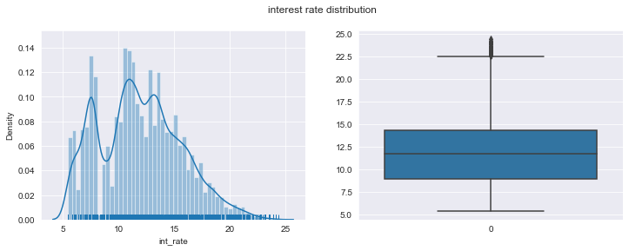
Analysis and Findings
From the plots below : most of the interest rates lies between 9% to 14.5%. Highest rates of interest i.e., 24.40%

Slide 6
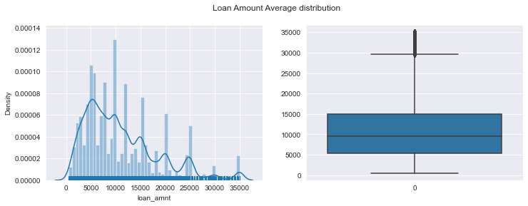
Analysis and Findings
From the plots below : the loan amount median is 10000,
Maximum number of people tend to take loan amount of 10000, and And very few people took more than $ 15000 loan amount.
No significance inference on default status based on these variables:
funded_amnt: Lending club approved most of Applied loan amount.Funded amount data is proportion to loan Amount, Which tells us that Lending club approved most of Applied loan amount.
funded_amnt_inv:The total amount committed by investors for that loan at that point in time.Borrowers got 100% loan amount from investors.

Slide 7
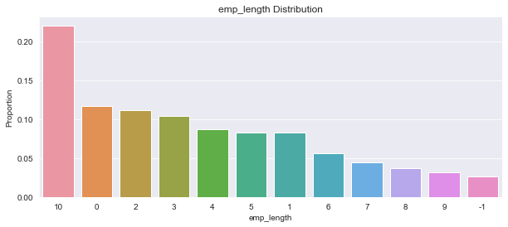
Analysis and Findings
Maximum loan seekers are from the group 10+ years followed by Juniors between 0 to 3 years

Slide 8
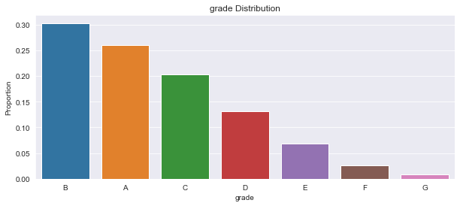
Analysis and Findings
Most borrowers fall under A and B grades than other grades

Slide 9
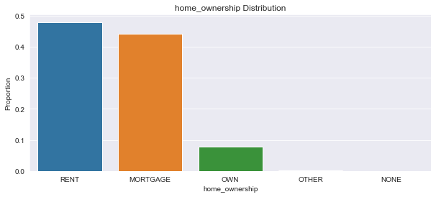
Analysis and Findings
Most borrowers either stay in rented properties or have mortgaged their homes

Slide 10
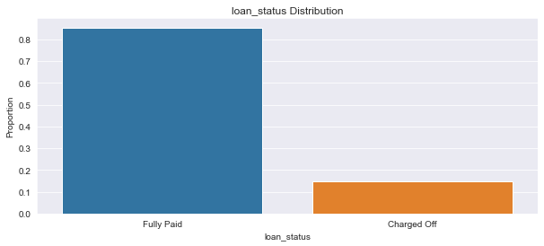
Analysis and Findings
86% of borrowers have paid the loan fully, whereas 14.4% have defaulted the loan
Around 1 in 5 borrowers are defaulters

Slide 11
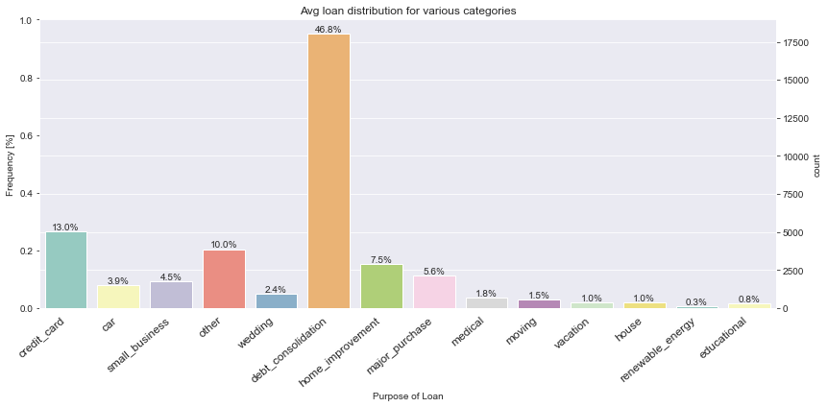
Analysis and Findings
From the plot below we can see that average default rate across all categories is 14.4%
Top Six Purpose of the Loan availed categories are
debt_consolidation
credit_card
other
home_improvement
major_purchase
small_business

Slide 12
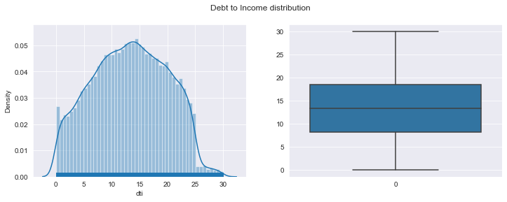
Analysis and Findings
The distribution is very much similar to normal distribution
All the barrower's who have Debt to Income ration less than 30

Slide 13
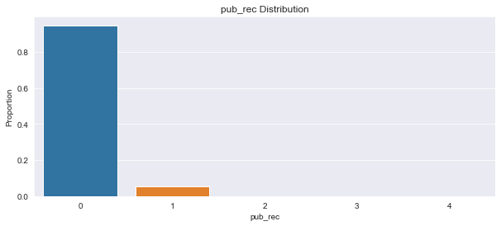
Analysis and Findings
Around 10% borrower's are having public derogatory records

Slide 14
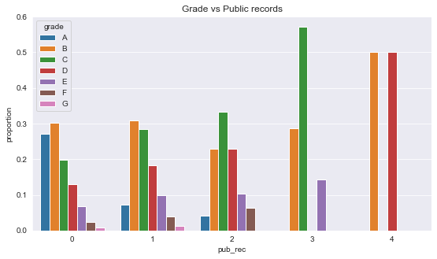
Analysis and Findings
'A' grade people are having less derogatory records than other grades
C,D,E graded people tend to have high pub_recs

Slide 15
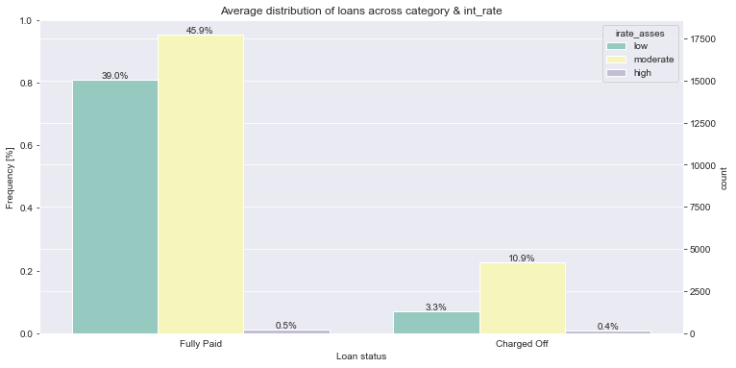
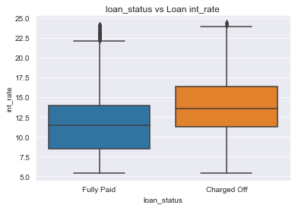
Analysis and Findings
Grater the interest rate more the chance of Defaulting the loan.
11.6% of moderate interest rate "charged off' and 0.4% high interest rate still change off.
Only 0.5% of high interest rate borrowers could able to pay off

Slide 16
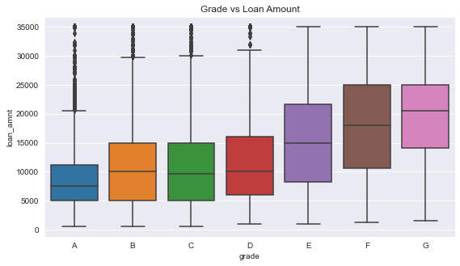
Analysis and Findings
Grade 'G' and 'H' have taken max loan amount. Lower Grades loans have higher loan amount

Slide 17
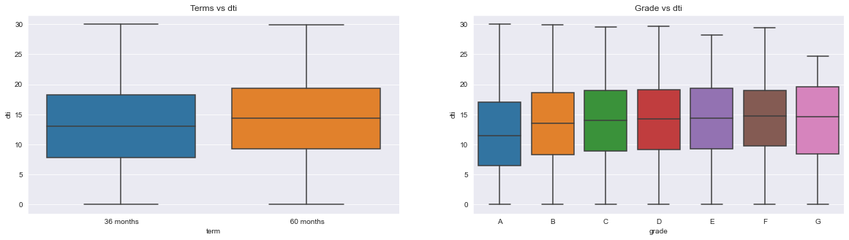
Analysis and Findings
People with high dti tend to get more tenure ie 60 months.
A Grade barrowers are having low DTI than Other grades.
DTI low is indicator of high repayment capability for repayment.
Most likely B, C, D loan grade borrowers tend to charge off compare to other loan grades

Slide 18
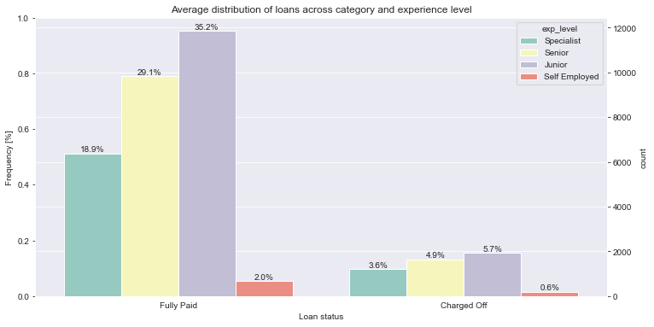
Analysis and Findings
In terms of Loan status & charge off status more Junior experience level are prone to charge off

Slide 19
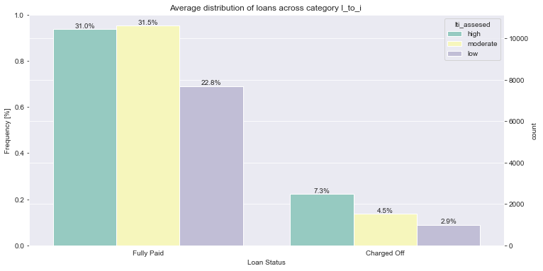
Analysis and Findings
The 7.2% of borrowers are charged off who has high Loan to Income ratio
Followed by 4.5% with moderate lti.
Mean 8/100 borrowers sure to charge off if they have High Lti ratio.
5/100 people with moderate lti chance of charged off
So its sure assume 12% of people with moderate and High lti are charged off at any given condition

Slide 20
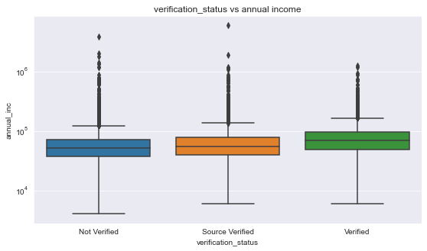
Analysis and Findings
For higher annual incomes : The income source was verified
For lower annual incomes the source was not verified for most of the cases
No significant inference can be derived from this graphs
Loan is Fully paid for most of the borrower's who had higher annual incomes

Slide 21
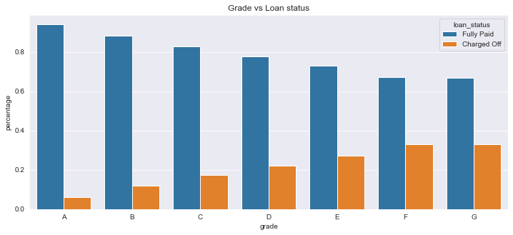
Analysis and Findings
The lower grade of loan the Charged off rate increases proportionately

Slide 22
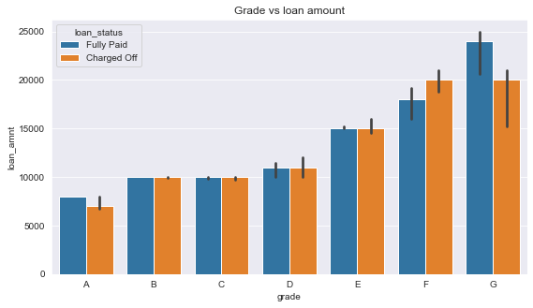
Analysis and Findings
The high loan amount is disbursed in lower grade loans which is also indicates higher charge off instances
The lower the Loan grade the Charged off rate increases proportionately

Slide 23
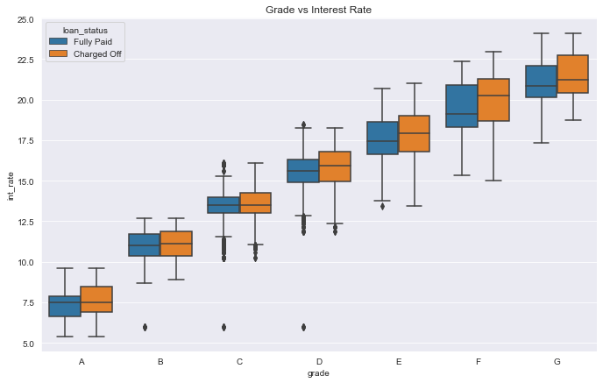
Analysis and Findings
The lower grade Loan has highest interest rate & also highest possibility of charge off conditions

Slide 24
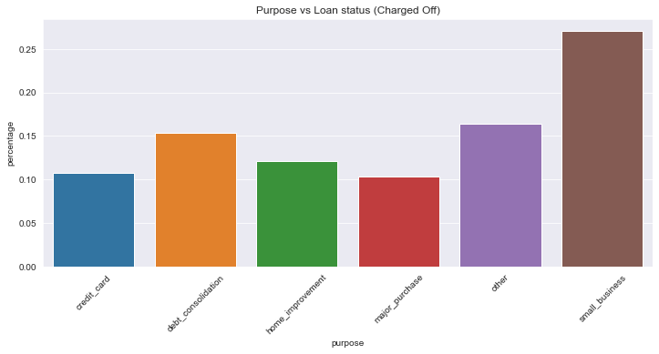
Analysis and Findings
The High charge off rate observed Loan borrowed for small business

Slide 25
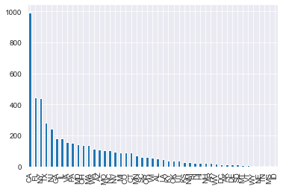
Analysis and Findings
People of California, Florida, New York, Texas and New Jersey like to take loans and not return them
Vermont, Wyoming, Nebraska, Mississippi, Tennessee and Idaho residents are honest

Slide 26
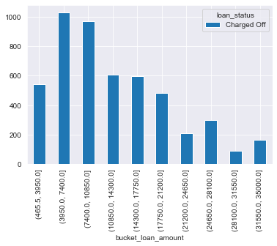
Analysis and Findings
Loans in the range USD 4000 to 11000 are risky

Slide 27
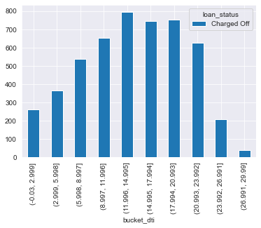
Analysis and Findings
People seeking loans that are 12 to 20 times their total income lie in the red zone

Slide 28
Conclusion
Key Driving factors:
dti
lti
int_rate
purpose
loan grades
pub_rec
emp_length

Slide 29
Conclusion
Key Insight from Driving Factors:
Most borrowers fall under A and B grades then other grades
14.4% defaulted the loan for various reason
Top Loan availed categories are
debt_consolidation
credit_card
20% borrowers with 60months tenure are have high public derogatory record
C,D,E loan graded borrowers tend to have having high pub_recs.
14% of moderate to high interest rate borrowers are probability "charged off'.
High loan grades borrowers have very high interest rate.
Lower Grades loans borrowers tends to borrow higher loan amount prone to charged off.
Most likely B, C, D loan grade borrowers tend to charge off compare to other loan grades
Borrowers with high DTI has high probability to default
Out of The Top 6 purpose for borrowing, the debt_consolidation and Credit card has higher DTI
Junior experience level are prone to charge off if they tend borrow tenure more than 60month & high interest rates.
12% of people with moderate and High lti are charged off at any given condition.
The loan with longer tenure with higher interest rate charge off is significant.
The High charge off rate observed Loan borrowed for small business

Slide 30
Broader Strategy
Make a Informed decision:
High chance of charge off
People from California, Florida, New York, Texas and New Jersey
dti OR lti rate high & Junior exp level & planned to take 60 month tenure & lent with high interest rate loan
Loan borrowed for credit card or debt consolidation and inclusive of any of the above condition
Small business inclusive all the above condition

Slide 31
Key Outcome
Look out for auditing dti and lti ratio which are highly likely driving factor for loan approval
Lower experience level loans lending should be restricted as per the lti ration.
Make mandatory grade examination for the borrowers before issuing loans to Low grade loan borrowers.
Small business loans are defaulted more. however small buisiness with lower dti or Lti can be considered for loan approval
Loan for credit card and debt consolidation should be provided shorter tenure loans, for which borrowers should be within the dti and lti acceptable range.
People with more number of public derogatory records are having more chance of filing a bankruptcy.
Lending club should make sure there are no public derogatory records for borrower

