Slide 1
PULSAR STAR PREDICTION

Slide 2
TEAM MEMBERS
K.Chetan sai - CB.EN.U4CSE15013
K.Anush reddy - CB.EN.U4CSE15022
P.Mithun Chandra - CB.EN.U4CSE15034
P.Satya Anirudh - CB.EN.U4CSE15035

Slide 3
INTRODUCTION
Pulsars are a rare type of Neutron star that produce radio emission detectable here on Earth.
Pulsar Star Dataset describes a sample of pulsar candidates collected during the High Time Resolution Universe Survey .
Classification techniques are used to determine whether the given data is pulsar star or not.

Slide 4
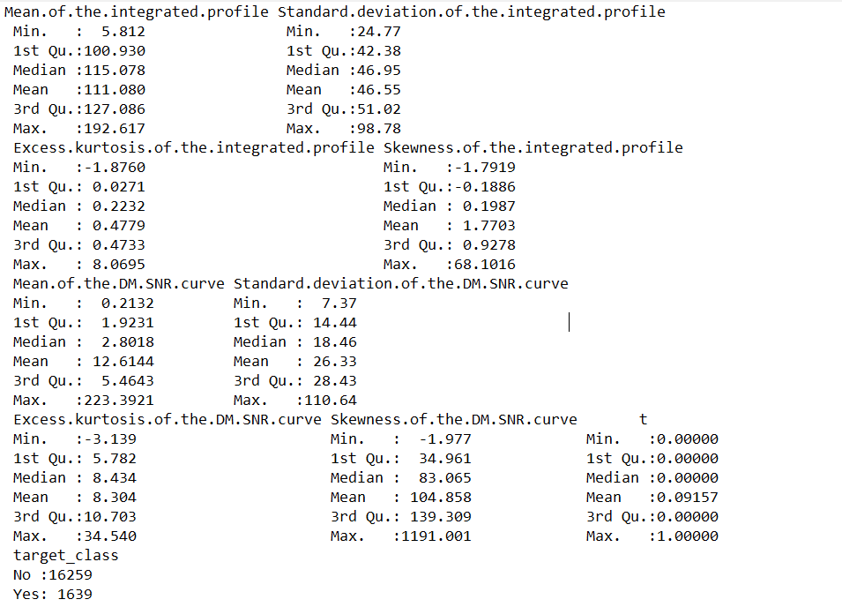
SUMMARY

Slide 5
ALGORITHMS
Naïve Bayes
KNN
Decision Tree
SVM

Slide 6
Naïve Bayes
Training and testing sets are created.
Prior probabilities are calculated.
Conditional probabilities are calculated.
naiveBayes function is used to classify the dataset.
Finally accuracy and precision are determined using mmetric function.
Accuracy value is 94.51.

Slide 7
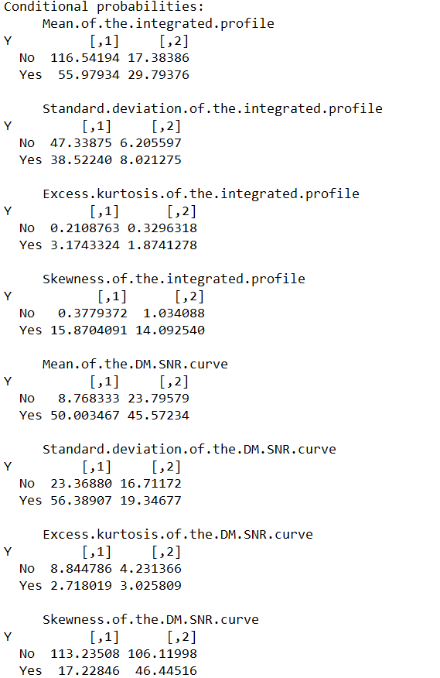
Conditional probabilities (Naïve Bayes)

Slide 8
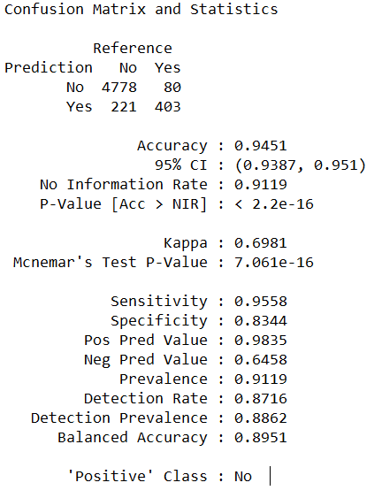
Confusion matrix(Naïve Bayes)

Slide 9
KNN
Normalized the numeric values to range[0,1].
Training and testing sets are created.
K-value(number of neighbours) is taken as 3.
Euclidean distance between the test data and each row of train data are calculated using knn function.
Crosstable function is used to match accuracy of the predicted values with the known values.
Confusionmatrix function is used to calculate the accuracy, specificity and sensitivity values.
ROC curve is drawn and area under roc curve is calculated.
Accuracy value is 97.8.

Slide 10
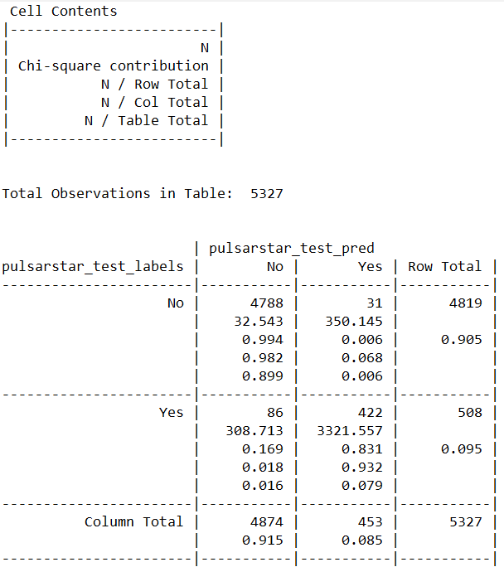
CROSS TABLE(KNN)

Slide 11
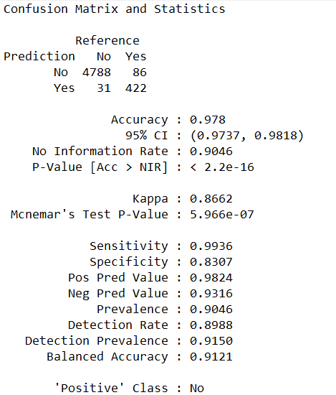
Confusion Matrix(KNN)

Slide 12
Decision Tree
Training and testing sets are created.
rpart function is used to train the dataset.
Predict function is used for prediction of the decision tree model.
Finally accuracy and precision are determined using confusionmatrix function.
Accuracy value is 97.74.

Slide 13
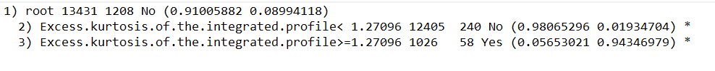
Decision Tree Structure

Slide 14
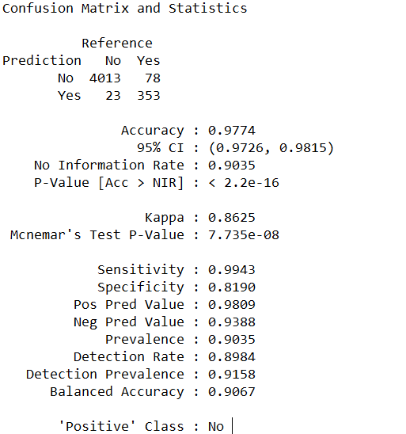
Confusion matrix(Decision Tree)

Slide 15
SVM
Mean of the integrated profile , Mean of the DM SNR curve are the two attributes considered for classification using linear SVM.
Training and testing sets are created.
svm method is used to train the dataset.
Finally accuracy and precision are determined using confusionmatrix function.
Accuracy value is 96.51.

Slide 16
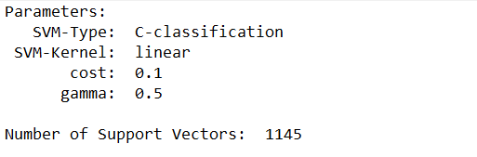
Classification (SVM)

Slide 17
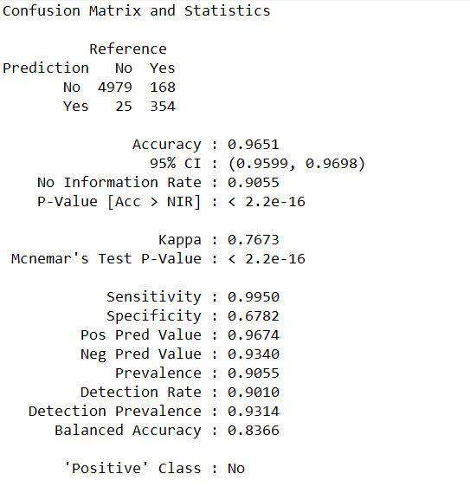
Confusion matrix(SVM)

Slide 18
Plots
Box plot
Q-Q plot
Scatter plot
Correlation is determined between Mean of the integrated profile and Mean of the DM SNR curve attributes .
Correlation value is -2.988408.

Slide 19
Conclusion
Accuracy of Naïve Bayes classifier is 94.51.
Accuracy of KNN classifier is 97.8.
Accuracy of Decision Tree classifier is 97.74.
Accuracy of SVM classifier is 96.51.
Based on these values, KNN is the best classifier that can be used for classification of pulsar star dataset.

