Slide 1
DATA SCIENCE
CUSTOMER SEGMENTATION
By:
Chetan M
Bindushree K P
Mahesh A C
Arpitha D

Slide 2
CONTENTS
OVERVIEW
INTRODUCTION
PROPOSED SYSTEM
CUSTOMER SEGMENTATION
CONCLUSION

Slide 3
OVERVIEW
The ultimate business goals that completing the project will address or contribute to. Ideally, these goals will overlap or be aligned with your company’s strategic goals.
The ultimate business goals that completing the project will address or contribute to. Ideally, these goals will overlap or be aligned with your company’s strategic goals.
We first describe the steps towards predicting customer’s behavior, such as collecting and preparing data, segmentation, and profile modelling.

Slide 4
INTRODUCTION
Nowadays market is characterized by being global, products and services are almost identical and there is an abundance of suppliers. And because of the size and complexity of the markets, mass marketing is expensive and the returns on investment are frequently questioned.
INTRODUCTION
1:1
Direct marketing
Segment based marketing
Mass Marketing
Communication with customers

Slide 5
Instead of targeting all prospects equally or providing the same incentive offers to everyone, a firm can select only those customers who meet certain profitability criteria based on their individual needs and buying patterns this is achieved by building model to predict the future value of individual based on demographic characteristics ,life-style, and previous behaviour.
The model produces information that will focuses customers retention and recruitment programs on building and keeping the most profitable customer base this is called customer behaviour modelling or customer profiling.
A customer profile is a tool to help target marketers better understand the characteristics of their customers base.

Slide 6
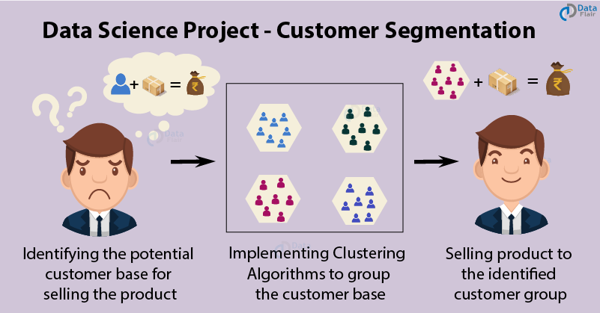
Customer Segmentation Project in Python
Customer Segmentation is one the most important applications of unsupervised learning. Using clustering techniques, companies can identify the several segments of customers allowing them to target the potential user base. In this machine learning project, we will make use of K-means clustering which is the essential algorithm for clustering unlabeled dataset.

Slide 7
There are three main approaches to market segmentation:
A priori segmentation the simplest approach, uses a classification scheme based on publicly available characteristics — such as industry and company size — to create distinct groups of customers within a market. However, a priori market segmentation may not always be valid, since companies in the same industry and of the same size may have very different needs.
Needs-based segmentation is based on differentiated, validated drivers (needs) that customers express for a specific product or service being offered. The needs are discovered and verified through primary market research, and segments are demarcated based on those different needs rather than characteristics such as industry or company size.
Value-based segmentation Differentiates customers by their economic value, grouping customers with the same value level into individual segments that can be distinctly targeted.

Slide 8
Customer Segmentation
Customer Segmentation is the process of division of customer base into several groups of individuals that share a similarity in different ways that are relevant to marketing such as gender, age, interests, and miscellaneous spending habits.
The technique of customer segmentation is dependent on several key differentiators that divide customers into groups to be targeted. Data related to demographics, geography, economic status as well as behavioral patterns play a crucial role in determining the company direction towards addressing the various segments.
Loyality
Profitability

Slide 9
Difficulties in making good segmentation:
Relevance and quality of data
Intuition
Continuous Process
Over-Segmentation
Advantages of Customer Segmentation:
Improving your whole product
Focusing your marketing message
Allowing your sales organization to pursue higher percentage opportunities
Getting higher quality revenues

Slide 10
k-means clustering
We are given a data set of items, with certain features, and values for these features (like a vector). The task is to categorize those items into groups. To achieve this, we will use the k-Means algorithm; an unsupervised learning algorithm.
The algorithm works as follows:
First we initialize k points, called means, randomly.
We categorize each item to its closest mean and we update the mean’s coordinates, which are the averages of the items categorized in that mean so far.
We repeat the process for a given number of iterations and at the end, we have our clusters.

Slide 11
Conclusion
This project helps for analysis of the data, especially for E-Commerce or marketing people based on customers data as per the customers are going to visit their website and helps owner to enhance their business strategy in future to attract the customer to earn maximum profit shares.

