Slide 1

B.V.V.S
BASAVESHWAR ENGINEERING COLLEGE, BAGALKOTE
DEPARTMENT OF COMPUTER APPLICATIONS (MCA)
Presentation on
“Smart Dustbin”
PRESENTED BY:
Laxmanna A Goudar
Chetan Melavanki
Sanganabasav Toravi
Project Coordinator:
Prof. C. M. Jangin
Asst Prof. Dept. of MCA
BEC,Bagalkote

Slide 2
SMART DUSTBIN

Slide 3
Abstract
Smart Dustbin as its name represents it works smartly or we can say that it is an automatic dustbin. it works like when you will come in front of this dustbin it will open automatically with the help of a servo motor. so there is some sensor work to detect the object in front of the dustbin.

Slide 4
Introduction
• Most of the cities, towns and villages in India are not well designed to facilitate the suitable garbage collection methods.
• Common Public dustbins are filling over with the garbage and no one is concerned to clear them up as and when they get completely packed with overflowing garbage.
• Keeping in view of this big problem, it will be a good suggestion to do something to deal with this unmanaged waste and from this, we have designed a simple system called IoT based Smart Dustbin using Arduino, Ultrasonic Sensor and Servo Motor, where the lid of the dustbin will automatically open itself upon detection of human body.
IoT devices are pieces of hardware, such as sensors, actuators, gadgets, appliances, or machines, that are programmed for certain applications and can transmit data over the internet or other networks.

Slide 5
Objectives
The main objective of this project is to
Design and build a prototype for an automatic open dustbin that can automatically open the lid when it detects the object who want to throw out their trash. It also can detect the level of the trash that inside the dustbin.
To get familiar with the Arduino and the respective sensors how to use them for a cause.
To analysis the dustbin program and set it up according to the physical distance for best Working.

Slide 6
Components required
Software Requirements
Operating System : Windows 8 or Above
Programming : C++
IDE : Arduino
Hardware Requirements
Processor : i3 above
Ram : 4GB (Minimum)
Hard Disk Space : 40GB

Slide 7
Modules
IOT Device with Arduino UNO Module.
IOT Device with Ultrasonic Sensor Module.
IOT Device with Servo Motor Module.
IOT with Buzzer Module.

Slide 8
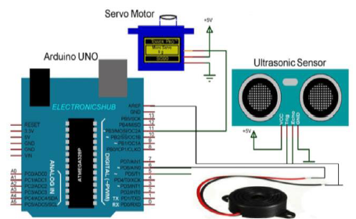
Architecture Diagram

Slide 9
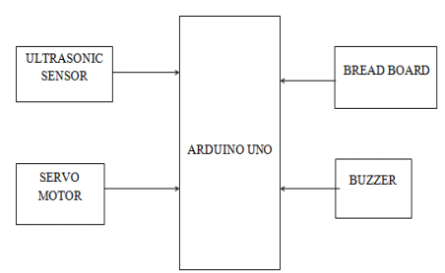
Data Flow Diagram

Slide 10
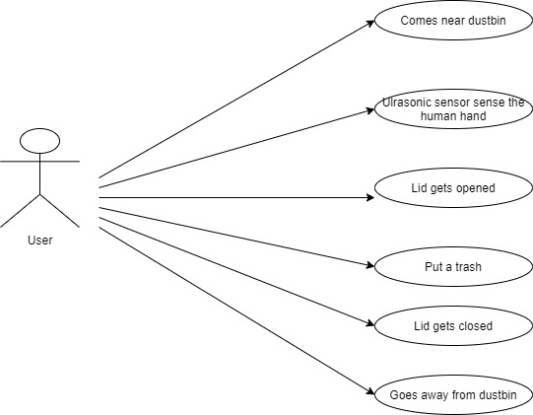
Working Procedure

Slide 11
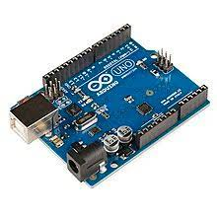
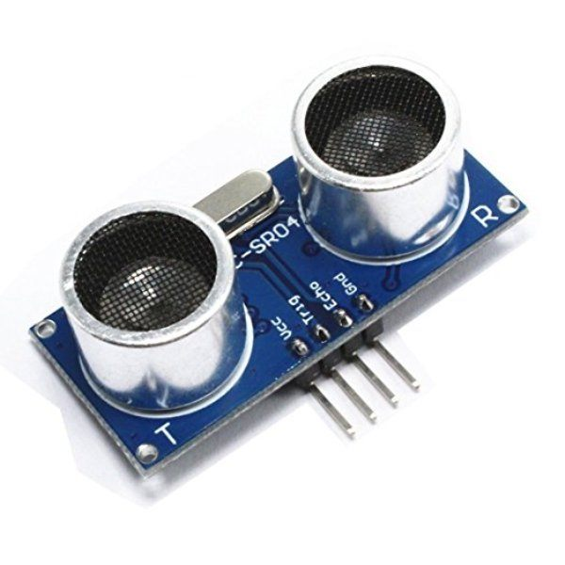
Validation Report(Screen Shots) Arduino UNO board Ultrasonic Sensor

Slide 12
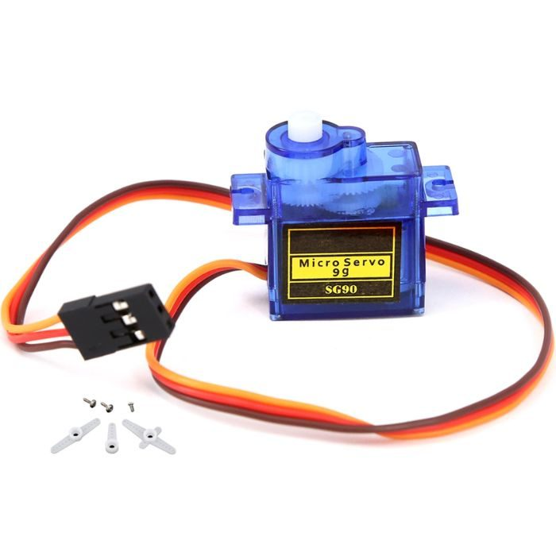
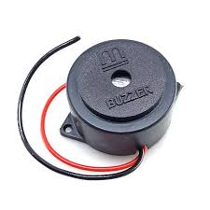
Servo Motor Buzzer

Slide 13
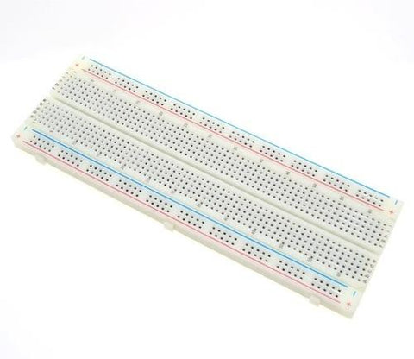
Bread Board

Slide 14
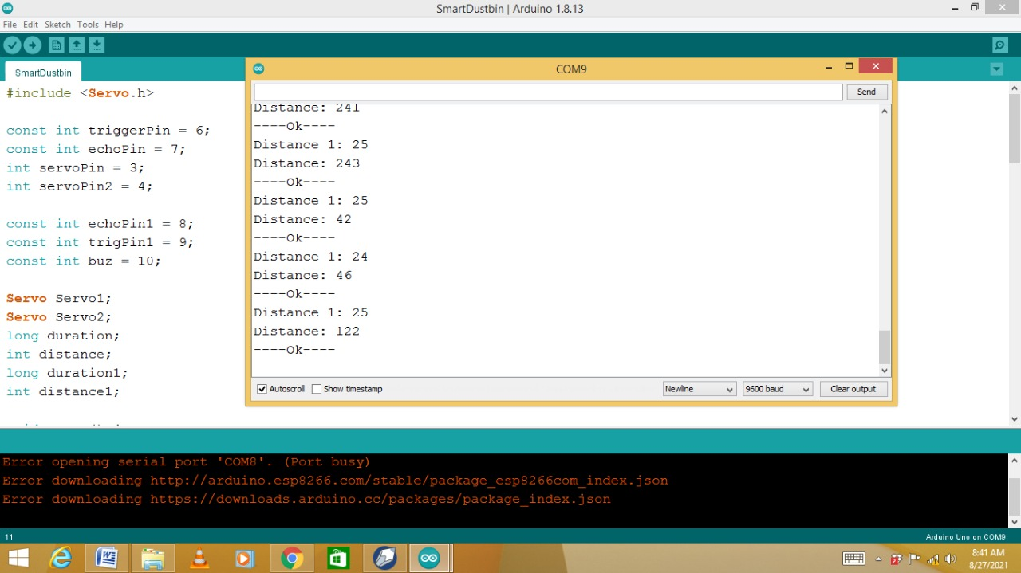
Code and Output Window

Slide 15
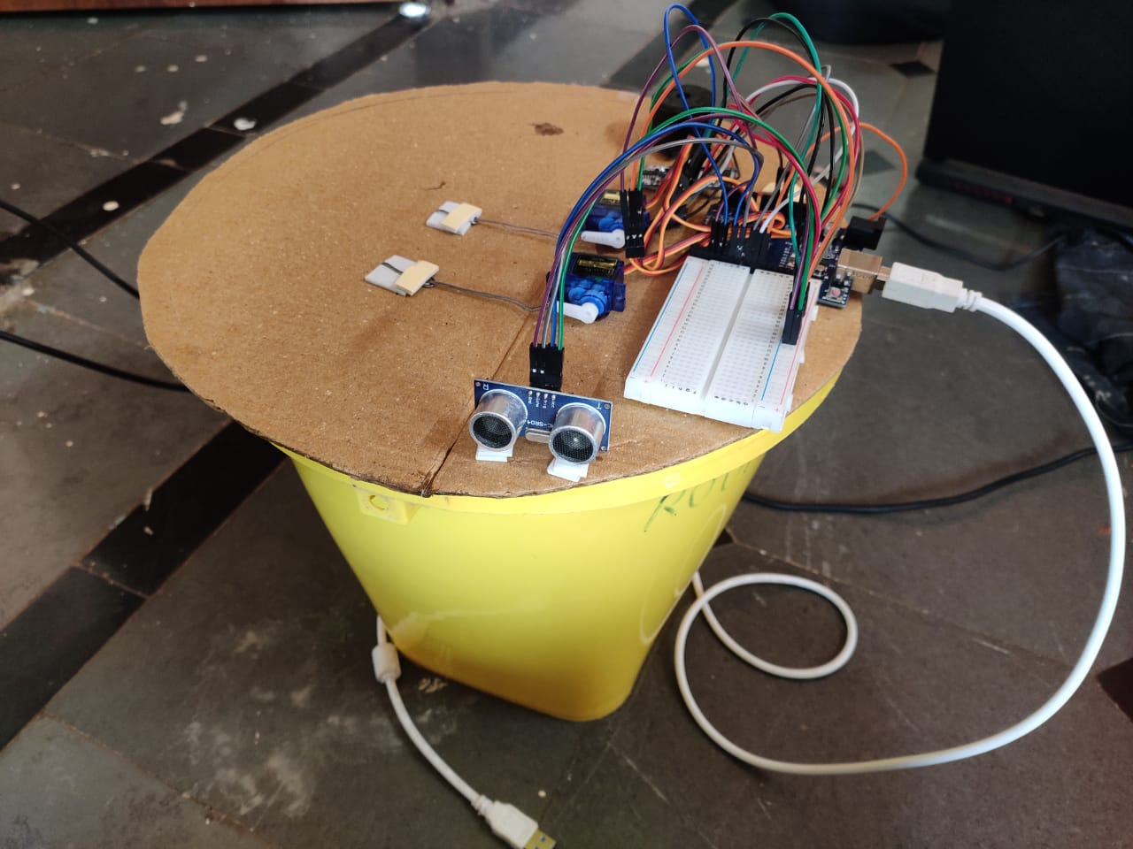
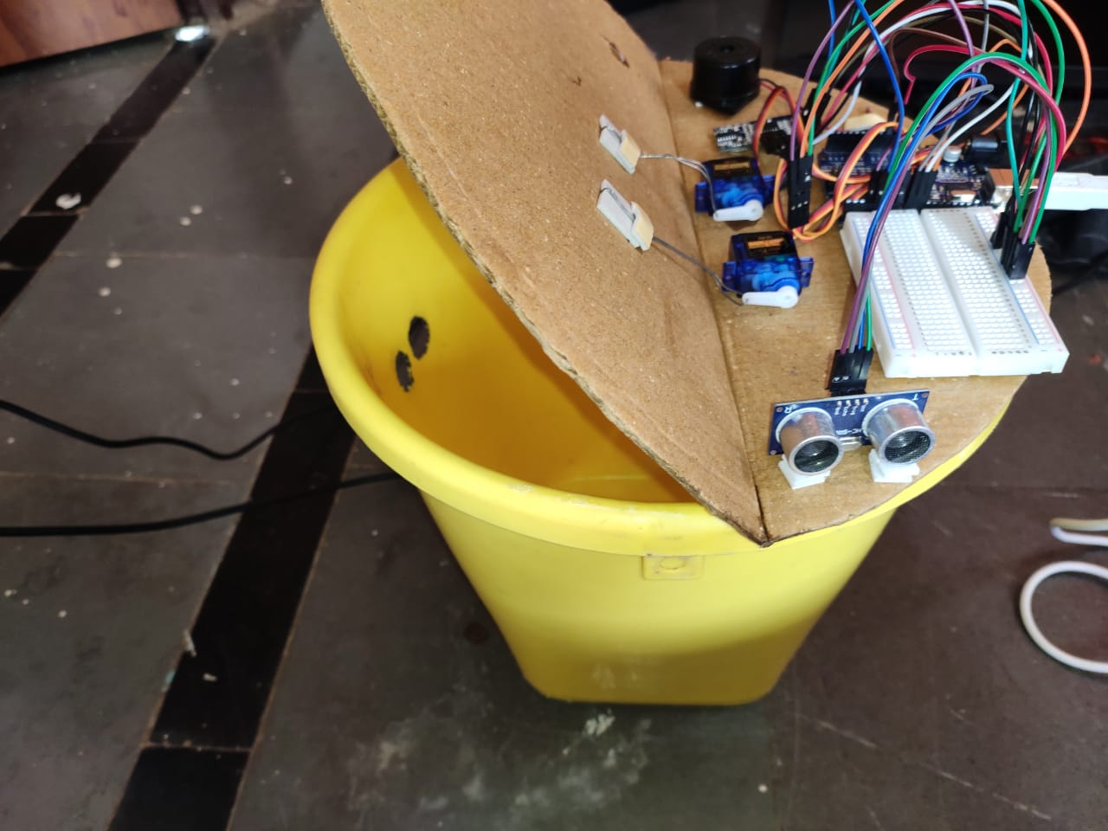
Closed Dustbin Lid Opened Dustbin Lid

