Slide 1

B.V.V.S
BASAVESHWAR ENGINEERING COLLEGE, BAGALKOTE
DEPARTMENT OF COMPUTER APPLICATIONS (MCA)
Presentation on
“Internship”
PRESENTED BY :
Chetan Melavanki
(2BA23MC008)
Under Guidence :
Prof. M. H. Shirur
Asst Prof. Dept. of MCA
BEC, Bagalkote
Project Coordinator :
Prof. S.S.Gujarathi
Assoc Prof. Dept. of MCA
BEC, Bagalkote

Slide 2
Introduction
The primary goal of this internship was to gain hands-on experience in full stack development. Over the course of 8 weeks, I worked with core technologies such as Python, HTML, CSS, JavaScript, Django, and MySQL.
This internship served as a bridge between theoretical knowledge and its practical application in real-world projects.

Slide 3
Orgnization Profile
Name: Apponix Technologies Pvt. Ltd.
Year Established: 2013
Headquarters: Bangalore, Karnataka, India
Hubli Branch Address: 2nd floor, Virupaksha Krupa building P.B. Road, Vidyanagar, Above Airtel Store, Opp KMC Main Gate Hubli
Website: https://www.apponix.com
Mission
To empower students and professionals with industry-relevant skills that enable them to achieve their career goals.

Slide 4
Departments
Training & Development: Delivered Python full stack sessions.
Student Support & Counseling: Helped with schedules and support.
Placement & Career Services: Explained job readiness processes.
Marketing & Admissions: Promoted courses, managed inquiries.
Administration & Operations: Maintained labs and resources.

Slide 5
Technical Skills Gained
Python: Basics, OOPs, data structures.
MySQL: Database design, CRUD operations.
Frontend: HTML, CSS, Bootstrap, JavaScript.
Django: MVT structure, views, forms, templates.

Slide 6
Projects
To-Do App:
Add/edit/delete tasks.
Mark tasks as completed.
.
Delete tasks.
Blog App:
Adding blogs and post.
category wise adding blogs.

Slide 7
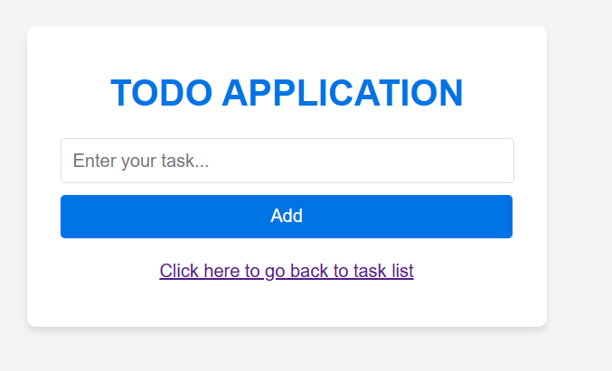
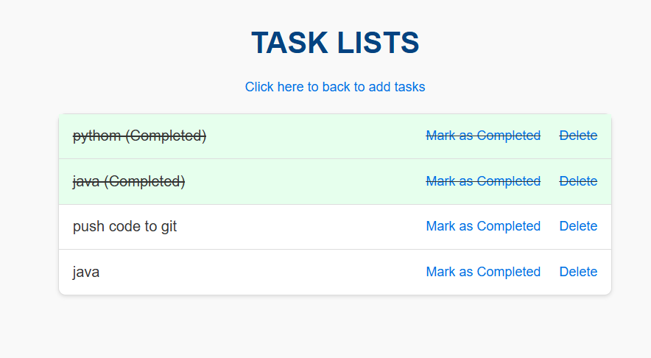
To-do Application Screnshots

Slide 8
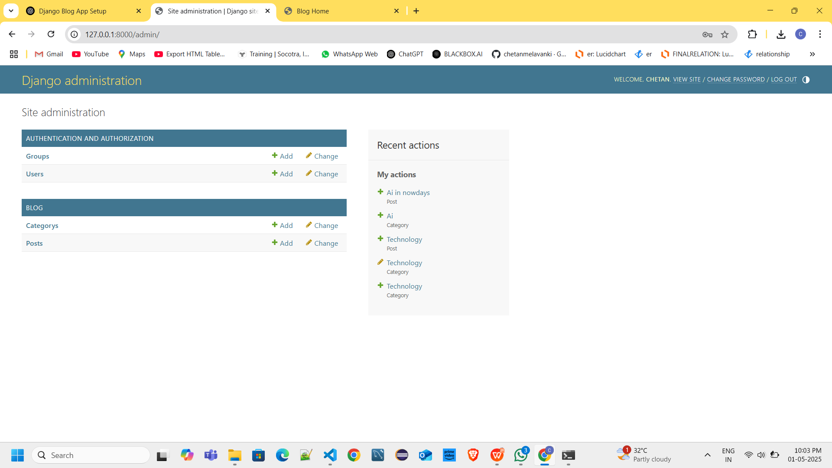
Blog Application Screnshots

Slide 9
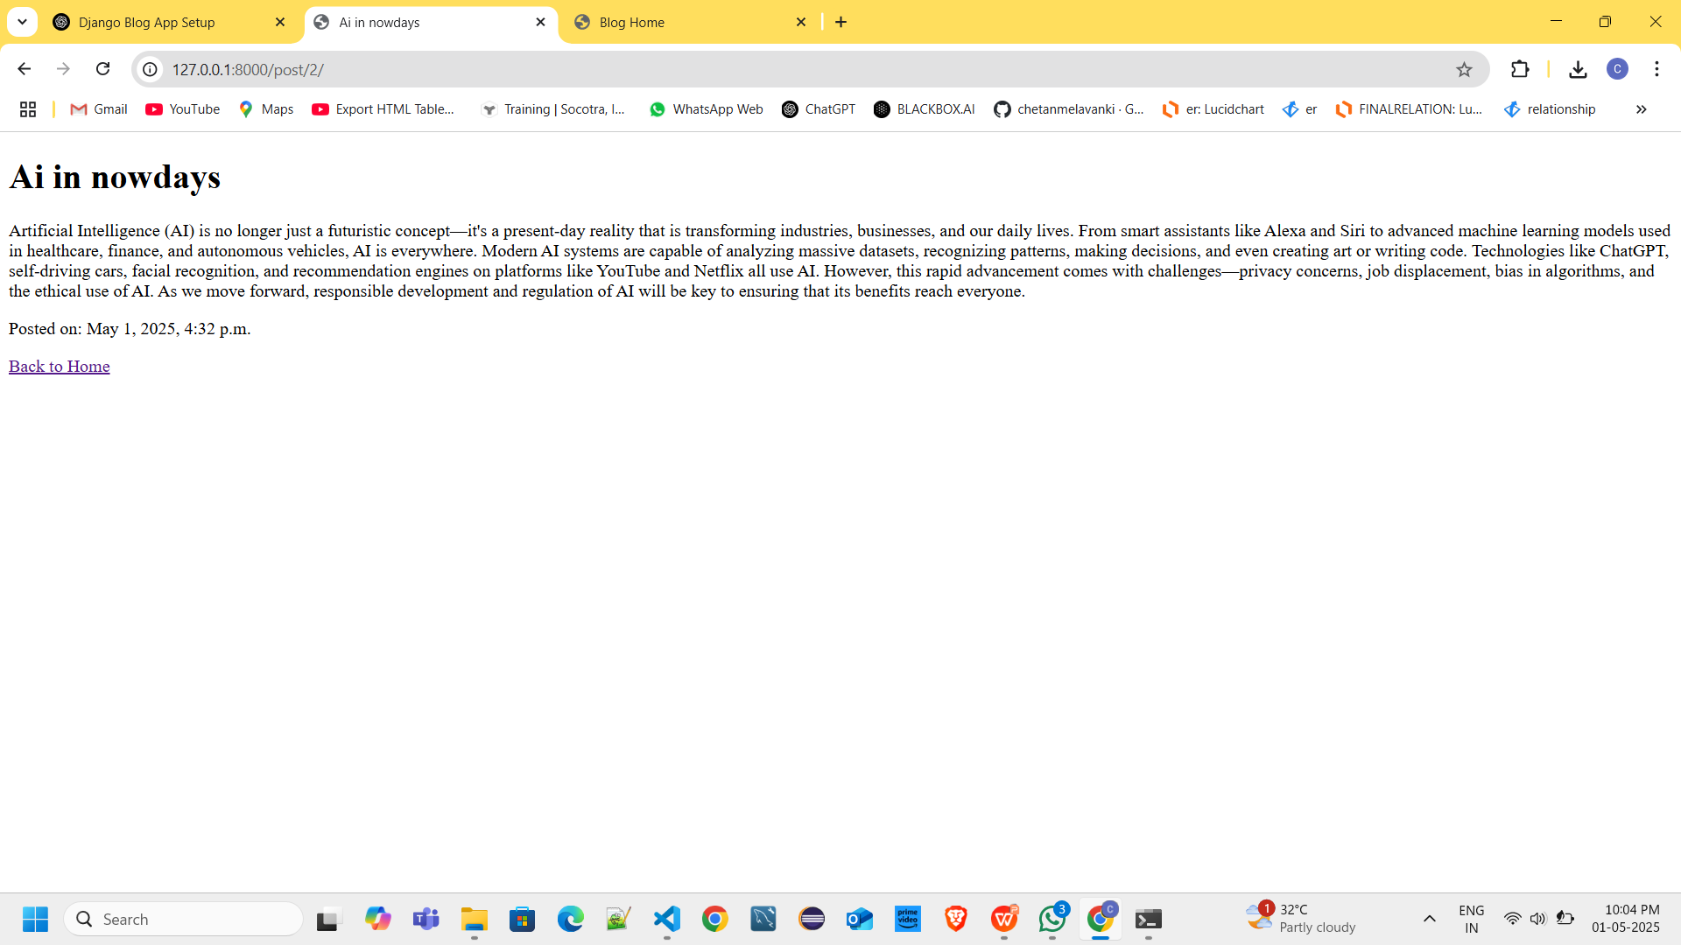
Blog Application Screnshots

Slide 10
Challenges Faced
Understanding MVT flow in Django.
Connecting backend data to frontend templates.
Debugging issues with database connectivity and routes.

Slide 11
Conclusion
This 8-week internship at Apponix Technologies was a highly enriching and transformative experience.
It allowed me to:
Strengthen my technical skills through hands-on training
Develop a better understanding of how the IT industry functions

Slide 12
Thank You

