Slide 1

Note: The data and information in this document is reflective of a hypothetical situation and client. This document is to be used for KPMG Virtual Internship purposes only.
Sprocket Central Pty Ltd
Data Analytics Approach
Chetan

Slide 2
Note: The data and information in this document is reflective of a hypothetical situation and client. This document is to be used for KPMG Virtual Internship purposes only.
Agenda
Introduction
Data Exploration
Model Development
Interpretation

Slide 3
Note: The data and information in this document is reflective of a hypothetical situation and client. This document is to be used for KPMG Virtual Internship purposes only.
Introduction
Analyze New Customers:
Discussed Factors in New Customers :-
Age Distribution.
Number of bike Purchased in past 3 year.
Job Industry of customer.
Number of cars that each state own.
Wealth Segment Customers.

Slide 4
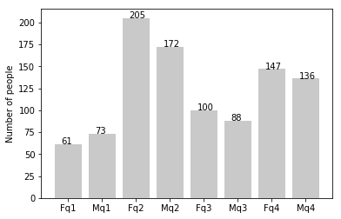
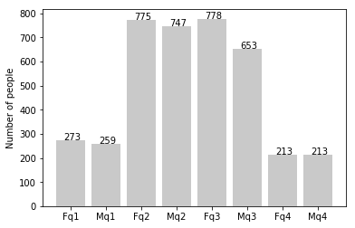
Note: The data and information in this document is reflective of a hypothetical situation and client. This document is to be used for KPMG Virtual Internship purposes only.
Data Exploration
q1: Under 25; q2: 25 to 48; q3: 48 to 59; q4: Over 59
Customer’s Age Distribution
NEW
Mostly our New Customer are in between 25 to 48 years old.
Number of customers from 48 to 59 years old has big drops on percentages.
There is a slightly increase in number of customers over 59 years old in term of percentages.
It looks like the percentages of under 25 years old not really change.
OLD

Slide 5
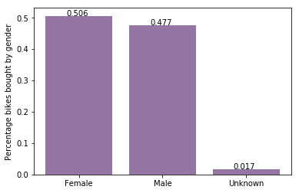
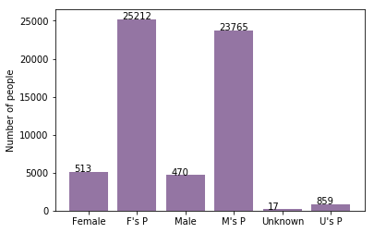
Note: The data and information in this document is reflective of a hypothetical situation and client. This document is to be used for KPMG Virtual Internship purposes only.
Model Development
Bike purchases last 3 years
NEW
As we can see, our new customers mostly Female with 50.6% purchases with total of 25,212 bikes
Male contributed to 47.7% purchases with 23,765 bikes
So we should focus on advertises on Female customers than Male customers
OLD

Slide 6
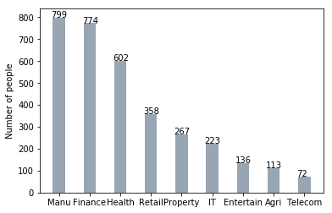
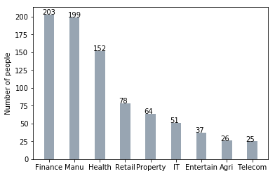
Note: The data and information in this document is reflective of a hypothetical situation and client. This document is to be used for KPMG Virtual Internship purposes only.
Interpretation
Job industry category
NEW
Mostly our new customers are on Finance industry and our Manufacturing customers are still on top 2.
The rest industries is still same .
Company Should focus on Customer those are in the manufacturing and finance.
OLD

Slide 7
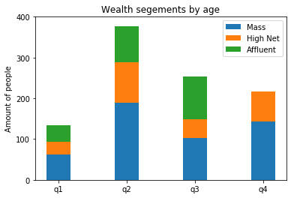
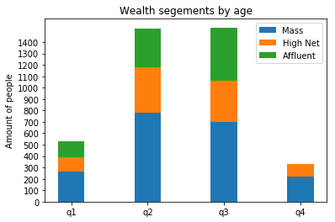
Note: The data and information in this document is reflective of a hypothetical situation and client. This document is to be used for KPMG Virtual Internship purposes only.
Interpretation
Wealth Segment:-
NEW
In all ages, the number of Mass Customers is the highest so we should focus on this social class.
After that, we should focus on High Net Customer.
Then Affluent Customers but mostly second and third quadrant.
OLD

Slide 8
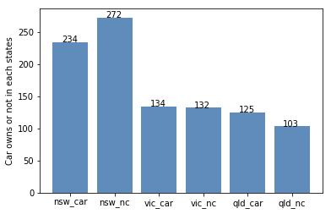
Note: The data and information in this document is reflective of a hypothetical situation and client. This document is to be used for KPMG Virtual Internship purposes only.
Interpretation
Car Owned by States:-
New South Wales should be considered the most since numbers of customers don’t own cars is significantly larger than that own.
Victoria and Queensland has more customers that own car that who don’t but we can try to have something so that those owns car will buy bikes.

