Slide 1
MarketAxess
Cloud Hackathon 2023
Team CloudTechies – Solution Architecture
Presented by –
Anand Prajapati Chetan Mordiya, Vaibhav Tiwari
#CloudAxess

Slide 2

#CloudAxess – Problem Statement (Functional)
To develop a generic trade ingestion system to validate, enrich and process trade data in high throughput and store in data store in such a way that the data extract/search is efficient based on some provided fields.
Team needs to deliver a prototype solution for file processing microservice just handling the ingestion, dummy enrichment, validation, and storing data for response generation and search.
Functional Requirements
System should ingest the data in real time from various pre-configured directories (EFS, S3, etc.) .i.e /mnt/cloudaxess/ingestion/client1
System should integrate with reference data store to get the reference data for enrichment and validations.
User to be notified by generating response in the various designated response folders (EFS, S3 etc.). i.e /mnt/cloudaxess/response/client1
System should store the data in such a way that in future the data should be easily searchable based on these fields (Transaction Id, Reporting Counterparty Code, Non-Reporting Counterparty Code, Security identifier and Date range).
Processing system should persist data along with processing status in persistence store.
Data should be searchable till one year of submission for future UI/UX extension.
Sample
Data
Trade Data
Instrument Data
Syntax Rules List
Response Data (Note the file name convention)

Slide 3
Key AWS/Cloud Services Used
API-Gateway : Request delegation to required service to enable users to upload file to the s3 bucket
AWS Lambda : S3 to EFS file movement. Triggered by Put Object Event on S3
AWS Aurora DB : High performant, Scalable and Available Relation database
AWS MSK : AWS Managed Stream for Kafka
Cloudwatch logs : Keep tracks of all logs
OpenSearch : Creating and Publishing search engine functionality
OpenShift : RedHat Kubernetes framework for containers.
S3 buckets :
Inbound bucket : landing zone of uploaded file
Response bucket : Final Response file generated

Slide 4
Key features of our Solution
High Performance : Able to process 1.4 million transactions in 1 hour – extrapolate to 14 million in 10 hrs (using 1 instance per service)
Highly Scalable : Services use async communication making it easier to scale up and down – hence controlling the cost
Secure : Encryption at rest and Encryption at transit (MSK and Aurora DB)
Dedicated Indexing service : Core and search functionality are loosely coupled. We won't lose file processing capability if there are any issues with downstream processing'
Not an AWS specific Architecture : Solution can be ported to use any Kafka+RDS service provided by other cloud service providers. Kubernetes and OpenSearch are opensource.

Slide 5
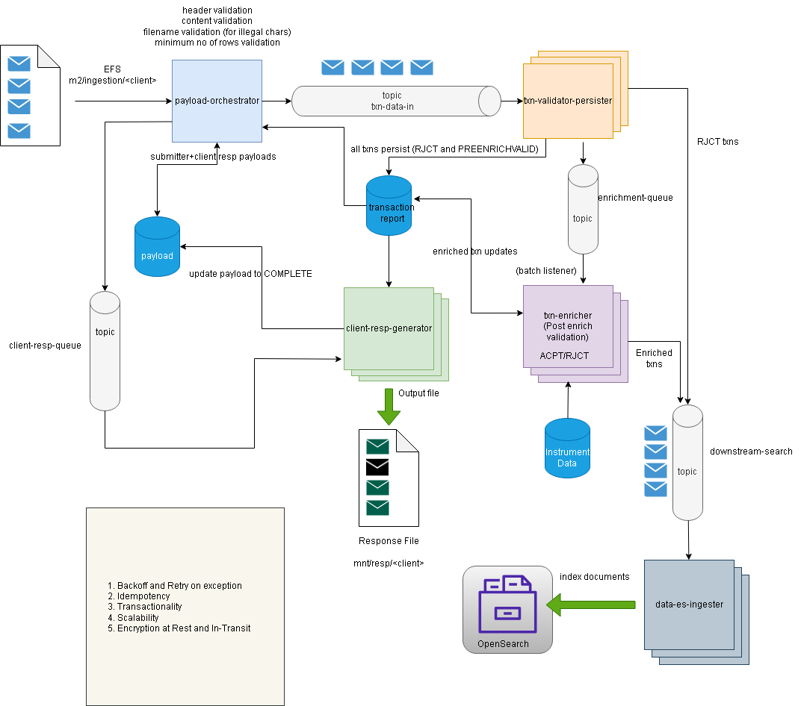
Solution Architecture Diagram (Core)

Slide 6
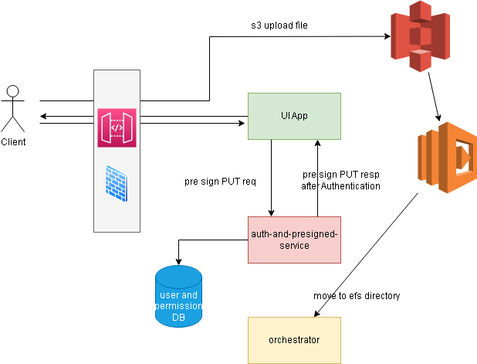
Solution Architecture Diagram (File Upload)

Slide 7
Key Principles on which observations made
TLS encryption between services
Use of CA certificates
IAM based RDS connectivity
Secret Based MSK connectivity
Redundancy & Replication
Distributed Data Management
Blue Green Deployment
Health Checks and Monitoring
Service Granularity
Loose Coupling
Scalable
Monitoring
CI/CD Pipelines
Performance
Reliability
Cost
01
02
03
04
05
06
Async Communication between services
Horizontal Scaling
Proper indexing in tables
Performance Testing
Message retry and Dead Letter Queue
Resilient Data Storage
Continuous Deployments and Rollback.
Resilient Communication between services
Right Sizing Resources Management
Containerization and Autoscaling
Serverless Computing
Security
Availability
Sustainability

Slide 8
Load Run stats
Duration | Transaction counts | Total files dropped | Transactions per file | Kafka batch size | Duration between files | TPS
30 mins | 360000 | 360 | 1000 | 100 | 5sec | 200
17 mins | 416000 | 416 | 1000 | 500 | 2sec | 407
56 mins | 1410000 | 141 | 10000 | 1000 | 3sec | 414 (max 425)
As we increase the kafka consumer batch size it increases the throughput but also the memory footprint of the application. 1000 seems to be the optimal kafka consumer batch size. the above results are for single instances of apps running in local env – for multi-instance setup we can get much higher throughput.

Slide 9
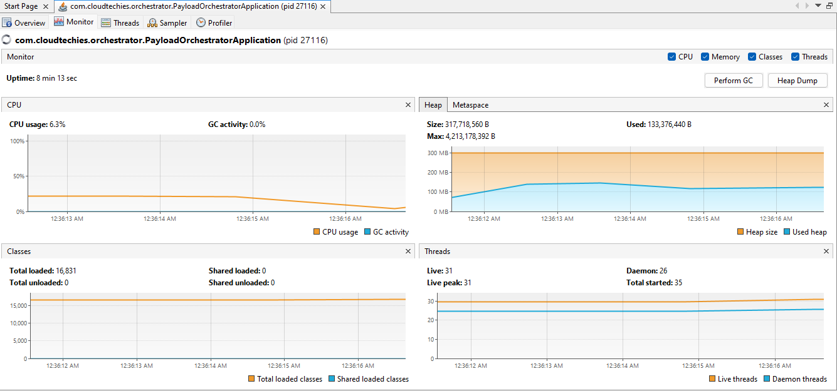
Payload Orchestrator and Splitter

Slide 10
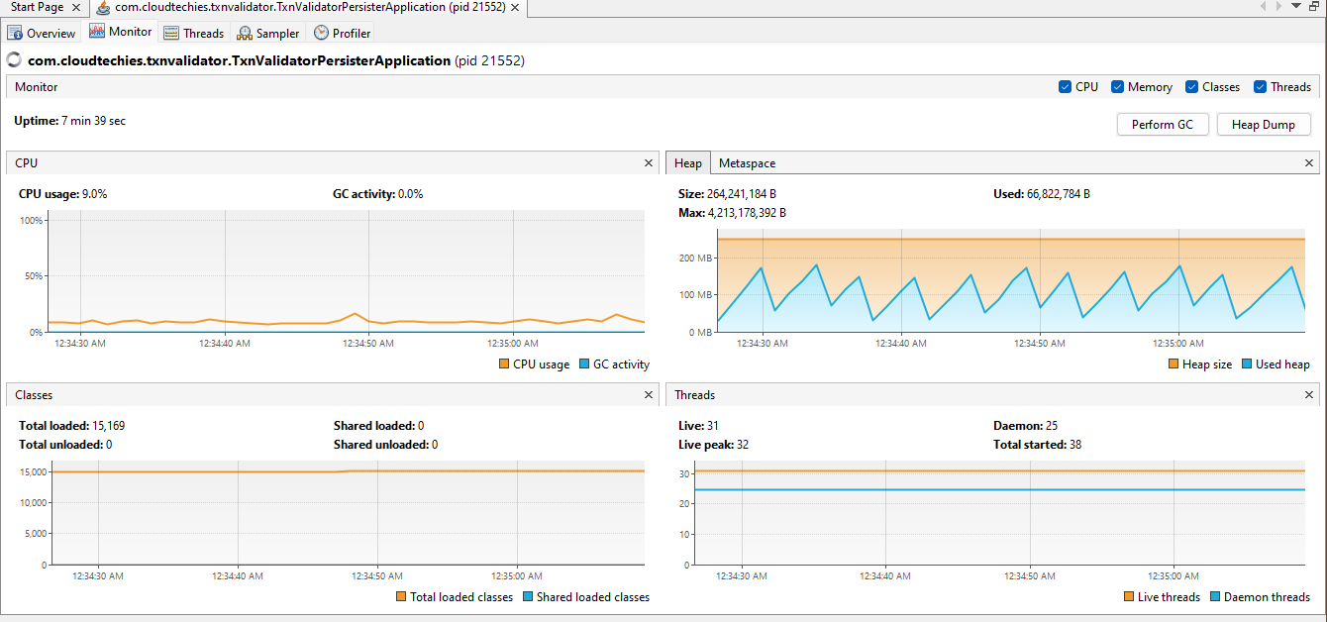
Transaction Validator & Persister

Slide 11
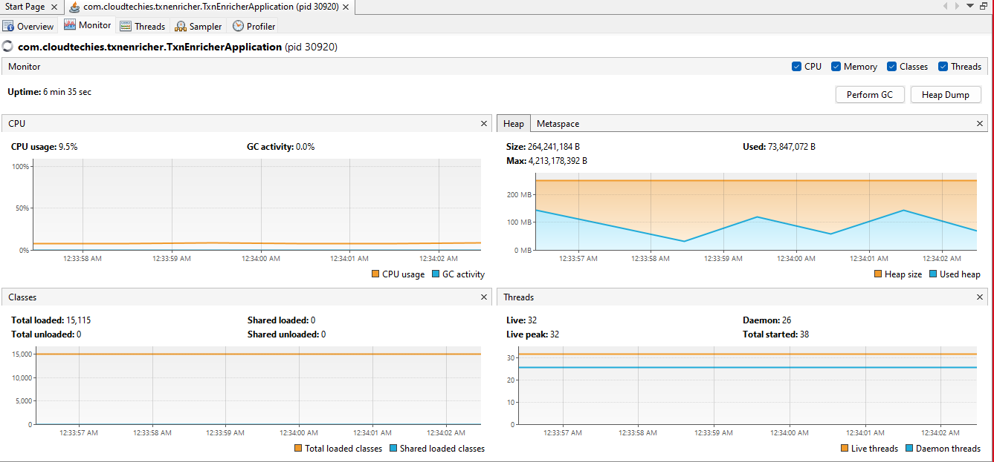
Transaction Enricher

Slide 12
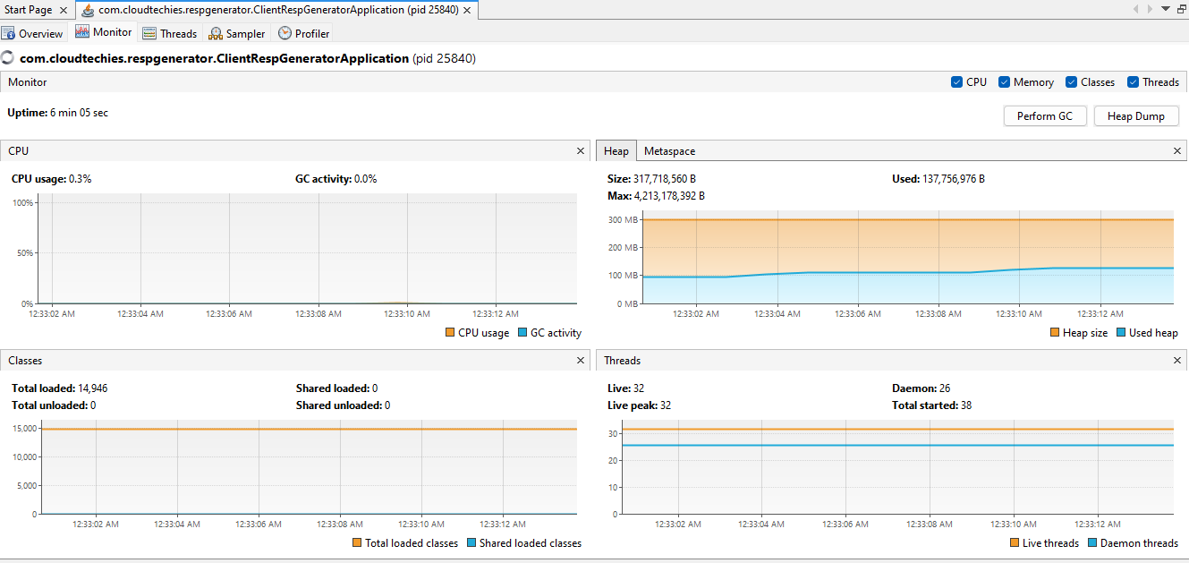
Client Resp Generator

Slide 13

Thank You

