Slide 1
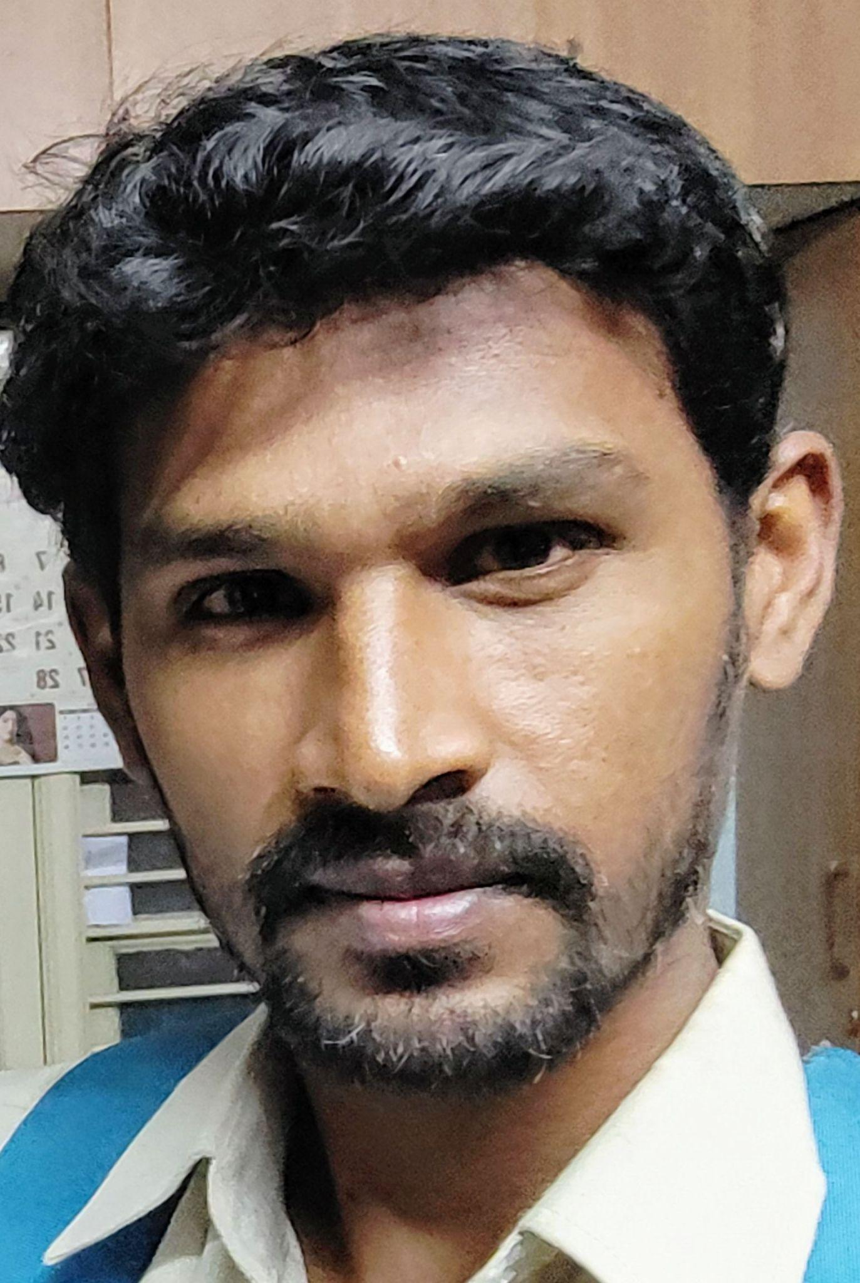
Name: Arya
Category: All Rounder
Age: 30 years Ph: 9611999614

Slide 2
A Ravindranath | 48 years
All Rounder | 9986998229

Slide 3
Aditya M | 34 years
All Rounder | 9902890795

Slide 4
Afthab | 23 years
Batsman | 7795259224

Slide 5
Ambrish | 32 years
All Rounder | 7619379377

Slide 6
Anil | 38 years
Batsman | 9108444706

Slide 7
Anil | 23 years
All Rounder | 9901115633

Slide 8
Anil Kumar B K | 35 years
All Rounder | 8310714306

Slide 9
Anil Kumar HR | 24 years
All Rounder | 9380619989

Slide 10
Anil Reddy | 26 years
All Rounder | 8123388804

Slide 11
Arjun Ramesh Tendulkar | 12 years
All Rounder | 9742386644

Slide 12
Arun Kumar | 26 years
Batsman | 9740489284

Slide 13
Arya | 30 years
All Rounder | 9611999614

Slide 14
Avinash | 29 years
Batsman | 8123744990

Slide 15
Azhar Khan | 39 years
Batsman | 8693908342

Slide 16
Babu Prasad | 32 years
All Rounder | 9620206600

Slide 17
Basavaraj | 23 years
Batsman | 9148634810

Slide 18
Basavaraj | 18 years
All Rounder | 9611144490

Slide 19
BC Harish Kumar | 40 years
All Rounder | 9845827989

Slide 20
Bharath | 26 years
All Rounder | 8123263208

Slide 21
Bharath | 27 years
All Rounder | 9900310361

Slide 22
Bharath R | 32 years
All Rounder | 9632558777

Slide 23
Bharath S | 29 years
Batsman | 7676765445

Slide 24
Bhargav K | 17 years
Batsman | 8123054335

Slide 25
Chandrashekar | 37 years
Batsman | 9663510908

Slide 26
Chetan Kumar N | 39 years
Bowler | 9945621717

Slide 27
Chetan N | 33 years
Batsman | 9611111666

Slide 28
Chethan | 31 years
Batsman | 9008796333

Slide 29
Chethan | 37 years
Batsman | 9845944474

Slide 30
Chethan Kumar | 36 years
Batsman | 9945829499

Slide 31
Devendra | 38 years
All Rounder | 9900922363

Slide 32
Dhanush B | 28 years
All Rounder | 9535988176

Slide 33
Dhanush N | 27 years
Batsman | 9738899414

Slide 34
Dhanush R | 20 years
Batsman | 7411352556

Slide 35
Dhanush R | 20 years
Batsman | 9980598523

Slide 36
Dharshan M | 23 years
All Rounder | 9886311767

Slide 37
Dhruva Kumar | 37 years
Batsman | 9886668883

Slide 38
Dishank | 35 years
All Rounder | 9008481848

Slide 39
Girish | 44 years
Batsman | 9745347173

Slide 40
Gopinath V | 40 years
All Rounder | 9900676026

Slide 41
Goutham | 23 years
Batsman | 7411721373

Slide 42
Govardhan | 22 years
Batsman | 7760993459

Slide 43
Guru Raghavendra
 | 9686623625

Slide 44
Harish M | 38 years
All Rounder | 9902032229

Slide 45
Hitesh G | 24 years
All Rounder | 9739050679

Slide 46
Indresh Kumar | 34 years
All Rounder | 9035751115

Slide 47
Ishthiyak | 26 years
Batsman | 9980181786

Slide 48
Jaga | 35 years
All Rounder | 9513631219

Slide 49
Jitin S | 20 years
All Rounder | 9900900666

Slide 50
Kailash | 32 years
All Rounder | 7259693680

Slide 51
Kantha Kumar | 32 years
All Rounder | 9742315080

Slide 52
Karagappa | 43 years
Batsman | 9845798817

Slide 53
Karthik | 36 years
All Rounder | 9972418999

Slide 54
Karthik P | 26 years
Batsman | 8880388889

Slide 55
Kashif | 20 years
All Rounder | 8971110413

Slide 56
Kiran | 29 years
Batsman | 9740834449

Slide 57
Kiran M | 23 years
Batsman | 7022550833

Slide 58
Kishan | 14 years
All Rounder | 7899392188

Slide 59
Kishore | 31 years
Batsman | 9535815098

Slide 60
Krishnamurthy | 32 years
Bowler | 9686333928

Slide 61
Kumar | 26 years
All Rounder | 7338632438

Slide 62
Kunal Bhargava | 38 years
All Rounder | 9739363656

Slide 63
Likith Reddy | 18 years
Bowler | 9880616057

Slide 64
Lingraj | 20 years
Batsman | 7349651319

Slide 65
Lokesh J | 22 years
Batsman | 7022190895

Slide 66
M Vamshi | 16 years
All Rounder | 9686616327

Slide 67
Madhu Prasad | 26 years
Batsman | 8050867265

Slide 68
Mahadev | 26 years
Batsman | 9742355554

Slide 69
Mahadev | 24 years
Batsman | 9900478358

Slide 70
Mahesh | 45 years
All Rounder | 9663993399

Slide 71
Mallikarjun | 34 years
Bowler | 9513465666

Slide 72
Manjunath | 47 years
All Rounder | 9916976357

Slide 73
Manjunath M | 44 years
Bowler | 9964821055

Slide 74
Manjunath NM
 | 9945194297

Slide 75
Manjunath P | 35 years
All Rounder | 9743015567

Slide 76
Manjunath P | 42 years
Batsman | 9964399249

Slide 77
Manjunatha | 31 years
All Rounder | 8147429118

Slide 78
Manjunatha BG | 32 years
All Rounder | 6362049445

Slide 79
Manjunth M
 | 9591589009

Slide 80
Manoj Reddy | 21 years
All Rounder | 8310511078

Slide 81
Mithun M | 25 years
All Rounder | 9591755567

Slide 82
Mithun Murthy | 20 years
All Rounder | 9741440817

Slide 83
Mithun Reddy | 35 years
All Rounder | 9986646222

Slide 84
Mohamad Ali | 26 years
All Rounder | 9353264372

Slide 85
Mohan M | 22 years
Batsman | 9148938382

Slide 86
Mohan Rao | 27 years
All Rounder | 7014841335

Slide 87
Munikrishna | 28 years
All Rounder | 9739586978

Slide 88
Murugesh M | 30 years
Batsman | 9739721772

Slide 89
Nagavendra M | 35 years
All Rounder | 8197661719

Slide 90
Nandan Chaitanya | 37 years
Batsman | 9964500100

Slide 91
Narayana Swamy | 29 years
Batsman | 9535689777

Slide 92
Narayanaswamy | 40 years
All Rounder | 9880296843

Slide 93
Naveen Kumar | 29 years
All Rounder | 8867282226

Slide 94
Naveen M | 28 years
All Rounder | 9902785999

Slide 95
Naveen Reddy | 40 years
All Rounder | 9901096669

Slide 96
Nikhil Prabhakar | 28 years
All Rounder | 9591101802

Slide 97
Nitesh S | 28 years
All Rounder | 9535991650

Slide 98
Nithin Kumar | 27 years
All Rounder | 8904774933

Slide 99
Noorulla | 37 years
Batsman | 9986188370

Slide 100
Pradeep | 42 years
Batsman | 9845554410

Slide 101
Pradeep BG | 35 years
Bowler | 9611494999

Slide 102
Prajwal L | 27 years
All Rounder | 9071198321

Slide 103
Prakash | 32 years
Batsman | 9742715666

Slide 104
Praveen Kumar N | 40 years
All Rounder | 9880739393

Slide 105
Punith V | 21 years
All Rounder | 6360452535

Slide 106
R Prajwal | 27 years
Batsman | 9980804533

Slide 107
Rajesh R | 35 years
All Rounder | 9986634888

Slide 108
Rajesh V | 39 years
All Rounder | 9880669969

Slide 109
Rama Chandra | 40 years
All Rounder | 9845976133

Slide 110
Ramesh G | 37 years
All Rounder | 9972723408

Slide 111
Ranjith | 25 years
All Rounder | 9686208176

Slide 112
Ravi Kumar BK | 37 years
Batsman | 9611106928

Slide 113
Ravindra | 40 years
Batsman | 9036110064

Slide 114
Rohit Reddy | 19 years
All Rounder | 9972629127

Slide 115
Roshan | 48 years
All Rounder | 9886749342

Slide 116
S Manish | 20 years
Batsman | 9380234874

Slide 117
Sachin G | 27 years
Batsman | 8217347563

Slide 118
Sachin N | 26 years
Batsman | 8073943636

Slide 119
Sandeep Kumar | 31 years
All Rounder | 9538076343

Slide 120
Sandeep Kumar S | 33 years
All Rounder | 9738342349

Slide 121
Sandeep Reddy | 34 years
All Rounder | 9980548880

Slide 122
Sandeep Wadhawan | 43 years
All Rounder | 9986015073

Slide 123
Sanjay BK | 27 years
All Rounder | 8217853871

Slide 124
Sanjay Kumar | 26 years
Batsman | 8147011437

Slide 125
Sanjay Kumar | 26 years
Batsman | 9620191414

Slide 126
Sanjay Kumar Appi
 | 9019913566

Slide 127
Santhosh Reddy | 39 years
All Rounder | 9845372233

Slide 128
Saravana | 24 years
Batsman | 9632322485

Slide 129
Satyajit Reddy | 20 years
All Rounder | 9535533664

Slide 130
Shankar M | 30 years
Batsman | 9742589701

Slide 131
Sharanu V | 21 years
All Rounder | 7022731680

Slide 132
Shashank | 21 years
Batsman | 7795582288

Slide 133
Shashi Kumar | 34 years
Batsman | 9148849740

Slide 134
Shashidhar | 30 years
Batsman | 9148046396

Slide 135
Shashidhar | 35 years
Batsman | 9632541001

Slide 136
Shiva | 36 years
All Rounder | 9986675261

Slide 137
Shiva C | 26 years
All Rounder | 9449777563

Slide 138
Shiva Kumar N | 41 years
All Rounder | 9845079668

Slide 139
Shiva Prasad | 25 years
Batsman | 7760218518

Slide 140
Shivanand | 31 years
All Rounder | 7204691096

Slide 141
Shivaraj K | 38 years
Batsman | 9916812444

Slide 142
Siddalinga
 | 9686229057

Slide 143
Sridhar | 29 years
Batsman | 9538658262

Slide 144
Sridhar M | 20 years
Batsman | 9606575937

Slide 145
Srikanth | 24 years
Batsman | 9535053189

Slide 146
Subramani | 27 years
Batsman | 6360937589

Slide 147
Subramani | 28 years
Batsman | 9902294137

Slide 148
Sudeep G | 20 years
All Rounder | 9538772943

Slide 149
Sujan Reddy B S | 24 years
Batsman | 9886335511

Slide 150
Suman Reddy | 28 years
Batsman, Wicket Keeper | 8296151789

Slide 151
Sunil | 33 years
Batsman | 9964122322

Slide 152
Sunil Diesel | 43 years
Wicket Keeper | 8317448327

Slide 153
Tarun Reddy | 26 years
Batsman | 7676761221

Slide 154
Uday Kiran | 25 years
Batsman | 7899049568

Slide 155
Uday Kumar | 37 years
Batsman | 9880080119

Slide 156
Umesh BK | 37 years
Batsman | 9900100178

Slide 157
Vajresh | 36 years
Batsman | 9845573427

Slide 158
Varchas Reddy | 22 years
All Rounder | 9611360570

Slide 159
Vasanth Kumar | 28 years
Batsman | 9742060594

Slide 160
Vijay Kumar | 42 years
All Rounder | 9591383139

Slide 161
Vikas | 24 years
Batsman | 7619518400

Slide 162
Vinay | 25 years
Batsman | 9742321215

Slide 163
Vinay G | 23 years
Batsman | 8123265156

Slide 164
Vinay Kumar | 27 years
All Rounder | 9113941421

Slide 165
Vishwas R | 26 years
All Rounder | 7676762367

Slide 166
VR Kshatriya | 32 years
All Rounder | 9632138055

Slide 167
Yash | 24 years
Batsman | 9008659880

Slide 168
Yeshwanth B S | 25 years
Batsman | 8073713026

Slide 169
Yeshwanth V | 27 years
Batsman | 9535500446

Slide 170
Yuvaraj | 25 years
Batsman | 9620310245

