Slide 1
E-Commerce Customer Segmentation & Prediction
Presented By : Chetan Paragi
Batch : BEC-FEB-2026-DSAI-4-E-CITY

Slide 2
Agenda
The Business Problem & Project Goal
The Dataset & Data Cleaning Journey
Exploratory Data Analysis — Understanding Our Customers
Feature Engineering — Building the RFM Story
Clustering — Discovering Natural Customer Segments
Segment Profiles — Meet the Four Customer Types
Classification — Teaching a Model to Recognize Segments
Model Evaluation
Business Recommendations & Final Takeaways

Slide 3
The Business Problem
An online retailer has thousands of customers but treats them all the same way in marketing.
Blanket campaigns waste budget on customers who would buy anyway, and fail to win back customers who are drifting away.
Goal: group customers into meaningful segments based on real purchase behaviour, then build a model that can instantly classify any customer, old or new, into the right segment.
This lets the marketing team design a different action for each type of customer.

Slide 4
Project Roadmap
1. Load and clean the raw transaction data
2. Explore the data (EDA) to understand sales and customer patterns
3. Engineer RFM features per customer (Recency, Frequency, Monetary)
4. Scale features and compare 4 clustering algorithms, keep the best
5. Label the resulting clusters (Champions / Promising / At-Risk / Hibernating)
6. Train 6 classification models on the cluster labels, keep the best
7. Save the winning model and build a live-prediction function
8. Translate results into business recommendations

Slide 5
The Dataset
Source: UCI Online Retail Dataset, real transactions from a UK-based online gift retailer
541,909 transaction rows across 8 columns
  InvoiceNo, StockCode, Description, Quantity, InvoiceDate, UnitPrice, CustomerID, Country
Time span: 1 Dec 2010 to 9 Dec 2011, about one year of trading
135,080 rows were missing a CustomerID and 5,268 rows were exact duplicates, signs the raw data needed real cleaning before it could be trusted.

Slide 6
Data Cleaning: From Raw to Reliable
Starting point: 541,909 rows
Removed rows with missing CustomerID -> 406,829 rows remain (-135,080)
Removed cancelled orders, InvoiceNo starting with 'C' -> 397,924 rows remain (-8,905)
Removed duplicate rows -> 392,732 rows remain (-5,192)
Removed rows with negative or zero quantity/price -> 392,692 rows remain (-40)
Final clean dataset: 392,692 transactions from 4,338 unique customers

Slide 7
Exploratory Data Analysis
Understanding overall sales and customer behaviour before building any model

Slide 8
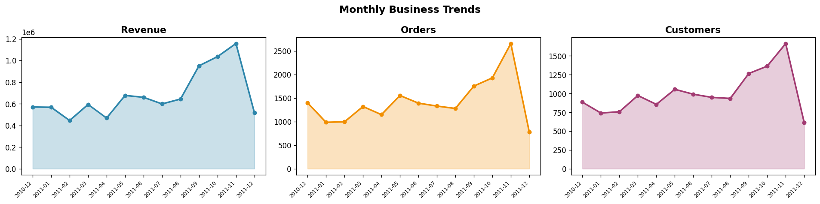
Monthly Business Trends
Revenue, orders and active customers all trend upward through the year and spike sharply in Sep-Nov as customers stock up ahead of Christmas, telling us exactly when to push the biggest campaigns.

Slide 9
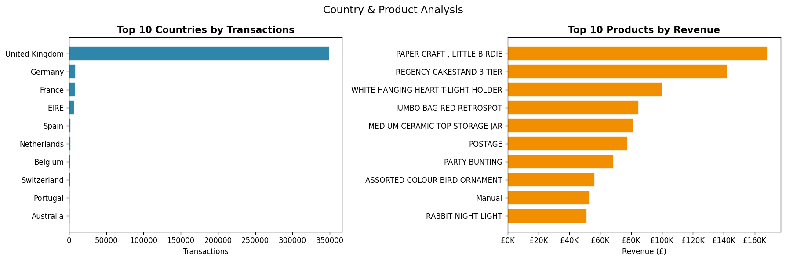
Where the Business Sells and What It Sells
The United Kingdom alone accounts for the vast majority of transactions, so international expansion is a growth lever, while gift and home-decor items (t-light holders, coat hangers, nesting boxes) drive the most revenue and are the safest bets for cross-sell bundles.

Slide 10
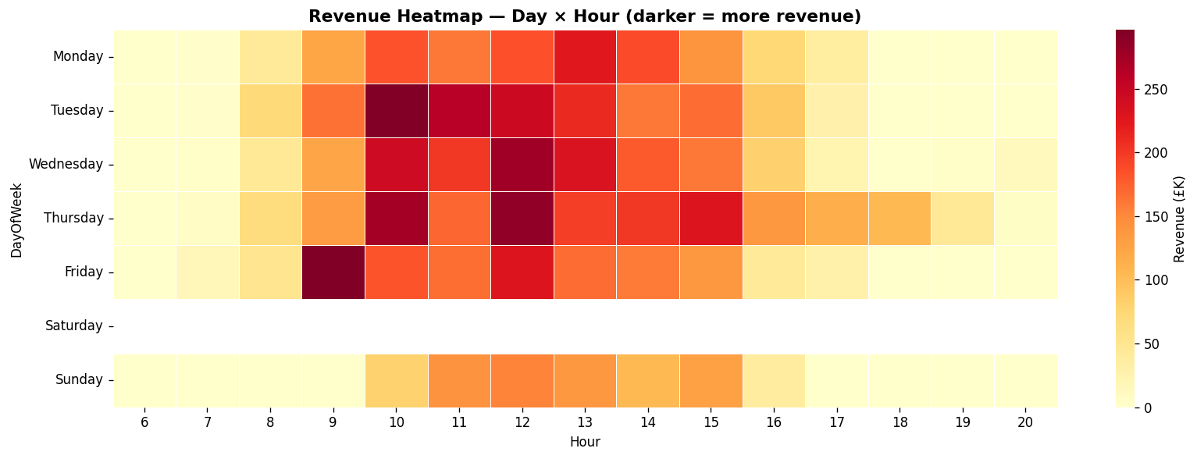
When Do Customers Shop?
Buying activity is concentrated late morning to early afternoon (roughly 10am-3pm) on weekdays, with almost no activity on Saturday, telling marketing exactly when to schedule emails and flash sales for maximum open and conversion rates.

Slide 11
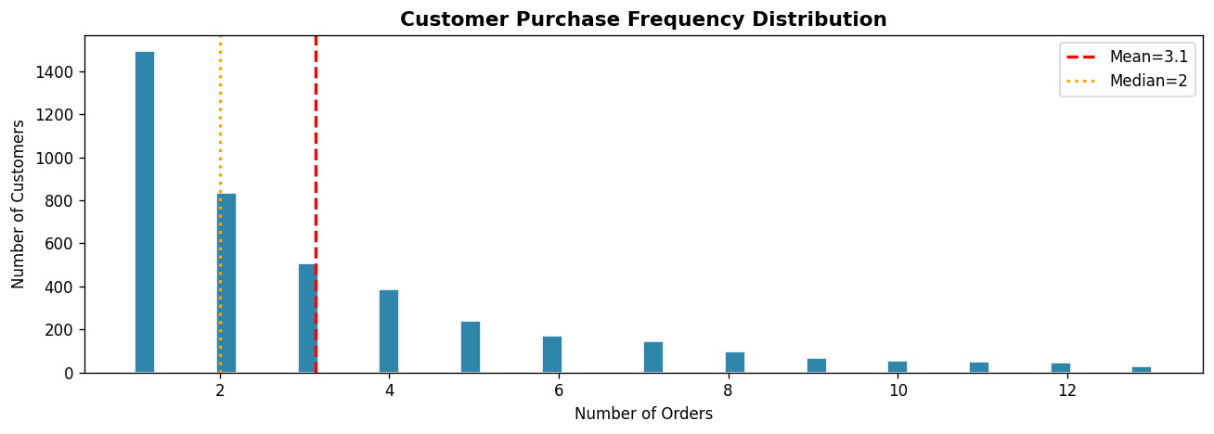
How Often Do Customers Come Back?
The vast majority of customers order only once or twice (mean 3.1, median 2 orders), meaning one-time buyers are the norm, not the exception, so converting a first purchase into a second is the single biggest lever for growth.

Slide 12
Feature Engineering
Turning raw transactions into one row per customer: The RFM table

Slide 13
Building the RFM Table
Every customer's entire purchase history is compressed into a handful of behavioural features:
R = Recency: days since the customer's last purchase (lower is better)
F = Frequency: number of distinct orders placed (higher is better)
M = Monetary: total amount spent (higher is better)
Plus supporting features: AvgOrderValue, NumProducts, TotalItems, an RFM_Score (1-5 scored R+F+M) and a CLV_Proxy (customer lifetime value estimate)
Result: 4,338 customers x 11 engineered features

Slide 14
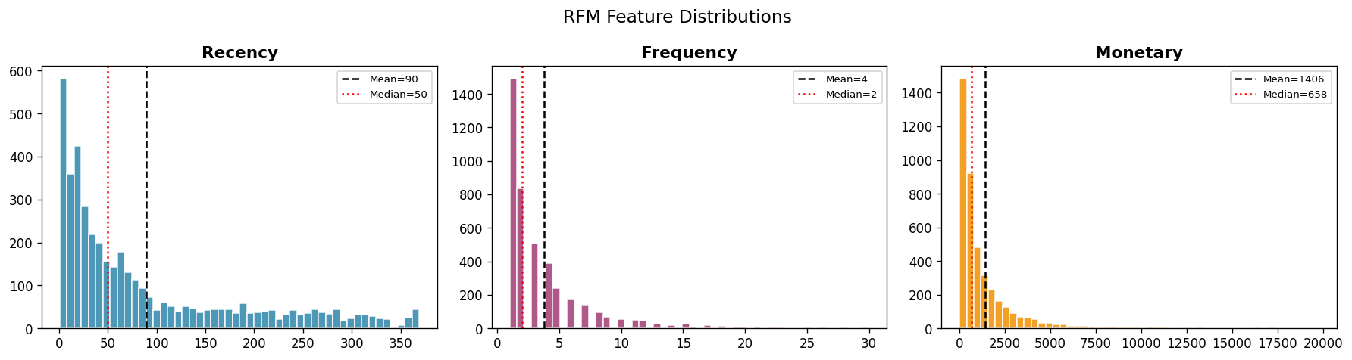
RFM Feature Distributions
All three RFM features are heavily right-skewed, a small group of customers buys very recently, very often and spends very heavily, while most customers sit near the low end, this imbalance is exactly why segmentation (rather than one blanket strategy) is needed.

Slide 15
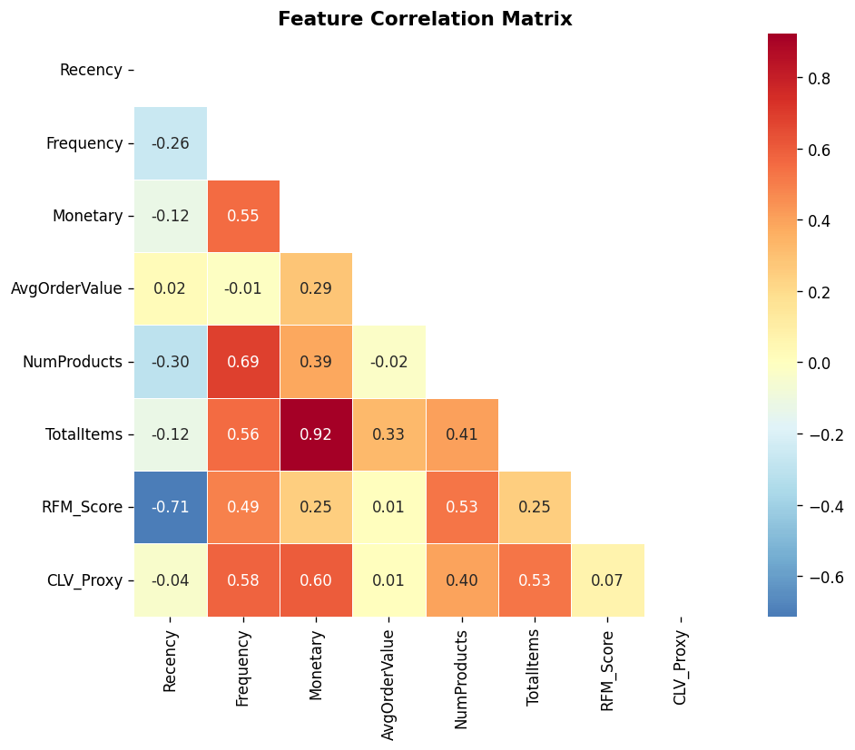
How Do the Features Relate to Each Other?
Frequency, Monetary, NumProducts and CLV_Proxy all move strongly together, while Recency is only weakly linked to the others, so 'how often and how much a customer buys' is the dominant signal separating customers, not just 'how recently' they bought.

Slide 16
Customer Segmentation
Letting the data reveal natural customer groups, no manual rules

Slide 17
Preparing for Clustering
Outliers capped at the 99th percentile on Monetary, AvgOrderValue, CLV_Proxy, Frequency and TotalItems, so a few extreme spenders don't distort the geometry.
All 8 features scaled with StandardScaler (mean = 0, std = 1) so no single feature dominates just because of its units.
Four different clustering algorithms are then trained on the same scaled data and compared head-to-head:
  K-Means, Hierarchical (Ward linkage), DBSCAN, Gaussian Mixture Model (GMM)
Compared on three metrics: Silhouette Score (higher/closer to +1 is better), Davies-Bouldin Index (lower/closer to 0 is better), Calinski-Harabasz Index (higher is better).

Slide 18
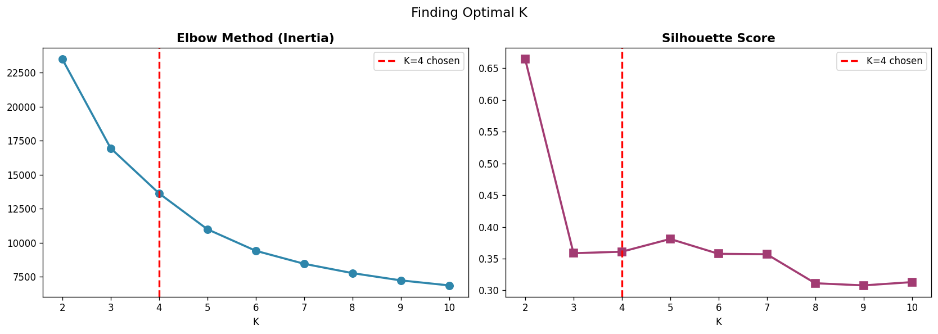
Finding the Right Number of Clusters
Inertia keeps falling as K increases with no sharp elbow, but the silhouette score peaks distinctly at K = 4 (after the trivial K = 2 split), confirming 4 is the number of genuinely distinct customer groups hiding in the data.

Slide 19
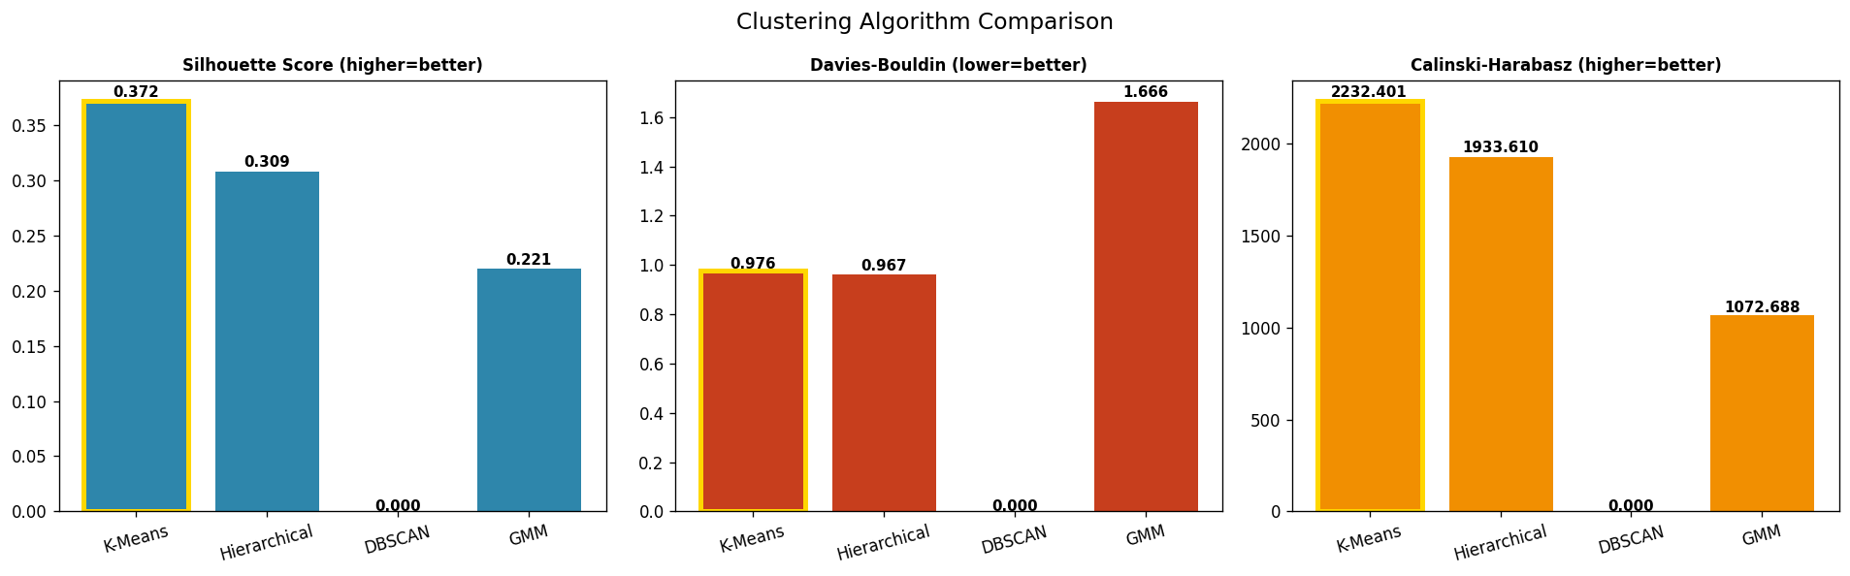
Four Algorithms, Head to Head
K-Means produces the best-separated, most compact clusters on all three metrics simultaneously, Hierarchical is a close second, DBSCAN collapses to a single noisy cluster (it can't handle this feature space), and GMM produces the weakest, most overlapping groups.

Slide 20
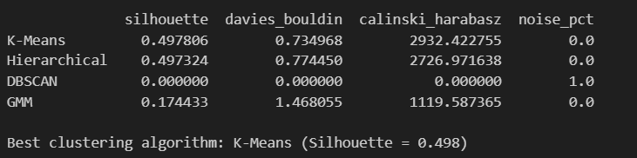
Clustering Evaluation Metrics
K-Means is the clear winner, a Silhouette Score of 0.498 signals genuinely well-separated clusters, and 0% noise points means every single customer was confidently assigned to a segment, nobody is left unclassified.

Slide 21
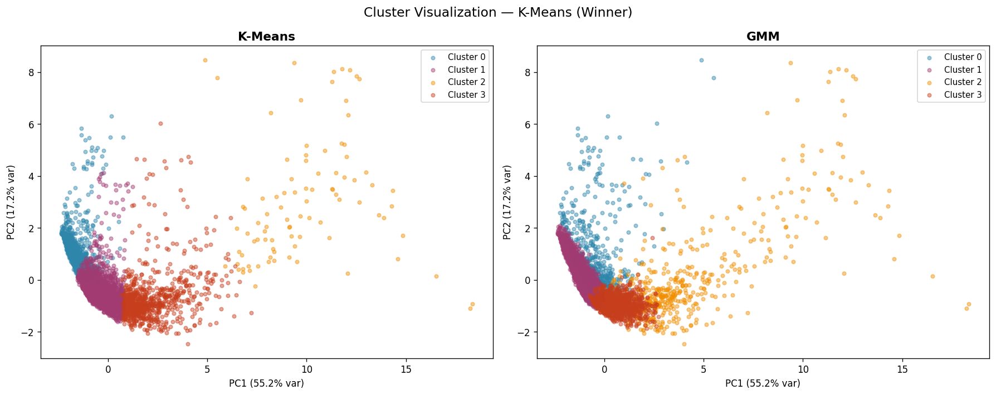
Visualizing the Clusters (PCA)
K-Means carves out 4 tight, mostly non-overlapping groups even after compressing 8 features down to 2 dimensions, while GMM's clusters visibly bleed into each other, visual confirmation that K-Means found the more genuine underlying structure.

Slide 22
Turning Clusters into Business Segments
Each of the 4 raw clusters is profiled on Recency, Frequency, Monetary and CLV, then automatically labelled by its behaviour:
Champions: most recent, most frequent, highest spend and CLV
Promising: recent, moderate frequency, healthy spend, building loyalty
At-Risk: slipping recency and spend, needs a nudge before they leave
Hibernating: long time since last purchase, low engagement
How to read it: Low Recency = good, High Frequency = good, High Monetary = good.

Slide 23
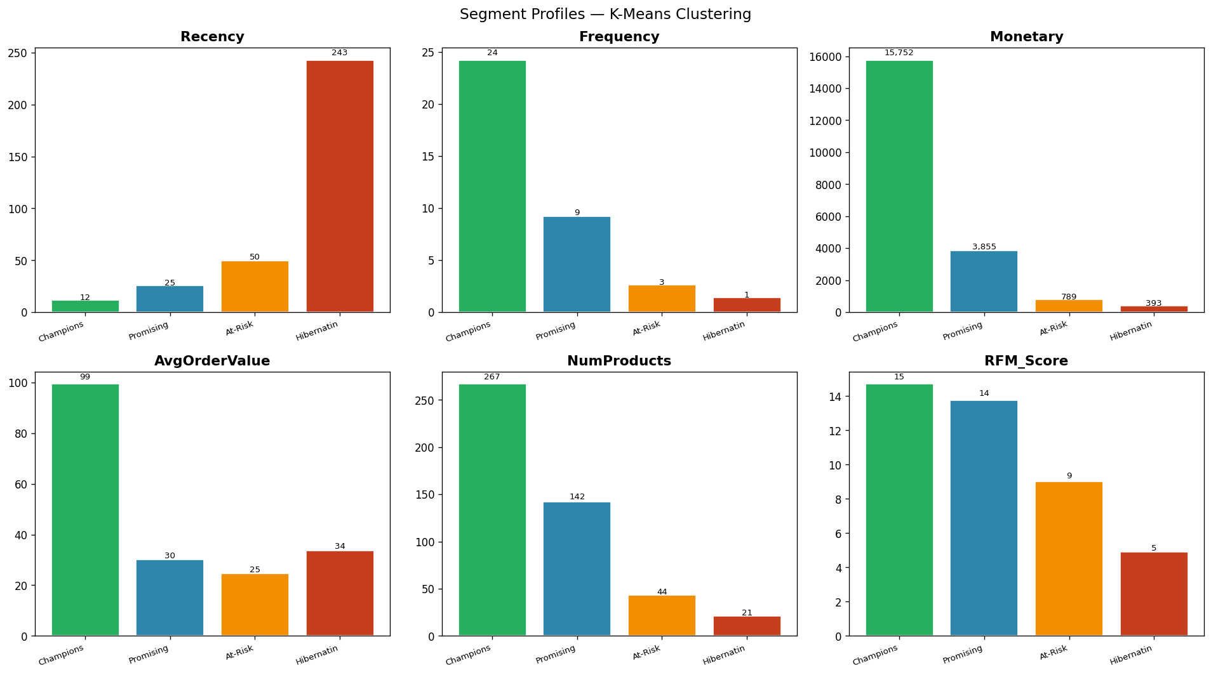
Segment Profiles at a Glance
One segment (Champions) dominates every single metric at once, recency, frequency, spend and product breadth all move together, while another (Hibernating) trails on all of them, confirming these are four genuinely distinct customer personas, not four random buckets.

Slide 24
Meet the Four Segments
Champions: 92 customers, GBP 1,449,143 total revenue
Promising: 828 customers, GBP 3,192,253 total revenue
At-Risk: 2,333 customers, GBP 1,839,920 total revenue
Hibernating: 1,085 customers, GBP 426,766 total revenue
A tiny group of 92 Champions (about 2% of customers) sits alongside 3,418 At-Risk and Hibernating customers who together still generate over GBP 2.2M, proof that segmentation, not one-size-fits-all marketing, is where the value is.

Slide 25
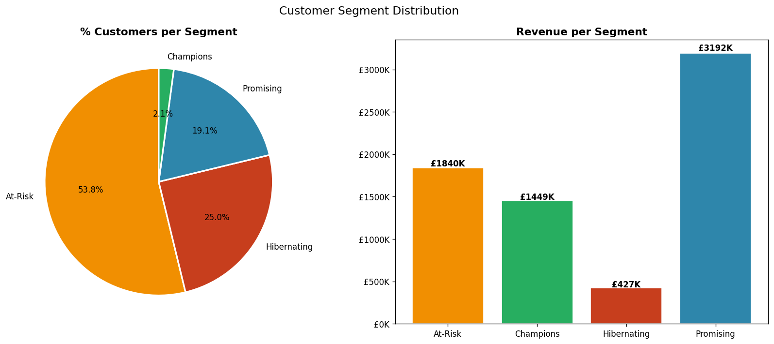
Customer and Revenue Split by Segment
At-Risk customers are over half the customer base (53.8%) but Promising customers, a much smaller group, generate the single largest slice of revenue, proof that customer count and customer value are not the same thing, and budget should follow value, not headcount.

Slide 26
Predicting the Segment
Training a classifier so any customer, existing or brand new, can be scored instantly

Slide 27
Why Add a Classifier?
Clustering only labels the customers we already have, it can't score a brand-new signup on day one.
Solution: use the cluster labels as the TARGET and train a supervised classifier that learns to predict segment membership from RFM features alone.
Data split 80/20: 3,470 customers to train, 868 held out to test
Six algorithms trained and compared:
  Random Forest, XGBoost, Gradient Boosting, SVM, KNN, Logistic Regression

Slide 28
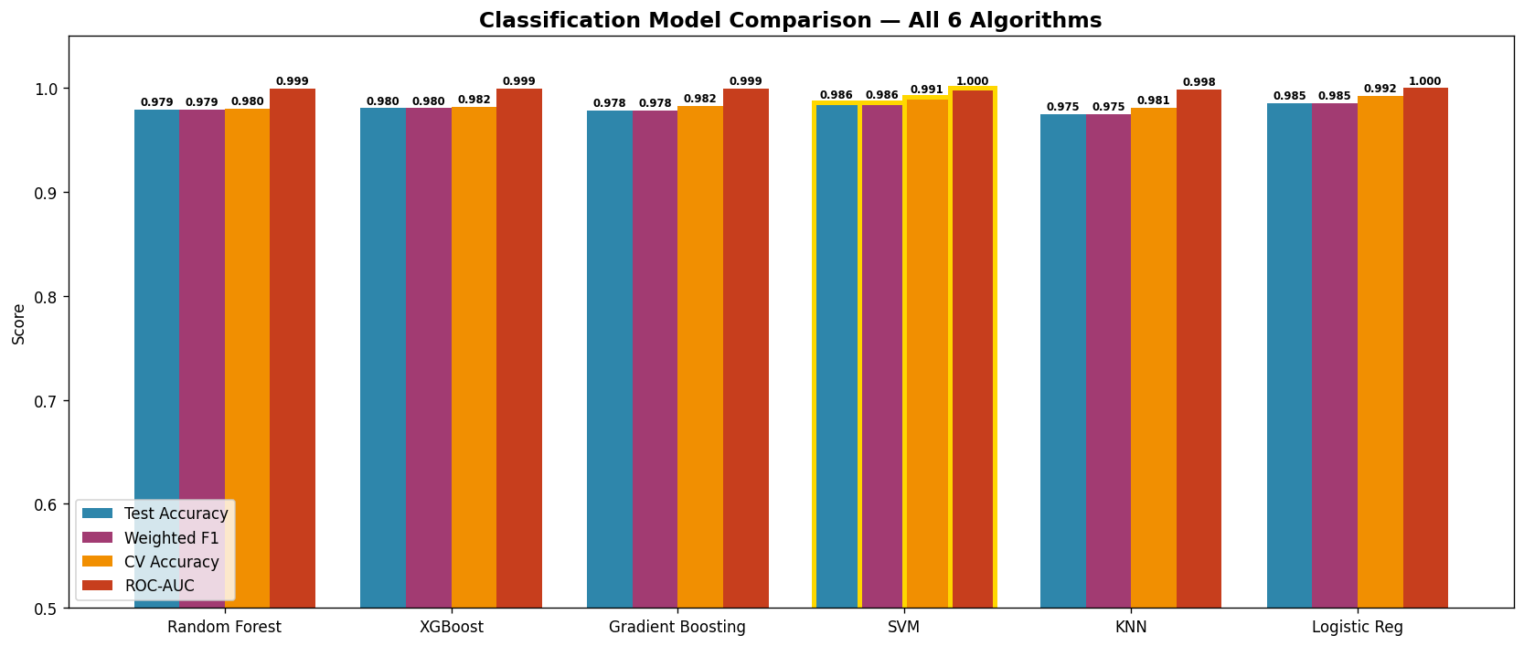
Six Classifiers, Head to Head
Every one of the six algorithms clears 97% accuracy on this task, meaning the RFM features are extremely predictive of segment membership, SVM and Logistic Regression edge out the tree-based models, showing the segment boundaries are close to linearly separable once features are scaled.

Slide 29
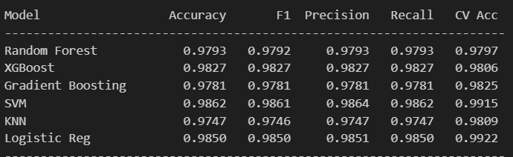
Classification Evaluation Metrics
SVM not only scores highest on the held-out test set but also on 5-fold cross-validation (99.15%), meaning its performance is stable and not a lucky split, giving confidence it will generalise well to brand-new customers in production.

Slide 30
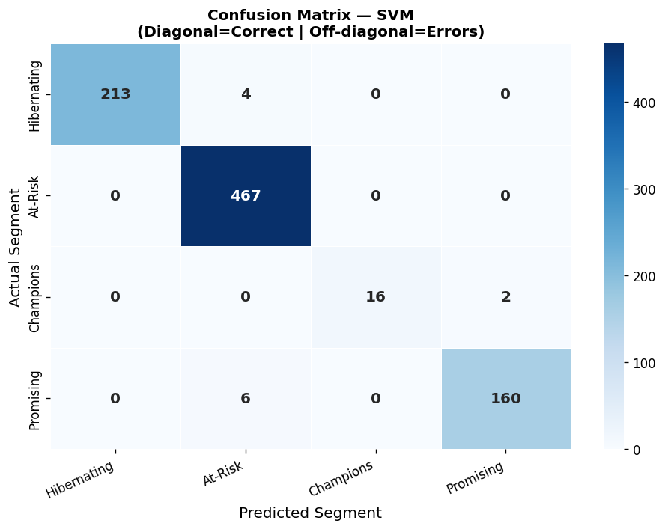
Confusion Matrix: Where Does the Model Get Confused?
Almost every prediction lands on the diagonal, the few mistakes the model makes are between Champions and Promising (behaviourally similar, high-value groups), never between opposite extremes like Champions and Hibernating, so even its errors are low-risk, sensible ones.

Slide 31
From Model to Action
What should marketing actually do with each segment?

Slide 32
Champions and Promising: Grow the Relationship
Champions (92 customers, GBP 1.45M revenue): Reward and Retain
  VIP loyalty programme with tiered rewards
  Early access to new products and exclusive deals
  Ask for reviews and referrals with bonus credits
Promising (828 customers, GBP 3.19M revenue): Nurture and Develop
  Personalised onboarding email series
  Bundle cross-sell offers to lift average order value
  First-time discount on a complementary category

Slide 33
At-Risk and Hibernating: Win Them Back
At-Risk (2,333 customers, GBP 1.84M revenue): Win-Back Campaign
  Personalised win-back email: 15-20% discount, 72-hour expiry
  NPS survey to uncover dissatisfaction root causes
  Phone outreach for the top 20% by historical spend
Hibernating (1,085 customers, GBP 427K revenue): Re-Engage or Sunset
  Aggressive 25-30% discount with urgency messaging
  SMS and push notification for dormant mobile users
  Suppress from active campaigns after 6 months of no response

Slide 34
Final Project Summary
Dataset: UCI Online Retail, 4,338 unique customers after cleaning
Clustering: 4 algorithms trained -> K-Means wins (Silhouette 0.498, Davies-Bouldin 0.735)
Classification: 6 algorithms trained -> SVM wins (Accuracy 98.62%, F1 98.61%, CV Accuracy 99.15%)
Deliverables: a saved, reusable model pipeline, a live CustomerID lookup, a scorer for brand-new customers, and a segmented customer CSV ready for Power BI / CRM import.
Outcome: marketing can now treat Champions, Promising, At-Risk and Hibernating customers differently, and score every new customer the moment they sign up.

Slide 35
Questions ?

Slide 36
Thank You!

