Slide 1

IBM Watsonx Challenge
Team Name: KoffeeKoders
Challenge Track Numer: 1 (Watsonx.ai track)

Slide 2
Challenge Description
Rental Car Company
Understand the customer satisfaction (Positive/Negative) from the Customer Feedback
Recommend an offer(Voucher, On-Demand Pickup, Premium Features, Free Upgrade) based on Customer Feedback
Fine tune the prompt for accuracy

Slide 3
Tools Used
Prompt LAB
Watson Studio
Watsonx.ai
Jupyter Notebooks
IAM Access Keys

Slide 4
Why we used PROMPT LAB
Rigorous testing of different prompts to fine-tune and select the best prompt suitable to deliver the solution
Low-Code No-Code
Simplistic UI
Availability of Different Models and elegant switching between different models
Can generate the equivalent codes in notebooks for sharing across teams

Slide 5
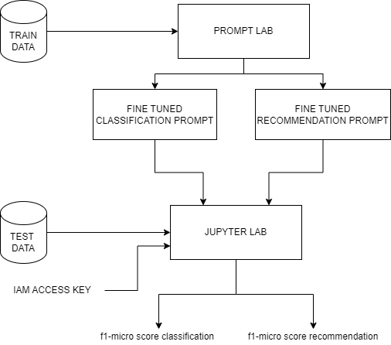
Solution Flow Overview

Slide 6
Demostration & Resources
Training data
Testing data
Final Code Notebook with Optimized Prompts
f1-Lower Scores determine the accuracy of the model. The range is between 0 to1. Closer the value is to 1, higher is the accuracy.

Slide 7
THANK YOU!!!

