Slide 1
SDLC (Software Development Life Cycle)

Slide 2
What is SDLC
The Software Development Life Cycle (SDLC) is a systematic process used for developing high-quality software. It breaks down the software development process into distinct phases that ensure the project is properly planned, executed, tested, and maintained. Each phase is crucial and provides the foundation for the next, resulting in a robust, reliable software product that meets user requirements and business needs.

Slide 3
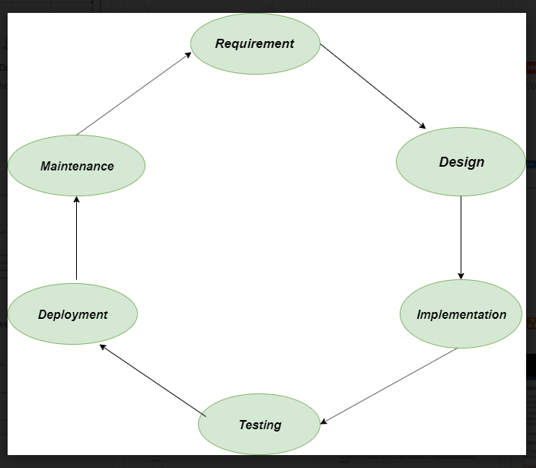
Phases of SDLC
Requirement Gathering and Analysis
Design
Development (Coding)
Testing
Deployment
Maintenance

Slide 4
1. Requirement Gathering and Analysis
It is the first and the most important phase of SDLC
In this phase the Business analyst collects the client's requirements
Based on that information it is then used to plan the basic project approach, expenditure, risk analysis, technical analysis, etc.
After planning a document is prepared called BRS (Business requirement specification)

Slide 5
2. Design
In this phase, the software design is created, which includes the overall architecture of the software, data structures, and interfaces. It has two steps:
High-level design (HLD): It gives the architecture of software products.
Low-level design (LLD): It describes how each and every feature in the product should work and every component.

Slide 6
3.Development (Coding)
The design is then implemented in code, usually in several iterations, and this phase is also called as Development.
things you need to know about this phase:
This is the longest phase in SDLC model.
This phase consists of Front end + Middleware + Back-end.
In front-end: Development of coding is done even SEO settings are done.
In Middleware: They connect both the front end and back end.
In the back-end: A database is created

Slide 7
4. Testing
The software is thoroughly tested to ensure that it meets the requirements and works correctly.
This stage refers to the testing of the software where software's defects are reported, tracked, fixed, and retested until the product reaches the quality standards defined in the SIRS (Software Requirement Specification)
Testing can be done manually and or by using automation tools

Slide 8
5. Deployment
After successful testing, The software is deployed to a production environment and made available to end-users.
Deployment Once the software is certified, and no bugs or errors are stated, then it is deployed. Then based on the assessment, the software may be released as it is or with suggested enhancement in the object segment. After the software is deployed, then its maintenance begins

Slide 9
6. Maintenance
Once the product is deployed in the market the client may want to update or want to do some changes to the product then the maintenance part does this task
Also, when product users use the software they may give feedback which should be resolved from time to time

Slide 10
SDLC MODELS
1. Waterfall Model
The Waterfall model is one of the oldest and most straightforward models in software development. It follows a linear and sequential approach where each phase must be completed before the next phase begins.
2. V-Model (Validation and Verification Model)
The V-Model is an extension of the Waterfall model and is based on the notion that each development stage has a corresponding testing phase. It emphasizes verification and validation.
3. Iterative Model
The Iterative Model involves developing an initial version of the software with partial functionality, then improving it through repeated cycles or iterations. Each iteration builds on the previous one until the software meets all requirements.

Slide 11
4. Spiral Model
The Spiral Model combines iterative development with the Waterfall model's systematic steps and risk analysis. It's ideal for large, complex, and high-risk projects.
5. Agile Model
The Agile Model emphasizes iterative development, collaboration between cross-functional teams, and flexibility in responding to changes. It breaks the development process into small, manageable pieces (called sprints) that are completed in fixed timeframes (usually 2-4 weeks).
6. Scrum Model (Agile Framework)
Scrum is a type of Agile methodology focusing on incremental progress through short cycles known as sprints. Each sprint results in a potentially shippable product increment.
Each SDLC model has its strengths and weaknesses, and the choice depends on project needs, resources, and risks.

