Slide 1

Consumer Goods ad-hoc Insights

Slide 2
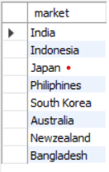
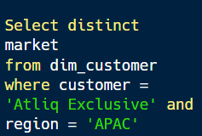
Atliq Exclusive operates its business in the APAC region
Question
Provide the list of markets in which customer "Atliq Exclusive" operates its business in the APAC region.
Output
Insights
Atliq Hardwares company operates its business in the APAC region in only 10 markets,but Atliq Exclusive customer operates its business in the APAC region in only 8 markets like India, Indonesia, Japan, Philippines, South Korea, Australia, Newzealand, Bangladesh.

Slide 3

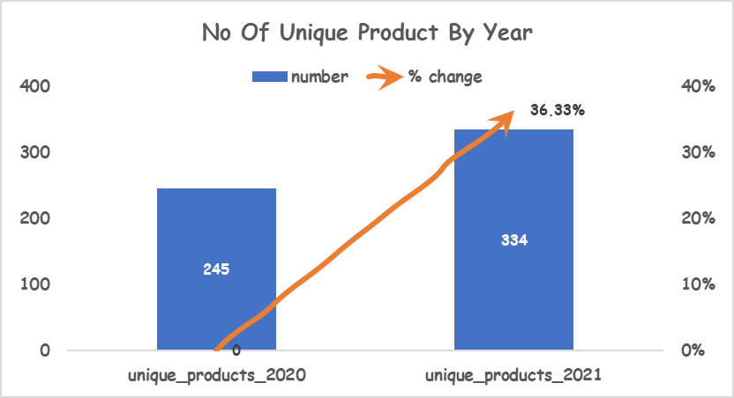
Percentage of unique product increase in 2021 vs. 2020
Question
What is the percentage of unique product increase in 2021 vs. 2020?
Output
Insights
Based on results comparing fiscal years 2020 and 2021, the number of unique products increased in 2021 is 89.
The percentage of unique products increased in 2021 vs. 2020 is 36.33%.

Slide 4
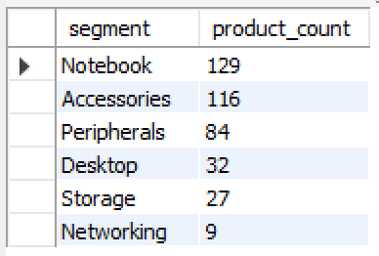
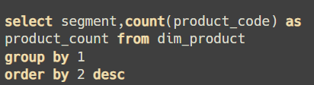
All the unique product counts for each segment
Question
Provide a report with all the unique product counts for each segment and sort them in descending order of product counts ?
Output

Slide 5
Conversion of Output to visual
Insights
Based on results Atliq Hardwares contains six segments like Notebook, Accessories, Peripherals, Desktop, Storage, Networking.
Notebook segment contains the maximum number of unique products count is 129 and Networking segment contains the minimum number of unique products count is 9.

Slide 6
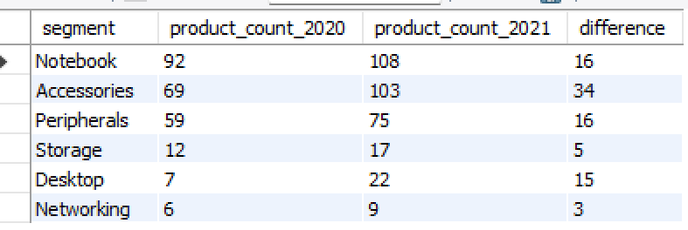
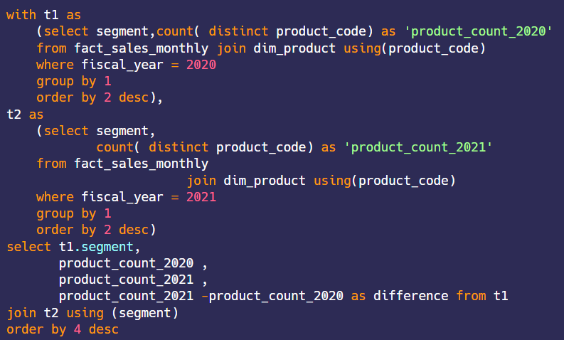
Segment wise the most increase in unique products in 2021 vs 2020
Question
Follow-up: Which segment had the most increase in unique products in 2021 vs 2020? The final output contains these fields , segment product_count_2020 product_count_2021 difference
Output

Slide 7
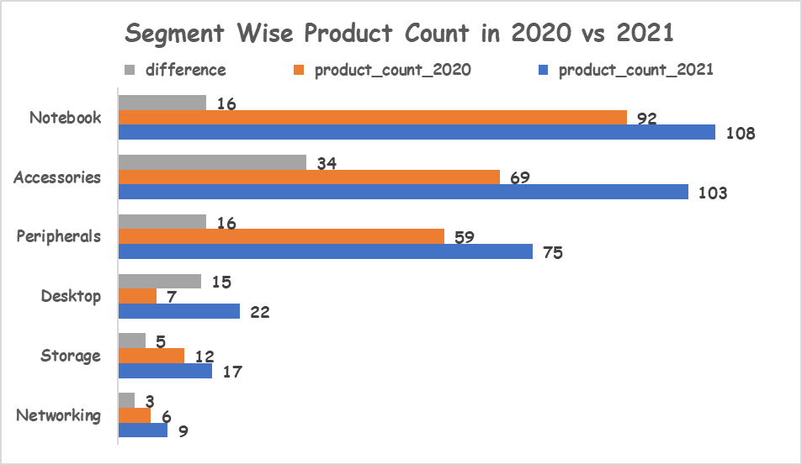
Conversion of Output to visual
Insights
Based on result Atliq Hardware in fiscal year 2021 every segment wise unique product count increased compared to fiscal year 2020.
Compared to fiscal years 2020.In 2021 Accessories segment increased maximum percentage is 38.20% and Networking segment increased minimum percentage is 3.37%

Slide 8
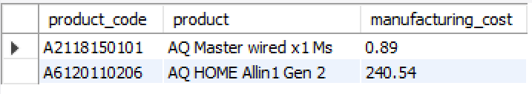
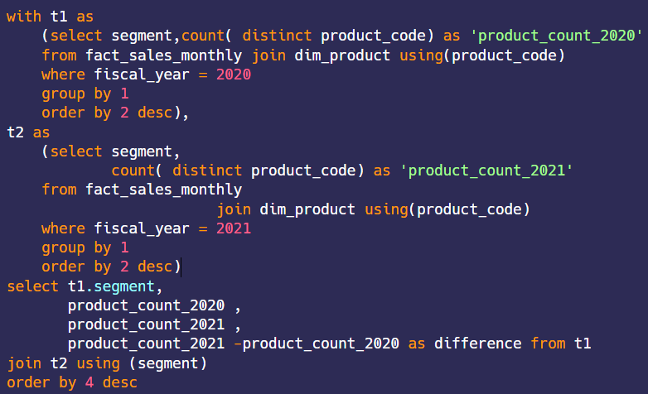
Product That Have Highest And Lowest Manufacturing Cost
Question
Get the products that have the highest and lowest manufacturing costs
Output

Slide 9
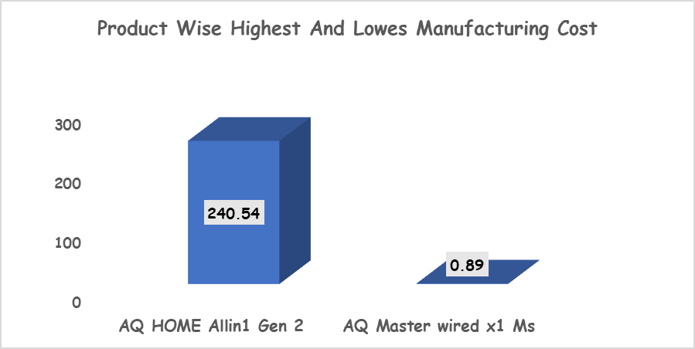
Conversion of Output to visual
Insights
AQ HOME Allin1 Gen 2 (A6120110206) product highest manufacturing cost is 240.54
AQ Master wired x1 Ms (A2118150101) product lowest manufacturing cost is 0.89

Slide 10
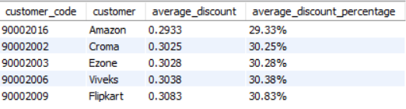
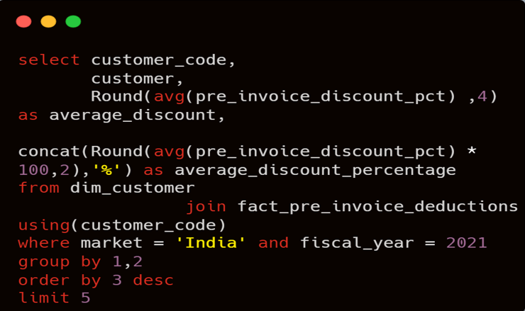
Top 5 customers that have high average pre_invoice_discount_pct (%) for the fiscal year 2021 in Indian Market
Question
Generate a report which contains the top 5 customers who received an average high pre_invoice_discount_pct for the fiscal year 2021 and in the Indian market.
Output

Slide 11
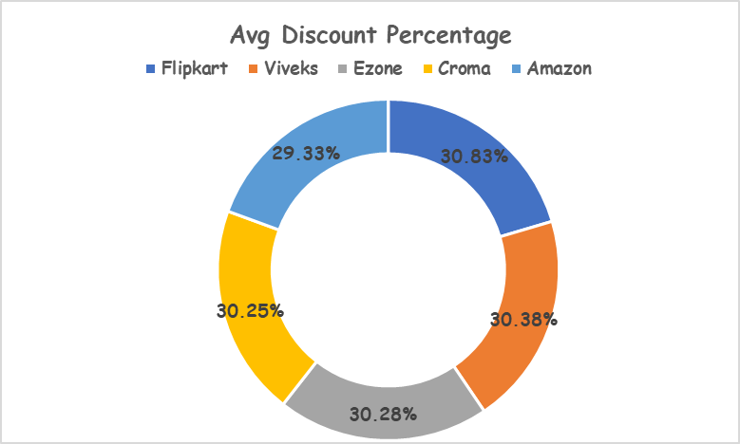
Conversion of Output to visual
Insights
Based on report in India the average high pre_invoice_discount_pct for the fiscal year 2021 And top 5 customers are Flipkart, Viveks, Ezone, Croma, Amazon.
For the fiscal year 2021 in india the maximum average highpre_invoice_discount_pct received by the customer Flipkart(9000200).

Slide 12
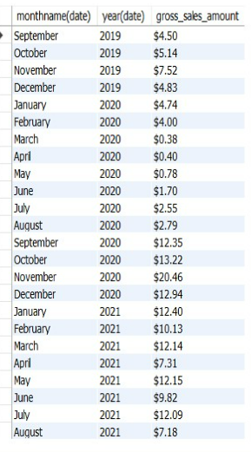
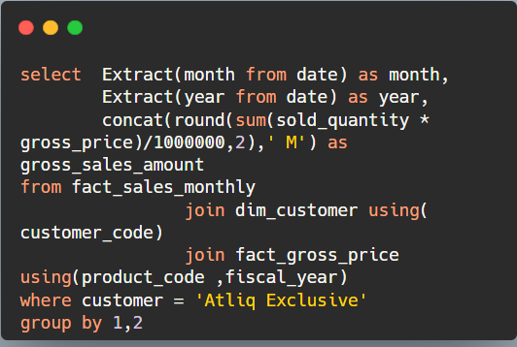
Gross sales amount for the customer “Atliq Exclusive” for each month
Question
Get the complete report of the Gross sales amount for the customer “Atliq Exclusive” for each month
Output

Slide 13
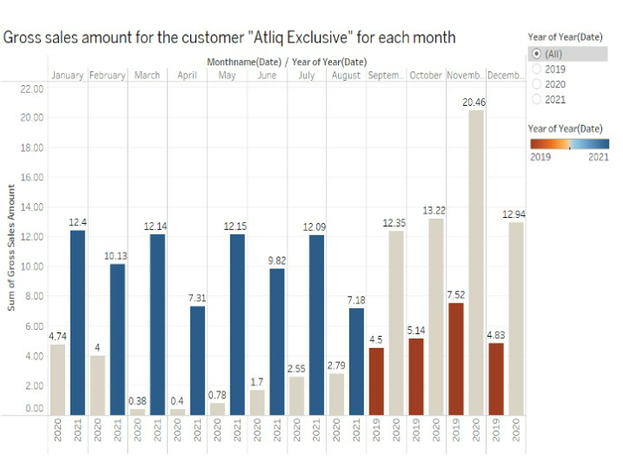
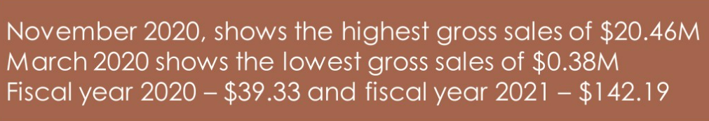
Conversion of Output to visual
Insights

Slide 14
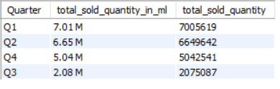
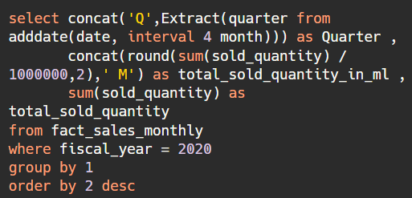
Maximum Sold Quantity In Quarter Of 2020
Question
In which quarter of 2020, got the maximum total_sold_quantity?
Output

Slide 15
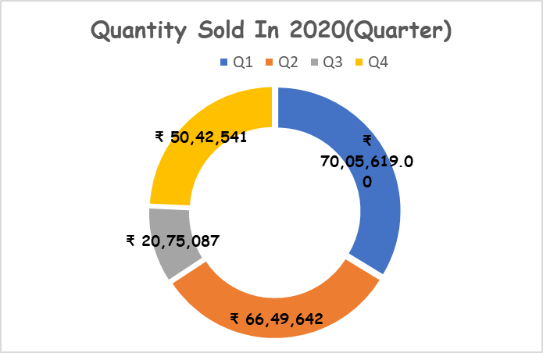
Conversion of Output to visual
Insights
Maximum total_sold_quantity Quarter of FY-2020 is Q1 ( 7005619 ).
Minimum total_sold_quantity Quarter of FY-2020 is Q3 ( 2075087 ).

Slide 16
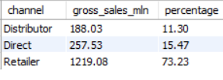
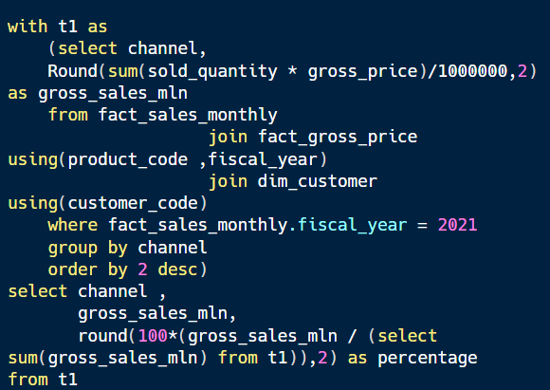
Channel wise gross sales in the fiscal year 2021 and the percentage of contribution
Question
Which channel helped to bring more gross sales in the fiscal year 2021 and the percentage of contribution?
Output

Slide 17
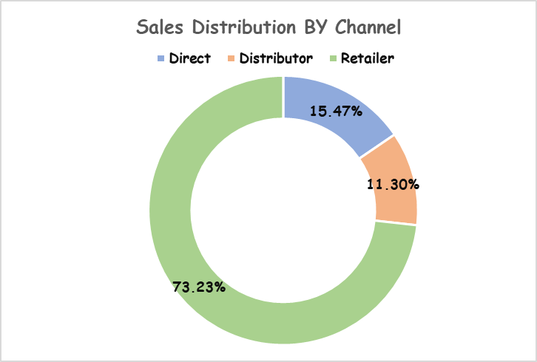
Conversion of Output to visual
Insights
Retailer channel helped to bring more gross sales in the fiscal year 2021 and the percentage of contribution is 73.23%.
Distributor channel has less gross sales in the fiscal year 2021 and the percentage of contribution is 11.30%.

Slide 18
Maximum Sold Quantity In Quarter Of 2020
Question
In which quarter of 2020, got the maximum total_sold_quantity?
Output

Slide 19
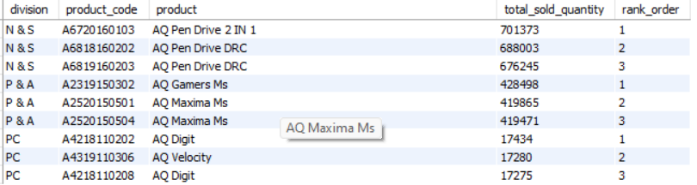
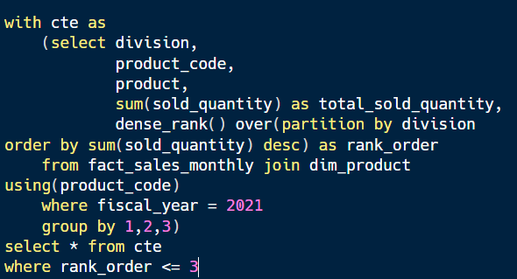
Top 3 products in each division that have high total_sold_quantity in fiscal year 2021
Question
Get the Top 3 products in each division that have a high total_sold_quantity in the fiscal year 2021?
Output

Slide 20
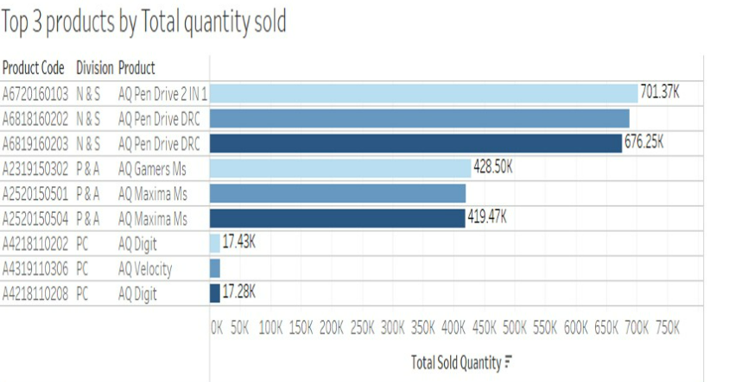
Conversion of Output to visual
Insights
As per report there are 3 divisions N &S , P & A , PC.
In N& S division AQ Pen Drive 2 IN 1(A6720160103) product ,P& A division Q Gamers Ms(A2319150302) product and PC division AQ Digit(A4218110202) product rank order is one.

