Slide 1




Vertical Handover
Heterogeneous Networks
N
Group Members:
Punit Vajpeyi Priyanka Bhavsar
Upasana Raj
Chetanraj Kadam
Group No: 09
Guided by-
Prof. H. A. Bhute

Slide 2
Outline
Mobility Management
Handover Management
Literature Survey
Context
Handover Decision
Scenarios
Results
Conclusion
Future Work
Testbed

Slide 3
Objective
To implement an intelligent handover which provides the user applications, flexibility to switch automatically between active interfaces that best suits them based on application, user requirements and interface capabilities.
3G
GPRS
Wi-Fi

Slide 4
Purpose
When MT moves from one network to another network.
When user behavior changes, with vehicular speed.
Experiences a heavy traffic load.

Slide 5
Mobility Management
MOBILITY MANAGEMENT
LOCATION MANAGEMENT
HANDOVER MANAGEMENT

Slide 6

Location Management
Use of location information to track an active mobile station between two consecutive phone calls.
Location Query
2) Location Update

Slide 7
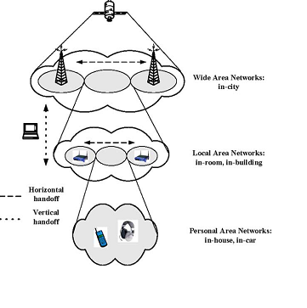
Handover Management
Wide Area Network
---- Horizontal
Handover
Vertical
Handover
Local Area Network
Personal Area Network

Slide 8
Vertical Handover Mechanisms
Mobile Controlled Handover
Mobile Controlled Handover
Handover Controlling Scheme
Mobile Assisted Handover
Network Controlled Handover
Handover in
integrated
system
Network Assisted Handover
Soft Handover (make-before-break)
Connection Transference Scheme
Hard Handover (break-before-make)

Slide 9
Handover Stages
Handover Management Process
Mobility
Scenarios
Context
Information Gathering
Handover Decision
Handover Execution
Connection
Transference
Scheme
Handover
Decision
Criteria
Handover
Controlling
Scheme
Handover
Decision Strategies

Slide 10
VHO Decision Strategies
VHO decision strategy | Advantages | Drawbacks
RSS based | Low implementation complexity | No multi criteria No user consideration
User Centric (UC) | High user consideration Low implementation complexity | No real time support
MADM | Multi criteria consideration Real time support | Weak user consideration Medium implementation complexity
Fuzzy Logic And Artificial Intelligence | User consideration | High implementation complexity
Context Aware (CA) | Multi criteria consideration Real time support High user consideration | Medium implementation complexity High delay

Slide 11
MADM Strategies
Simple Additive Weighting (SAW)
Multiplicative Exponent Weighting (MEW)
Technique for Order Preference by Similarity to Ideal Solution (TOPSIS)
Grey Relational Analysis (GRA)
Analytic Hierarchy Process (AHP)

Slide 12
Comparison between MADM methods
MADM Method | Advantages | Disadvantages
SAW | Easy to use and understand -good performance for voice connections | -poor value parameter can be out weighted by a very good value of another one
TOPSIS | Simple and comprehensive concept -good performance for voice connections | - More sensitive to user performance and parameter value
MEW | -least sensitive method -good performance for data connections | -penalizes alternatives with poor attribute values more heavily
GRA | -can handle many parameters giving a precise solution -good performance for voice connections | -complicated -length of process increases with number of levels and pair wise decisions
AHP | -can handle many parameters giving a precise solution -good performance for voice connections | -medium complexity -length of process increases with number of levels and pair wise decisions

Slide 13
Context
Application Type
Network
Real Time
Non real time
RSS
Bandwidth
Jitter
Packet loss
RTT
Terminal
Battery
Velocity
VHO History
Number of HO successful

Slide 14
Handover Decision
NO
AHP
If RSS and bandwidth weak? And User changing rapidly
Gather all QoS Parameters
YES
Reflexive

Slide 15
Analytic Hierarchy Process
Update Context
Switch To Best Network
Compare The Best Sorted Network With The Current Network
Sort The Obtained Networks
Compare The Terminal Thresholds
Compare Application And Network Thresholds

Slide 16
Reflexive – An RSS based approach
Compare RSS with
threshold values
Take rapid
decision
Update Context

Slide 17





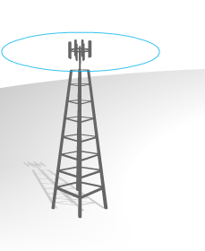

Scenarios
Internet
Out of Town
Wi-Max
In the office
Wi-Fi
Ethernet
Wi-Fi
In the car
Cellular
Wi-Fi
Wi-Fi
AP3
Wi-Fi
AP1
AP2
17

Slide 18
Results : RSSi graph
RSSi
Types of Network

Slide 19
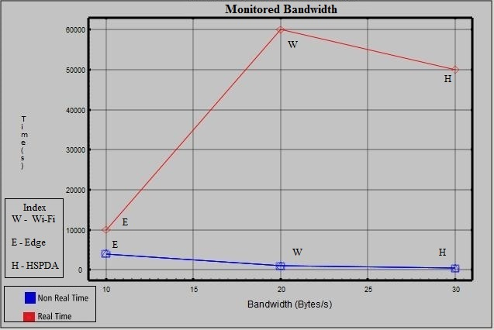
Results : Bandwidth graph

Slide 20
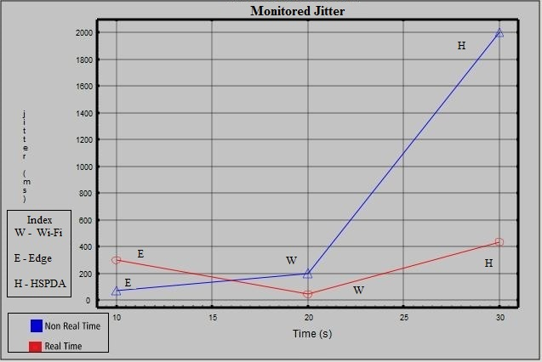
Results : Jitter graph

Slide 21
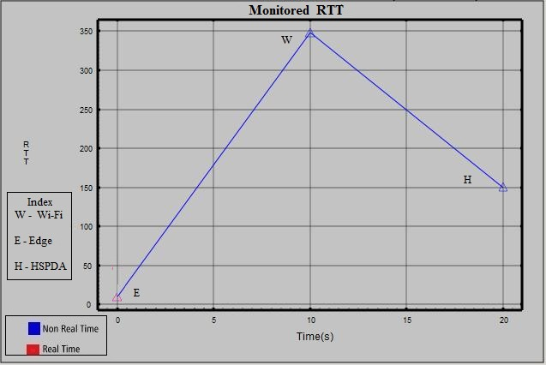
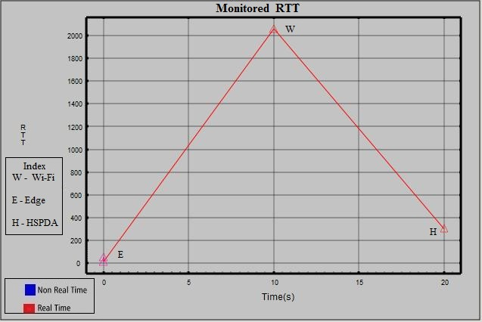
Results : RTT graph

Slide 22

Conclusion
Flexibility between active interfaces.
Satisfies seamless connectivity needs as per environment.
Application based context evaluation.

Slide 23
Future Work
Need for recognition to diversified applications.
Minimize battery consumption of MT.
Application based security needed.
Device/platform independency.

Slide 24
Testbed
ROUTER
(LINUX)
INTERNET
ISDN
MODEM
HUB
TARGET MOBILE PHONE
ACCESS
POINT

Slide 25
References
[1] Stevens-Navarro, E., & Wong, V. (2006) Comparison between vertical handoff decision algorithms for heterogeneous wireless networks. Proceedings of the IEEE vehicular technology conference (pp. 947–951).
[2] Meriem Kassar , et.al, “An overview of vertical handover decision strategies in heterogeneous wireless networks, France, Science Direct, 31 January 2008.
[3] Mariem Zakeri, et.al , “Context Aware Vertical Handover Decision Making In Heterogeneous Wireless Networks”, IEEE, 2012.
[4] S.Balsubramanium et.al “Context Vertical Handover Supporting Pervasive Computing in Future Wireless Networks” IEEE, 2012.
[5] Tansir Ahmed, Kyandoghere Kyamakya, et.al “Scenarios and Vertical Handover Strategies in Heterogeneous Networks Environment”, IEEE, 2006.
[6] Tansir Ahmed, Kyandoghere Kyamakya , et.al “A Context Aware Vertical Handover Decision Algorithm For Multimode Mobile Terminals And Its Performance Analysis for GPRS- Wi-Fi Handover” , IEEE, 2008.
[7] Mandeep Kaur Gondara and Dr. Sanjay Kadam, “Requirements Of Vertical Handover Mechanism In 4G Wireless Networks”, IEEE, April 2011.
[8] Behrouz Shahgoli Ghahfarokhi, Naser Movahedinia ,“Context Gathering And Management For Centralized Context-Aware Handover In Heterogeneous Mobile Networks”, IEEE,January,2012.
[9] Stenio Fernandes and Ahmed Karmouch, “Design And Analysis Of An IEEE 802.21 Based Mobility Management Architecture: A Context –Aware Approach” , Springer, 5th July,2013.
[10] Nickolay Amelichev, “Implementing Automatic Handover Solutions For Linux*-Based Mobile Devices”, Proceeding Of The 11th Conference Of Fruct Association, 2011.
[11] Sangki Ko and Kwangsue Chung, “A Handover-Aware Seamless Video Real time Scheme In heterogeneous Wireless Networks”, Springer, 2013.
[12] Sourav Dhar, Amitava Ray and Rabindranath Bera,“Cognitive Vertical Handover Engine For vehicularCommunication”,Springer,2012.
[13] P.Vetrivelan and P.Narayanasamy, “SMIRT with Call Admission Control (CAC) Based Vertical Handover Decision for Seamless Mobility in Multi-Access 4G Heterogeneous Wireless Overlay Networks”, IMECS, Hong Kong, 2012,
[14] S. Tekinay and B. Jabbari, “An effective prioritization scheme for handovers in cellular networks,” in Proc. 1st Int. Conf. Universal Pers. Com- mun., Dallas, TX, Sep. 1992, pp. 13.05/1–13.05/5
[15] “Mobility Management Scheme for Context-Aware Transactions in Pervasive and Mobile Cyberspace”,
Muhammad Younas, Member, IEEE, and Irfan Awan, Member, IEEE.
[16] “Connectivity Support in Heterogeneous Wireless Networks”, Anna Maria Vegni1 and Roberto Cusani, et.al, www.intechopen.com.
[17] “An overview of vertical handover techniques : Algorithm, protocols and tools”, Johann Marque Barja, et.al, Computer Communication Journal, Elseveir.
[18] “Context Aware Handover on Smartphones” Qi Han , et.al, Institute of Engineering, University of Chinese academy, Beijing,IEEE, 2013.
[19] “A Survey on Handovers – Lessons for 60 GHz Based Wireless Systems”, Bien Van Quang, et.al, IEEE communication survey & tutorial, VOL. 14, NO. 1, first quarter 2012.
[20] ”Location based handover for multimode mobile terminals”, Tansir Ahmedd, et.al
[21] “A survey of vertical handover decision algorithms in 4th generation heterogeneous wireless networks”, Xiaohuan Yan, et.al, Computer Networks, Elseveir, 20120

Slide 26

THANK YOU…
Questions
Or
Concerns

Slide 27
Important Documents
Synopsis
SRS
Results
Published paper

